Slide 1
Waves

Slide 2
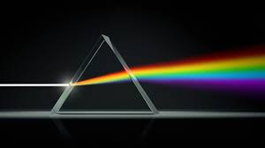
Waves Part 1

Slide 3
A-Level Physics
1. Development of practical skills in physics
2. Foundations of Physics
3. Forces and motion
4. Electrons, waves and photons
5. Newtonian world and astrophysics
6. Particles and medical physics
4.1 Charge and current
4.2 Energy, power and resistance
4.3. Electrical circuits
4.4. Waves
4.5 Quantum Physics
Introduction to waves
Wave properties and oscilloscopes (PAG)
Electromagnetic waves
Reflection and refraction
Snell’s Law
Total internal reflection
Polarisation and intensity
Superposition and interference
Diffraction of waves and interference
Youngs Double slit (PAG)
Stationary vs. progressive waves
Measuring the speed of sound (PAG)

Slide 4
Introduction to waves
Describe the differences between types of waves
Use key wave terminology
Calculate wave speed

Slide 5
What is a wave?
Learning Outcome: Describe the differences between types of waves

Slide 6
What is a wave?
Learning Outcome: Describe the differences between types of waves
A wave is a transfer of energy by an oscillating motion
The oscillation can be either up and down, backwards and forwards or side to side.
The material a wave travels through is the medium
The wave moves, the medium doesn’t

Slide 7
Annotate any features/properties of the two waves
Crest
Trough
Compression
Rarefraction
Longitudinal wave

Slide 8
Learning Outcome: Describe the differences between types of waves
Transverse waves go either side to side or up and down perpendicular to the direction of energy movement
Longitudinal waves go backwards and forwards along the wave in the same direction as the energy transfer
Direction of energy movement
Notes:
Use slinky to demonstrate difference between transverse and longitudinal waves

Slide 9
Learning Outcome: Describe the differences between types of waves
Crest
Transverse wave
Trough
Compression
Rarefraction
Longitudinal wave

Slide 10
Learning Outcome: Use key wave terminology
Wave Property | Definition
Amplitude
Displacement
Wavelength
Period
Frequency
Notes:
Annotate on the diagram the direction of propagation and oscillation and period, wavelength and amplitude

Slide 11
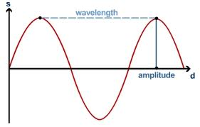
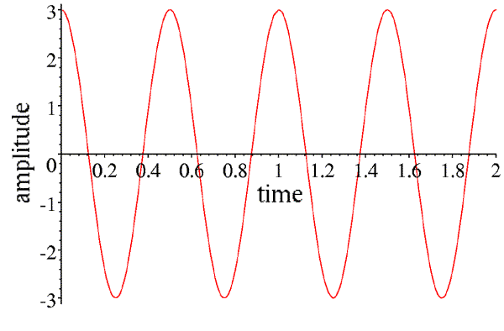
Learning Outcome: Use key wave terminology
Wave Property | Definition
Amplitude | The maximum displacement from it’s undisturbed position.
Displacement | Distance from equilibrium position at a given time
Wavelength | The distance from one point on a wave to the equivalent point on an adjacent wave
Period | Time for one wavelength to pass a fixed point
Frequency | The number of waves past a fixed point per second. Measured in Hertz (Hz) Period = 1/frequency
Displacement
Frequency
Period
Notes:
Annotate on the diagram the direction of propagation and oscillation and period, wavelength and amplitude

Slide 12
Learning Outcome: Calculate wave speed
The speed that a wave travels at depends on the medium it is passing through, this is the speed energy is transferred
Wave speed = frequency x wavelength
v (m/s) f (Hz) λ (m)

Slide 13
Learning Outcome: Calculate wave speed
The speed that a wave travels at depends on the medium it is passing through, this is the speed energy is transferred
Wave speed = frequency x wavelength
v (m/s) f (Hz) λ (m)
1. A wave has a frequency of 5 Hz and a wavelength of 2 m, what is its wave speed?
= 5 x 2 = 10 m/s

Slide 14
Learning Outcome: Calculate wave speed
The speed that a wave travels at depends on the medium it is passing through, this is the speed energy is transferred
Wave speed = frequency x wavelength
v (m/s) f (Hz) λ (m)
1. A wave has a frequency of 5 Hz and a wavelength of 2 m, what is its wave speed?
= 5 x 2 = 10 m/s
2. If a wave is travelling at 5 m/s and has a wavelength of 10m what is the frequency of the wave?
frequency = Wave speed ÷ wavelength
= 5 ÷ 10 = 0.5 Hz

Slide 15
Learning Outcome: Use key wave terminology
Transverse wave
Crest
Wave Property | Definition
Amplitude (A) | The maximum displacement from it’s undisturbed position.
Displacement (s) | Distance from equilibrium position at a given time
Wavelength (λ) | The distance from one point on a wave to the equivalent point on an adjacent wave
Period (T) | Time for one wavelength to pass a fixed point
Frequency (f) | The number of waves past a fixed point per second. Measured in Hertz (Hz) Period = 1/frequency
Trough
Longitudinal wave
Compression
Rarefraction
Wave speed = frequency x wavelength
v (m/s) f (Hz) λ (m)
Notes:
Annotate on the diagram the direction of propagation and oscillation and period, wavelength and amplitude

Slide 16
A-Level Physics
1. Development of practical skills in physics
2. Foundations of Physics
3. Forces and motion
4. Electrons, waves and photons
5. Newtonian world and astrophysics
6. Particles and medical physics
4.1 Charge and current
4.2 Energy, power and resistance
4.3. Electrical circuits
4.4. Waves
4.5 Quantum Physics
Introduction to waves
Wave properties and oscilloscopes (PAG)
Electromagnetic waves
Reflection and refraction
Snell’s Law
Total internal reflection
Polarisation and intensity
Superposition and interference
Diffraction of waves and interference
Youngs Double slit (PAG)
Stationary vs. progressive waves
Measuring the speed of sound (PAG)

Slide 17
Electromagnetic waves
State the different waves in the electromagnetic spectrum
State properties of all electromagnetic waves
Compare and contrast electromagnetic waves

Slide 18
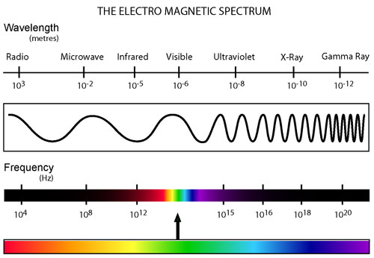
Learning Outcome: State the different waves in the electromagnetic spectrum

Slide 19
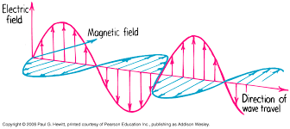
Learning Outcome: State properties of all electromagnetic waves
5 Properties of electromagnetic radiation:
All EM waves travel at the same speed (300,000,000 m/s)
All transverse waves
Different EM waves have a different wavelength and frequency
Can all travel through a vacuum e.g. space
Consist of perpendicular magnetic and electrical waves

Slide 20
Learning Outcome: Compare and contrast electromagnetic waves
In teams you need to make a presentation on one electromagnetic wave.
Your presentation must include:
- Wavelength and frequency range
- At least two uses, including why your particular wave is used for that purpose over others?
- How ionising it is (if at all)
- Mostly absorbed by or passes through matter?
- A super fun fact
Notes:
Copies of EM radiation handouts in Physics office

Slide 21
A-Level Physics
1. Development of practical skills in physics
2. Foundations of Physics
3. Forces and motion
4. Electrons, waves and photons
5. Newtonian world and astrophysics
6. Particles and medical physics
4.1 Charge and current
4.2 Energy, power and resistance
4.3. Electrical circuits
4.4. Waves
4.5 Quantum Physics
Introduction to waves
Wave properties and oscilloscopes (PAG)
Electromagnetic waves
Reflection and refraction
Snell’s Law
Total internal reflection
Polarisation and intensity
Superposition and interference
Diffraction of waves and interference
Youngs Double slit (PAG)
Stationary vs. progressive waves
Measuring the speed of sound (PAG)

Slide 22
Reflection, refraction and Snell’s Law
Describe reflection and refraction
Describe what is meant by a refractive index
Use Snell’s Law to link refractive index and angles of refraction

Slide 23
Learning Outcome: Describe reflection and refraction
What is reflection?

Slide 24
Learning Outcome: Describe reflection and refraction
On a white board draw a labelled ray diagram of reflection off a mirror…

Slide 25
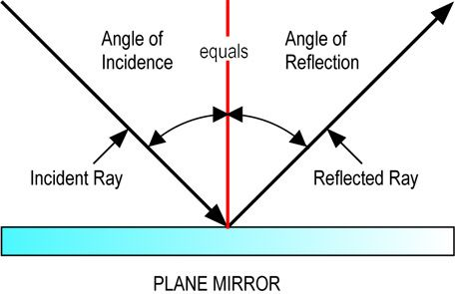
Learning Outcome: Describe reflection and refraction

Slide 26
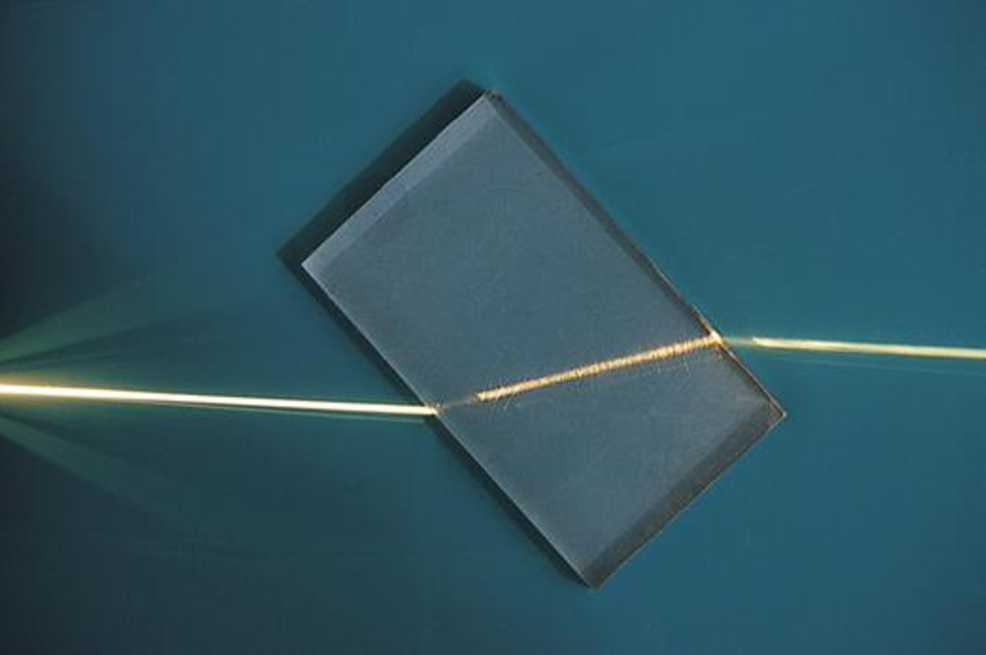
Learning Outcome: Describe reflection and refraction
What is refraction?

Slide 27
Learning Outcome: Describe reflection and refraction
On a white board draw a labelled ray diagram of refraction of light through a glass block…

Slide 28
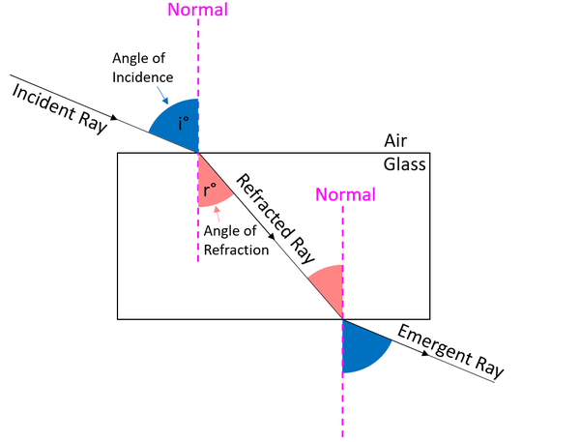
Learning Outcome: Describe reflection and refraction

Slide 29
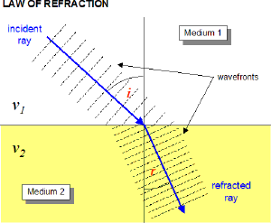
Refraction
Learning Outcome: Describe reflection and refraction
Waves can be refracted or “bent” as they cross the boundary between two different mediums (materials).
Refraction is a change in direction of the wave due to a slowing down or speeding up of the wave.
The speed of the light wave changes depending on the density of the material
Speed = Wavelength x frequency
The wavelength of the wave changes not the frequency

Slide 30
Learning Outcome: Describe reflection and refraction
Add an additional ray of light for a less dense glass

Slide 31
Learning Outcome: Describe reflection and refraction
Add an additional ray of light for a less dense glass

Slide 32
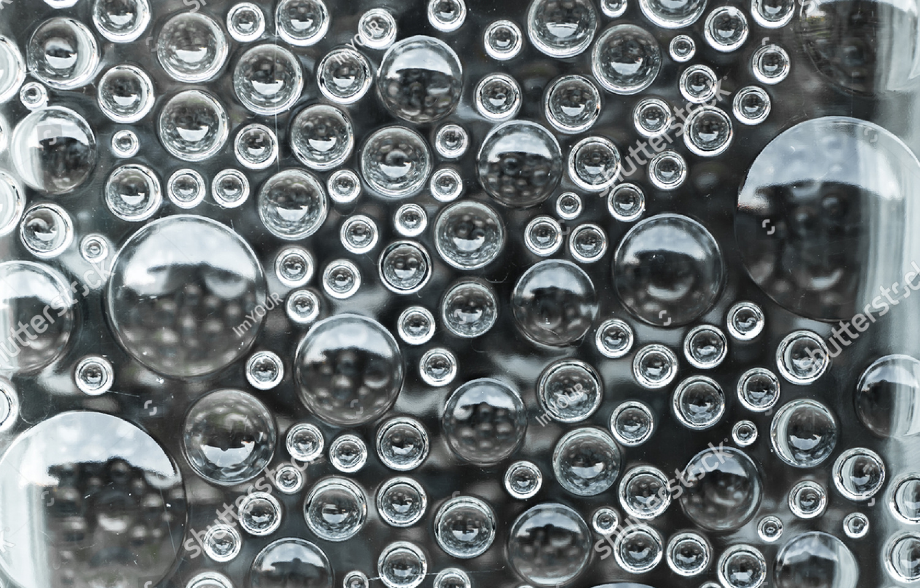
Learning Outcome: Describe reflection and refraction
On a white board draw a labelled ray diagram of refraction of light as it travels through a air bubble within a glass block…

Slide 33
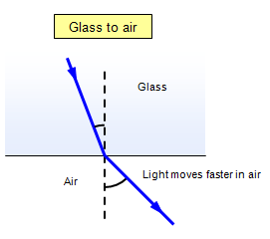
Learning Outcome: Describe reflection and refraction
On a white board draw a labelled ray diagram of refraction of light as it travels through a air bubble within a glass block…

Slide 34
Learning Outcome: Describe what is meant by a refractive index
The degree and direction of “bending” depends on the relative refractive index of both materials
Refractive index is a measure of how quickly light is able to travel through the material, the denser the material the slower it travels
It is measured relative to the speed of light in a vacuum
Refractive index of a material (n) = Speed of light in a vacuum (c)
Speed of light in the material (v)
n = c/v

Slide 35
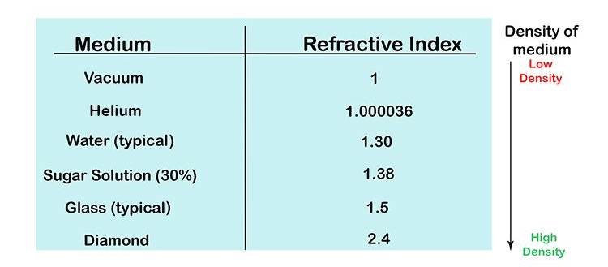
Learning Outcome: Describe what is meant by a refractive index
Refractive index of air = 1

Slide 36
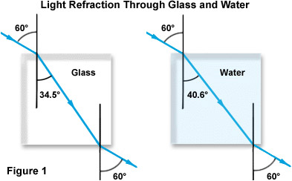
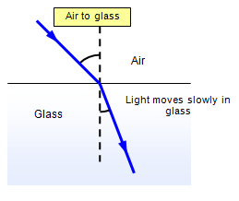
Learning Outcome: Describe what is meant by a refractive index
The degree and direction of “bending” depends on the relative refractive index of both materials
The larger the difference in the refractive index the greater the change in angle
Glass has a higher refractive index than water
If a wave goes from a higher to a lower refractive index it bends away from the normal. E.g. glass to air
If a wave goes from a lower to a higher refractive index it bends towards the normal. E.g. Air to glass
Refractive index of a material (n) = Speed of light in a vacuum (c)
Speed of light in the material (v)

Slide 37
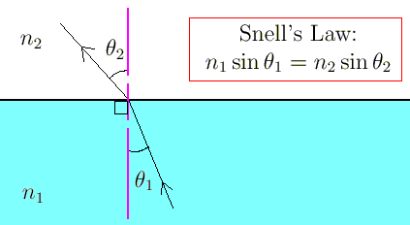
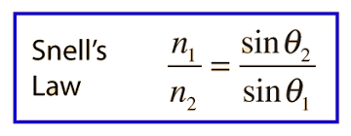
Learning Outcome: Use Snell’s Law to link refractive index and angles of refraction
Snell’s Law links together the angles of refraction and the refractive index of materials
n₁sin₁ = constant

Slide 38
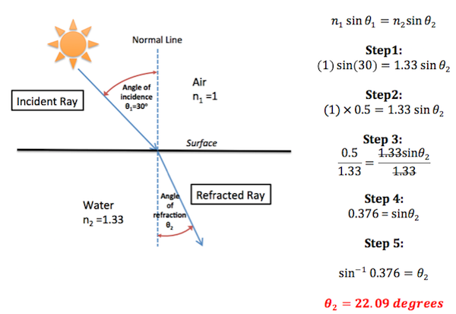
Learning Outcome: Use Snell’s Law to link refractive index and angles of refraction

Slide 39
A-Level Physics
1. Development of practical skills in physics
2. Foundations of Physics
3. Forces and motion
4. Electrons, waves and photons
5. Newtonian world and astrophysics
6. Particles and medical physics
4.1 Charge and current
4.2 Energy, power and resistance
4.3. Electrical circuits
4.4. Waves
4.5 Quantum Physics
Introduction to waves
Wave properties and oscilloscopes (PAG)
Electromagnetic waves
Reflection and refraction
Snell’s Law
Total internal reflection
Polarisation and intensity
Superposition and interference
Diffraction of waves and interference
Youngs Double slit (PAG)
Stationary vs. progressive waves
Measuring the speed of sound (PAG)

Slide 40
Total Internal Reflection
Describe what is meant by total internal reflection
Use the critical angle to obtain values for the refractive index
Explain uses of total internal reflection

Slide 41
Shine a light ray into a rectangular block Slowly increase the angle of incidence What do you observe at a particular angle of incidence Why does this happen? Would it happen if the ray of light was going from air to glass/plastic?
Learning Outcome: Describe what is meant by total internal reflection

Slide 42
Total internal reflection occurs where the angle of incidence results in an angle of refraction greater than 90° so only reflection occurs at a boundary For this to occur the light must entering a less optically dense material (lower refractive index) so the light is bent away from the normal The critical angle is the angle of incidence above which total internal reflection occurs. Find the critical angle for your block
Learning Outcome: Describe what is meant by total internal reflection

Slide 43
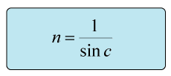
Learning Outcome: Describe what is meant by total internal reflection
If going into air n₂ = 1
n₁sinθ_{C} = 1

Slide 44
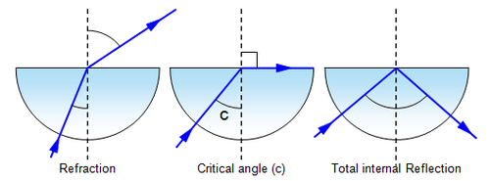
Using the semi-circular block find its refractive index What property of the semi-circular block makes it suited for this purpose?
Learning Outcome: Use the critical angle to obtain values for the refractive index

Slide 45
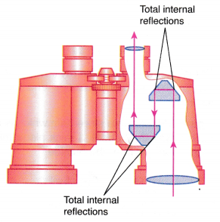
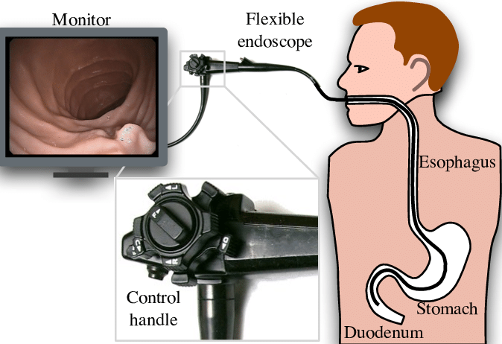
Learning Outcome: Explain uses of total internal reflection
Total internal reflection allows highly efficient transmission of light

Slide 46
A-Level Physics
1. Development of practical skills in physics
2. Foundations of Physics
3. Forces and motion
4. Electrons, waves and photons
5. Newtonian world and astrophysics
6. Particles and medical physics
4.1 Charge and current
4.2 Energy, power and resistance
4.3. Electrical circuits
4.4. Waves
4.5 Quantum Physics
Introduction to waves
Wave properties and oscilloscopes (PAG)
Electromagnetic waves
Reflection and refraction
Snell’s Law
Total internal reflection
Polarisation and intensity
Superposition and interference
Diffraction of waves and interference
Youngs Double slit (PAG)
Stationary vs. progressive waves
Measuring the speed of sound (PAG)

Slide 47
Polarisation and intensity
Describe what is meant by polarisation of waves
Describe experiments to show polarisation
Explain what is meant by intensity

Slide 48
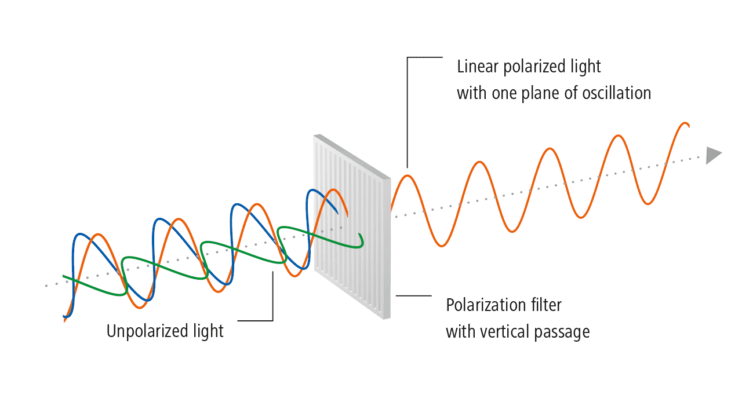
Polarisation is filtering of light into a particular plane
Learning Outcome: Describe what is meant by polarisation of waves

Slide 49
Using the semi-circular block find its refractive index What property of the semi-circular block makes it suited for this purpose?

Slide 50
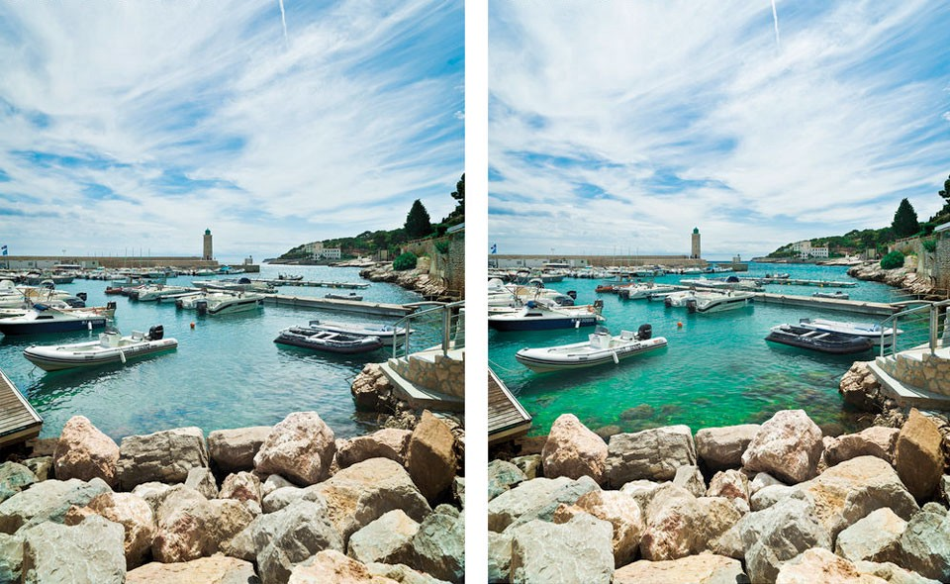
Using the semi-circular block find its refractive index What property of the semi-circular block makes it suited for this purpose?

Slide 51
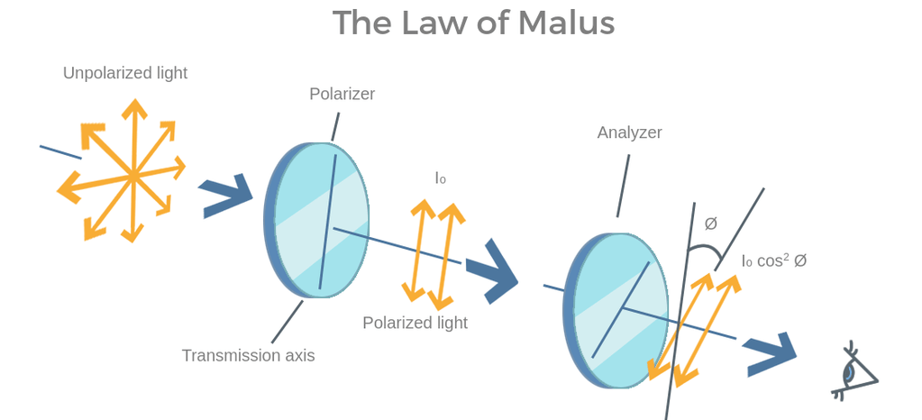
Rotate the analyser in 10° intervals and record the light intensity
Learning Outcome: Describe experiments to show polarisation

Slide 52
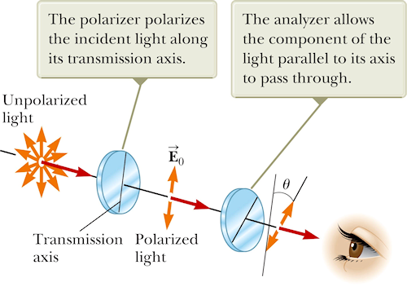
Learning Outcome: Describe experiments to show polarisation

Slide 53
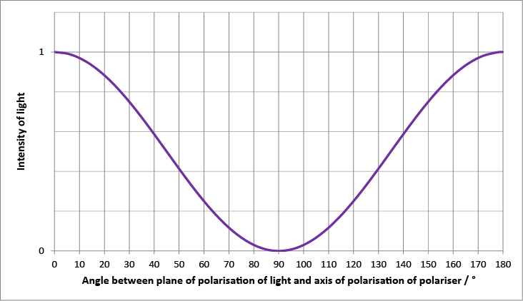
Learning Outcome: Describe experiments to show polarisation

Slide 54
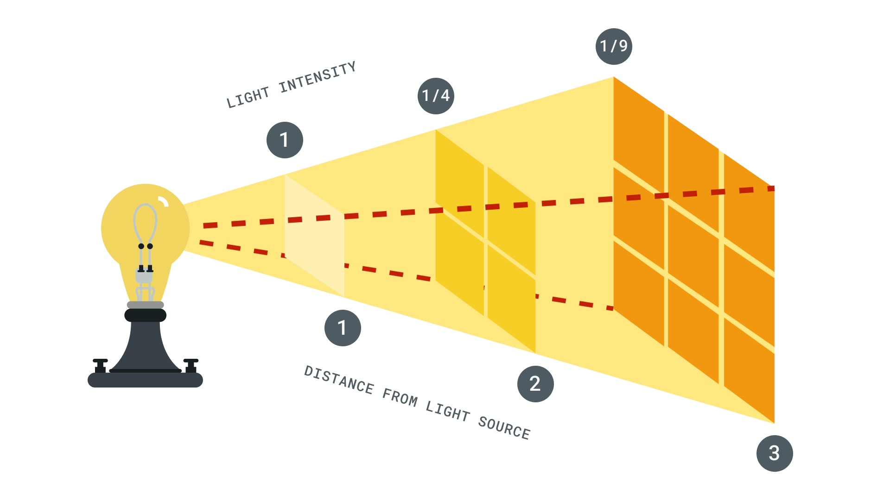
Intensity is the power per unit area (Wm⁻²) I = P/A
Learning Outcome: Explain what is meant by intensity
Intensity follows an inverse square law with distance from source

Slide 55
The higher the intensity the higher the amplitude of a wave
Learning Outcome: Explain what is meant by intensity
I α A²
Amplitude decreases from wave source and intensity decreases

Slide 56
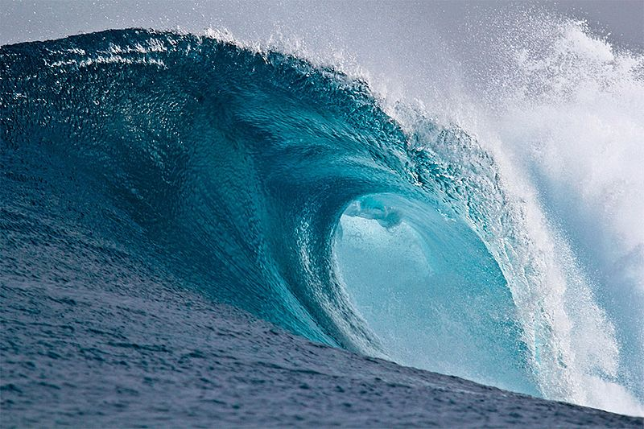
Waves Part 2

Slide 57
A-Level Physics
1. Development of practical skills in physics
2. Foundations of Physics
3. Forces and motion
4. Electrons, waves and photons
5. Newtonian world and astrophysics
6. Particles and medical physics
4.1 Charge and current
4.2 Energy, power and resistance
4.3. Electrical circuits
4.4. Waves
4.5 Quantum Physics
Introduction to waves
Wave properties and oscilloscopes (PAG)
Electromagnetic waves
Reflection and refraction
Snell’s Law
Total internal reflection
Polarisation and intensity
Superposition and interference
Diffraction of waves and interference
Youngs Double slit (PAG)
Stationary vs. progressive waves
Measuring the speed of sound (PAG)

Slide 58
Superposition and interference
Define the terms superposition and interference
Describe constructive and destructive interference in terms of path and phase difference
Evaluate overall displacement as a result of interference

Slide 59
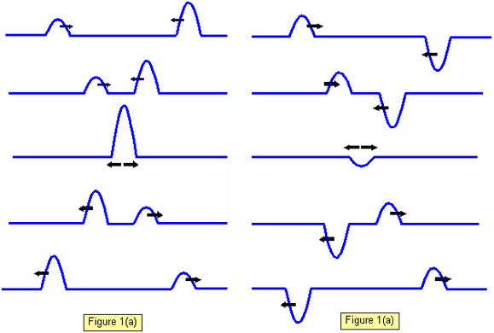
Superposition occurs when two or more waves overlap Interference is the resultant effect of the waves overlapping
Learning Outcome: Define the terms superposition and interference

Slide 60
Constructive interference- sum of displacements is greater than the individual displacements
Learning Outcome: Describe constructive and destructive interference in terms of path and phase difference
Destructive interference- sum of displacements is less than the individual displacements

Slide 61
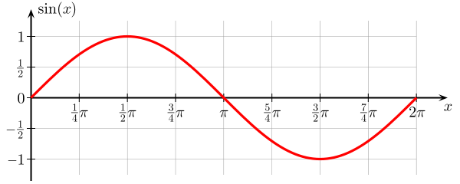
Path difference- The difference between two waves at a time in terms of wavelength (or two points on the same wave)
Learning Outcome: Describe constructive and destructive interference in terms of path and phase difference
0 λ
¼ λ
½ λ
¾ λ
1 λ
0°
90°
180°
270°
360°
Phase difference- The difference between two waves at a time in terms of angle (or two points on the same wave)

Slide 62
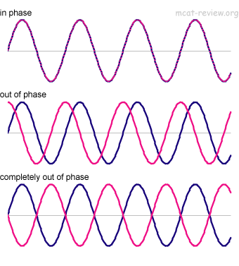
Path difference = 0 λ Phase difference = 0°
Learning Outcome: Describe constructive and destructive interference in terms of path and phase difference
Path difference = ¼ λ Phase difference = 90°
Path difference = ½ λ Phase difference = 180°

Slide 63
In phase, no path difference
Learning Outcome: Describe constructive and destructive interference in terms of path and phase difference
Completely out of phase, ½ λ path difference

Slide 64
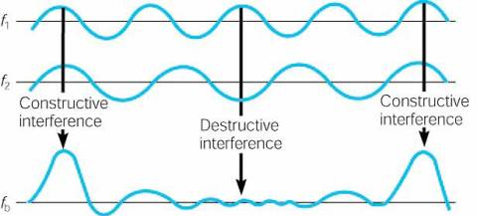
Learning Outcome: Evaluate overall displacement as a result of interference

Slide 65
A-Level Physics
1. Development of practical skills in physics
2. Foundations of Physics
3. Forces and motion
4. Electrons, waves and photons
5. Newtonian world and astrophysics
6. Particles and medical physics
4.1 Charge and current
4.2 Energy, power and resistance
4.3. Electrical circuits
4.4. Waves
4.5 Quantum Physics
Introduction to waves
Wave properties and oscilloscopes (PAG)
Electromagnetic waves
Reflection and refraction
Snell’s Law
Total internal reflection
Polarisation and intensity
Superposition and interference
Diffraction of waves and interference
Youngs Double slit (PAG)
Stationary vs. progressive waves
Measuring the speed of sound (PAG)

Slide 66
Diffraction
Describe what is meant by diffraction
Describe interference effects from diffraction of two sources
Explain Young’s double slit experiment and other two source interference effects

Slide 67
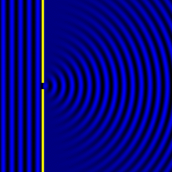
Diffraction is the spreading out of a wave as it passes through a gap/slit
Learning Outcome: Describe what is meant by diffraction
The closer the size of the gap/slit is to the wavelength of the wave the greater the diffraction effect

Slide 68
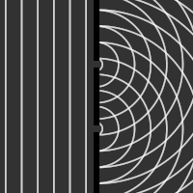
Learning Outcome: Describe interference effects from diffraction of two sources
Two slits create two coherent wave sources
Coherent waves have a constant phase difference
The two wave sources then interfere with each other

Slide 69
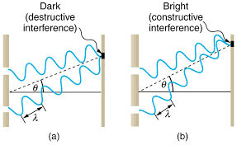
Young’s Double Slit Experiment
Learning Outcome: Explain Young’s double slit experiment and other two source interference effects
A wave created from each slit will travel slightly different distances to the screen
Where two waves meet at the screen in phase/with a path difference of nλ constructive interference occurs- bright line appears
Where two waves meet at the screen completely out of phase/ with a path difference of ½λ destructive interference occurs

Slide 70
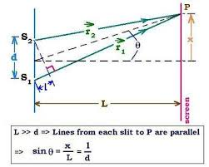
Young’s Double Slit Experiment
Learning Outcome: Explain Young’s double slit experiment and other two source interference effects
λ = ax/D
Where x is the separation distance between two adjacent maxima,
a is the slit separation distance and D is the distance to screen
a
λ
D

Slide 71
Interference of sound
Learning Outcome: Explain Young’s double slit experiment and other two source interference effects
Destructive interference as wave 1 travels exactly ½ a wavelength less than wave 2- waves meet completely out of phase
Loud
Quiet
Constructive interference as both waves travel the same distance
Loud
Quiet
Constructive interference as wave 1 travels exactly one wavelength less than wave 2- waves meet in phase
Loud

Slide 72
Interference of sound
Learning Outcome: Explain Young’s double slit experiment and other two source interference effects
Wave 1
Loud
Wave 2
Constructive interference as both waves travel the same distance

Slide 73
Interference of sound
Learning Outcome: Explain Young’s double slit experiment and other two source interference effects
Wave 1
Quiet
Wave 2
Destructive interference as wave 1 travels exactly ½ a wavelength less than wave 2- waves meet completely out of phase

Slide 74
Interference of sound
Learning Outcome: Explain Young’s double slit experiment and other two source interference effects
Wave 1
Loud
Wave 2
Constructive interference as wave 1 travels exactly one wavelength less than wave 2- waves meet in phase

Slide 75
Interference of sound
Learning Outcome: Explain Young’s double slit experiment and other two source interference effects
Destructive interference as wave 1 travels exactly ½ a wavelength less than wave 2- waves meet completely out of phase
Loud
Quiet
Constructive interference as both waves travel the same distance
Loud
Quiet
Constructive interference as wave 1 travels exactly one wavelength less than wave 2- waves meet in phase
Loud

Slide 76
A-Level Physics
1. Development of practical skills in physics
2. Foundations of Physics
3. Forces and motion
4. Electrons, waves and photons
5. Newtonian world and astrophysics
6. Particles and medical physics
4.1 Charge and current
4.2 Energy, power and resistance
4.3. Electrical circuits
4.4. Waves
4.5 Quantum Physics
Introduction to waves
Wave properties and oscilloscopes (PAG)
Electromagnetic waves
Reflection and refraction
Snell’s Law
Total internal reflection
Polarisation and intensity
Superposition and interference
Diffraction of waves and interference
Youngs Double slit (PAG)
Stationary vs. progressive waves
Measuring the speed of sound (PAG)

Slide 77
Stationary and progressive waves
Describe how stationary waves are created
Describe features of stationary waves
Describe stationary waves in open and closed tubes

Slide 78
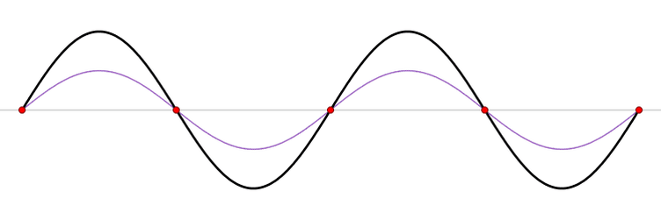
Learning Outcome: Describe how a stationary wave is created
The blue line represents the initial wave, this is reflected back at a boundary, creating the red wave
The blue wave and red wave then superimpose causing destructive and constructive interference and a resulting stationary wave (the black wave)

Slide 79
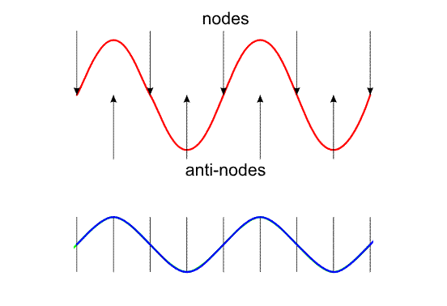
Learning Outcome: Describe features of stationary waves
Destructive interference
Constructive interference

Slide 80
Learning Outcome: Describe features of stationary waves

Slide 81
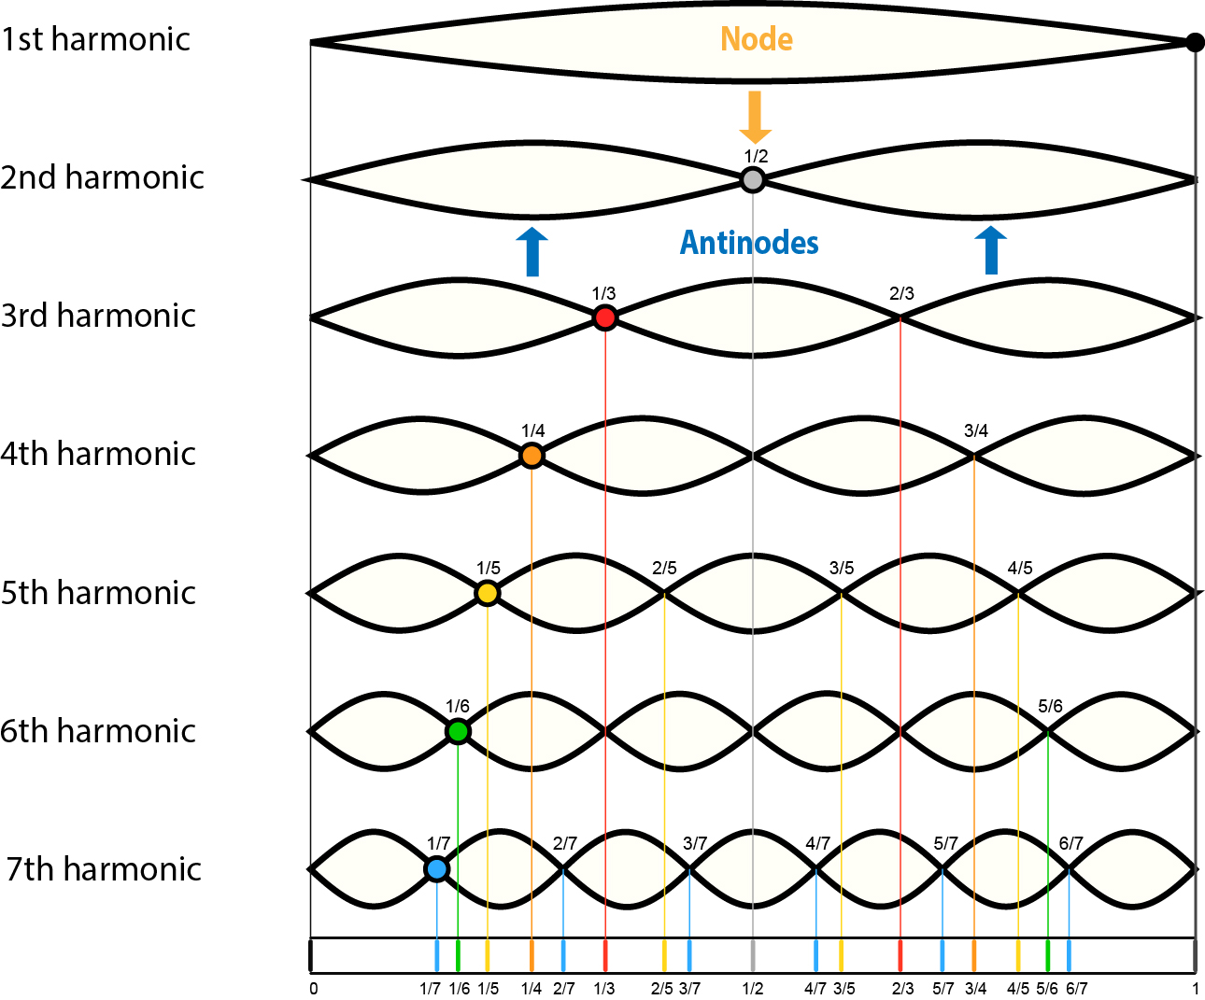
Stationary waves form harmonics where the length between fixed points equals the exact length between 2 or more nodes. The first harmonic forms at the fundamental frequency
Learning Outcome: Describe stationary waves in open and closed tubes
½ λ
1 λ
1½ λ
2 λ
2½ λ
3 λ
3½ λ

Slide 82
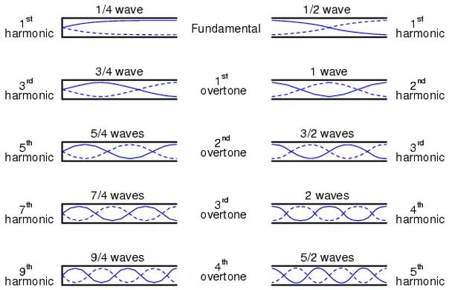
Learning Outcome: Describe stationary waves in open and closed tubes

Slide 83
Learning Outcome: Describe stationary waves in open and closed tubes
½ λ
1 λ
1½ λ
2 λ
2½ λ
3 λ
3½ λ
Open end = antinode
Closed end = node
V = f λ

