Slide 1
Particles summary sheet
Density
Density is defined as…..
The equation for density is……..
For the following experiments, include a bullet pointed method and diagram:
How to find the density of a regular object
How to find the density of an irregular object
How to find the density of a liquid
States of matter
Draw labelled diagrams summarising the properties of solids, liquids and gases
Heating materials and specific heat capacity
Describe the process of conduction for heating a solid
Describe an experiment to investigate the effectiveness of insulation

Slide 2
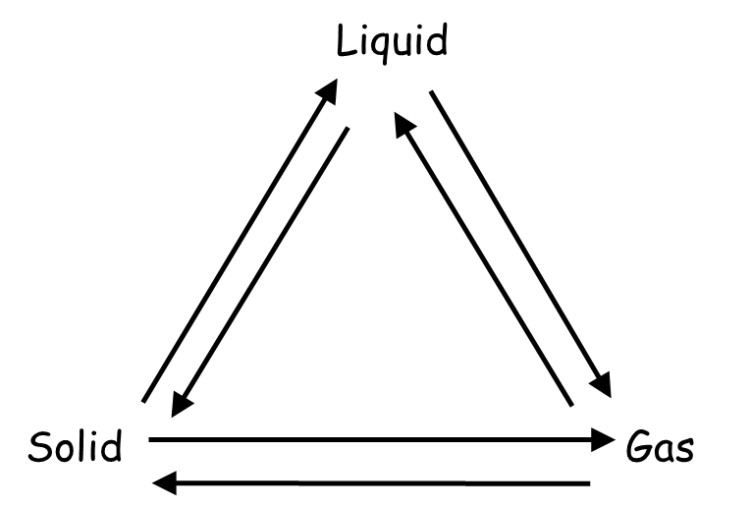
Particles summary sheet
Specific heat capacity
Specific heat capacity is defined as…. (include the equation)
Describe an experiment to measure the specific heat capacity of a material
Changing state and specific latent heat
Add on labels to describe each change of state
Why is a change in state described as a physical rather than chemical change?
Specific latent heat is defined as….. (include the equation)
Internal Energy
Sketch and label a graph to show how the temperature of a substance
changes as it changes from a solid to a liquids to a gas, You must include:
The solid, liquid and gas phases
Melting/freezing and boiling/condensing
When specific heat capacity is relevant
When specific latent heat is relevant
Where kinetic energy increases and why
Where potential energy increases and why
A definition of internal energy and how this changes
Temperature
Time

