Slide 1
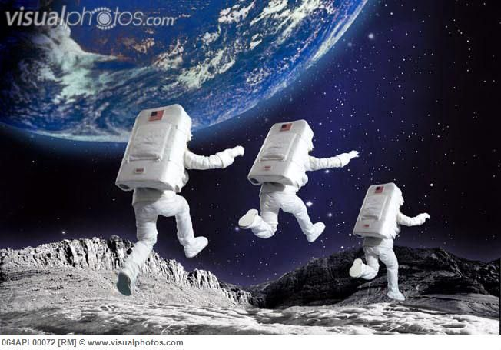
Gravitational fields

Slide 2
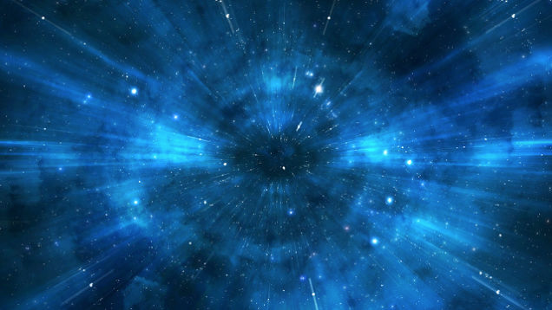
A-Level Physics
1. Development of practical skills in physics
2. Foundations of Physics
3. Forces and motion
4. Electrons, waves and photons
5. Newtonian world and astrophysics
6. Particles and medical physics
5.1 Thermal Physics
5.2 Circular motion
5.3. Oscillations
5.4. Gravitational fields
5.5 Astrophysics
5.4.1. Newton’s law of gravitation
5.3.2. Gravity of point masses
5.3.3. Kepler’s laws
5.3.4. Satellites
5.3.5. Gravitational potential
5.3.6. Gravitational potential energy

Slide 3
Newton’s law of gravitation
Describe the gravitational field around a point mass
Describe Newton’s law of gravitation
Apply Newton’s law of gravitation to calculate gravitational fields

Slide 4
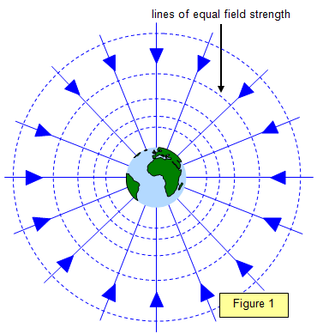
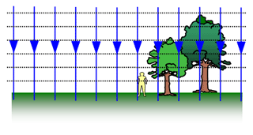
Learning Outcome: Describe the gravitational field around a point mass
Anything with mass will create a gravitational field around it
What would the field lines around a point mass look like?
What would these field lines look like at the Earth’s surface?

Slide 5
Learning Outcome: Describe the gravitational field around a point mass
An object with mass placed in the gravitational field of another object will feel an attractive force towards the centre of mass of the object causing the field.
How can you calculate the magnitude of this force?
F = mg
Force = mass x gravitational field strength (at that point!)
Gravitational field strength at a particular point is defined as:
The gravitational force per unit mass of an object placed in the field at that point

Slide 6
Learning Outcome: Describe the gravitational field around a point mass
F = mg
Force = mass x gravitational field strength
Force (N) | Mass (kg) | Gravity (N/kg)
50 | 4000
 | 3.4 | 9.81
3000 | 0.045
0.025 |  | 20.5
 | 300 | 1.6
Gravitational field strength at a particular point is defined as:
The gravitational force per unit mass of an object placed in the field at that point

Slide 7
Learning Outcome: Describe the gravitational field around a point mass
F = mg
Force = mass x gravitational field strength
Force (N) | Mass (kg) | Gravity (N/kg)
50 | 4000 | 0.0125
33.35 | 3.4 | 9.81
3000 | 0.045 | 6666.67
0.025 | 0.00122 | 20.5
480 | 300 | 1.6

Slide 8
Newton’s law of gravitation
Learning Outcome: Describe Newton’s law of gravitation
The force between two point masses is:
Directly proportional to the product of the masses
F α Mm
Inversely proportional to the square of the masses separation
F α 1/r²
Express this as one equation:
F α Mm/r² or F = - GMm/r²
G = Gravitational constant = 6.67 x 10⁻¹¹ N m² kg⁻²
What would the units be?

Slide 9
A satellite of mass 70 kg orbits the Earth at a height of 10,100 km above the surface. The mass of the Earth is 5.97 x 10²⁴ kg and has a radius of 6370 km. What is the gravitational force on the satellite due to Earth? 103 N
Learning Outcome: Apply Newton’s law of gravitation to calculate gravitational fields
F = - GMm/r²
G = Gravitational constant = 6.67 x 10⁻¹¹ N m² kg⁻²

Slide 10
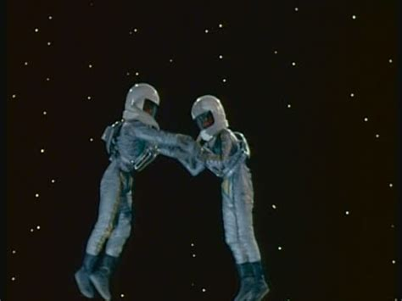
Learning Outcome: Apply Newton’s law of gravitation to calculate gravitational fields
Two people, each with a mass of 70 kg appear, initially stationary in space 2 m apart. Ignoring the expansion of the universe, and the effects of any nearby mass. How long would it take until they touch?
What problems are there with your calculation?
F = - GMm/r²
G = Gravitational constant = 6.67 x 10⁻¹¹ N m² kg⁻²
F = 6.67 x 10⁻¹¹ x 70 x 70/ 2² = 8.17 x 10⁻⁸ N
a = F/m = 8.17 x 10-8/70 = 1.17 x 10⁻⁹
s = ut + 0.5 at² (s = 1 m as accelerating towards each other)
t = √s/0.5a = √1/0.5 x 1.17 x 10-9
t = 41393 s or 690 mins or 11.5 hours
Notes:
F=

Slide 11
4.0 x 10¹⁶ kg
Learning Outcome: Apply Newton’s law of gravitation to calculate gravitational fields
6.5 x 10¹⁶ kg
A
C
900 x 10⁶ m
1470 x 10⁶ m
B
2.0 x 10¹⁶ kg
F = - GMm/r²
G = Gravitational constant = 6.67 x 10⁻¹¹ N m² kg⁻²
What is the resultant force on B?
Notes:
Text book p340/341

Slide 12
4.0 x 10¹⁶ kg
Learning Outcome: Apply Newton’s law of gravitation to calculate gravitational fields
6.5 x 10¹⁶ kg
A
C
1470 x 10⁶ m
900 x 10⁶ m
B
2.0 x 10¹⁶ kg
F = - GMm/r²
G = Gravitational constant = 6.67 x 10⁻¹¹ N m² kg⁻²
What is the resultant force on B? 77 kN

Slide 13
A-Level Physics
1. Development of practical skills in physics
2. Foundations of Physics
3. Forces and motion
4. Electrons, waves and photons
5. Newtonian world and astrophysics
6. Particles and medical physics
5.1 Thermal Physics
5.2 Circular motion
5.3. Oscillations
5.4. Gravitational fields
5.5 Astrophysics
5.4.1. Newton’s law of gravitation
5.3.2. Gravity of point masses
5.3.3. Kepler’s laws
5.3.4. Satellites
5.3.5. Gravitational potential
5.3.6. Gravitational potential energy

Slide 14
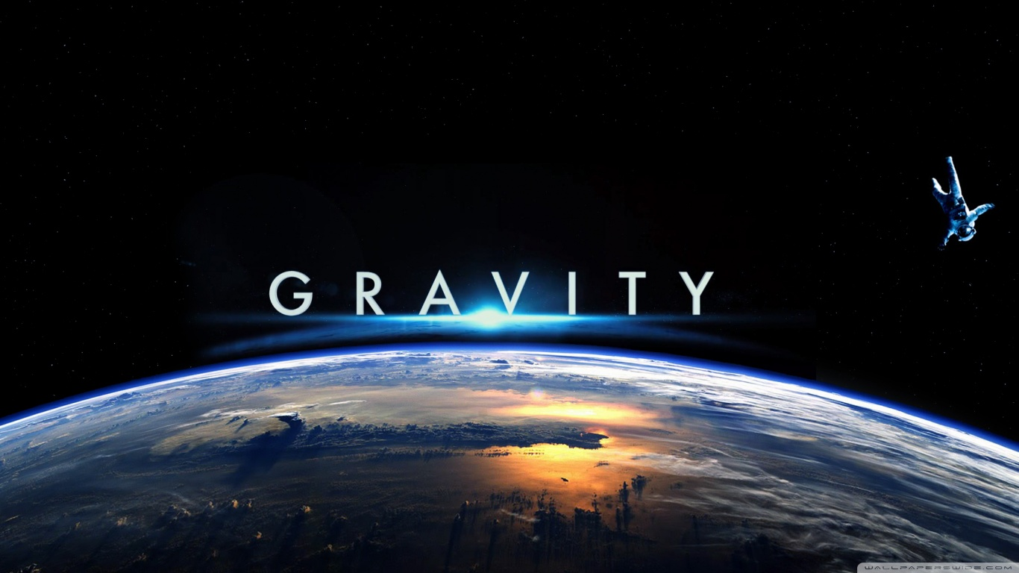
Gravity of point masses
Link between Newton’s laws of gravitation and circular motion
Derive an equation for gravitational field strength
Demonstrate graphically relationships between g and r for point masses

Slide 15
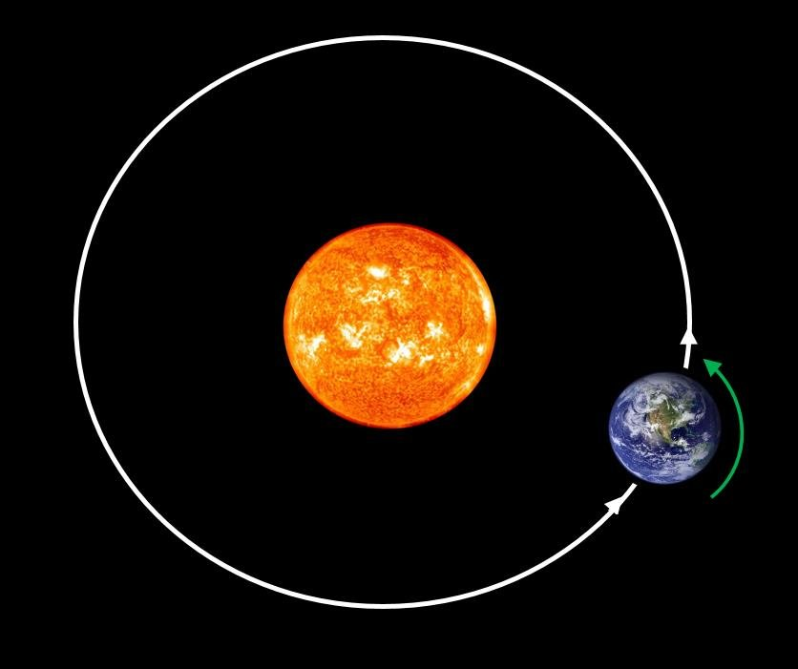
Learning Outcome: Link between Newton’s laws of gravitation and circular motion
For any object in orbit:
Gravitational force = Centripetal force
GMm/r² = mv²/r
GM/r = v²

Slide 16
Learning Outcome: Derive an equation for gravitational field strength
From the two equations from last lesson:
F = mg and F = -GMm/r²
Derive a further equation for g in terms of G, M and r
What can you say about g from your equation?

Slide 17
Learning Outcome: Derive an equation for gravitational field strength
From the two equations from last lesson:
F = mg and F = -GMm/r²
Derive a further equation for g in terms of G, M and r
g = -GM/r²
Therefore g is:
- Directly proportional to the mass of the object
Inversely proportional to the square of the distance from the centre of mass of the object
Remember that this only works for radial fields- we assume at the Earth’s surface the field is uniform

Slide 18
Learning Outcome: Derive an equation for gravitational field strength
Calculate the percentage difference between the gravitational field strength at the surface of the Earth (sea level) and at the top of the tallest building on Earth- the Burj Khalifa in Dubai at 828 m, given the radius of Earth is 6370 km and the mass of Earth = 5.97 x 10²⁴ kg

Slide 19
Learning Outcome: Derive an equation for gravitational field strength
Calculate the percentage difference between the gravitational field strength at the surface of the Earth (sea level) and at the top of the tallest building on Earth- the Burj Khalifa in Dubai at 828 m, given the radius of Earth is 6370 km and the mass of Earth = 5.97 x 10²⁴ kg
g_{sl} = 9.81344 ms⁻² (or N kg⁻¹)
g_{bk} = 9.81089 ms⁻² (or N kg⁻¹)
% diff = (9.81344- 9.81089) x 100 = 0.026%
9.81344

Slide 20
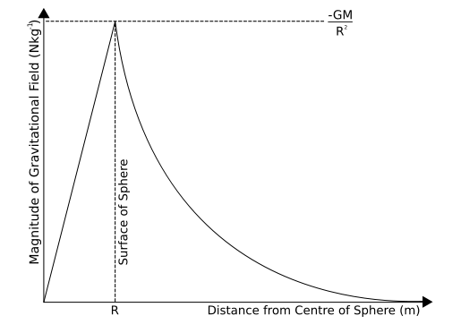
Imagine you are at the centre of the Earth and you travel outwards to 1 million km above the surface. Draw a graph of g versus r
Learning Outcome: Demonstrate graphically relationships between g and r for point masses

Slide 21
Learning Outcome: Demonstrate graphically relationships between g and r for point masses

Slide 22
What would a graph of g versus 1/r2 look like?
Learning Outcome: Demonstrate graphically relationships between g and r for point masses
Notes:
Straight line through origin

Slide 23
What would a graph of g versus 1/r2 look like?
Learning Outcome: Demonstrate graphically relationships between g and r for point masses
1/r²
Gradient = GM
g
Notes:
Straight line through origin
Inverse square law!

Slide 24
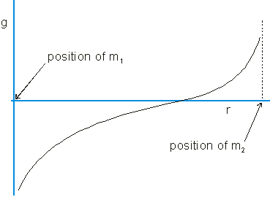
What would a graph of resultant g versus r look like on a journey from the Earth to the moon
Learning Outcome: Demonstrate graphically relationships between g and r for point masses
Notes:
Straight line through origin

Slide 25
If the moon has a mass of 7.35 x 10²² kg and Earth has a mass of 5.97 x 10²⁴ kg, how far from Earth would the resultant force be 0, if the Earth moon distance is 3.8 x 10⁸ m
Learning Outcome: Demonstrate graphically relationships between g and r for point masses
Notes:
Straight line through origin

Slide 26
If the moon has a mass of 7.35 x 10²² kg and Earth has a mass of 5.97 x 10²⁴ kg, how far from Earth would the resultant force be 0, if the Earth moon distance is 3.8 x 10⁸ m? 342,00 km from Earth
Learning Outcome: Demonstrate graphically relationships between g and r for point masses
Notes:
Straight line through origin

Slide 27
A-Level Physics
1. Development of practical skills in physics
2. Foundations of Physics
3. Forces and motion
4. Electrons, waves and photons
5. Newtonian world and astrophysics
6. Particles and medical physics
5.1 Thermal Physics
5.2 Circular motion
5.3. Oscillations
5.4. Gravitational fields
5.5 Astrophysics
5.4.1. Newton’s law of gravitation
5.3.2. Gravity of point masses
5.3.3. Kepler’s laws
5.3.4. Satellites
5.3.5. Gravitational potential
5.3.6. Gravitational potential energy

Slide 28
Kepler’s Laws
State Kepler’s three laws
Describe and explain each of the three laws
Link Kepler’s laws to Newton’s laws of gravitation

Slide 29
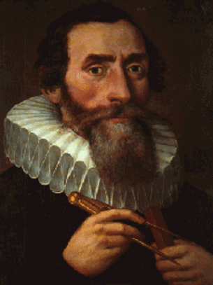
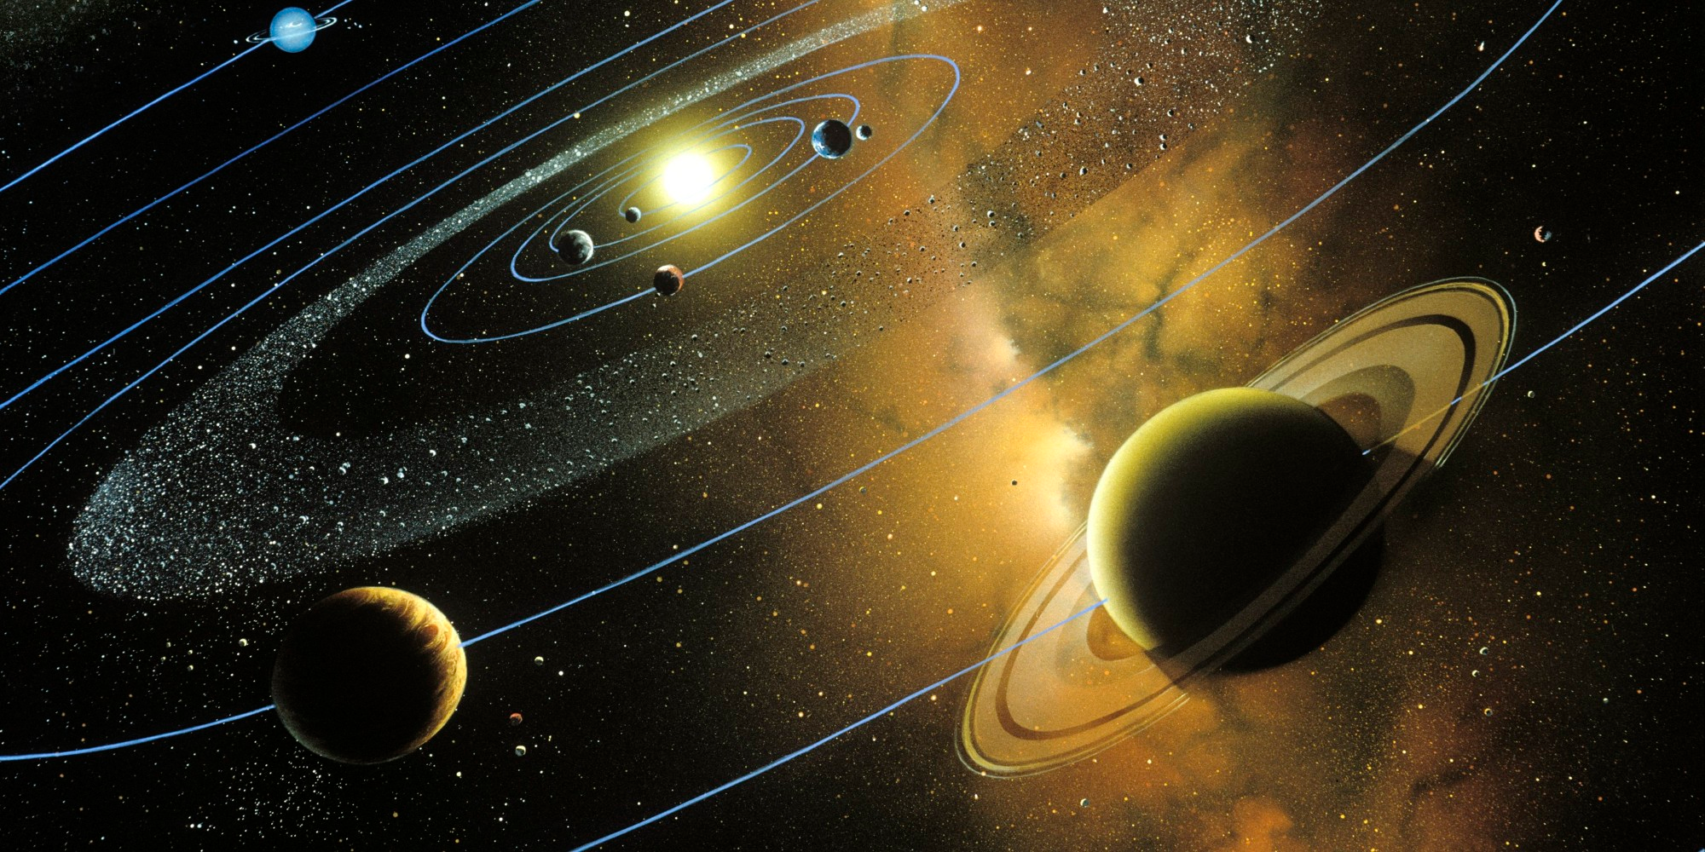
Kepler’s Laws
Learning Outcome: Describe and explain each of the three laws
The orbit of a planet is an ellipse with the Sun at one of the two foci.
A line segment joining a planet and the Sun sweeps out equal areas during equal intervals of time.
The square of the orbital period of a planet is proportional to the cube of the semi-major axis of its orbit.
T² α r³
The period squared is proportional to the mean radius cubed.
Notes:
https://gfycat.com/shamelessunacceptableblackmamba

Slide 30
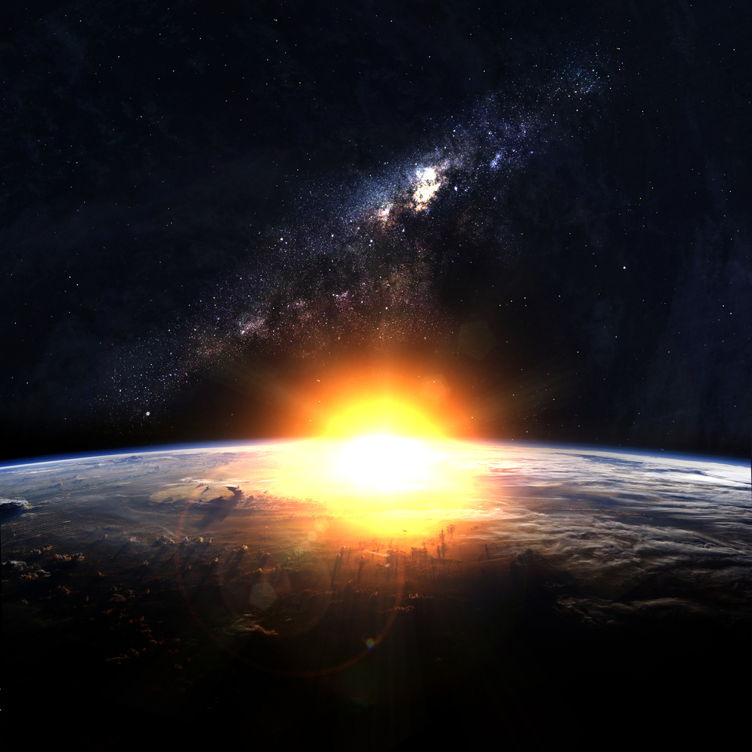
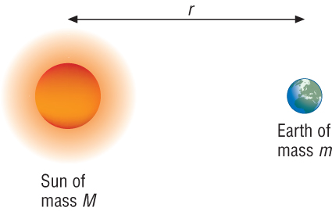
Newton’s law of Gravitation
Learning Outcome: Link Kepler’s laws to Newton’s laws of gravitation
The radius of the Earth’s orbit is 1.5 x 10¹¹m. Knowing the orbit takes 365 days calculate the mass of the Sun?
G = Gravitational constant = 6.67 x 10⁻¹¹ N m² kg⁻²
GMm/r² = mv²/r
GM/r = v²
M = rv²/G (v = d/t = (2π x 1.5 x 10¹¹)/ (365 x 24 x 60 x 60) = 29885.8 ms⁻¹)
M = (1.5 x 10¹¹ x 29885.8²)/6.67 x 10⁻¹¹
M = 1.34 x 1020/ 6.67 x 10⁻¹¹
M = 2.01 x 10³⁰ kg

Slide 31
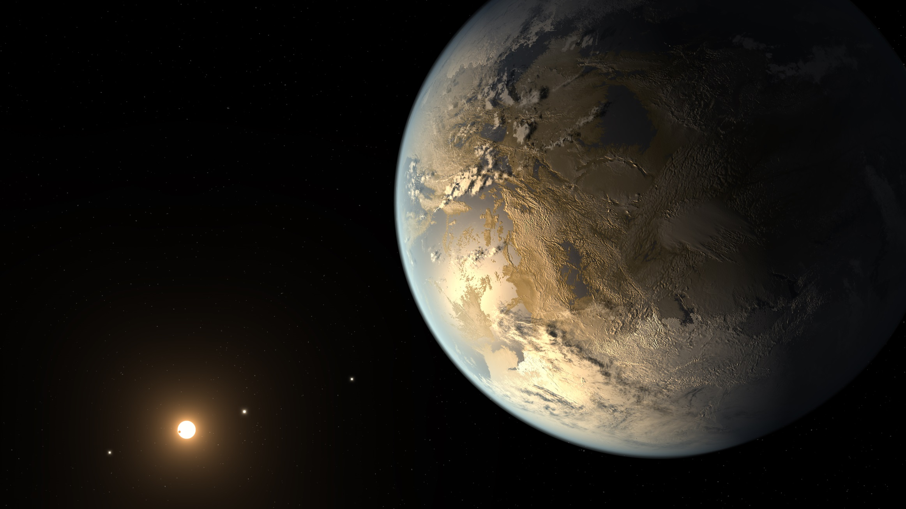
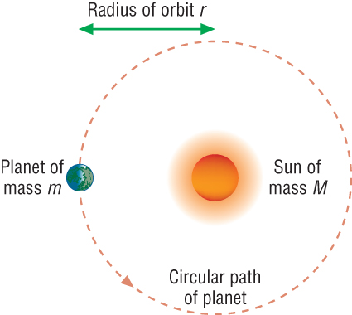
Newton’s treatment of Kepler’s Laws
Learning Outcome: Link Kepler’s laws to Newton’s laws of gravitation
Using the fact that:
GM/r = v² and the equation for orbital velocity
Derive the constant of proportionality between the period and radius of the orbit as r³ α T²

Slide 32
Newton’s treatment of Kepler’s Laws
Learning Outcome: Link Kepler’s laws to Newton’s laws of gravitation
Using the fact that:
v² = GM/r
Derive the constant of proportionality between the period and radius of the orbit as T² α r³
v = 2πr/T
(2πr/T)² = GM/r
4π²r²/T² = GM/r
T² = 4π²r³ / GM Therefore constant = 4π²/ GM

Slide 33
Newton’s treatment of Kepler’s Laws
Learning Outcome: Link Kepler’s laws to Newton’s laws of gravitation
Neptune is 4.5 x 10¹² m from the sun, the sun has a mass of 1.99 x 10³⁰ kg, Calculate the orbital period in Earth years

Slide 34
Newton’s treatment of Kepler’s Laws
Learning Outcome: Link Kepler’s laws to Newton’s laws of gravitation
Neptune is 4.5 x 10¹² m from the sun, the sun has a mass of 1.99 x 10³⁰ kg, Calculate the orbital period in Earth years
165 Earth years

Slide 35
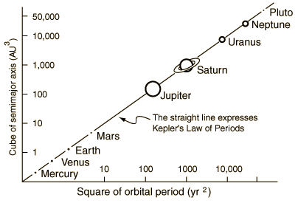
Learning Outcome: Link Kepler’s laws to Newton’s laws of gravitation
Planet | Period T/s | T² | Mean Radius r/m | r³
Mercury | 7.60 x 10⁶ |  | 5.79 x 10¹⁰
Venus | 1.94 x 10⁷ |  | 1.08 x 10¹¹
Earth | 3.16 x 10⁷ |  | 1.50 x 10¹¹
Mars | 5.94 x 10⁷ |  | 2.28 x 10¹¹
Jupiter | 3.75 x 10⁸ |  | 7.78 x 10¹¹
Saturn | 9.30 x 10⁸ |  | 1.43 x 10¹²
Uranus | 2.65 x 10⁹ |  | 2.87 x 10¹²
Neptune | 5.20 x 10⁹ |  | 4.50 x 10¹²

Slide 36
A-Level Physics
1. Development of practical skills in physics
2. Foundations of Physics
3. Forces and motion
4. Electrons, waves and photons
5. Newtonian world and astrophysics
6. Particles and medical physics
5.1 Thermal Physics
5.2 Circular motion
5.3. Oscillations
5.4. Gravitational fields
5.5 Astrophysics
5.4.1. Newton’s law of gravitation
5.3.2. Gravity of point masses
5.3.3. Kepler’s laws
5.3.4. Satellites
5.3.5. Gravitational potential
5.3.6. Gravitational potential energy

Slide 37
Satellites
Describe how satellites are put into orbit
Describe different types of satellite orbits and their uses
Calculate the radius of satellite orbits

Slide 38
Satellite
Learning Outcome: Describe how satellites are put into orbit
A satellite needs to be moving at a certain speed to stay in its orbit. If it is going too fast it will fly off into space. If it is going too slowly it will fall to Earth.
v² = GM/r
The force of gravity is greatest close to a planet, so satellites that are in low orbits need to move faster than satellites in high orbits.

Slide 39
Learning Outcome: Describe how satellites are put into orbit

Slide 40
Polar Orbits
Learning Outcome: Describe different types of satellite orbits and their uses
If the satellite is in an orbit that takes it over the North and South Poles, it will eventually cover all parts of the Earth as the Earth spins beneath it.
This kind of orbit is called a polar orbit.

Slide 41
Geostationary Orbits
Learning Outcome: Describe different types of satellite orbits and their uses
Some satellites are far enough from the Earth to take exactly 24 hours to complete one orbit. This means that these satellites will stay over the same place on the Earth all the time. This kind of orbit is called a geostationary orbit.
Satellites in geostationary orbits must be over the equator as the centre of the orbit must be the centre of the earth.

Slide 42
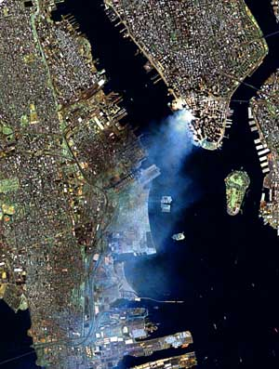
Low-level Satellites
Learning Outcome: Describe different types of satellite orbits and their uses
Not geostationary.
Orbits typically 500km above the Earth
Less expensive
Greater detail can be seen from them.

Slide 43
Uses of Satellites
Learning Outcome: Describe different types of satellite orbits and their uses
The list below shows some different uses for satellites. For each use, say which type of orbit would be best, and explain why.
a Investigating the ozone holes over the Arctic and Antarctic
b Transmitting satellite TV pictures
c Investigating sea temperatures in the world’s oceans
d Making maps of Africa and Asia
e Helping to make weather forecasts for Europe

Slide 44
Newton’s law of Gravitation
Learning Outcome: Calculate the radius of satellite orbits
The radius of the Earth is 6370 km and has a mass of 5.97 x 1024 kg. Calculate the altitude of geostationary satellites above the equator.
T² = 4π²r³ / GM

Slide 45
Newton’s law of Gravitation
Learning Outcome: Calculate the radius of satellite orbits
The radius of the Earth is 6370 km and has a mass of 5.97 x 1024 kg. Calculate the altitude of geostationary satellites above the equator.
T² = 4π²r³ / GM
r = 4.22 x 10⁷ m
Altitude = 4.22 x 10⁷ – 6.37 x 10⁶ = 3.6 x 10⁷ m

Slide 46
A-Level Physics
1. Development of practical skills in physics
2. Foundations of Physics
3. Forces and motion
4. Electrons, waves and photons
5. Newtonian world and astrophysics
6. Particles and medical physics
5.1 Thermal Physics
5.2 Circular motion
5.3. Oscillations
5.4. Gravitational fields
5.5 Astrophysics
5.4.1. Newton’s law of gravitation
5.3.2. Gravity of point masses
5.3.3. Kepler’s laws
5.3.4. Satellites
5.3.5. Gravitational potential
5.3.6. Gravitational potential energy

Slide 47
Gravitational potential
Define gravitational potential
Describe how gravitational potential varies away from a point mass
Calculate changes in gravitational potential

Slide 48
Learning Outcome: Define gravitational potential
Gravitational potential (V_{g}) is the work done per unit mass to move an object to that point from infinity
The unit for Vg is therefore Jkg⁻¹
Gravitational potential is taken to be a maximum of 0 Jkg⁻¹ at infinity
All values of of gravitational potential are negative

Slide 49
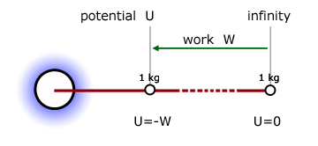
Learning Outcome: Define gravitational potential

Slide 50
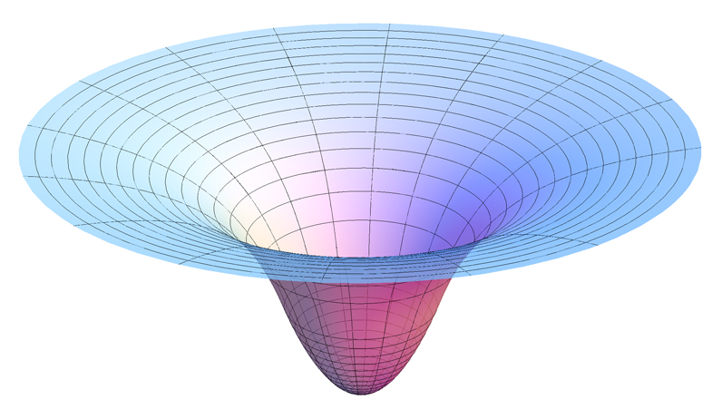

Slide 51
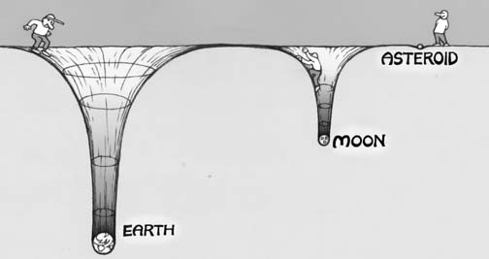

Slide 52
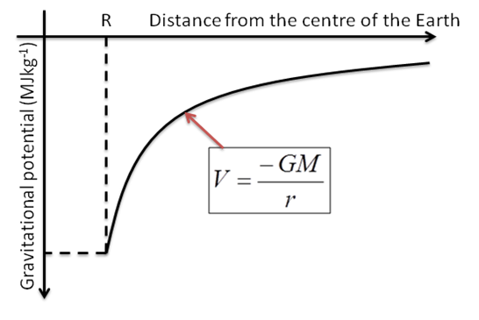
Learning Outcome: Describe how gravitational potential varies away from a point mass
How would gravitational potential vary from the centre of the Earth to infinity?

Slide 53
Learning Outcome: Describe how gravitational potential varies away from a point mass
What things would influence the gravitational potential?

Slide 54
Learning Outcome: Describe how gravitational potential varies away from a point mass
What things would influence the gravitational potential?
V_{g} α M
V_{g} α 1/r

Slide 55
Learning Outcome: Describe how gravitational potential varies away from a point mass
Moving away from a point mass where r equals the distance from the point mass:
V_{g} α M
V_{g} α 1/r
Therefore if M = 0, Vg = 0 and if r =∞, Vg → 0
V_{g} = - GM
r
r

Slide 56
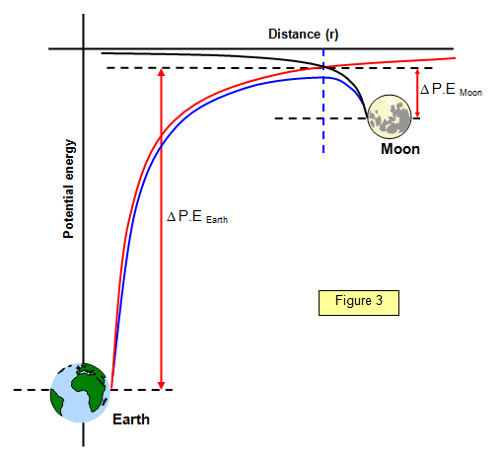
Learning Outcome: Describe how gravitational potential varies away from a point mass

Slide 57
Learning Outcome: Describe how gravitational potential varies away from a point mass

Slide 58
Learning Outcome: Calculate changes in gravitational potential
mass of Earth = 5.98 x 10²⁴ kg
radius of Earth at the Equator = 6.38 x 10⁶ m
radius of Earth at the poles = 6.36 x 10⁶ m
Show that the gravitational potential at the Earth's equator is about -6.25 x 10⁷ J kg⁻¹.
b) Show that the magnitude of the gravitational potential at one of the poles is about 1.003 times the magnitude at the equator.

Slide 59
A-Level Physics
1. Development of practical skills in physics
2. Foundations of Physics
3. Forces and motion
4. Electrons, waves and photons
5. Newtonian world and astrophysics
6. Particles and medical physics
5.1 Thermal Physics
5.2 Circular motion
5.3. Oscillations
5.4. Gravitational fields
5.5 Astrophysics
5.4.1. Newton’s law of gravitation
5.3.2. Gravity of point masses
5.3.3. Kepler’s laws
5.3.4. Satellites
5.3.5. Gravitational potential
5.3.6. Gravitational potential energy

Slide 60
Gravitational potential
Define gravitational potential energy
Calculate work done from force-distance graphs
Calculate escape velocity

Slide 61
Learning Outcome: Define gravitational potential
Gravitational potential (V_{g}) is the work done per unit mass to move an object to a point within a gravitational field from infinity
The unit for Vg is therefore Jkg⁻¹
Gravitational potential energy is the work done to move an object to a point within a gravitational field from infinity
The unit for E_{GPE} = J

Slide 62
Learning Outcome: Define gravitational potential
What equation links gravitational potential and gravitational potential energy?
E = Vg m
Using the above equation and the gravitational potential equation derive an equation for gravitational potential energy
Vg = -GM/r
E = -GM/r x m
E= -GMm/r

Slide 63
Learning Outcome: Define gravitational potential
A) Given that the mass of the Earth is 5.97 x 10²⁴ kg, with a radius of 6370 km. What would be the gravitational potential energy of a 75 kg satellite in orbit 1200 km above the surface?
B) What would the change in gravitational potential energy be if the satellites orbit increases to 5000 km?
E = -GMm/r
Notes:
GPE question?

Slide 64
Learning Outcome: Define gravitational potential
A) Given that the mass of the Earth is 5.97 x 10²⁴ kg, with a radius of 6370 km. What would be the gravitational potential energy of a 75 kg satellite in orbit 1200 km above the surface?
B) What would the change in gravitational potential energy be if the satellites orbit increases to 5000 km?
E = -GMm/r
A) -3.95 x 10⁹ J
B) At 5000 km GPE= -2.62 x 10⁹ J
Notes:
GPE question?

Slide 65
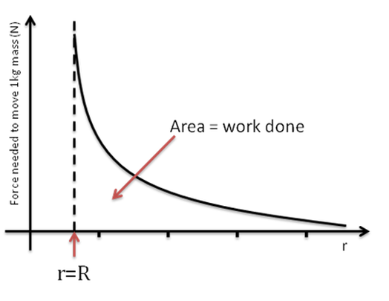
Learning Outcome: Describe how gravitational potential varies away from a point mass
How does gravitational force vary with distance from an objects gravitational field.
How could you calculate the work done to move an object within a gravitational field from your graph?

Slide 66
Learning Outcome: Calculate escape velocity
How can you escape a gravity well?

Slide 67
Learning Outcome: Calculate escape velocty
An object must be provided with kinetic energy at least equal to the gravitational potential energy it gains
½mv² = GMm/r
v = √2GM/r
The escape velocity is the velocity necessary for an object to overcome the gravitational pull of the planet that object is on
As both GPE and kinetic energy are dependant on mass, escape velocity is independent of mass

Slide 68
Learning Outcome: Calculate escape velocty
v = √2GM/r
Which planet is most difficult to escape from; Earth, Mars Mercury or Venus?
Planet | Mass (kg) | Radius (m) | Escape velocity (m/s)
Earth | 5.98 x 10²⁴ | 6.38 x 10⁶ | 1.1 x 10⁴
Mars | 6.46 x 10²³ | 3.39 x 10⁶ | 5.04 x 10³
Mercury | 3.35 x 10²³ | 2.44 x 10⁶ | 4.28 x 10³
Venus | 4.90 x 10²⁴ | 6.06 x 10⁶ | 1.04 x 10⁴

