Slide 1
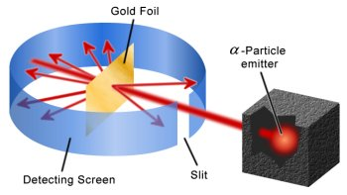
Atomic Structure and Radioactivity Summary Sheet
Development of atomic theory
Bohr- modern atomic theory
Draw a labelled diagram of Bohr’s atomic model and describe the difference to Rutherford’s model
Define the following terms:
Atomic number
Mass number
Isotope
Ion
Dalton
What did Dalton suggest?
Thomson
What experiments did J.J. Thomson do, what did they show and what was his model (include a diagram)?
Property | Protons | Neutrons | Electrons
Location
Charge
Mass
Discovered by?
Rutherford
Add labels to the below diagram of Rutherford’s gold leaf experiment to describe and explain the three ways which particles travel through the gold foil and why
Notes:
Students given this sheet to complete when reviewing others posters

Slide 2
Radioactivity and fission/fusion
Alpha, beta and gamma radiation
Half life
Sketch a graph a the space below to show how the radioactive activity of a sample changes with time. Add the following to your graph; a definition of half life and how you would find this from the graph, what “activity” means and the units for this.
Property | Alpha | Beta | Gamma
What is it?
Symbol
Charge
Speed in air
Distance travelled in air
Stopped by?
Effect in magnetic field?
Why is it dangerous and it what situation is it most dangerous?
Describe a useful use
Example decay equation
Activity
Time
Nuclear fission and fusion
Sketch and label a diagram below to illustrate nuclear fission
Explain the purpose of the following components in a nuclear reactor
Moderator-
Control rods-
Sketch and label a diagram below to illustrate nuclear fusion
X → Y +
X → Y +
X → Y +

