Slide 1
Forces part 1 summary sheet
Definitions
Complete the following definitions:
Weight
Mass
Scalar quantity
Vector quantity
Hooke’s law
Elastic deformation
Plastic deformation
Distance
Displacement
Acceleration
Speed
Velocity
Terminal velocity
Stopping distance
Thinking distance
Braking distance
Experiments
Describe an experiment to demonstrate Hooke’s law (relationship between force and extension on a spring)
You should include:
A labelled apparatus diagram
A method (about 5 bullet points)
A sketch graph of the expected results.

Slide 2
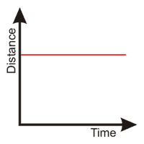
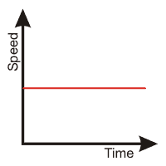
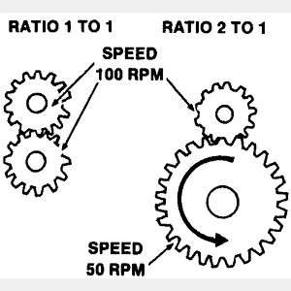
Theory – Forces
Draw a free body diagram for a skier going down a slope
Describe the principle of moments
Explain how a lever, like the one below, acts as a force multiplier to lift the rock
Describe which gear set below would be useful for cycling up hill on a bike
Graphs of motion
On the distance-time graph below draw and label lines to represent
A stationary object
Two objects moving at constant speed- one fast, one slow
An object accelerating
An object decelerating
On the speed-time graph below draw and label lines to represent
A stationary object
Two objects moving at constant speed- one fast, one slow
An object accelerating
An object decelerating
On the speed-time graph below sketch the change in speed of an object as it falls from a height, add labels to explain the change in acceleration including how and why the drag force acting on the object changes until it reaches terminal velocity.
On the speed-time graph sketch the change in speed of a car from the moment the driver sees a hazard until the car comes to a stop. Label the thinking and braking distance

