Slide 1
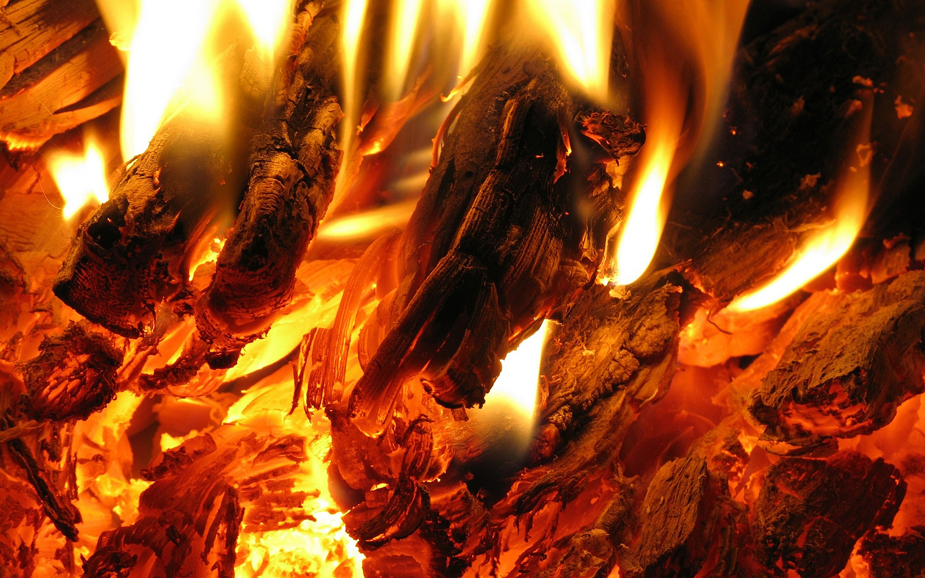
Thermal Physics
Notes:
Give out prepare for learning and get to complete first task

Slide 2
States of matter and Brownian motion
States of matter and Brownian motion
Specific heat capacity and temperature
Investigating specific heat capacity PAG
Specific latent heat and internal energy
Amount of substance
The kinetic theory and pressure of a gas
Investigating gases
Boyle’s Law and finding absolute zero PAG
The ideal gas equation
The Boltzmann constant
Module 5: Newtonian world and astrophysics
Module 6: Particles and medical physcis
5.1: Thermal Physics
5.2: Circular Motion
5.3: Oscillations
5.4 Gravitational fields
5.5 Astrophysics and cosmology

Slide 3
States of matter and Brownian motion
Explain the kinetic model of matter
Analyse the density of Solids, Liquids and Gases
Describe Brownian motion in each state and experiments that show this

Slide 4
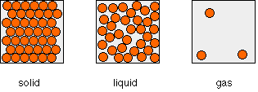
The kinetic model
Learning Outcome: Explain the kinetic model of matter
Notes:
Get students to draw the model for a solid, liquid and gas in turn and add descriptions

Slide 5
Property | Solid | Liquid | Gas
Arrangement of particles | Regular | Random | Random
Particle movement | Vibrate around a fixed position | Move around each other | Quick, in all directions
Particle closeness | Very close | Close | Far apart
Density | Larger than a liquid | Slightly smaller than a solid | 1000’s of times smaller than a solid or liquid
Intermolecular forces | Very strong | Strong | Weak

Slide 6
Density
Learning Outcome: Analyse the density of solids, liquids and gases
STP means standard temperature and pressure that is, 273K and 100kPa (atmospheric pressure).
Substance | Solid Density / kg m⁻³ | Liquid Density / kg m⁻³ | Gas Density / kg m⁻³
Oxygen | 1300 | 1100 | 1.43 at STP
Carbon Dioxide | 1600 |  | 1.98 at STP
Water | 920 | 1000 | 0.59 at b/p
Sodium | 970 | 930 | (0.24) at b/p
Aluminium | 2700 | 2400 | (0.12) at b/p

Slide 7
Key Points about Density
Learning Outcome: Analyse the density of solids, liquids and gases
Solids and Liquids are of the order 1000 times denser than gases.
Solids are usually a little denser than the corresponding liquids. Liquid water is an exception to this.
Pressure and temperature do not alter the density of solids and liquids very much.
For gases on the other hand, a change in pressure or temperature has a significant effect.

Slide 8
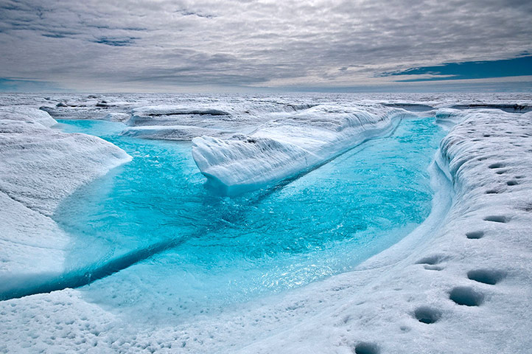
Atomic or Molecular Spacing
Learning Outcome: Analyse the density of solids, liquids and gases
The mass of one water molecule = 3.0 x 10⁻²⁶kg
Calculate the number of molecules in 1m³ of ice, water and steam?
1 m³ of ice contains
1 m³ of water contains
1 m³ of steam contains

Slide 9
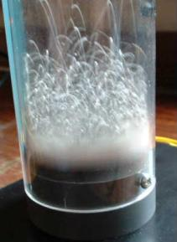
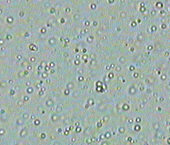
Brownian Motion
Learning Outcome: Describe Brownian motion and experiments that show this
Kinetic theory (the idea particles are in continuous random motion) was proven by Robert Brown who observed a weak solution of milk and later pollen grains in suspension with a high-powered microscope, and saw that the particles of milk and the pollen grains showed a continuous violent and random motion.

Slide 10
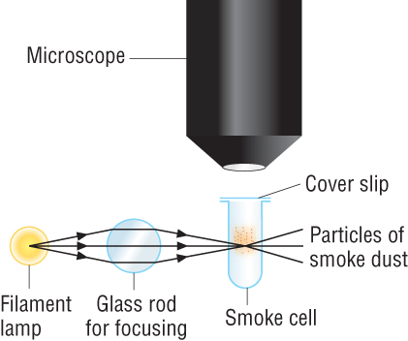
Experiments to show Brownian Motion
Learning Outcome: Describe Brownian motion and experiments that show this
The motion of molecules in a gas is invisible to the naked eye. If however, some smoke is introduced into a small glass container and the container is well illuminated and viewed through a microscope the effect of molecular motion can be seen.

Slide 11
Experiments to show Brownian Motion
Learning Outcome: Describe Brownian motion and experiments that show this

Slide 12
Conclusions of Brownian Motion
Learning Outcome: Describe Brownian motion and experiments that show this
All molecules are continuously moving randomly in different directions and different speeds.
Air particles are much smaller than the smoke particles

Slide 13
Pattern of Movement: Solids
Learning Outcome: Describe Brownian motion and experiments that show this
As a solid is heated, its temperature rises, and the kinetic energy of the molecules increases. Because it is solid, the position of each molecule cannot change resulting in greater vibration energy around the equilibrium position.

Slide 14
Pattern of Movement: Liquids
Learning Outcome: Describe Brownian motion and experiments that show this
In a liquid the same effect occurs however a small amount of translational energy will be added to increased vibrational energy.

Slide 15
Pattern of Movement: Gases
Learning Outcome: Describe Brownian motion and experiments that show this
In a gas the chaotic movement of the particles make almost all of the energy translational

Slide 16
Specific heat capacity
States of matter and Brownian motion
Specific heat capacity and temperature
Investigating specific heat capacity PAG
Specific latent heat and internal energy
Amount of substance
The kinetic theory and pressure of a gas
Investigating gases
Boyle’s Law and finding absolute zero PAG
The ideal gas equation
The Boltzmann constant
Module 5: Newtonian world and astrophysics
Module 6: Particles and medical physics
5.1: Thermal Physics
5.2: Circular Motion
5.3: Oscillations
5.4 Gravitational fields
5.5 Astrophysics and cosmology
Notes:
Give out prepare for learning and get to complete first task

Slide 17
Specific heat capacity
Define what is meant by temperature and the difference to heat
Define and apply the concept of Specific Heat Capacity
Apply the equation E=mcΔT

Slide 18
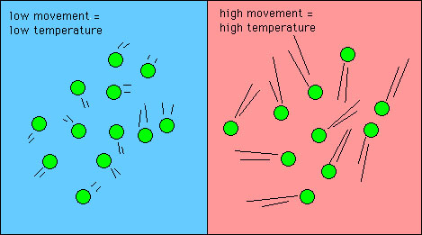
Temperature
Learning Outcome: Define what is meant by temperature
Temperature is a measure of the kinetic energy of a system
If the temperature of a system rises, the molecules travel more rapidly and their kinetic energy rises

Slide 19
Learning Outcome: Define what is meant by temperature
There are three scales of temperature:
Fahrenheit- 0 °F, was established as the temperature of a solution of brine made from equal parts of ice and salt
Celsius- Based on the boiling and freezing point of water
Kelvin - An absolute scale of temperature. It does not depend on any properties of a substance.
Kelvin = Celsius + 273.15.
Zero Kelvin = “Absolute zero”- no kinetic energy
Notes:
How would increased temperature affect the potential energy, how would it effect the internal energy?

Slide 20
Temperature vs. heat vs. conductivity
Learning Outcome: Define what is meant by temperature
Temperature- a measure of only the kinetic energy of a system
Heat- refers of transfer of energy from a hotter to a colder object
Conductivity- Effects how hot or cold an object feels. A better conductor of heat energy will feel warmer or colder.
Thermal equilibrium occurs between two objects when there is zero resultant energy transfer between them.
Notes:
Try different materials and test their “temperature”

Slide 21
Learning Outcome: Define what is meant by temperature
How do you increase temperature?

Slide 22
Learning Outcome: Define what is meant by temperature
How do you increase temperature?
Add heat/thermal energy?
You have a beaker of 10 ml of water and another one of 100 ml of water. You put each one over a bunsen burner for 2 mins suppling a total of 2000 J of heat energy directly to the water.
The temperature of the 100 ml beaker rises by 2°C, how much will the temperature of the 10 ml beaker rise? Why?

Slide 23
Learning Outcome: Define what is meant by temperature
How do you increase temperature?
Add heat/thermal energy?
You have a beaker of 100 ml of water and another one of 100 ml of oil. You put each one over a bunsen burner for 2 mins suppling a total of 2000 J of heat energy directly to the liquid.
Will the temperature change be the same? If not, why not?

Slide 24
Specific Heat Capacity
Learning Outcome: Define and apply the concept of Specific Heat Capacity
Per unit mass
“Ability to Hold”
Thermal Energy
Specific Heat Capacity is the quantity of thermal energy required to raise the temperature of a unit mass of a substance by a unit temperature rise.

Slide 25
Specific Heat Capacity
Learning Outcome: Apply the equation for Specific Heat Capacity
The quantity of hot water required for one part of the cycle in a dishwasher is 4.5 litre. The inlet temperature of the water on a cold day is only 5°C and is required in the machine at a temperature of 65°C.
The time allowed for heating the water is 15 minutes. What power from the heater is required?
SHC of Water = 4200 Jkg⁻¹K⁻¹; 1 litre of water has a mass of 1kg

Slide 26
Specific Heat Capacity
Learning Outcome: Apply the equation for Specific Heat Capacity
The quantity of hot water required for one part of the cycle in a dishwasher is 4.5 litre. The inlet temperature of the water on a cold day is only 5°C and is required in the machine at a temperature of 65°C.
The time allowed for heating the water is 15 minutes. What power from the heater is required?
SHC of Water = 4200 Jkg⁻¹K⁻¹; 1 litre of water has a mass of 1kg
E = 4.5 x 4200 x 60 = 1.134 x 10⁶ J
t = 15 x 60 = 900s
1.134 x 10⁶ / 900 = 1260W

Slide 27
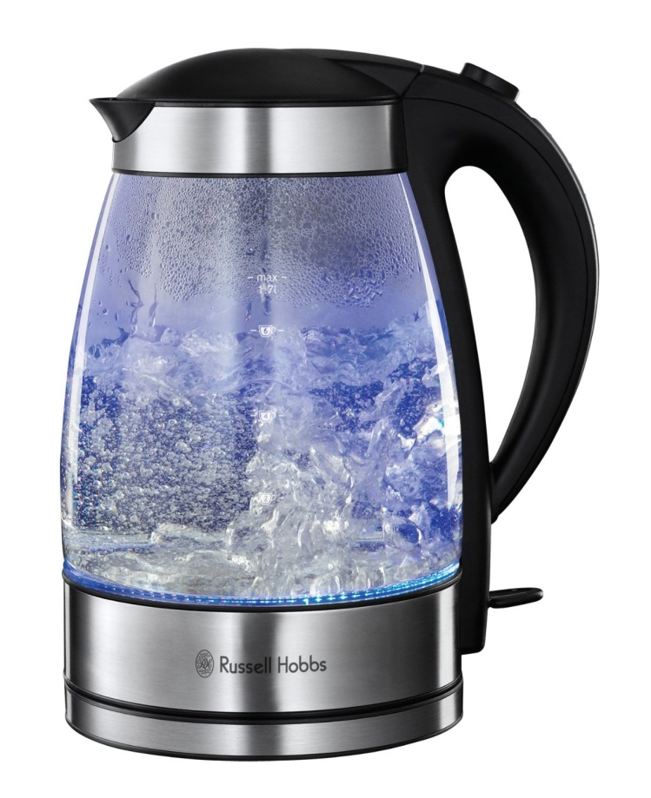
Deducing the Specific Heat Capacity
Learning Outcome: Apply the equation for Specific Heat Capacity
On the base of an electric kettle, you can see its power.
If a known mass of water at a known temperature is placed in the kettle and it is switched on, the time taken for it to reach 100°C can be found.
This gives all the information required to find c.
If this kettle has a power of 1.2kW and it takes 233 seconds to boil 0.88kg of water from 25°C, calculate the specific heat capacity of water?

Slide 28
Deducing the Specific Heat Capacity
Learning Outcome: Apply the equation for Specific Heat Capacity
If this kettle has a power of 1.2kW and it takes 233 seconds to boil 0.88kg of water from 25°C, calculate the specific heat capacity of water?
c= E E = Pt
mΔT
c = 1200 x 233 = 4236.4 Jkg⁻¹K⁻¹
0.88 x 75

Slide 29
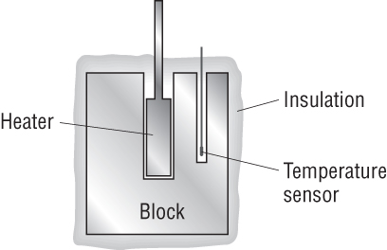
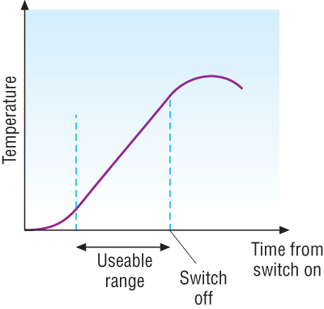
Deducing the Specific Heat Capacity
Learning Outcome: Describe an electrical experiment to determine the specific heat capacity of a solid or a liquid
A Block of metal of mass, m has two holes drilled into it: one for an electrical heater and the other for a temperature sensor that can be connected to a data logger. The metal is well lagged, and the heater is switched on.
Either the power of the heater needs to be known or both the current I and the potential difference across the heater V need to be measured.
The apparatus used for measuring the specific heat capacity of a metal

Slide 30
Learning Outcome: Describe an electrical experiment to determine the specific heat capacity of a solid or a liquid

Slide 31
Specific latent heat and internal energy
States of matter and Brownian motion
Specific heat capacity and temperature
Investigating specific heat capacity PAG
Specific latent heat and internal energy
Amount of substance
The kinetic theory and pressure of a gas
Investigating gases
Boyle’s Law and finding absolute zero PAG
The ideal gas equation
The Boltzmann constant
Module 5: Newtonian world and astrophysics
Module 6: Particles and medical physics
5.1: Thermal Physics
5.2: Circular Motion
5.3: Oscillation
5.4 Gravitational fields
5.5 Astrophysics and cosmology
Notes:
Give out prepare for learning and get to complete first task

Slide 32
Specific latent heat and internal energy
Analyse heating and cooling curves and explain various sections of the graph linking to internal energy
Define Latent Heat of Fusion and Latent Heat of Vaporisation and how to calculate these
Describe experiments to show Latent Heat of Fusion and Latent Heat of Vaporisation

Slide 33
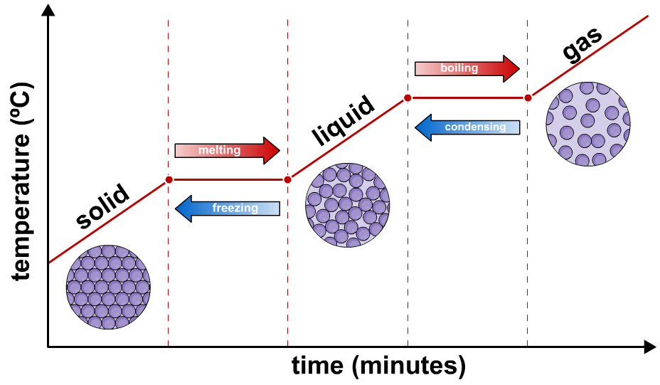
Learning Outcome: Analyse heating and cooling curves and link to internal energy
As Heat energy is transferred to the material the particles gain kinetic energy and therefore the temperature increases. Changes in temperature are linked to the specific heat capacity of an object.

Slide 34
Learning Outcome: Analyse heating and cooling curves and link to internal energy
Heat energy is also transferred to the material whilst it is changing state but the temperature DOES NOT CHANGE because the energy is being used to move the particles further apart against the intermolecular forces, increasing the potential energy. This is the Latent Heat Energy.
As Heat energy is transferred to the material the particles gain kinetic energy and therefore the temperature increases. Changes in temperature are linked to the specific heat capacity of an object.

Slide 35
Defining Internal Energy
Learning Outcome: Analyse heating and cooling curves and link to internal energy
The internal energy of a body is the sum of the random distributions of kinetic and potential energies of all of the molecules in the body.
Electrostatic Potential energy is energy resulting from forces between particles and the separation of these particles
Kinetic energy is energy from movement of particles which can be vibrational or translational
Remember it is the random kinetic and potential energy within the system. Changes that affect the kinetic or potential energy of the whole system do not count!

Slide 36
Learning Outcome: Analyse heating and cooling curves and link to internal energy
Potential energy increases significantly, but not kinetic energy
Kinetic energy increases, and potential energy increases slightly (as particles move apart slightly)
INTERNAL ENERGY INCREASES

Slide 37
Learning Outcome: Define Latent Heat of Fusion and Latent Heat of Vaporisation
 | Internal Kinetic Energy per kilogram/J | Internal Potential Energy per kilogram/J | Total Internal Energy per kilogram/J
Ice at 0°C | 1.9 x 10⁵ | Reference Zero | 1.9 x 10⁵
Water at 0°C | 1.9 x 10⁵ | 3.3 x 10⁵ | 5.2 x 10⁵
Water at 100°C | 2.6 x 10⁵ | 6.8 x 10⁵ | 9.4 x 10⁵
Steam at 100°C | 2.6 x 10⁵ | 27.8 x 10⁵ | 30.4 x 10⁵

Slide 38
Learning Outcome: Define Latent Heat of Fusion and Latent Heat of Vaporisation
Specific Heat Capacity is the amount of energy needed to raise the temperature of 1kg of a substance by 1°C.
The Latent Heat of Fusion of a substance is the quantity of energy per unit mass required to change it at constant temperature from a solid to a liquid.
The Latent Heat of vaporisation of a substance is the quantity of energy per unit mass required to change it at constant temperature from a liquid to a vapour.

Slide 39
Scalds from water and steam
Learning Outcome: Define Latent Heat of Fusion and Latent Heat of Vaporisation
We assume that our hand is at 37 ºC, and that we put 10 g of water at 100 ºC accidentally on our hand. The water will cool to 37 ºC. Assuming that all the heat energy "lost" by the water will be gained by our hand, How much energy will be gained?
If the same 10g had been steam therefore would have to condense first, give the latent heat of vaporisation 2260000 J/kg. What would be the difference in energy?

Slide 40
Scalds from water and steam
Learning Outcome: Define Latent Heat of Fusion and Latent Heat of Vaporisation
We assume that our hand is at 37 ºC, and that we put 10 g of water at 100 ºC accidentally on our hand. The water will cool to 37 ºC. Assuming that all the heat energy "lost" by the water will be gained by our hand, How much energy will be gained?
If the same 10g had been steam therefore would have to condense first, give the latent heat of vaporisation 2260000 J/kg. What would be the difference in energy?
Heat "lost" by water = m c Δθ = 0.01 x 4200 x 63 =2,646 J.
But if the 10 g had been steam then the steam would first have to condense.
Heat "lost" in condensing = ml = 0.01 x 2260000 = 22,600 J
So the heat lost in 10 g of steam turning to water at 37 ºC is 22,600 + 2,646 = 25,246 J.
This is nearly ten times as much as the water alone!

Slide 41
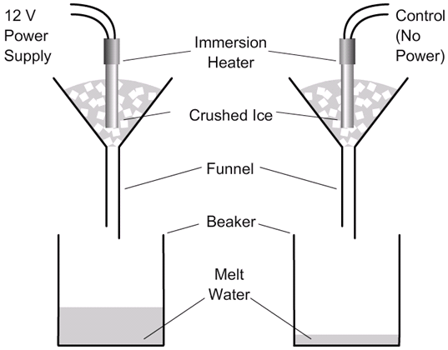
Learning Outcome: Describe experiments to show latent heat of fusion
Experiment to show the latent heat of fusion

Slide 42
Learning Outcome: Describe experiments to show latent heat of fusion
Experiment to show the latent heat of fusion
1) E= mL_{f}
2) E = Pt
3) P=VI
4) E = VIt
Substitute 4) into 1):
5) VIt = mL_{f}
6) L_{f} = VIt
m_{a}-m_{b}

Slide 43
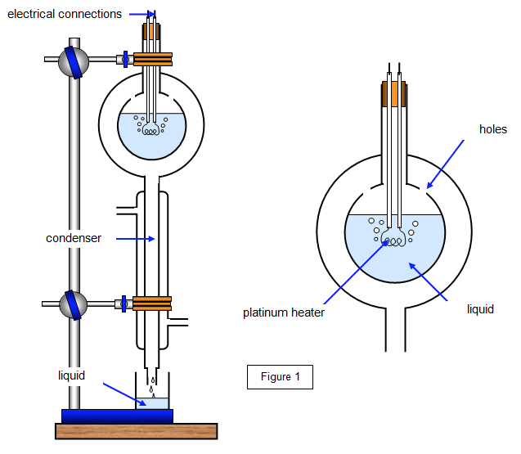
Learning Outcome: Describe experiments to show latent heat of vaporisation
Experiment to show the latent heat of vapourisation
How could you eliminate the heat lost to surroundings?

Slide 44
Learning Outcome: Describe experiments to show latent heat of vaporisation
Need to repeat at 2 different V and I
From first set of data collection you will get:
V₁I₁t = m₁ L_{v} + Q (where Q is energy transferred to surroundings)
From second set of data collection you will get:
2) V₂I₂t =m₂L_{v} + Q
Substituting 1 into 2 will give:
(V₂I₂-V₁I₁)t=(m₂-m₁)L_{v}
So L_{v} can be found

Slide 45
Learning Outcome: Describe experiments to show latent heat of vaporisation
Describe an experiment to calculate the specific latent heat of vaporisation?
Include in your answer:
A labelled diagram of arrangement or description
List of measurements to be taken
Explanation of how to calculate Specific latent heat of vapourisation
8 marks

Slide 46
Learning Outcome: Describe experiments to show latent heat of vaporisation
Describe an experiment to calculate the specific latent heat of vaporisation?
Equipment (Description or diagram) 2 marks
liquid in vessel with holes for vapour to escape
Heater in vapour
Condenser below liquid vessel
Container to collect condensed water
Voltmeter connected in parallel with heater
Ammeter connected in series with heater
Measurements 3 marks
Heat water to boiling point
Measure voltage, current and mass of water water vapour collected over time
Change voltage and current then measure voltage, current and mass of water water vapour collected over same time

Slide 47
Learning Outcome: Describe experiments to show latent heat of vaporisation
Describe an experiment to calculate the specific latent heat of vaporisation?
Explanation 3 marks
From first set of data collection you will get:
V₁I₁t = m₁ L_{v} + Q (where Q is energy transferred to surroundings)
From second set of data collection you will get:
2) V₂I₂t =m₂L_{v} + Q
Substituting 1 into 2 will give:
(V₂I₂-V₁I₁)t=(m₂-m₁)L_{v}
So L_{v} can be found
Notes:
Question 4, June 2012

Slide 48
The amount of substance
Thermal Physics
States of matter and Brownian motion
Specific heat capacity and temperature
Investigating specific heat capacity PAG
Specific latent heat and internal energy
Amount of substance
The kinetic theory and pressure of a gas
Investigating gases
Boyle’s Law and finding absolute zero PAG
The ideal gas equation
The Boltzmann constant
Module 5: Newtonian world and astrophysics
Module 6: Particles and medical physics
5.1: Thermal Physics
5.2: Circular Motion
5.3: Oscillation
5.4 Gravitational fields
5.5 Astrophysics and cosmology
Notes:
Give out prepare for learning and get to complete first task

Slide 49
The amount of substance
Define a mole and avogadro’s constant
Explain what is meant by a “particle”
Calculate number of particles and moles in substances

Slide 50
Avogadro Constant
Learning Outcome: Define a mole of a substance and the Avogadro constant
We use Avogadro’s constant to determine the number of molecules of any quantity of any substance.
The mass of 12 grams of an isotope of carbon called carbon-12 is used as a reference.
It contains 6.02214 x 10²³ atoms.
This number is called Avogadro constant and is represented by the symbol, N_{A}.

Slide 51
Avogadro Constant
Learning Outcome: Define a mole of a substance and the Avogadro constant
In most scientific experiments even small quantities of material contain vast numbers of individual molecules.
Because working with very large numbers can lead to unnecessary mistakes, a new quantity called the amount of substance was introduced into the system.
Its unit is a mole (mol) and is defined as:

Slide 52
Avogadro’s Constant
Learning Outcome: Define a mole of a substance and the Avogadro constant

Slide 53
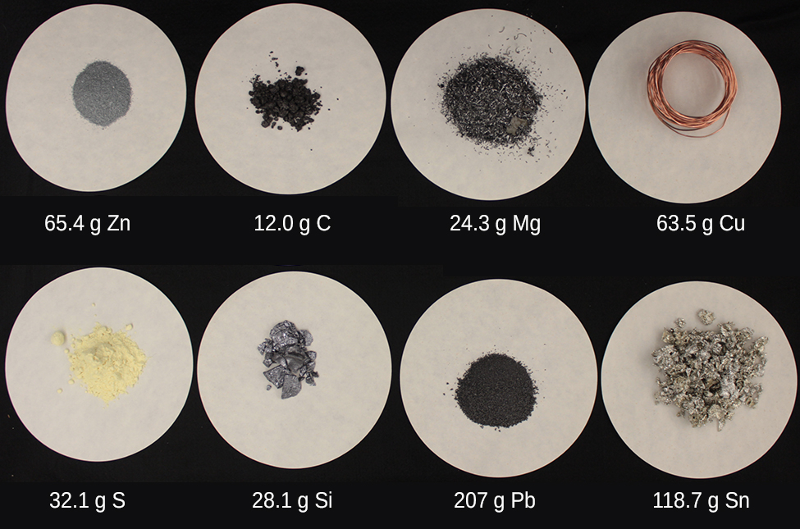
Avogadro Constant
Learning Outcome: Define a mole of a substance and the Avogadro constant
If these are all 1 mole, why the different masses?

Slide 54
Avogadro Constant
Learning Outcome: Define a mole of a substance and the Avogadro constant
1 mol = The atomic mass of the element (1 a.u.)

Slide 55
Learning Outcome: Explain what is meant by a particle
How many particles does 1 mole of Hydrogen contain compared to 1 mole of Oxygen?
What about 1 mole of water?
How does this compare to the number of atoms?
How many atoms in 1 mole of Nitrogen atoms and 1 mole of Nitrogen molecules?

Slide 56
Learning Outcome: Explain what is meant by a particle
How many particles does 1 mole of Hydrogen contain compared to 1 mole of Oxygen?
What about 1 mole of water?
How does this compare to the number of atoms?
How many particles in 1 mole of Nitrogen atoms and 1 mole of Nitrogen molecules?
What would be our definition of a “particle” then?

Slide 57
Learning Outcome: Explain what is meant by a particle
How many particles does 1 mole of Hydrogen contain compared to 1 mole of Oxygen?
What about 1 mole of water?
How does this compare to the number of atoms?
How many particles in 1 mole of Nitrogen atoms and 1 mole of Nitrogen molecules?
Particles are single units e.g. atoms or molecules

Slide 58
Learning Outcome: Calculate number of particles and moles
One mole of a substance contains N_{A} particles
Two moles of a substance contains ?

Slide 59
Learning Outcome: Calculate number of particles and moles
One mole of a substance contains N_{A} particles
Two moles of a substance contains 2N_{A} particles
n moles of a substance contains ?

Slide 60
Learning Outcome: Calculate number of particles and moles
One mole of a substance contains N_{A} particles
Two moles of a substance contains 2N_{A} particles
n moles of a substance contains nN_{A} particles
Therefore number of particles, N:
N = nN_{A}
n=m where m_{a} is the atomic mass of an element
m_{a}

Slide 61
Learning Outcome: Calculate number of particles and moles
But… how can you work out number of moles from a mass?
How many moles are there in 640g of O₂

Slide 62
Learning Outcome: Calculate number of particles and moles
But… how can you work out number of moles from a mass?
How many moles are there in 640g of O₂
1 mole = 1 atomic mass (1 a.u.)
Atomic mass of O₂ is 2 x 16 = 32g
640 = 20 moles
32
n=m where m_{R} is the relative molecular mass
m_{R}

Slide 63
Learning Outcome: Calculate number of particles and moles
Using the 2 equations complete the table
Chemical formula | Total mass/g | Combined atomic mass of one particle/g | Number of moles | Number of particles | Number of atoms
H₂O | 560 mg
NaCl₂ |  |  | 71
 | 128 |  | 4 | (4 *N_{a}) | (8*N_{a})
C₆H₁₂O₆ |  |  | 8000
Au | 2 kg
Clue: A common gas |  | 44 | 80 |  | (240*N_{a})

Slide 64
Learning Outcome: Calculate number of particles and moles
Using the 2 equations complete the table
Chemical formula | Total mass/g | Combined atomic mass of one particle/g | Number of moles | Number of particles | Number of atoms
H₂O | 560 mg | 18 | 0.03111 | 1.87 x 10²² | 5.6 x 10²²
NaCl₂ | 6603 | 93 | 71 | 4.27 x 10²⁵ | 1.28 x 10²⁶
O₂ | 128 | 32 | 4 | 4Na | 8Na
C₆H₁₂O₆ | 1,440,000 | 180 | 8000 | 4.82 x 10²⁷ | 1.16 x10²⁹
Au | 2 kg | 197 | 10.15 | 6.1 x 10²⁴ | 6.1 x 10²⁴
CO₂ | 3520 | 44 | 80 | 4.8 x 10²⁵ | 240Na

Slide 65
Kinetic theory and gas pressure
States of matter and Brownian motion
Specific heat capacity and temperature
Investigating specific heat capacity PAG
Specific latent heat and internal energy
Amount of substance
The kinetic theory and pressure of a gas
Investigating gases
Boyle’s Law and finding absolute zero PAG
The ideal gas equation
The Boltzmann constant
Module 5: Newtonian world and astrophysics
Module 6: Particles and medical physics
5.1: Thermal Physics
5.2: Circular Motion
5.3: Oscillation
5.4 Gravitational fields
5.5 Astrophysics and cosmology
Notes:
Give out prepare for learning and get to complete first task

Slide 66
Kinetic theory and gas pressure
Explain the kinetic model for a gas
Derive the equation for Gas pressure using the Kinetic Model of Gases
Apply equation for gas pressure from the kinetic model

Slide 67
Kinetic Model of a Gas
Learning Outcome: Explain the kinetic model for gases
What is meant by a Model?
“A simplified representation constructed for a purpose.”
Brownian motion describes particles as in “constant random motion”
The kinetic model of a gas describes the motion of that gas.

Slide 68
Kinetic Model of a Gas- assumptions of an “ideal gas”
Learning Outcome: Explain the kinetic model for gases
1. Gases consist of molecules in continuous rapid, random motion (Brownian motion)
2. Collisions are perfectly Elastic
3. The gravitational force on the molecules is negligible.
4. No intermolecular force exists except during collisions.
5. The total volume of the molecules is negligible compared with the volume of the container.
6. The gas has a large number of particles

Slide 69
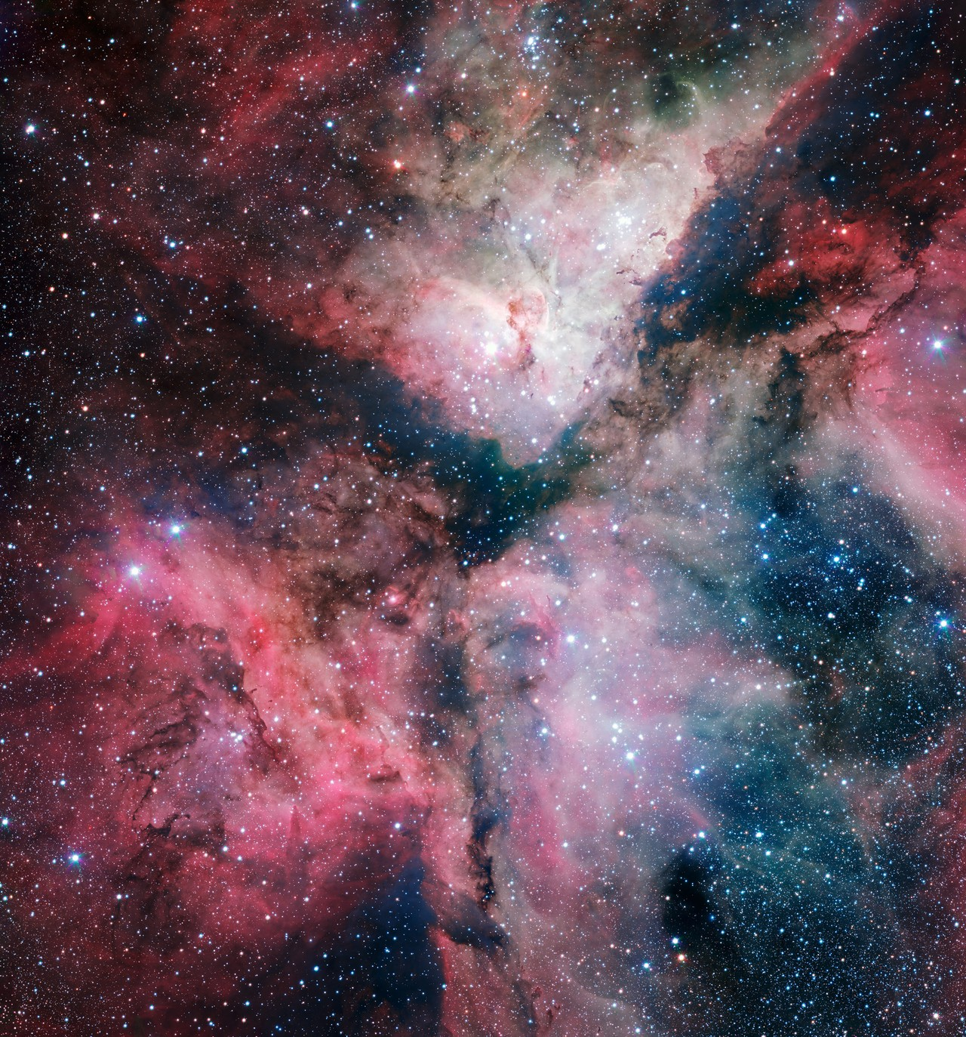
Pressure
Learning Outcome: Explain the kinetic model for gases
Learning Outcome: Derive the equation for Gas pressure using the Kinetic Model of Gases
All gases exert pressure on the walls of their container caused by the gas molecules colliding with the container walls
Pressure is defined as the Force per unit area. The SI unit of pressure is the Pascal, Pa.

Slide 70
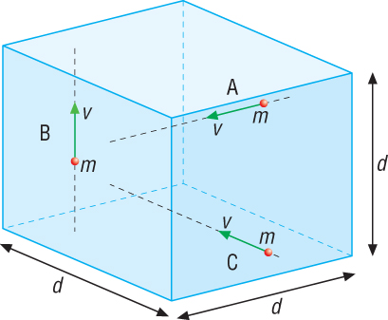
Learning Outcome: Derive the equation for Gas pressure using the Kinetic Model of Gases
Imagine 3 molecules moving in a cubic box of side length, d. The molecules has mass, m and are travelling with speed, v.
Molecule A is moving horizontally from right to left, B is vertically from bottom to top and C is horizontally from front to back.

Slide 71
Learning Outcome: Derive the equation for Gas pressure using the Kinetic Model of Gases
Consider molecule A, when it hits the wall, it will bounce back with velocity, v since we are assuming elastic collisions with the wall
The momentum of the molecule = mv_{x}.
This results in a momentum change of:
mv_{x} - (-mv_{x}) = 2mv_{x}
Notes:
Momentum towards and away from wall

Slide 72
Learning Outcome: Derive the equation for Gas pressure using the Kinetic Model of Gases
Consider molecule A, when it hits the wall, it will bounce back with velocity, v since we are assuming elastic collisions with the wall
The momentum of the molecule = mv_{x}.
This results in a momentum change of:
mv_{x} - (-mv_{x}) = 2mv_{x}
∆t= 2d
v
The next time it hits that same wall will be after its travelled a distance of 2d.
Notes:
Momentum towards and away from wall

Slide 73
Learning Outcome: Derive the equation for Gas pressure using the Kinetic Model of Gases
∆t= 2d
v
∆p = 2mv
From the above 2 equations how could you calculate the force exerted on the wall?

Slide 74
Learning Outcome: Derive the equation for Gas pressure using the Kinetic Model of Gases
∆t= 2d
v
∆ρ = 2mv
Newton’s second law tells us that force = rate of change of momentum
F = ∆ρ
∆t
F= mv²
d
v

Slide 75
Pressure
Learning Outcome: Explain the kinetic model for gases
Learning Outcome: Derive the equation for Gas pressure using the Kinetic Model of Gases
All gases exert pressure on the walls of their container caused by the gas molecules colliding with the container walls
Pressure is defined as the Force per unit area. The SI unit of pressure is the Pascal, Pa.

Slide 76
Learning Outcome: Derive the equation for Gas pressure using the Kinetic Model of Gases
The gas pressure equation!
PV= Nmc²
3
Where:
P = Pressure
V = Volume of container
N = Number of particles
m = mass of a particle
c² = Mean square speed- this is the average speed of all the particles squared. The root mean square speed, is the average speed

Slide 77
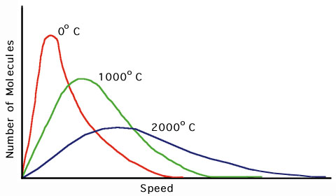
Internal Energy of a gas- Maxwell-Boltzmann distribution
Learning Outcome: Derive the equation for Gas pressure using the Kinetic Model of Gases
Temperature of gas

Slide 78
Learning Outcome: Derive the equation for Gas pressure using the Kinetic Model of Gases
PV= Nmc²
3
Density= mass
volume
Total mass of gas = Nm
P= ρc²
3
ρ= Nm
V

Slide 79
Learning Outcome: Apply the equation for Gas pressure from the Kinetic Model of Gases
A cylinder has a volume of 500 cm³. It is filled with a gas of density 1.4 kg m⁻³, and the pressure in the cylinder is 2.5 x 10⁵ Pa.
Calculate:
The mean square speed of all the molecules
The square root of the mean square speed of all the molecules (the root mean square speed)

Slide 80
Learning Outcome: Apply the equation for Gas pressure from the Kinetic Model of Gases
A cylinder has a volume of 500 cm³. It is filled with a gas of density 1.4 kg m⁻³, and the pressure in the cylinder is 2.5 x 10⁵ Pa.
Calculate:
The mean square speed of all the molecules
The square root of the mean square speed of all the molecules (the root mean square speed)
The kinetic energy of all the molecules

Slide 81
Learning Outcome: Apply the equation for Gas pressure from the Kinetic Model of Gases
A cylinder has a volume of 500 cm³. It is filled with a gas of density 1.4 kg m⁻³, and the pressure in the cylinder is 2.5 x 10⁵ Pa.
Calculate:
The mean square speed of all the molecules
The square root of the mean square speed of all the molecules (the root mean square speed)
The kinetic energy of all the molecules

Slide 82
Learning Outcome: Apply the equation for Gas pressure from the Kinetic Model of Gases
c) The kinetic energy of all the molecules
Since mn = total mass of the gas.

Slide 83
Learning Outcome: Apply the equation for Gas pressure from the Kinetic Model of Gases
c) The kinetic energy of all the molecules
Since mn = ρV
Kinetic energy = 190J to 2 sig. figs.

Slide 84
Learning Outcome: Apply the equation for Gas pressure from the Kinetic Model of Gases
Nitrogen gas is kept in a closed container of volume 730 cm³ at a temperature of 27 ºC and a pressure of 1.0 × 10⁵ Pa. The density of nitrogen is 1.25 kg m⁻³.
Calculate:
The mean square speed of all the molecules
The square root of the mean square speed of all the molecules
The kinetic energy of all the molecules

Slide 85
Learning Outcome: Apply the equation for Gas pressure from the Kinetic Model of Gases
Nitrogen gas is kept in a closed container of volume 730 cm³ at a temperature of 27 ºC and a pressure of 1.0 × 10⁵ Pa. The density of nitrogen is 1.25 kg m⁻³.
Calculate:
The mean square speed of all the molecules
2.4 x 10⁵ m²s⁻²
The square root of the mean square speed of all the molecules
490 ms⁻¹
The kinetic energy of all the molecules
109 J

Slide 86
Investigating gases
States of matter and Brownian motion
Specific heat capacity and temperature
Investigating specific heat capacity PAG
Specific latent heat and internal energy
Amount of substance
The kinetic theory and pressure of a gas
Investigating gases
Boyle’s Law and finding absolute zero PAG
The ideal gas equation
The Boltzmann constant
Module 5: Newtonian world and astrophysics
Module 6: Particles and medical physics
5.1: Thermal Physics
5.2: Circular Motion
5.3: Oscillation
5.4 Gravitational fields
5.5 Astrophysics and cosmology
Notes:
Give out prepare for learning and get to complete first task

Slide 87
Investigating gases
Explain Boyle’s Law and use it in calculations
Explain Charles’ law and use it in calculations
Explain the temperature-pressure law and use it in calculations to find absolute zero

Slide 88
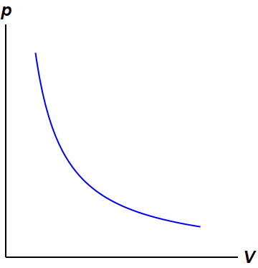
Boyle’s Law
Learning Outcome: Explain Boyle’s law
“The volume of a fixed mass of gas is inversely proportional to the pressure exerted on it, provided the temperature is kept constant.”
pV = Constant p₁V₁ =p₂V₂
Regardless of the gas Boyle’s Law holds however it breaks down if either:
The gas is close is close to its boiling point
If very high pressures are used
Under these conditions the molecules themselves are occupying a considerable fraction of the volume of their condition.

Slide 89
Question
Learning Outcome: Explain Boyle’s law
The pressure in the Bournemouth Eye Helium Balloon is kept at 3000 Pa above atmospheric pressure. On a day when the atmospheric pressure is 101000 Pa, the volume of Helium is 5500m³. What will be the volume V₂ of Helium when the temperature is unchanged but atmospheric pressure is only 98000?
P₁V₁ = P₂V₂

Slide 90
Question
Learning Outcome: Explain Boyle’s law
The pressure in the Bournemouth Eye Helium Balloon is kept at 3000 Pa above atmospheric pressure. On a day when the atmospheric pressure is 101000 Pa, the volume of Helium is 5500m³. What will be the volume V₂ of Helium when the temperature is unchanged but atmospheric pressure is only 98000?
P₁V₁ = P₂V₂
V₂ = 104000 x 5500 / 101000 = 5660 m³.

Slide 91
Questions
Learning Outcome: Explain Boyle’s law
1. A cylinder of volume 0.020 m³ contains nitrogen gas at a pressure of 80 atmospheres. The valve is opened and gas is collected at atmospheric pressure until the pressure in the cylinder has fallen to 60 atmospheres. What is the volume of the released nitrogen gas?
2. A bubble of diameter of 1.5mm escapes from a diver’s helmet at a depth of 40m where the pressure is 5.0 atmospheres.
Calculate the minimum diameter at the surface.
b) Why is the diameter likely to be greater than your calculated answer?

Slide 92
Charles’ Law
Learning Outcome: Explain Charles’ law
Volume is directly proportional to temperature for a fixed pressure of gas
V= Constant T
V₁ = V₂
T₁ T₂

Slide 93
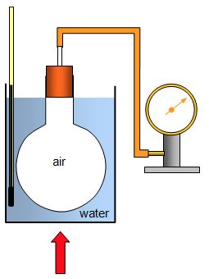
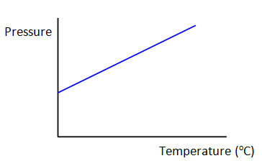
Pressure- temperature law
Learning Outcome: Explain the pressure-temperature law
Pressure is directly proportional to the absolute temperature under conditions of constant volume
P= Constant T
P₁ = P₂
T₁ T₂

Slide 94
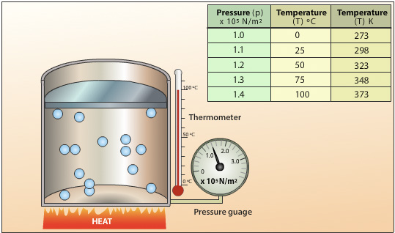
Extrapolating to Find Absolute Zero
Learning Outcome: Apply algebraic reasoning to extrapolate absolute zero
How could you use this data to find absolute zero?

Slide 95
Pressure- temperature law
Learning Outcome: Explain the pressure-temperature law
Pressure 1 | Temperature 1 | Pressure 2 | Temperature 2
3 x 10⁶ Pa | 34 K |  | 25 ℃
4 atm | 256 K | 10 atm
5 kNm⁻² |  | 5 x 10⁴ Pa | 34 ℃
 | 89 ℃ | 3 x 10⁷ Pa | 560 K

Slide 96
Pressure- temperature law
Learning Outcome: Explain the pressure-temperature law
Pressure 1 | Temperature 1 | Pressure 2 | Temperature 2
3 x 10⁶ Pa | 34 K | 2.6 x 10⁷ Pa | 25 ℃
4 atm | 256 K | 10 atm | 640 K
5 kNm⁻² | 30.7 K | 5 x 10⁴ Pa | 34 ℃
1.9 x 10⁷ Pa | 89 ℃ | 3 x 10⁷ Pa | 560 K

Slide 97
The ideal gas equation
States of matter and Brownian motion
Specific heat capacity and temperature
Investigating specific heat capacity PAG
Specific latent heat and internal energy
Amount of substance
The kinetic theory and pressure of a gas
Investigating gases
Boyle’s Law and finding absolute zero PAG
The ideal gas equation
The Boltzmann constant
Module 5: Newtonian world and astrophysics
Module 6: Particles and medical physics
5.1: Thermal Physics
5.2: Circular Motion
5.3: Oscillation
5.4 Gravitational fields
5.5 Astrophysics and cosmology
Notes:
Give out prepare for learning and get to complete first task

Slide 98
Learning Outcome: Apply the gas laws to derive the ideal gas equation
V = constant
T
P = constant
T
PV = constant
PV = constant
T

Slide 99
Learning Outcome: Apply the gas laws to derive the ideal gas equation
V = constant
T
P = constant
T
PV = constant
PV = constant
T
P₁V₁ = P₂V₂
T₁ T₂

Slide 100
Question
Learning Outcome: Apply the gas laws to derive the ideal gas equation
In one cylinder of a diesel engine, a piston compresses air at a temperature of 23°C and a pressure 1.00 x 10⁵ Pa to 1/25 of it’s original volume. The pressure rises to 9.06 x 10⁶ Pa. What will the temperature of the air be after this compression?

Slide 101
Question
Learning Outcome: Apply the gas laws to derive the ideal gas equation
In one cylinder of a diesel engine, a piston compresses air at a temperature of 23°C and a pressure 1.00 x 10⁵ Pa to 1/25 of it’s original volume. The pressure rises to 9.06 x 10⁶ Pa. What will the temperature of the air be after this compression?
P₁V₁ = P₂V₂
T₁ T₂
T₂ = P₂V₂T₁
P₁V₁
T₂ = 9.06 x 10⁶x 1 x 296
1.00 x 10⁵ x 25
T₂ = 1073 K

Slide 102
Learning Outcome: Apply the gas laws to derive the ideal gas equation
PV = constant
T
P₁V₁ = P₂V₂
T₁ T₂
The constant depends on:
The amount of gas present (number of moles, n)
R is the molar gas constant
8.31 Jmol⁻¹K⁻¹
PV = nRT

Slide 103
Learning Outcome: Apply the gas laws to derive the ideal gas equation
PV = constant
T
P₁V₁ = P₂V₂
T₁ T₂
The constant depends on:
The amount of gas present (number of moles, n)
R is the molar gas constant
8.31 Jmol⁻¹K⁻¹
PV = nRT
This is the equation of state for an ideal gas
Note:This only works for an ideal gas

Slide 104
Learning Outcome: Apply the gas laws to derive the ideal gas equation
PV = nRT
P | V | n | T
54 Pa | 56 cm³ | 78
3 Pa | 0.3 m³ |  | 45 C
 | 2 mm³ | 21 | 341 K
42 kPa |  | 5 | 23 K
 | 56 nm³ | 890 | 340 C
106 KPa | 389 km³ |  | 1.4 K

Slide 105
Learning Outcome: Apply the gas laws to derive the ideal gas equation
PV = nRT
P | V | n | T
54 Pa | 56 cm³ | 78 | 4.6 x 10⁻⁶K
3 Pa | 0.3 m³ | 3.4 x 10⁻⁴ | 45 C
3 x 10¹³ | 2 mm³ | 21 | 341 K
42 kPa | 0.02 m³ | 5 | 23 K
8.1 x 10³¹ | 56 nm³ | 890 | 340 C
106 KPa | 389 km³ | 3.5 x 10¹⁵ | 1.4 K

Slide 106
The Boltzmann constant
States of matter and Brownian motion
Specific heat capacity and temperature
Investigating specific heat capacity PAG
Specific latent heat and internal energy
Amount of substance
The kinetic theory and pressure of a gas
Investigating gases
Boyle’s Law and finding absolute zero PAG
The ideal gas equation
The Boltzmann constant
Module 5: Newtonian world and astrophysics
Module 6: Particles and medical physics
5.1: Thermal Physics
5.2: Circular Motion
5.3: Oscillation
5.4 Gravitational fields
5.5 Astrophysics and cosmology
Notes:
Give out prepare for learning and get to complete first task

Slide 107
The Boltzmann constant
Define the Boltzmann constant
Deduce the equation for mean translational kinetic energy of atoms
Explain the proportionality of the mean translational kinetic energy of an atom

Slide 108
Molar Gas Constant
Number of moles
Learning Outcome: Define the Boltzmann constant
What is the volume occupied by a mole of oxygen molecules at standard pressure and temperature (101300 Pa and 273.3K)
Notes:
Molar gas constant is used for moles

Slide 109
Molar Gas Constant
Number of moles
Learning Outcome: Define the Boltzmann constant
What is the volume occupied by a mole of oxygen molecules at standard pressure and temperature (101300 Pa and 273.3K)
V = 1 x 8.3145 x 273.3
101300
V = 0.022 m³
Notes:
Molar gas constant is used for moles

Slide 110
Boltzmann Constant
Number of moles
Molar gas constant
Boltzmann constant
Number of atoms/
molecules
Learning Outcome: Define the Boltzmann constant
Notes:
Use the Boltzmann constant for atoms/molecules

Slide 111
Boltzmann Constant
Number of moles
Molar gas constant
Boltzmann constant
Number of atoms/
molecules
Learning Outcome: Define the Boltzmann constant
k = 1 x 8.3145
6.02 x 10²³

Slide 112
Boltzmann Constant
Learning Outcome: Define the Boltzmann constant
The Boltzmann constant is useful when considering the gas equation for molecules rather than moles. R is the gas constant for one mole of molecules. The Boltzmann constant, k, is the gas constant for one single molecule.

Slide 113
Questions
Learning Outcome: Define the Boltzmann constant
Nitrate salts (NO₃⁻) when heated can produce nitrites (NO₂⁻) plus oxygen (O₂). A sample of potassium nitrate is heated and the O₂ gas produced is collected in a 750 ml flask. The pressure of the gas in the flask is 2.8 atmospheres and the temperature is recorded to be 53.6°C.
How many moles of O₂ gas were produced and how many molecules?

Slide 114
Questions
Learning Outcome: Define the Boltzmann constant
Nitrate salts (NO₃⁻) when heated can produce nitrites (NO₂⁻) plus oxygen (O₂). A sample of potassium nitrate is heated and the O₂ gas produced is collected in a 750 ml flask. The pressure of the gas in the flask is 2.8 atmospheres and the temperature is recorded to be 53.6°C.
How many moles of O₂ gas were produced and how many molecules?
PV = nRT
n = PV/RT
n = ((2.8 x 101325) x (750 x 1 x 10⁻⁶)) / 8.31 x (53.6 + 273)
n = 0.078 mol O₂ were produced
PV = NkT
N = ((2.8 x 101325) x (750 x 1 x 10⁻⁶)) / 1.38x10⁻²³ x (53.6 + 273)
N= 4.72 x 10²²

Slide 115
Boltzmann Constant
Learning Outcome: Deduce the equation for mean translational kinetic energy of atoms
Gas pressure equation
PV= Nmc²
3
Ideal gas equation
Mean translational kinetic energy

Slide 116
Learning Outcome: Deduce the equation for mean translational kinetic energy of atoms
NkT= Nmc²
3
kT= mc²
3
E_{k} = ½ mv²= ½ mc²
2E_{k} = mc²
3kT= mc²
2E_{k} = 3KT

Slide 117
Learning Outcome: Explain the proportionality of the mean translational kinetic energy of an atom
Kinetic energy is:
Directly proportional to the absolute temperature of a molecule
Constant at a given temperature
For an ideal gas:
All internal energy = kinetic energy
Therefore internal energy is directly proportional to temperature

Slide 118
Learning Outcome: Explain the proportionality of the mean translational kinetic energy of an atom
½ mc²= 3kT
2
Calculate the average speed of an oxygen molecule at room temperature (21°C) and it’s mean translational kinetic energy? (M_{R} O₂= 0.032) m = M_{R} N_{A} 6.02 x 10²³
N_{A}

Slide 119
Learning Outcome: Explain the proportionality of the mean translational kinetic energy of an atom
½ mc²= 3kT
2
Calculate the average speed of an oxygen molecule at room temperature (21°C) and it’s mean translational kinetic energy?
c = √3kT = √3 x 1.3807 x 10⁻²³ x 294= √228906= 478.4 ms⁻¹
m 5.32 x 10⁻²⁶
m = M_{R} = 0.032 = 5.32 x 10⁻²⁶
N_{A} 6.02 x 10²³

Slide 120
Learning Outcome: Explain the proportionality of the mean translational kinetic energy of an atom
½ mc²= 3kT
2
Calculate the average speed of an oxygen molecule at room temperature (21°C) and it’s mean translational kinetic energy?
c = √3kT = √3 x 1.3807 x 10⁻²³ x 294= √228906= 478.4 ms⁻¹
m 5.32 x 10⁻²⁶
E = ½ mc²= 0.5 x 5.32 x 10⁻²⁶ x 228906 = 6.09 x 10⁻²¹ J

