Slide 1
Charging Capacitors and capacitance
Capacitors
Module 5: Newtonian world and astrophysics
Module 6: Particles and medical physics
6.1: Capacitors
6.2: Electric fields
6.3: Electromagnetism
6.4 Nuclear and particle physics
6.5 Medical imaging
1. Charging capacitors and capacitance
2. Capacitors in series and parallel
3. Energy stored in a capacitor
4. Charging and discharging capacitors

Slide 2
Charging capacitors
Describe what a capacitor is
Describe how a capacitor becomes charged
Explain the concept of capacitance and the Farad

Slide 3
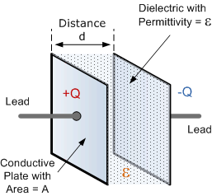
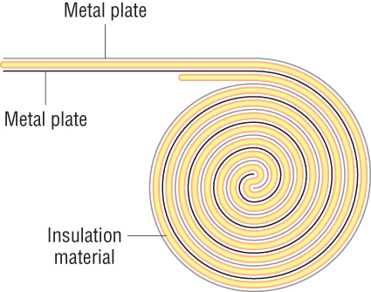
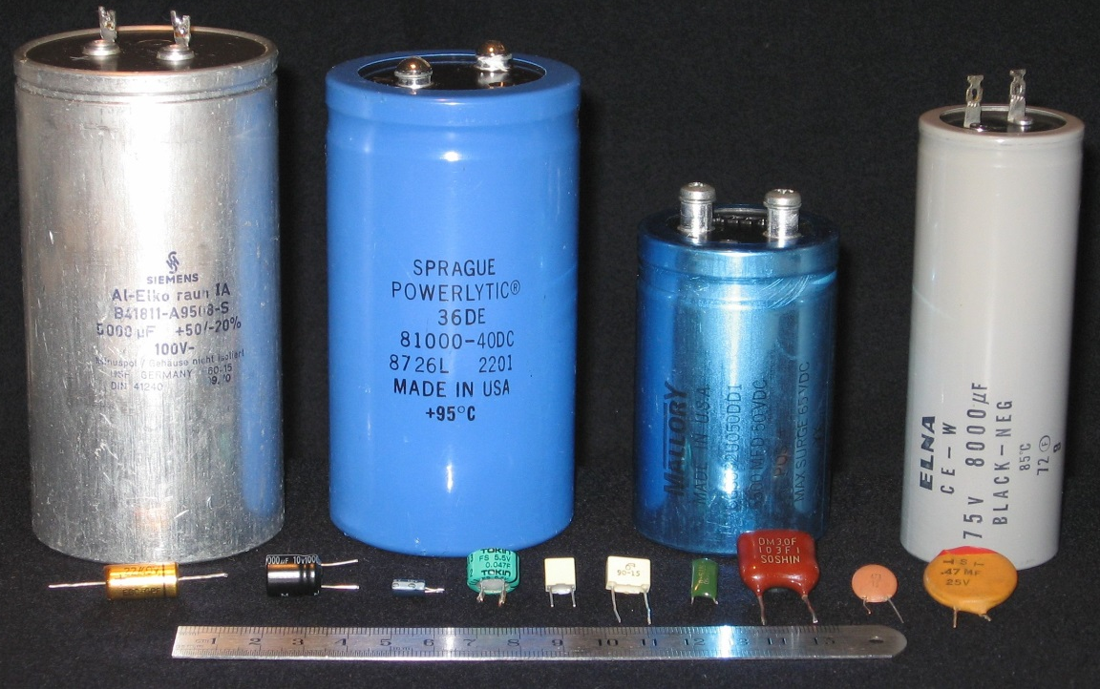
Learning Outcome: Describe what a capacitor is and how they work
A capacitor is an electrical component that stores electricity by separating charges on to two electrical conductors (plates) with an insulator between them
Capacitors are used where energy is required to be stored for a short amount of time and the energy is easily retrieved e.g. a camera flash
Notes:
https://www.stem.org.uk/resources/elibrary/resource/28835/bin-bag-capacitor

Slide 4
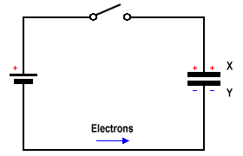
Charging capacitors
Learning Outcome: Describe how a capacitor becomes charged
2. As the electrons arrive, they repel an equal number of electrons on the opposite plate and these electrons flow to the positive terminal of the battery.
-
3. As negative electrons build up on the plate they start to resist the build-up of extra electrons reducing the current
Eventually when the capacitor is fully charged the current will be reduced to 0 A
1. Electrons flow from the negative terminal of a battery to a capacitor and spread out on one of the plates.
Result: The two plates end up with an equal but opposite charge
Notes:
https://phet.colorado.edu/sims/cheerpj/capacitor-lab/latest/capacitor-lab.html?simulation=capacitor-lab
https://www.youtube.com/watch?v=IvFVu7Jxa2I

Slide 5
Capacitance
Learning Outcome: Explain the concept of capacitance and the Farad
Capacitance, C, is defined as the charge stored in a capacitor per unit potential difference.
It’s unit, the Farad, is one coulomb per volt.
C = Q
V
Capacitance = Charge
Potential difference

Slide 6
Capacitance
Learning Outcome: Explain the concept of capacitance and the Farad
Capacitance/F | Charge/C | Potential difference/V
2.2μF |  | 9V
 | 600μC | 12V
0.2mF | 4mC
 | 2mC | 8V
C = Q
V

Slide 7
Capacitance
Learning Outcome: Explain the concept of capacitance and the Farad
Capacitance/F | Charge/C | Potential difference/V
2.2μF | 19.8μC | 9V
50μF | 600μC | 12V
0.2mF | 4mC | 20V
250μF | 2mC | 8V
C = Q
V

Slide 8
Capacitance
Learning Outcome: Explain the concept of capacitance and the Farad
A capacitor is charged with a current of 4 mA for 1 minute, if the potential difference across the capacitor is 4 V, what is its capacitance?

Slide 9
Capacitance
Learning Outcome: Explain the concept of capacitance and the Farad
A capacitor is charged with a current of 4 mA for 1 minute, if the potential difference across the capacitor is 4 V, what is its capacitance?
Q = I x t
C = Q = I x t = 0.004 x 60
V V 4
C = 60mF

Slide 10
What factors would affect capacitance of a capacitor?
Learning Outcome: Explain the concept of capacitance and the Farad
Plate separation
Plate size
Insulating material
Notes:
https://phet.colorado.edu/sims/cheerpj/capacitor-lab/latest/capacitor-lab.html?simulation=capacitor-lab

Slide 11
Capacitors in series and parallel
Capacitors
Module 5: Newtonian world and astrophysics
Module 6: Particles and medical physics
6.1: Capacitors
6.2: Electric fields
6.3: Electromagnetism
6.4 Nuclear and particle physics
6.5 Medical imaging
1. Charging capacitors and capacitance
2. Capacitors in series and parallel
3. Energy stored in a capacitor
4. Charging and discharging capacitors

Slide 12
Capacitors in series and parallel
Describe how to measure capacitance in a series and parallel circuit
Evaluate circuits containing series and parallel capacitors
Explain techniques to investigate capacitors in both series and parallel

Slide 13
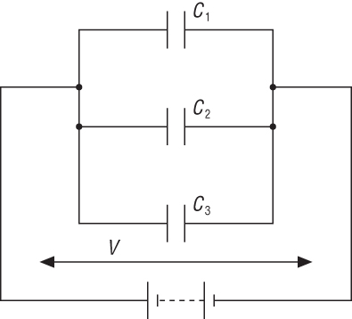
Capacitors in parallel
Learning Outcome: Describe how to measure capacitance in a series and parallel circuit
C = C₁ + C₂ + C₃
Each capacitor would have an individual charge, what would the total charge of the circuit be?
Q = Q₁ + Q₂ + Q₃
How could you write this as a product of C and V?

Slide 14
Capacitors in parallel
Learning Outcome: Describe how to measure capacitance in a series and parallel circuit
CV = C₁V + C₂V + C₃V
Simplify this equation to give the equation for capacitors in series
CV = V ( C₁ + C₂ + C₃)
C = C₁ + C₂ + C₃

Slide 15
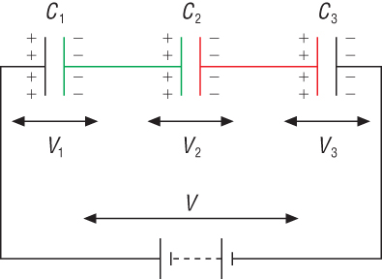
Capacitors in series
Learning Outcome: Describe how to measure capacitance in a series and parallel circuit
1 = 1 + 1 + 1
C C₁ C₂ C₃
What is the connection between the total voltage and the voltage across each capacitor?
V = V₁ + V₂ + V₃
How would charge vary across this circuit?

Slide 16
Capacitors in series
Learning Outcome: Describe how to measure capacitance in a series and parallel circuit
Q = Q + Q + Q
C C₁ C₂ C₃
Which simplifies to:
1 = 1 + 1 + 1
C C₁ C₂ C₃

Slide 17
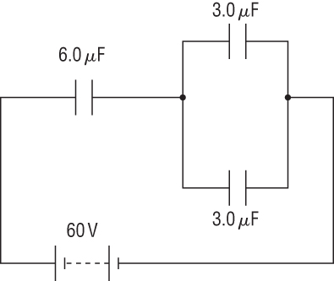
Learning Outcome: Evaluate circuits containing series and parallel capacitors
What is the total capacitance in this circuit, and calculate the charge and voltage across each capacitor?
C₂
C₁
C₃

Slide 18
Learning Outcome: Evaluate circuits containing series and parallel capacitors
What is the total capacitance in this circuit, and calculate the charge and voltage across each capacitor?
Capacitance:
Capacitors in parallel:
3+3= 6
Capacitors in series:
⅙ + ⅙ = 2/6 = 0.33
Total capacitance:
1/0.33 = 3 μF
C₂
C₁
C₃

Slide 19
Learning Outcome: Evaluate circuits containing series and parallel capacitors
What is the total capacitance in this circuit, and calculate the charge and voltage across each capacitor?
Charge:
Q=VC
= 60 x 3 x 10⁻⁶
= 180 μC
C₁: 180 μC
C₂: 90 μC
C₃: 90 μC
C₂
C₁
C₃

Slide 20
Learning Outcome: Evaluate circuits containing series and parallel capacitors
What is the total capacitance in this circuit, and calculate the charge and voltage across each capacitor?
Voltage: V=Q/C
C₁: 180 x 10⁻⁶/6 x10⁻⁶
= 30 V
C₂: 90 x 10⁻⁶/3 x10⁻⁶
= 30 V
C₃: 90 x 10⁻⁶/3 x10⁻⁶
= 30 V
C₂
C₁
C₃

Slide 21
Energy stored in a capacitor
Capacitors
Module 5: Newtonian world and astrophysics
Module 6: Particles and medical physics
6.1: Capacitors
6.2: Electric fields
6.3: Electromagnetism
6.4 Nuclear and particle physics
6.5 Medical imaging
1. Capacitors
2. Capacitors in series and parallel
3. Energy stored in a capacitor
4. Charging and discharging capacitors

Slide 22
Energy stored in a capacitor
Describe how capacitors can be used as storage of energy
Explain how to calculate energy stored in a capacitor
Apply equations to calculate energy stored in a capacitor

Slide 23
Learning Outcome: Describe how capacitors can be used as storage of energy
Capacitor- fast charge and discharge
Capacitors- Alot of energy suddenly
Capacitors- absorb energy surges
Capacitor- longer life, don’t degrade, don’t rely on chemicals
Capacitor- less unpleasant chemicals
Batteries- more energy into a space and weight
Batteries- Slower energy discharge
Batteries- safer
Both- store energy
Both- discharge when attached to a circuit
Both- will gradually discharge
Both provide DC current
Notes:
Capacitor- fast charge and discharge
Capacitors- Alot of energy suddenly
Capacitors- absorb energy surges
Capacitor- longer life, don’t degrade, don’t rely on chemicals
Capacitor- less unpleasant chemicals
Batteries- more energy into a space and weight
Batteries- Slower energy discharge
Batteries- safer
Both- store energy
Both- discharge when attached to a circuit
Both- will gradually discharge
Both provide DC current

Slide 24
Learning Outcome: Explain how to calculate energy stored in a capacitor
Energy stored in a capacitor
= work done to separate charges on the two plates
What equations are there to calculate work done or energy in electrical circuits?
For a capacitor: W = ½ QV

Slide 25
Learning Outcome: Explain how to calculate energy stored in a capacitor
What would a voltage versus charge graph look like for a capacitor?
V
Gradient = capacitance
Area under the graph = work done
Q

Slide 26
Learning Outcome: Explain how to calculate energy stored in a capacitor
For a capacitor: W = ½ QV
Q =CV

Slide 27
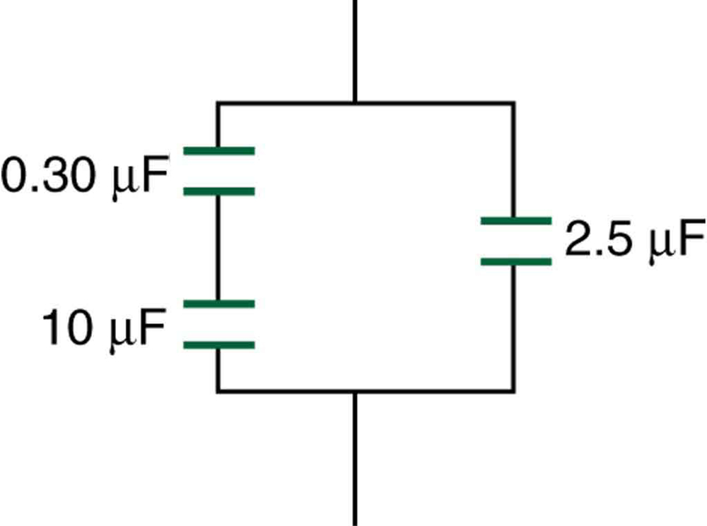
Learning Outcome: Apply equations to calculate energy stored in a capacitor
All these capacitors are fully charged. The E.M.F supplied to the circuit is 24 V. Which capacitor would have the most energy stored in it?
Notes:
The voltage is split across the capacitors with 24V for the one in parallel and 24V shared between the other two at 23.9V for the smaller capacitance and 0.1V for the larger. E=1/2CV²
So the largest voltage with the largest capacitance will have the most energy of 72mJ

Slide 28
Learning Outcome: Apply equations to calculate energy stored in a capacitor
All these capacitors are fully charged. The E.M.F supplied to the circuit is 24 V. Which capacitor would have the most energy stored in it? The 2.5𝜇F at 72 mJ

Slide 29
Charging and discharging capacitors
Capacitors
Module 5: Newtonian world and astrophysics
Module 6: Particles and medical physics
6.1: Capacitors
6.2: Electric fields
6.3: Electromagnetism
6.4 Nuclear and particle physics
6.5 Medical imaging
1. Capacitors
2. Capacitors in series and parallel
3. Energy stored in a capacitor
4. Charging and discharging capacitors

Slide 30
Charging and discharging capacitors
Describe changes in current, p.d. and charge as a capacitor charges and discharges
Explain how resistance and capacitance effects rate of charge and discharge
Apply the time constant (Ⲧ) for charging and discharging capacitors

Slide 31
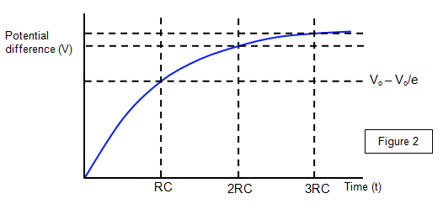
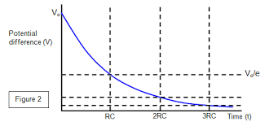
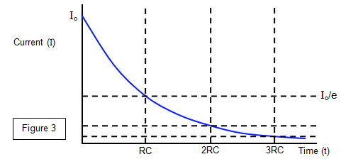
Learning Outcome: Describe changes in current, p.d. and charge as capacitors charge and discharge
Voltage/Charge charging
Voltage/Charge discharging
Current charging/discharging
-
What things would affect the shape of these graphs?
Notes:
How these change with increased capacitance/resistance in circuit

Slide 32
Learning Outcome: Apply the time constant (Ⲧ) for charging and discharging capacitors
All exponential equations have the general equation:
x = x₀ e^{-kt}
Where -k is a decay constant and t is time
x is your present quantity, x₀ is your original quantity
For any exponential decay a variable (x) will reduce by the same proportion over a given time period

Slide 33
Learning Outcome: Apply the time constant (Ⲧ) for charging and discharging capacitors
For radioactive decay we use the term “half life”- which is the time for the variable to halve
The relationship between the decay constant, k (written as λ when we are referring to radioactivity) and half life is…
λ= ln (2)
t_{½}
This is mathematically horrible!

Slide 34
Learning Outcome: Apply the time constant (Ⲧ) for charging and discharging capacitors
A more “mathematically easy” concept used for capacitors is a “time constant”, Ⲧ
k = 1
T
Ⲧ is the time taken for a variable (x) to reduce to 1/e (or approx 37%) of the original value (x₀)
As the two factors which affect the rate of “decay” of a capacitor variable are capacitance (C) and resistance (R)
Ⲧ = CR
x = x₀ e^{-kt}
x = x₀ e^{-t/CR}

Slide 35
Learning Outcome: Apply the time constant (Ⲧ) for charging and discharging capacitors
Three equations can be derived to calculate charge, current and voltage for a given time for a discharging capacitor
x = x₀ e^{-t/CR}
Q = Q₀ e^{-t/CR}
I = I₀ e^{-t/CR}
V = V₀ e^{-t/CR}

Slide 36
Learning Outcome: Apply the time constant (Ⲧ) for charging and discharging capacitors
A 100 μF capacitor has been fully charged to hold 4.8 mC of charge and is discharged through a 500 kΩ resistor
Calculate:
a) The time constant for the circuit
b) The charge present on the plates after 100s
c) The potential difference across the plates at 100s
d) The potential difference across the plates after 0s
e) The time taken for the charge on the plates to decrease to 1.0 mC
Ⲧ = CR
Q= VC
Q = Q₀ e^{-t/CR}
I = I₀ e^{-t/CR}
V = V₀ e^{-t/CR}

Slide 37
Learning Outcome: Apply the time constant (Ⲧ) for charging and discharging capacitors
A 100 μF capacitor has been fully charged to hold 4.8 mC of charge and is discharged through a 500 kΩ resistor
Calculate:
a) The time constant for the circuit 50 s
b) The charge present on the plates after 100s 6.5x10⁻⁴ C
c) The potential difference across the plates at 100s 6.5 V
d) The potential difference across the plates after 0s 48 V
e) The time taken for the charge on the plates to decrease to 1.0 mC 78 s
Ⲧ = CR
Q= VC
Q = Q₀ e^{-t/CR}
I = I₀ e^{-t/CR}
V = V₀ e^{-t/CR}

Slide 38
Learning Outcome: Apply the time constant (Ⲧ) for charging and discharging capacitors
Three equations can also be derived to calculate charge, current and voltage for a given time for a charging capacitor
V = V_{f} (1-e^{-t/CR})
Q = Q_{f} (1-e^{-t/CR})
I = I₀ e^{-t/CR}

Slide 39
Learning Outcome: Apply the time constant (Ⲧ) for charging and discharging capacitors
A 500 μF capacitor is charged with a 24 V power supply and a 2 MΩ resistor
Calculate:
a) The time constant for the circuit
b) The potential difference across the plates after 10 mins
c) The charge across the plates after 10 mins
d) The time taken for the potential difference across the plates to reach 90% of the maximum value
Ⲧ = CR
Q= VC
Q = Q_{f} (1-e^{-t/CR})
I = I₀ e^{-t/CR}
V = V_{f} (1-e^{-t/CR})

Slide 40
Learning Outcome: Apply the time constant (Ⲧ) for charging and discharging capacitors
A 500 μF capacitor is charged with a 24 V power supply and a 2 MΩ resistor
Calculate:
a) The time constant for the circuit 1000 s
b) The potential difference across the plates after 10 mins 10.8 V
c) The charge across the plates after 10 mins 5.4 mC
d) The time taken for the potential difference across the plates to reach 90% of the maximum value 2300 s
Ⲧ = CR
Q= VC
Q = Q_{f} (1-e^{-t/CR})
I = I₀ e^{-t/CR}
V = V_{f} (1-e^{-t/CR})

