Slide 1
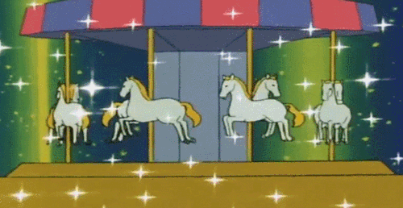
Circular Motion

Slide 2
A-Level Physics
1. Development of practical skills in physics
2. Foundations of Physics
3. Forces and motion
4. Electrons, waves and photons
5. Newtonian world and astrophysics
6. Particles and medical physics
5.1 Thermal Physics
5.2 Circular motion
5.3. Oscillations
5.4. Gravitational fields
5.5 Astrophysics
5.2.1. Angular velocity and the radian
5.2.2.Centripetal acceleration
5.2.3. Centripetal forces

Slide 3
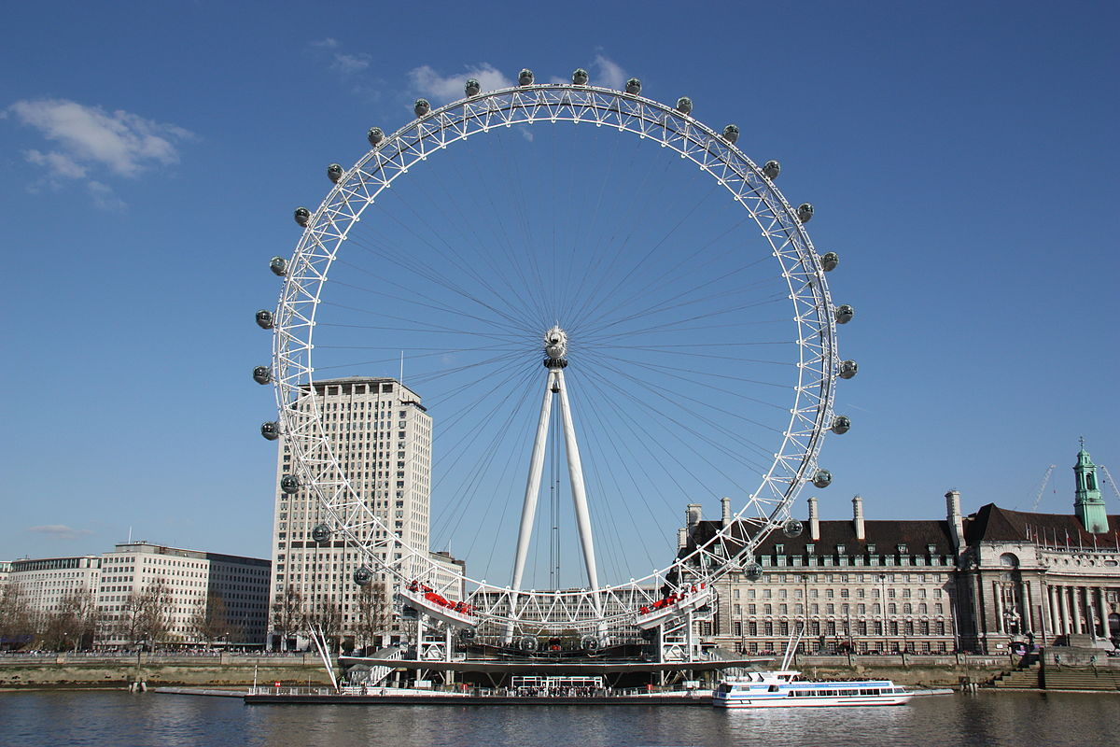
Angular velocity and the radian
Understand the difference between radians and degrees
Define the terms of frequency and period in circular motion
Calculate angular velocity

Slide 4
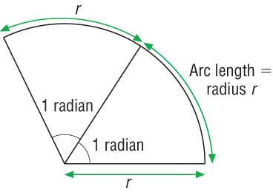
Radians
Learning Outcome: Understand the difference between radians and degrees
The radian is the SI unit of angle and is defined differently from degrees.
One radian is the angle subtended at the centre of a circle by an arc of length equal to the circle’s Radius
Notes:
There is no good reason why there are 360 degrees in a circle!

Slide 5
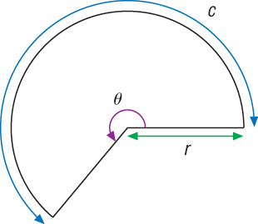
Radians
Learning Outcome: Understand the difference between radians and degrees
Any angle, θ, measured in radians, is given by the curved distance along the arc of a circle, c, divided by the radius, r, of the circle.
θ = c/r

Slide 6
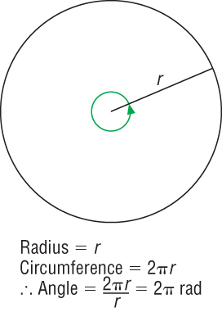
Radians
Learning Outcome: Understand the difference between radians and degrees
How many radians in a whole circle?
Can you find a general formula linking degrees and radians?

Slide 7
Radians
Learning Outcome: Understand the difference between radians and degrees
The angle in radians for one complete rotation can be found by applying the previous equation
θ = c/r
360° = 2π rad
Therefore π/180 = 1°
or 1 rad = 180/π = 57.3 °

Slide 8
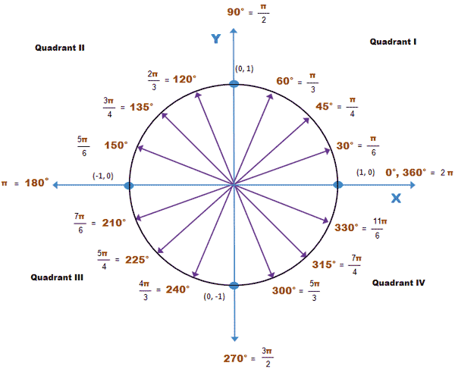
Radians
Learning Outcome: Understand the difference between radians and degrees

Slide 9
Radians questions- draw diagrams to help!
Learning Outcome: Understand the difference between radians and degrees
Passengers on a fairground roundabout are 4.0m from its centre of rotation. It rotates once every 12s.
a) Write down the angular displacement in degrees and radians of a passenger after a time of 2s, 6s, 9s and 12s. (Is it easier to work in degrees or in radians, expressed as a number, or in radians expressed in units of π?)
b) How long does it take for a passenger to move through an angle of π/2 radians.
c) The ticket collector walks radially towards a passenger from the centre of the roundabout at 1.5ms⁻¹. Through what angle in degrees and in radians, has the roundabout turned when she reaches the passenger? Sketch her path relative to the ground viewed from above.
Notes:
Tell students to draw a diagram to help them!

Slide 10
Radians questions- draw diagrams to help!
Learning Outcome: Understand the difference between radians and degrees
Passengers on a fairground roundabout are 4.0m from its centre of rotation. It rotates once every 12s.
a) Write down the angular displacement in degrees and radians of a passenger after a time of 2s, 6s, 9s and 12s.
2s= 60 degrees or π/3 radians, 6s = 180 degrees or π radians, 9s = 270 degrees or 1.5 π radians, 12s = 360 degrees or 2π radians
b) How long does it take for a passenger to move through an angle of π/2 radians. 3 s
c) The ticket collector walks radially towards a passenger from the centre of the roundabout at 1.5ms⁻¹. Through what angle in degrees and in radians, has the roundabout turned when she reaches the passenger? Sketch her path relative to the ground viewed from above. 2.67 s to reach, 80 degrees, 4/9 π rad
Notes:
Tell students to draw a diagram to help them!

Slide 11
Period T of circular Motion
Learning Outcome: Define the terms of frequency and period in circular motion
When an object travels with constant speed in a circular orbit, the time it takes to complete one complete revolution is called the period, T, of rotation.
The frequency, f, is the number of rotations per unit time (per second)
What equation links frequency and period?

Slide 12
Period T of circular Motion
Learning Outcome: Define the terms of frequency and period in circular motion
When an object travels with constant speed in a circular orbit, the time it takes to complete one complete revolution is called the period (T) of rotation.
The frequency (f) is the number of rotations per unit time (per second)
What equation links frequency and period?
f= 1/T

Slide 13
Learning Outcome: Calculate angular velocity
Suggest an equation for the speed around a circle

Slide 14
Learning Outcome: Calculate angular velocity
Suggest an equation for the speed around a circle
V=2πr/T
V=2πrf
The orbital speed is controlled by the period/frequency and the radius r of the orbit
Notes:
V= 2pier/T or 2 pierf

Slide 15
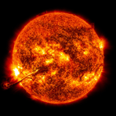
Period T of circular Motion
Learning Outcome: Calculate angular velocity
Orbital paths
A
B
If the two Moons have the same period of orbit, state and explain which would have greater orbital speed? [2 marks]

Slide 16
Period T of circular Motion
Learning Outcome: Calculate angular velocity
Orbital paths
A
B
V=2πr/T
V=2πrf
If the two Moons have the same radius of orbit, but A has a period double that of B, state and explain which would have greater orbital speed? [2 marks]

Slide 17
Angular Velocity
Learning Outcome: Calculate angular velocity
Orbital paths
A
B
Angular velocity (ω) is the “rate of change of angle”:

Slide 18
Angular velocity
Learning Outcome: Calculate angular velocity
Orbital paths
A
B
Angular velocity (ω) is the “rate of change of angle”:
If the two Moons have the same period of orbit, state and explain which would have greater angular velocity? [2 marks]

Slide 19
Angular Velocity
Learning Outcome: Calculate angular velocity
Orbital paths
A
B
Angular velocity (ω) is the “rate of change of angle”:
Write three expressions for ω in terms of θ and t, π and T and π and f

Slide 20
Angular Velocity
Learning Outcome: Calculate angular velocity
Orbital paths
A
B
Angular velocity (ω) is the “rate of change of angle”:
ω= θ or if t = T ω= 2π or ω= 2πf
t T

Slide 21
Orbital speed versus angular velocity
Learning Outcome: Calculate angular velocity
v = 2πr/T
ω= 2π/T
Write an equation for v in terms of ω

Slide 22
Orbital speed versus angular velocity
Learning Outcome: Calculate angular velocity
v = 2πr/T
ω= 2π/T
Write an equation for v in terms of ω
v = rω
As r increases v increases but ω is always constant

Slide 23
Learning Outcome: Calculate angular velocity
What is the angular velocity of the second, minute and hour hands in rad s⁻¹?

Slide 24
Learning Outcome: Calculate angular velocity
What is the angular velocity of the second, minute and hour hands?
Second: 0.1 radians per second
Minute: 1.7 x 10⁻³ rad s⁻¹
Hour: 1.5 x 10⁻⁴ rad s⁻¹

Slide 25
A-Level Physics
1. Development of practical skills in physics
2. Foundations of Physics
3. Forces and motion
4. Electrons, waves and photons
5. Newtonian world and astrophysics
6. Particles and medical physics
5.1 Thermal Physics
5.2 Circular motion
5.3. Oscillations
5.4. Gravitational fields
5.5 Astrophysics
5.2.1. Angular velocity and the radian
5.2.2.Centripetal acceleration
5.2.3. Centripetal forces

Slide 26
Centripetal acceleration
Explain how objects moving in a circle are accelerating
Describe how to calculate centripetal acceleration
Apply the equation for centripetal acceleration

Slide 27
Learning Outcome: Explain how objects moving in a circle are accelerating
The orbital speed of these horses is constant, why are they accelerating?

Slide 28
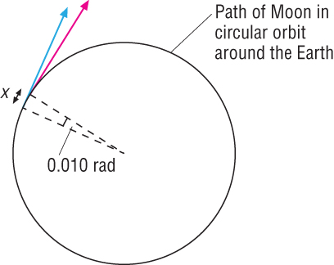
Centripetal Acceleration
Learning Outcome: Describe how to calculate centripetal acceleration
The acceleration of a body moving in a circle with a constant speed is called the centripetal acceleration.
It always acts towards the centre of the circle.
a = v²/r
How could this be expressed in angular velocity, ω?

Slide 29
Centripetal Acceleration
Learning Outcome: Describe how to calculate centripetal acceleration
The acceleration of a body moving in a circle with a constant speed is called the centripetal acceleration.
It always acts towards the centre of the circle.
v = rω
a = (rω)²/r
a = ω²r
a = v²/r

Slide 30
Learning Outcome: Apply the equation for centripetal acceleration
1. All astronauts undergo training inside a rotating test rig to simulate, among other things, the large g-forces experienced at take-off. An astronaut moves in a circle of radius 9.0m at a rotation frequency of 0.50Hz.
Calculate her:
Speed
Centripetal acceleration in ms⁻² and in units of g.
2. In a particle accelerator, electrons travel very close to the speed of light, 3.0 x 10⁸ ms⁻¹. The LEP (large electron-positron collider) accelerator at CERN has a circumference of 27 km. Estimate the centripetal acceleration of the electrons and positrons in this machine.
3. A geostationary satellite orbits in a circular path 900km above the Earth’s Surface. The radius of the Earth is 6400km. Calculate the orbital speed of the satellite

Slide 31
Learning Outcome: Apply the equation for centripetal acceleration
1. All astronauts undergo training inside a rotating test rig to stimulate, among other things, the large g-forces experienced at take-off. An astronaut moves in a circle of radius 9.0m at a rotation frequency of 0.50Hz.
Calculate her:
Speed (c/T=56.5/2=28.3 ms⁻¹)
Centripetal acceleration in ms⁻² and in units of g.
a= v²/r= 28.3²/9 = 88.8 ms⁻² or 9.1 g’s
2. In a particle accelerator, electrons travel very close to the speed of light, 3.0 x 10⁸ ms⁻¹. The LEP (large electron-positron collider) accelerator at CERN has a length of 27 km. Estimate the centripetal acceleration of the electrons and positrons in this machine.
a= 2.09 x 10¹³ ms⁻²
Q3. A geostationary satellite orbits in a circular path 900km above the Earth’s Surface. The radius of the Earth is 6400km. Calculate the orbital speed of the satellite
v=c/T = 45867252.7/86400 = 530.87 ms⁻¹

Slide 32
A-Level Physics
1. Development of practical skills in physics
2. Foundations of Physics
3. Forces and motion
4. Electrons, waves and photons
5. Newtonian world and astrophysics
6. Particles and medical physics
5.1 Thermal Physics
5.2 Circular motion
5.3. Oscillations
5.4. Gravitational fields
5.5 Astrophysics
5.2.1. Angular velocity and the radian
5.2.2.Centripetal acceleration
5.2.3. Centripetal forces

Slide 33
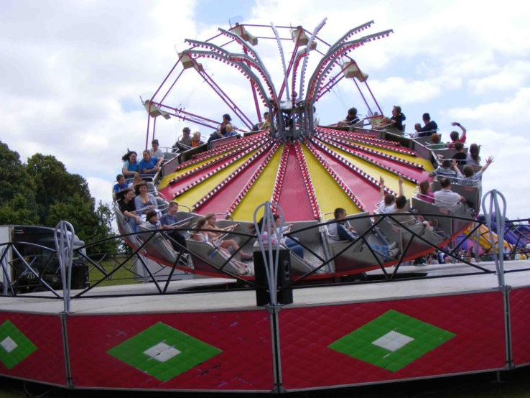
Centripetal forces
Describe and identify the forces that cause objects to move in circular paths
Derive the equation for centripetal force
Apply the equation for centripetal force

Slide 34
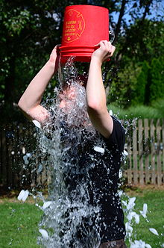
Learning Outcome: Describe and identify the forces that cause objects to move in circular paths
Why does this not happen?

Slide 35
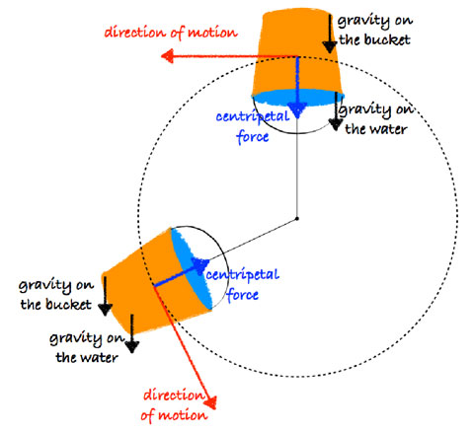
Learning Outcome: Describe and identify the forces that cause objects to move in circular paths

Slide 36
Learning Outcome: Describe and identify the forces that cause objects to move in circular paths
When an object is travelling around in a circle, it is subject to Newton’s Laws in exactly the same way as any object travelling in a straight line.
Newton’s laws apply to all objects at all times unless they are travelling near the speed of light.
Newton’s 1st Law
Why then does an object travel in a circle?
F_{g}
v
F_{g}
R

Slide 37
Learning Outcome: Derive the equation for centripetal force
When an object is travelling around in a circle, it is subject to Newton’s Laws in exactly the same way as any object travelling in a straight line.
Derive an equation for centripetal force using Newton’s 2nd Law
v
F_{g}

Slide 38
Learning Outcome: Derive the equation for centripetal force
When an object is travelling around in a circle, it is subject to Newton’s Laws in exactly the same way as any object travelling in a straight line.
Derive an equation for centripetal force using Newton’s 2nd Law and centripetal acceleration equation
F=ma
a=v²/r
v
F= mv²/r
F_{g}
F= m ω ²r

Slide 39
Learning Outcome: Derive the equation for centripetal force
F= mv²/r
The mass of the moon is 7.35 x 10²² kg. The speed of the moon’s orbit is 1020 ms⁻¹ with a radius 3.84 x 10⁸m.
Calculate the force the Earth exerts on the Moon and hence determine the ratio of Earth’s acceleration to the Moon’s, given the mass of the Earth is 6 x 10²⁴kg.
v
F_{g}

Slide 40
Learning Outcome: Derive the equation for centripetal force
The mass of the moon is 7.35 x 10²² kg. The speed of the moons orbit is 1020 ms⁻¹ with a radius 3.84 x 10⁸m.
Calculate the force the Earth exerts on the Moon and hence determine the ratio of Earth’s acceleration to the Moon’s, given the mass of the Earth is 6 x 10²⁴kg.
F= 7.35 x 10²² x 1020² / 3.84 x 10⁸
= 1.99 x 10²⁰ N
m_{m}a_{m}=m_{E} a_{E}
7.35 x 10²² a_{m} = 6 x 10²⁴ a_{E}
a_{m} = 81.6 a_{E}
F= mv²/r
v
F_{g}

Slide 41
Learning Outcome: Derive the equation for centripetal force
When an object is travelling around in a circle, it is subject to Newton’s Laws in exactly the same way as any object travelling in a straight line.
Newton’s 3rd Law
The mass of the moon is approximately 80th the mass of the Earth, so the force the moon exerts on the Earth causes tides, but otherwise cause only a comparatively small wobble effect on the Earth.
Important to note there is only one force in this case.
v
F_{g}

Slide 42
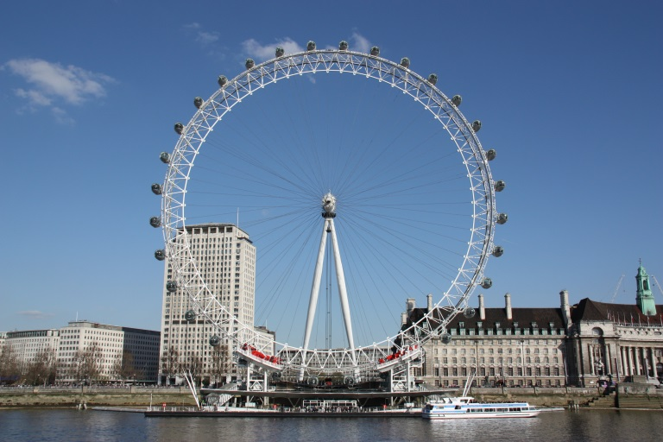
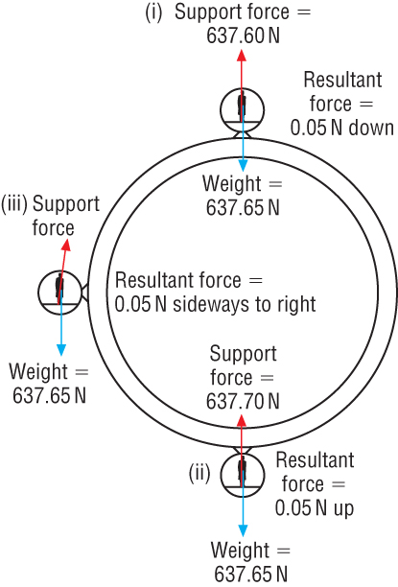
Centripetal Force
Learning Outcome: Apply the equation for centripetal force
A person riding on the London Eye has a mass of 65.0kg. The radius of the circle travelled through at constant speed is 60.0m and one revolution takes 30minutes.
Calculate:
Speed of the person
Acceleration
Force on the person

Slide 43
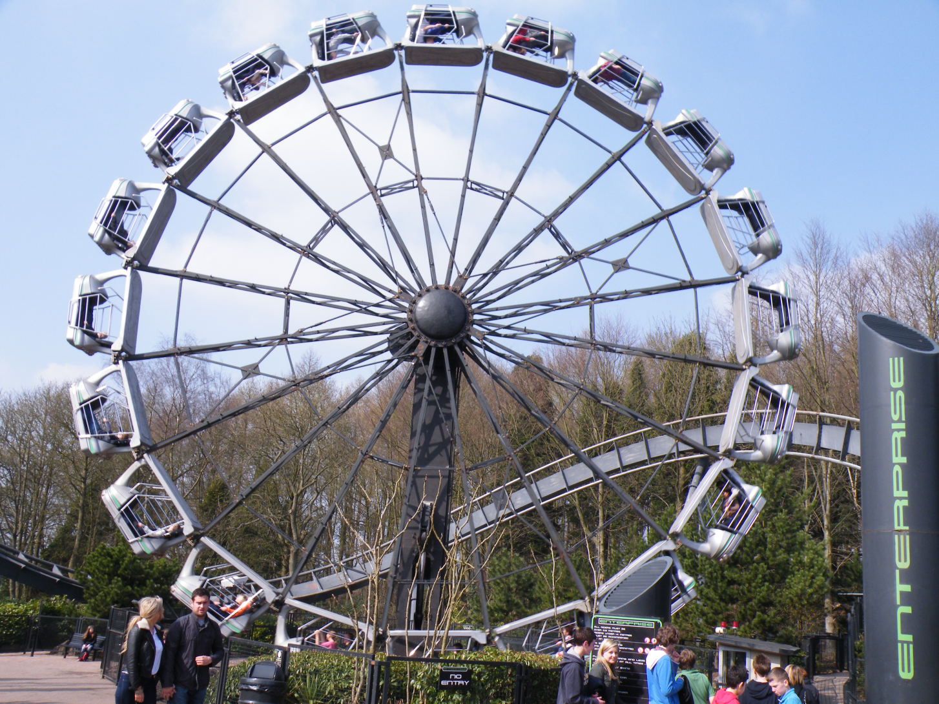
Learning Outcome: Apply the equation for centripetal force
Q. In this theme park ride, in which many cabs are swung in a vertical circle, the occupants are vertically upwards at the bottom of the ride and vertically downwards at the top. A person of mass 50kg is sitting in one of the cabs, with a centre of gravity 6.2m from the centre of rotation. The cabs rotate once every 3.2s. Calculate the normal reaction of the seat at the top and at the bottom.

Slide 44
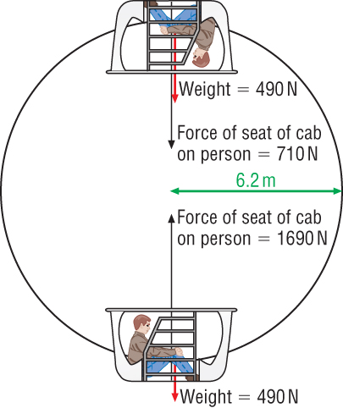
Learning Outcome: Apply the equation for centripetal force
Q. In this theme park ride, in which many cabs are swung in a vertical circle, the occupants are vertically upwards at the bottom of the ride and vertically downwards at the top. A person of mass 50kg is sitting in one of the cabs, with a centre of gravity 6.2m from the centre of rotation. The cabs rotate once every 3.2s. Calculate the normal reaction of the seat at the top and at the bottom.

Slide 45
A-Level Physics
1. Development of practical skills in physics
2. Foundations of Physics
3. Forces and motion
4. Electrons, waves and photons
5. Newtonian world and astrophysics
6. Particles and medical physics
5.1 Thermal Physics
5.2 Circular motion
5.3. Oscillations
5.4. Gravitational fields
5.5 Astrophysics
5.2.1. Angular velocity and the radian
5.2.2.Centripetal acceleration
5.2.3. Centripetal forces

Slide 46
Centripetal forces investigation
Describe an experiment to investigate centripetal forces using a mass on a string
Explain how to determine the mass of the bung from a F versus v² graph
Describe an experiment using a conical pendulum to show circular motion

Slide 47
Learning Outcome: Describe an experiment to investigate centripetal forces using a mass on a string
F= mv²/r
And how could they calculate the bung mass, m

Slide 48
Ball on a string
Learning Outcome: Describe an experiment to investigate centripetal forces using a mass on a string

Slide 49
Ball on a string
Learning Outcome: Explain how to determine the mass of the bung from a F versus v² graph

Slide 50
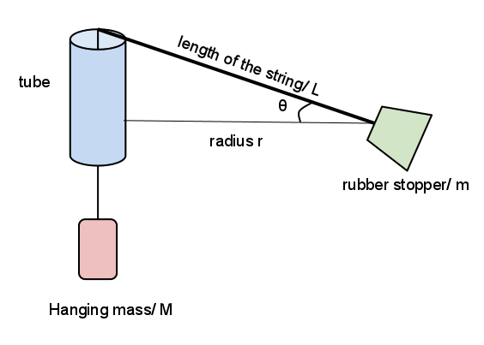
5.2.2 Investigating circular motion using a whirling bung
Apparatus |  | Analysis | Determine avg. bung speed from: v = s/t So v = 10 x 2πr t Plot a graph of F against v² with a line of best fit. Where F = the weight on the string F = mv² r So, the gradient of the line will equal m/r The mass of the bung can be determined from r = 0.3m
Method | Mark a point on the string 0.3m from the bung and attach 1N weight to string The bung is whirled in a circle at constant speed with a radius of 0.3 m Measure the time, t, for 10 revolutions Repeat for different values of centripetal force by adding mass, m | Reducing error/ H&S | Repeat experiment several times and get mean value Ensure the mark on the string is easy to see to help keep the radius constant Wear eye protection Do not do this in crowded areas

Slide 51
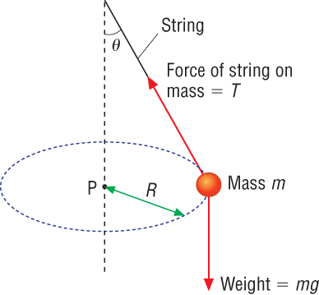
Conical Pendulum
Learning Outcome: Describe an experiment using a conical pendulum to show circular motion
The tension in the string needs to provide both the vertical and horizontal component.
Write two equations for the horizontal and vertical components of the force

Slide 52
Conical Pendulum
Learning Outcome: Describe an experiment using a conical pendulum to show circular motion
The tension in the string needs to provide both the vertical and horizontal component. Write two equations for the horizontal and vertical components of the force
Vertical: Tcosθ= mg
Horizontal Tsinθ= mv²/r
Sinθ/cosθ = v²/rg = tanθ
Note that mass is unimportant

Slide 53
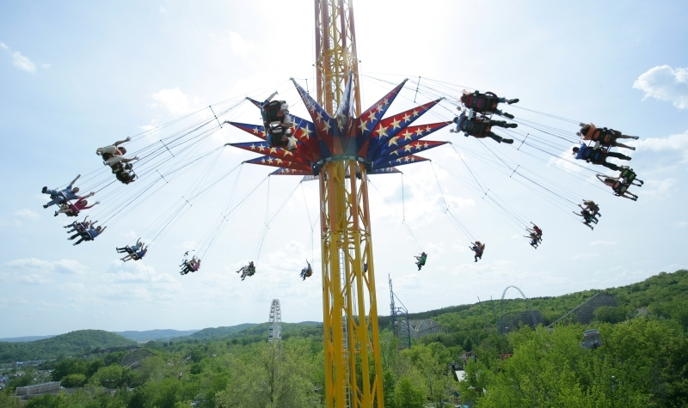
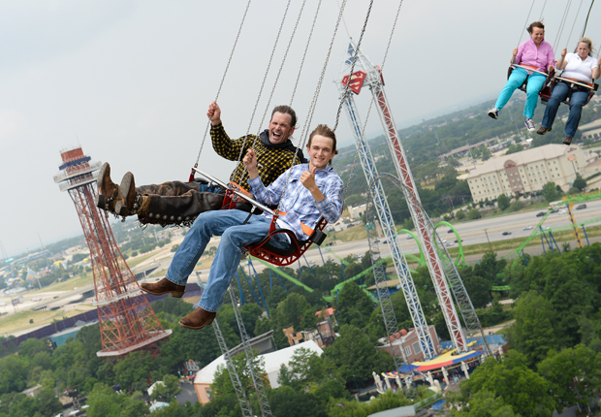
Conical Pendulum
Learning Outcome: Describe an experiment using a conical pendulum to show circular motion
A rider on the swings is spinning with a period of 4s at a distance of 3.2 metres from the centre. Determine the angle from the vertical which the rider spins?

