Slide 1

Forces

Slide 2

A-Level Physics
1. Development of practical skills in physics
2. Foundations of Physics
3. Forces and motion
4. Electrons, waves and photons
5. Newtonian world and astrophysics
6. Particles and medical physics
3.1 Motion
3.2 Forces
3.3. Work, Energy and power
3.4. Materials
3.5 Newton’s laws and momentum
3.2.1 Introduction to forces
3.2.2.Resolving forces
3.2.3. Moments and torque
3.2.4.Drag forces and terminal velocity
3.2.5. Density and pressure
3.2.6. Archimedes principle

Slide 3
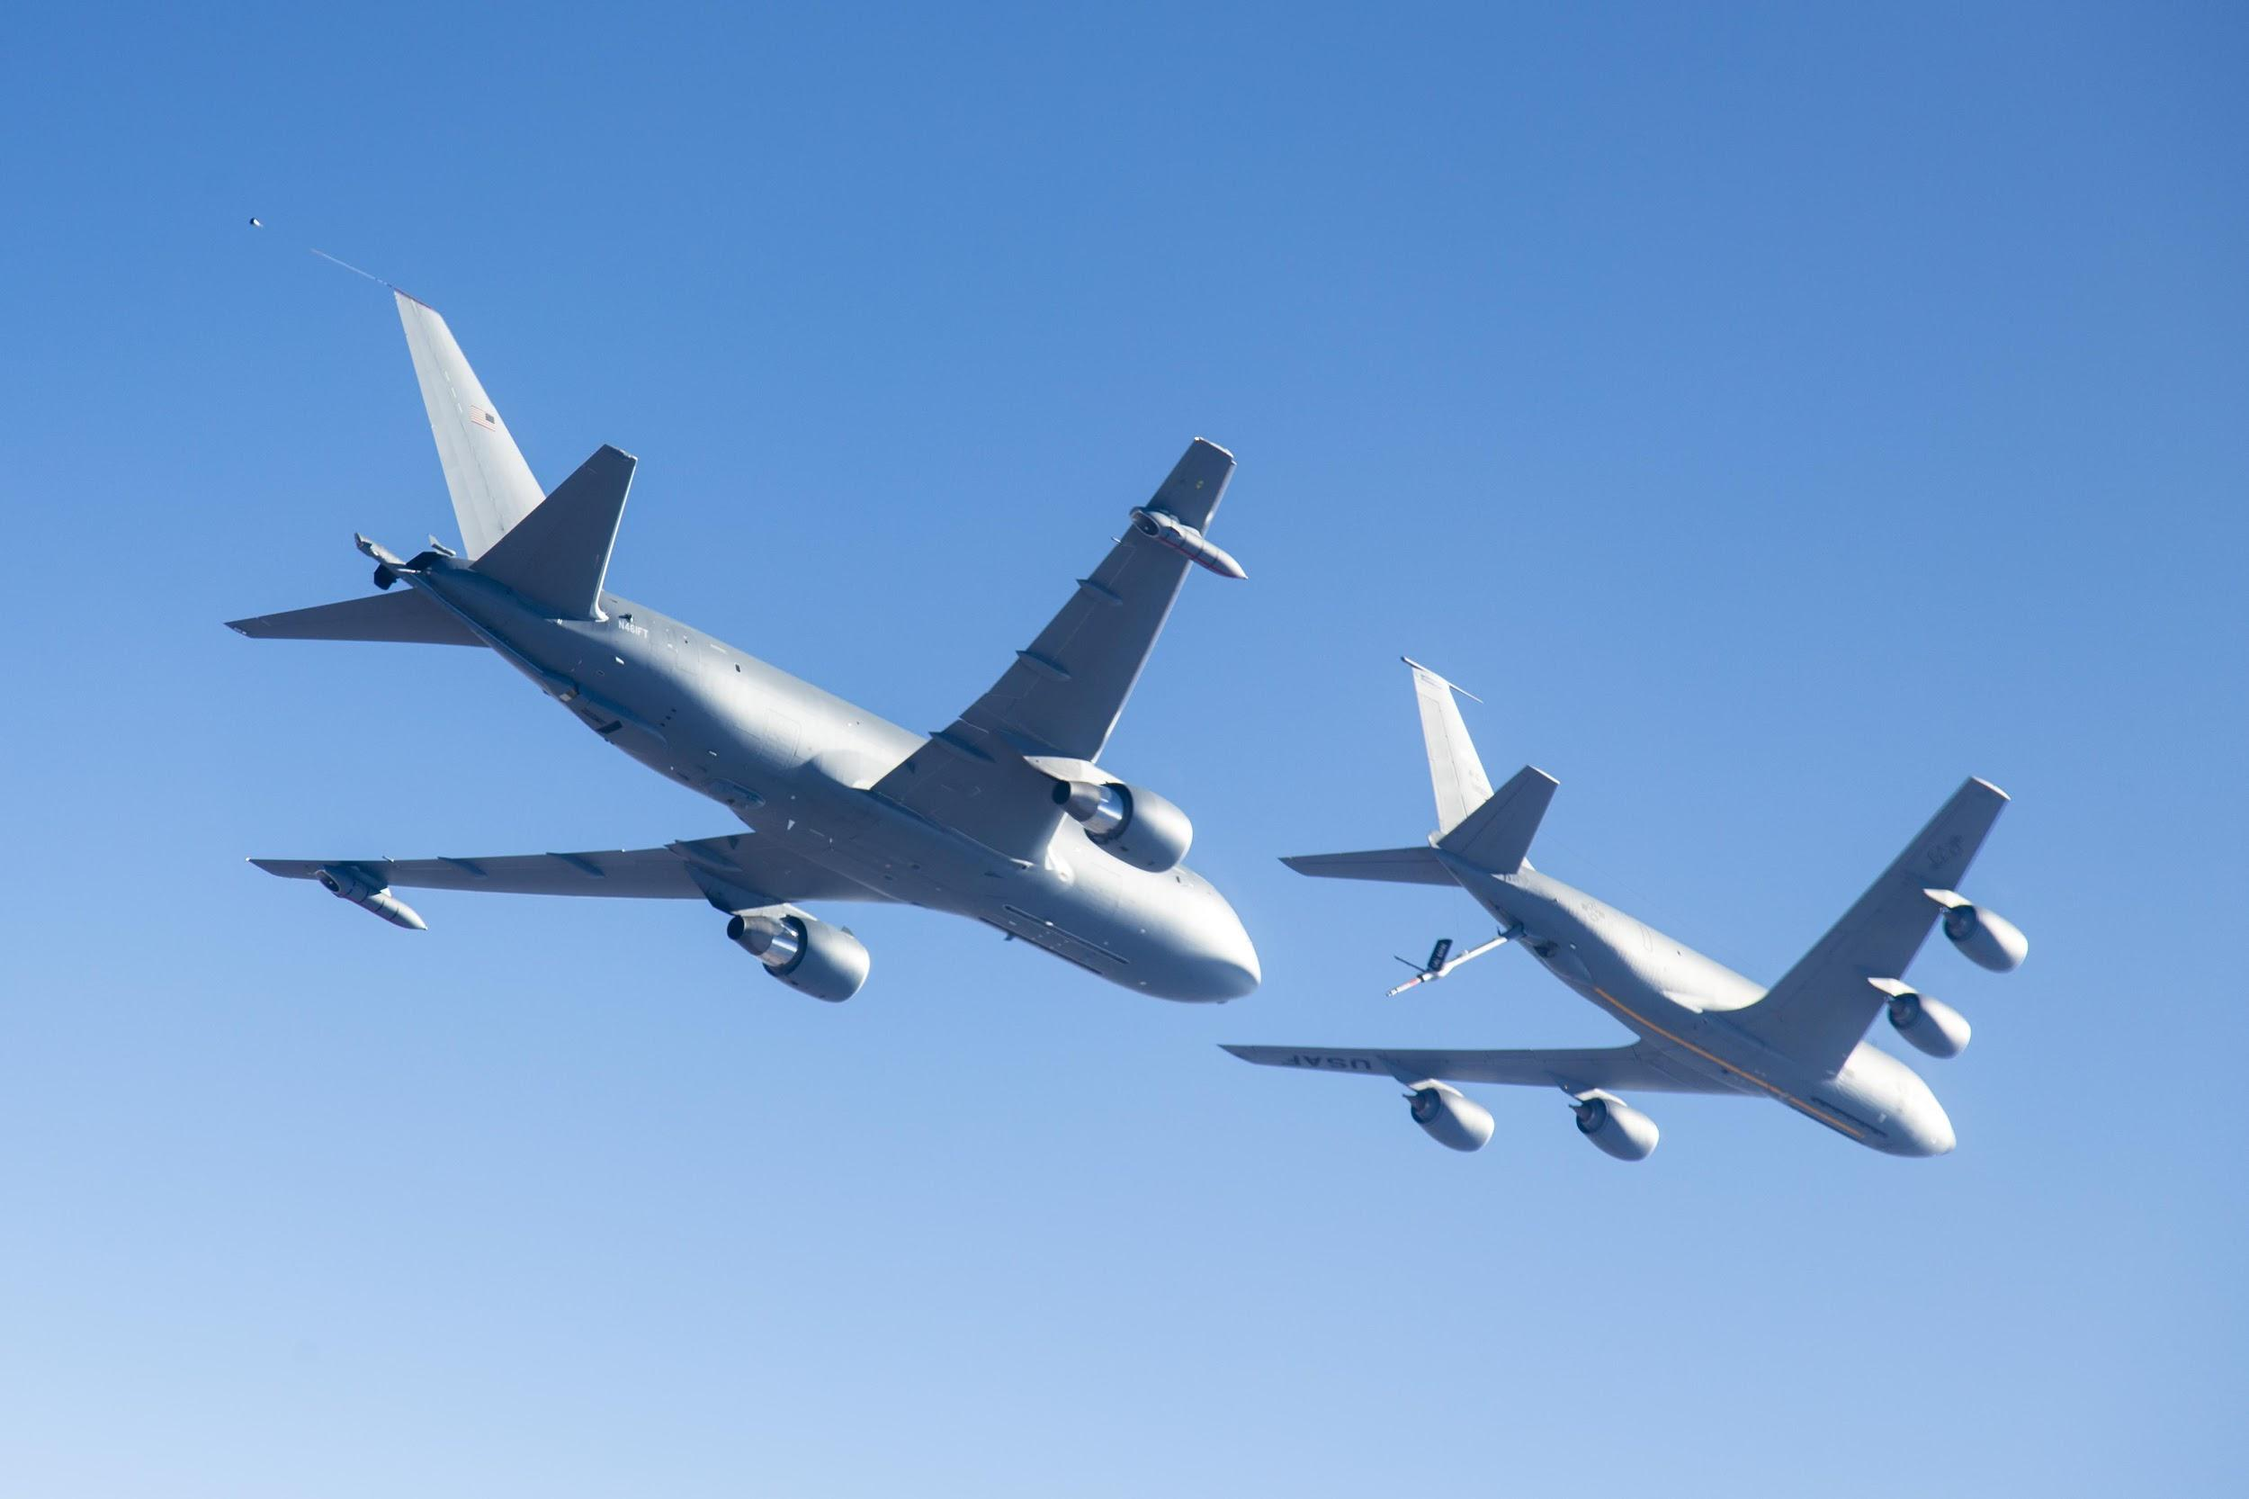
Introduction to forces
Describe what is meant by a force and give examples of forces
Describe the link between force and acceleration
Explain the difference between weight and mass

Slide 4
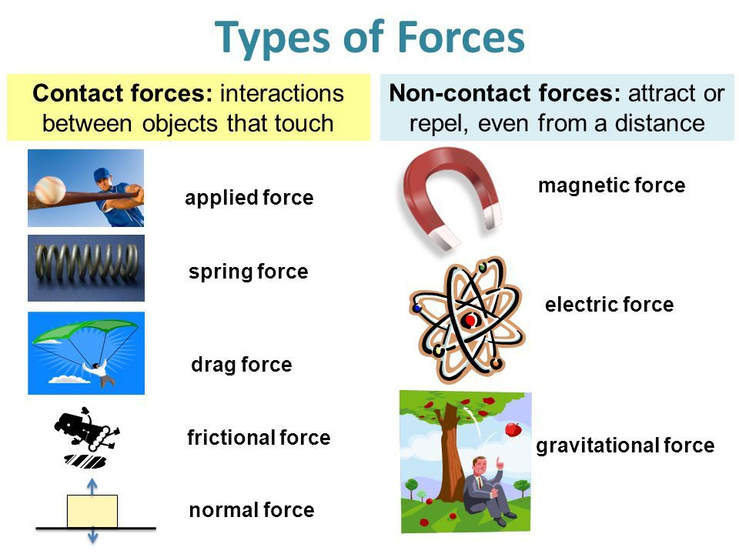
Notes:
Students come up with own definitions of these two words

Slide 5

Learning Outcome: Describe what is meant by a force and give examples of forces
What is a force?

Slide 6
Learning Outcome: Describe what is meant by a force and give examples of forces
What is a force?
“A force is a push or a pull that acts on an object due to the interaction with another object”

Slide 7
Learning Outcome: Divide forces into contact and non-contact forces
A force is a push or a pull that acts on an object due to the interaction with another object
Forces are vectors- they have magnitude and direction
Forces are measured in Newtons (N)
Forces can be either contact (physically touching) or non-contact (physically separated)
What is a force?
Contact:
Friction
Air resistance/Drag
Tension
Action/Thrust
Normal/Contact
Upthrust
Non-contact:
Gravitational
Electrostatic
Magnetic

Slide 8
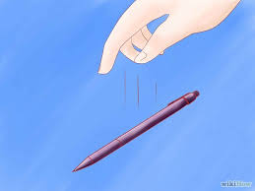
You drop a pencil from a height, what do you observe?
Learning Outcome: Describe the link between force and acceleration
You can not “see” a force, you can only see the acceleration caused by a force acting on a mass
A gravitational force from the Earth acts on the mass of the pen causing you to observe an acceleration towards the ground
What is the link between force and acceleration?

Slide 9
Learning Outcome: Describe the link between force and acceleration
Force = mass x acceleration
F = ma
e.g. a 600 kg car accelerates forwards at 5 ms⁻²
What forwards force must be applied to the car?
F = 600 x 5 = 3000 N

Slide 10
Learning Outcome: Explain the difference between mass and weight
Weight and mass are not the same
Mass is a physical property of an object (the amount of substance) measured in Kilograms (kg)
Weight is the downward force due to gravity acting on a mass, measured in Newton's (N)

Slide 11
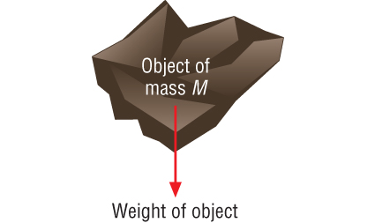
What is weight?
Learning Outcome: Explain the difference between mass and weight
Weight is the downward force due to gravity acting on a mass.
Weight (N) = mass (kg) x acceleration due to gravity (m/s²)
W= mg
On Earth g= 9.81 m/s²

Slide 12
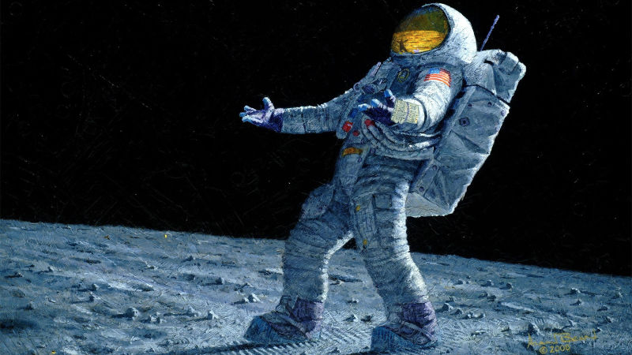
Why do you weigh less on the moon?
Learning Outcome: Explain the difference between mass and weight
On Earth acceleration due to gravity is about 10 m/s²
On the moon it is only 1.6 m/s²
Weight (N) = mass (kg) x acceleration due to gravity (m/s²)
If a person has a mass of 100 kg calculate how much he will weigh on the Earth and the moon?
If a person has a mass of 100 kg on Earth he will weigh:
Weight = 100 x 10 = 1000 N
If a person has a mass of 100 kg on the Moon he will weigh:
Weight = 100 x 1.6 = 160 N

Slide 13
A-Level Physics
3.1 Motion
3.2 Forces
3.3. Work, Energy and power
3.4. Materials
3.5 Newton’s laws and momentum
3.2.1 Introduction to forces
3.2.2.Resolving forces
3.2.3. Weight versus mass
3.2.4. Moments and torque
3.2.5.Drag forces and terminal velocity
3.2.6. Density and pressure
3.2.7. Archimedes principle
1. Development of practical skills in physics
2. Foundations of Physics
3. Forces and motion
4. Electrons, waves and photons
5. Newtonian world and astrophysics
6. Particles and medical physics
3.2.1 Introduction to forces
3.2.2.Resolving forces
3.2.3. Moments and torque
3.2.4.Drag forces and terminal velocity
3.2.5. Density and pressure
3.2.6. Archimedes principle

Slide 14
Resolving forces
Draw free body diagrams
Describe what is meant by a resultant force and calculate this
Solve problems with multiple forces at angles

Slide 15

Draw all the forces acting on a car assuming it is moving forwards
Learning Outcome: Draw free-body diagrams showing forces acting on objects

Slide 16
Learning Outcome: Draw free-body diagrams showing forces acting on objects
A free body diagram is a simple sketch of the object showing all the forces that are acting on it.
To draw a proper free body diagram, you must:
1. Draw a quick sketch of the object. Often a simple box will do.
2. Forces are drawn from their point or surface of action
3. For every force acting on that object draw a vector that shows the size and direction of the force.
4. Label each arrow based on the type of force it is.

Slide 17
Learning Outcome: Draw free-body diagrams showing forces acting on objects
You are trying to push a heavy box across the floor. It's causing you some trouble because the floor is not very smooth. Sketch a free body diagram of the box.
(N)
Notes:
Teacher does this example on the board

Slide 18
1. A book is at rest on a table. | 2. A duck is floating on a pond. | 3. An egg is free-falling from a nest in a tree.
4. A flying squirrel is gliding from a tree to the ground at constant velocity. | 5. A rightward force is applied to a book in order to move it across a desk at constant velocity. | 6. A student rests a backpack upon his shoulder. The pack is suspended motionless by one strap from one shoulder.
7. A skydiver is descending with a constant velocity. | 8. A force is applied to the right to drag a sled across loosely packed snow with a rightward acceleration. | 9. Make up your own story and diagram

Slide 19
Learning Outcome: Describe what is meant by a resultant force and calculate this
500 N
1200 N
50 N
50 N
Resultant force = force in one – forces in opposite direction direction
Resultant forces causes a change in the speed/direction of an object

Slide 20
Learning Outcome: Describe what is meant by a resultant force and calculate this
500 N
1200 N
Resultant = 1200- 600= 600 N forwards
50 N
50 N
Resultant force = force in one – forces in opposite direction direction
Resultant forces cause acceleration (change in the speed/direction) of an object, no resultant force = no change in velocity (constant speed)

Slide 21
Learning Outcome: Describe what is meant by a resultant force and calculate this
Calculate the resultant force and state the direction this acts in.
2N
4N
2N
7N
7N
20N
B
C
D
4N
E
4N
A
15N
7N
10N
20N
2N
4N
6N
10N
10N
1N
1N
4N
2N
2N

Slide 22
Learning Outcome: Describe what is meant by a resultant force and calculate this
Calculate the resultant force and state the direction this acts in.
2N
4N
2N
7N
7N
20N
B
C
D
4N
E
4N
A
15N
7N
10N
20N
2N
4N
6N
10N
10N
1N
1N
4N
2N
2N
10 N up
14 N left
10 N up
2 N up
2 N right

Slide 23
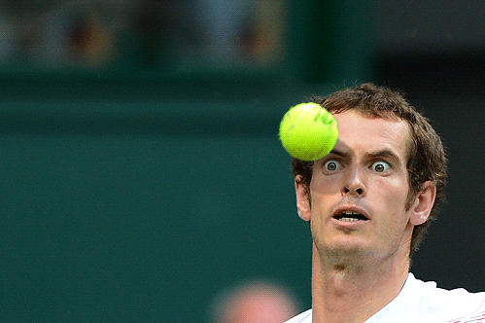
Learning Outcome: Solve problems with multiple forces at angles
A tennis player hits a tennis ball into a strong cross-wind. Which direction would the ball go, how could you calculate the resultant force?
10 N
80 N
Notes:
Students to discuss in their groups which ones they think will have a direction and list them on paper or on a whiteboard

Slide 24
Learning Outcome: Solve problems with multiple forces at angles
A tennis player hits a tennis ball into a strong cross-wind. Which direction would the ball go, how could you calculate the resultant force?
10 N
80 N

Slide 25
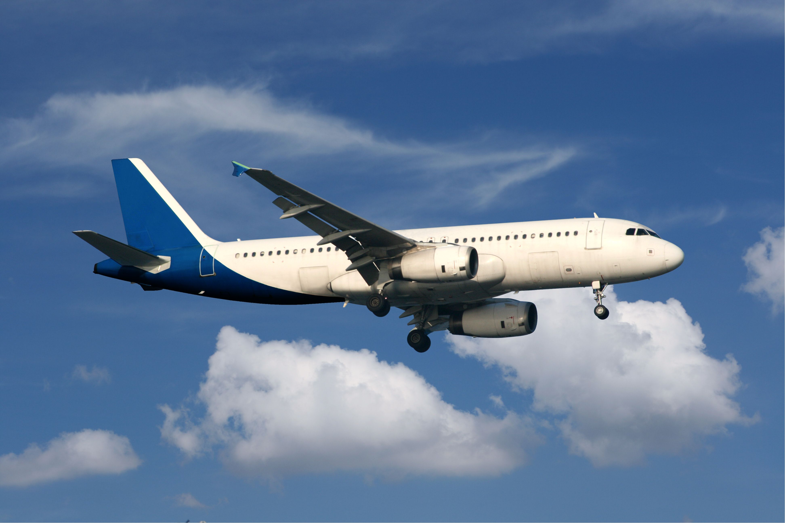
Learning Outcome: Solve problems with multiple forces at angles
If this plane is in equilibrium. How could you work out the action force?
40°
Action
Air resistance 5000 N
Notes:
Students to discuss in their groups which ones they think will have a direction and list them on paper or on a whiteboard

Slide 26
Learning Outcome: Solve problems with multiple forces at angles
If this plane is in equilibrium. How could you work out the action force?
40°
Action
Air resistance 5000 N

Slide 27
Learning Outcome: Solve problems with multiple forces at angles
If this plane is in equilibrium. How could you work out the action force?
Hypotenuse= 5000, Angle = 40, Adjacent = ?
5000 x cos40 = 3830 N
40°
Action
Air resistance 5000 N

Slide 28
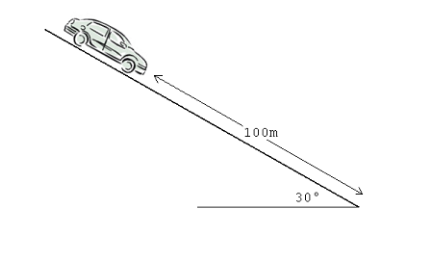
Learning Outcome: Solve problems with multiple forces at angles
What component of the weight acts down the slope
Weight 10000 N
Notes:
Students to discuss in their groups which ones they think will have a direction and list them on paper or on a whiteboard

Slide 29
Learning Outcome: Solve problems with multiple forces at angles
What component of the weight acts down the slope
Hypotenuse = 10,000
Angle = 60
Adjacent = ?
10000 x cos 60 = 5000 N
60˚
Weight 10000 N
Notes:
Students to discuss in their groups which ones they think will have a direction and list them on paper or on a whiteboard

Slide 30
Learning Outcome: Solve problems with multiple forces at angles
This object is attached at two points, how could you calculate the weight of the object (assuming the system is in equilibrium)
Tension = 20 N
45°
75°
Tension = 15 N
Weight?

Slide 31
Learning Outcome: Solve problems with multiple forces at angles
Method 1) Sine or cosine rule
a² = b² + c² – 2bc cosA
a² = 20² + 15² – 2 x 15 x2 0 x (cos 60)
= 325
a = 18.02
Tension = 20 N
45°
Tension = 15 N
75°
Tension = 15 N
75°
60°
Tension = 20 N
45°
Weight?

Slide 32
Learning Outcome: Solve problems with multiple forces at angles
Method 2- Find vertical components of both tensions and add them together
Cos 45 x 20 = 14.14 N
Cos 75 x 15 = 3.88 N
Tension = 20 N
45°
75°
Tension = 15 N
Weight?
Weight = 14.14 + 3.88 = 18.02 N

Slide 33
A-Level Physics
1. Development of practical skills in physics
2. Foundations of Physics
3. Forces and motion
4. Electrons, waves and photons
5. Newtonian world and astrophysics
6. Particles and medical physics
3.1 Motion
3.2 Forces
3.3. Work, Energy and power
3.4. Materials
3.5 Newton’s laws and momentum
3.2.1 Introduction to forces
3.2.2.Resolving forces
3.2.3. Moments and torque
3.2.4.Drag forces and terminal velocity
3.2.5. Density and pressure
3.2.6. Archimedes principle

Slide 34
Moments
Describe the idea of centre of mass
Describe and apply the principal of moments
Apply the principle of moments for forces at an angle

Slide 35
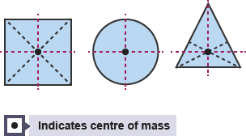
Learning Outcome: Describe the idea of centre of mass
Weight always acts towards the centre of mass of an object
The centre of mass of an object is the point at which its mass can be thought of as being concentrated
For symmetrical objects with evenly distributed mass the centre of mass lies where the axes of symmetry meet
0.06%
0.9%
0.04%
21%

Slide 36
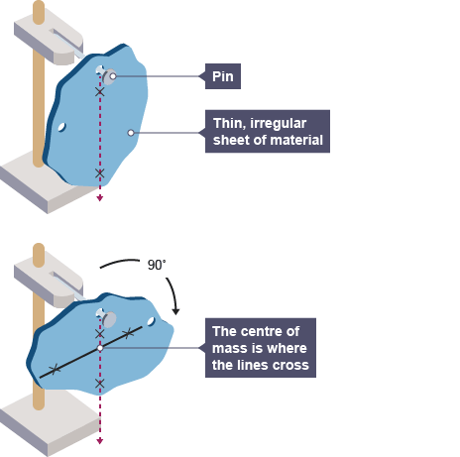
Learning Outcome: Describe the idea of centre of mass
Cut out an irregular shape from the card
Out three holes evenly distributed the edges of the card
Hang the card from a clamp stand through one of the holes
Hang a plumbline from the nail and draw on the line where it hangs
Hang the card from a different hole and repeat the above step twice
The centre of mass is where the lines cross

Slide 37
Principal Of Moments
Moment = force x distance from pivot
Learning Outcome: Apply the principal of moments
Moment (Nm) | Force (N) x Distance from Pivot (m)
An object is balanced when the...
Sum of Anti-
Clockwise Moments
Sum of Clockwise Moments
=
=
Notes:
Remember to state Moment is a turning force

Slide 38
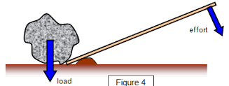
Moment = force x distance from pivot
Learning Outcome: Apply the principal of moments
Pivot points
Forces can cause rotation around a fixed point or PIVOT.
For example, in the diagram below, the mound of earth acts as a pivot, and an effort force can be applied to rotate the wooden rod and move the load.
2 m
A force applied at a particular distance from a pivot produces a turning effect or MOMENT
20N
Moment = 20 x 2 = 40 Nm

Slide 39
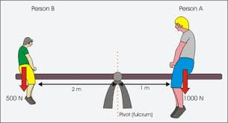
Learning Outcome: Apply the principal of moments
Moment (Nm) | Force (N) x Distance from Pivot (m)
Anticlockwise
Clockwise
If balanced:
Total anticlockwise moment = Total clockwise moment
500 x 2 = 1000 x 1
1000 = 1000
Therefore people are balanced
Notes:
Remember to state Moment is a turning force

Slide 40
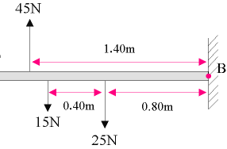
Learning Outcome: Apply the principal of moments
F
Moment (Nm) | Force (N) x Distance from Pivot (m)
Clockwise
Anticlockwise
Clockwise
Anticlockwise
Anticlockwise
Find F:
Total anticlockwise moment = Total clockwise moment
(15 x (0.4+0.8)) + (25 x 0.8) = F x 1.4
18 + 20 = 1.4 F
38 = 1.4 F F = 27.14 N
Notes:
Remember to state Moment is a turning force

Slide 41
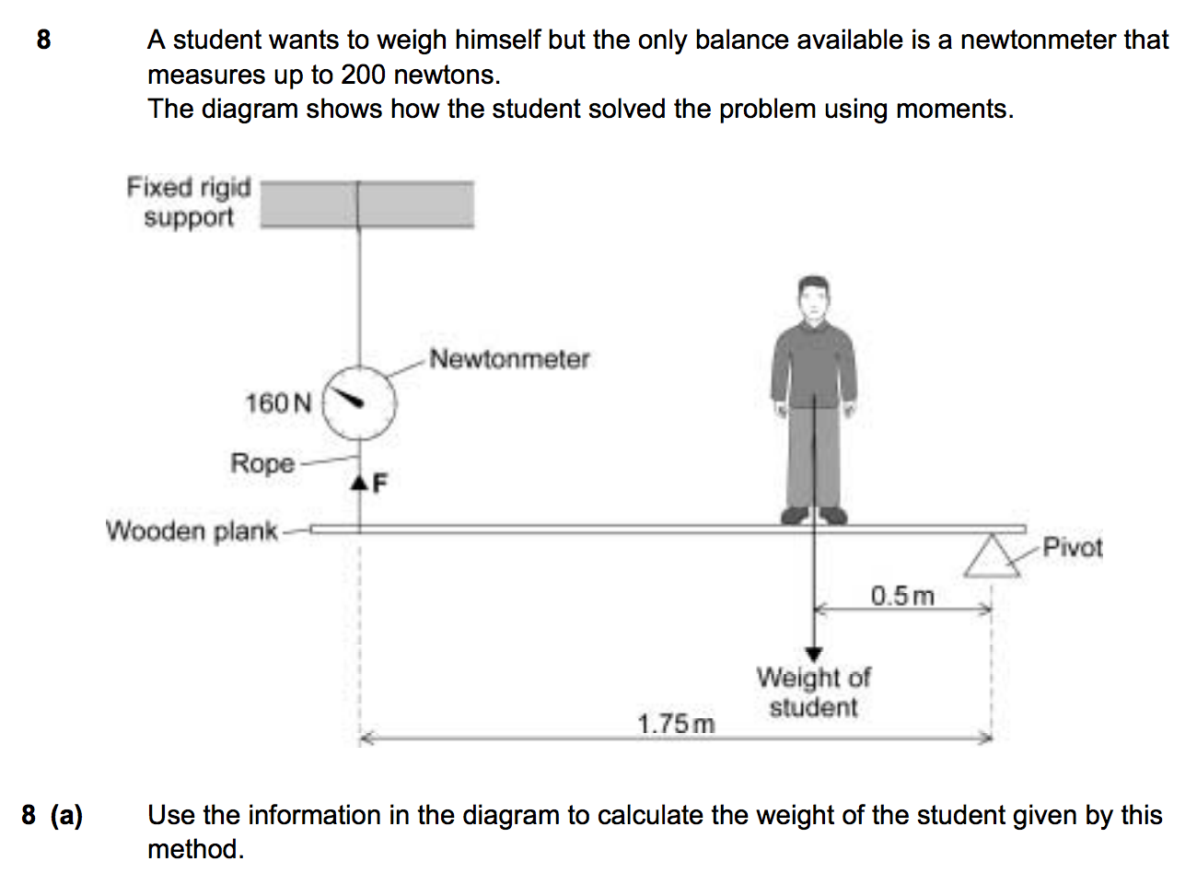
Learning Outcome: Apply the principal of moments

Slide 42
Learning Outcome: Apply the principal of moments
Clockwise
Anticlockwise
Total anticlockwise moment = total clockwise moment
160 x 1.75 = W x 0.5
280 = 0.5 W
W = 560 N

Slide 43
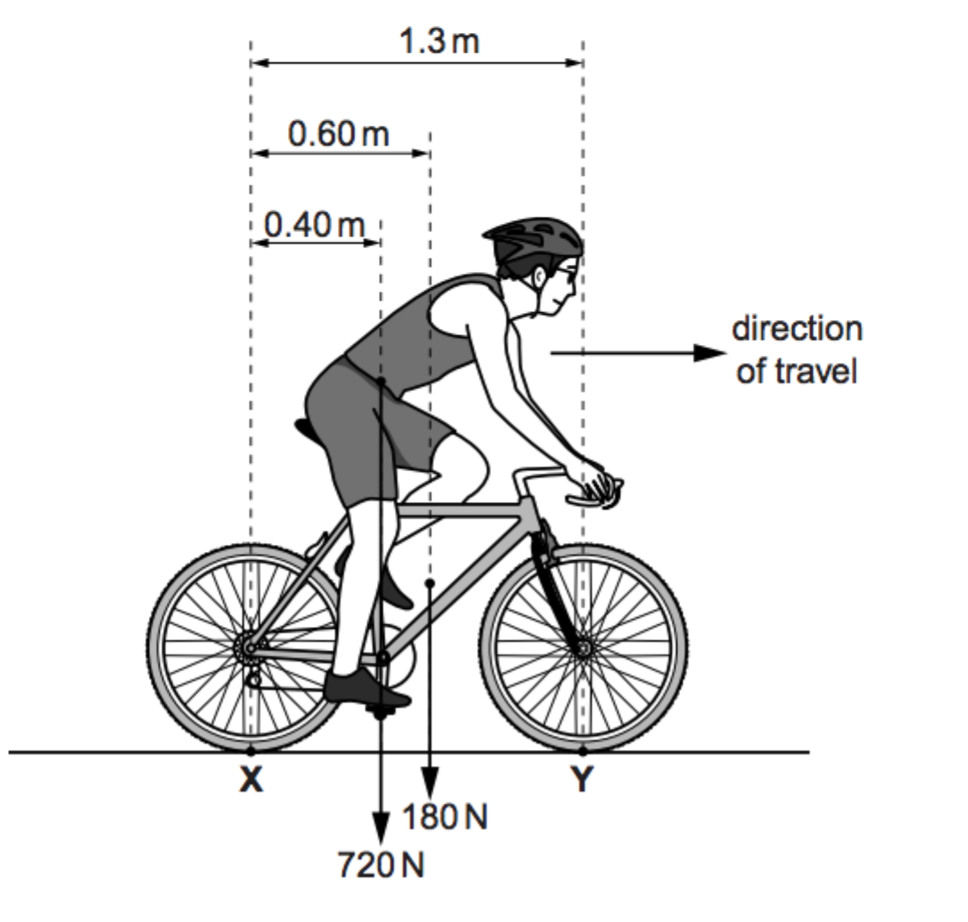
Learning Outcome: Apply the principal of moments
A Level questions are different to GCSE questions in two ways:
The diagrams are more complicated
There is no fixed, or multiple pivot points

Slide 44
Learning Outcome: Apply the principal of moments
Find the force acting at Y
Draw yourself a simplified diagram with all forces
Solve to find the unknown using the principal of moments
Total clockwise moment=Total anticlockwise moment
(720 x 0.4) + (180 x 0.6) = (Y x 1.3)
288 + 108 = 1.3 Y
396 = 1.3 Y Y = 304.6 N
1.3 m
Anti- clockwise
X
0.6 m
Y
0.4 m
720 N
180 N
Clockwise
Clockwise

Slide 45
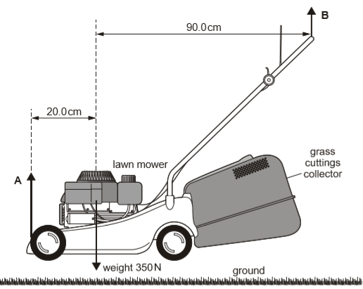
Learning Outcome: Apply the principal of moments
Find the force acting at B
Draw yourself a simplified diagram with all forces
Mark the unknown you are not trying to find as the pivot point,
Identify your clockwise and anticlockwise moments around this pivot
Solve to find the unknown using the principal of moments
Total clockwise moment=Total anticlockwise moment
(350 x 0.2) = (B x (0.2 + 0.9))
70 = 1.1 B
B = 63.6 N
Anti- clockwise
A
90 cm
B
20 cm
X
350 N
Clockwise

Slide 46
When a force is applied at an angle: moment = force x
Learning Outcome: Apply the principle of moments for forces at an angle
perpendicular distance of the line of action of a force from the axis or point of rotation (pivot)
Notes:
Remember to state Moment is a turning force

Slide 47
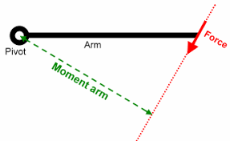
When a force is applied at an angle: moment = force x
Learning Outcome: Apply the principle of moments for forces at an angle
perpendicular distance of the line of action of a force from the axis or point of rotation (pivot)
Notes:
Remember to state Moment is a turning force

Slide 48
moment = force x
Learning Outcome: Apply the principle of moments for forces at an angle
perpendicular distance of the line of action of a force from the axis or point of rotation (pivot)
Find the moment
0.2 m
50 N
40°
Notes:
Remember to state Moment is a turning force

Slide 49
moment = force x
Learning Outcome: Apply the principle of moments for forces at an angle
perpendicular distance of the line of action of a force from the axis or point of rotation (pivot)
0.2 m
40°
50 N
x
40°
Method 1
x = 0.2 cos 40
= 0.15
Moment = 50 x 0.15
= 7.66 Nm
0.15 m
Notes:
Remember to state Moment is a turning force

Slide 50
moment = force x
Learning Outcome: Apply the principle of moments for forces at an angle
perpendicular distance of the line of action of a force from the axis or point of rotation (pivot)
0.2 m
Fh
50 N
40°
Method 2
Fv = 50 cos 40
= 38.3 N
No component of Fh contributes to moment
Moment = 38.3 x 0.2
= 7.66 Nm
Fv
38.3 N
Notes:
Remember to state Moment is a turning force

Slide 51
Learning Outcome: Apply the principle of moments for forces at an angle
10 N
y N
50°
2 m
4 m
What is the moment produced by the 10 N force?
((sin 50 x 10) x 2) = 15.32 Nm
Use this to find y:
Clockwise moments = anticlockwise moments
( y x 4) = ((sin 50 x 10) x 2)
4y = 15.32
y = 3.83 N

Slide 52
Learning Outcome: Apply the principle of moments for forces at an angle
10 N
7 N
6 N
y N
50°
1 m
3 m
2 m
4 m
Clockwise moments = anticlockwise moments
( y x 4) + (6 x 1) = (7 x 3) + ((cos 40 x 10) x 2)
4y + 6 = 21 + 15.32
4y + 6 = 36.32
4y = 30.32
y = 7.58

Slide 53
A-Level Physics
1. Development of practical skills in physics
2. Foundations of Physics
3. Forces and motion
4. Electrons, waves and photons
5. Newtonian world and astrophysics
6. Particles and medical physics
3.1 Motion
3.2 Forces
3.3. Work, Energy and power
3.4. Materials
3.5 Newton’s laws and momentum
3.2.1 Introduction to forces
3.2.2.Resolving forces
3.2.3. Moments and torque
3.2.4.Drag forces and terminal velocity
3.2.5. Density and pressure
3.2.6. Archimedes principle

Slide 54
Torque of a couple
Describe how rotational motion is caused and what is meant by a couple
Define and derive an equation for torque
Calculate torque for couples

Slide 55
Learning Outcome: Describe how rotational motion is caused
What will happen if a force is applied as below:
Translational motion as force in line with centre of mass
How about now?
Translational and rotational motion

Slide 56
Torque of a couple = One force x perpendicular separation between the forces
Learning Outcome: Define and derive an equation for torque
What if you want just rotational motion?
A pair of equal in magnitude and opposite in direction forces around a pivot-
a couple
F
d
F

Slide 57
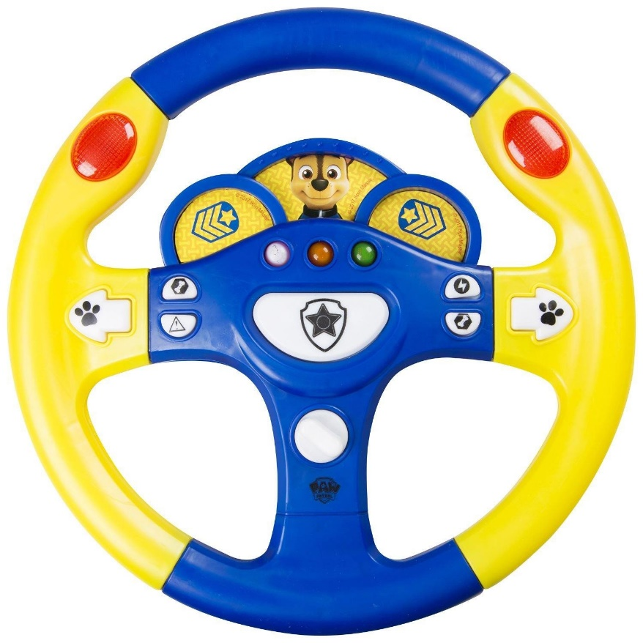
Learning Outcome: Calculate torque for couples
Torque of a couple = One force x perpendicular separation between the forces
Torque = 20 x (0.16 x 2)
= 6.4 Nm
20 N
16 cm
20 N
Notes:
Remember to state Moment is a turning force

Slide 58
A-Level Physics
1. Development of practical skills in physics
2. Foundations of Physics
3. Forces and motion
4. Electrons, waves and photons
5. Newtonian world and astrophysics
6. Particles and medical physics
3.1 Motion
3.2 Forces
3.3. Work, Energy and power
3.4. Materials
3.5 Newton’s laws and momentum
3.2.1 Introduction to forces
3.2.3.Resolving forces
3.2.3. Moments and torque
3.2.4.Drag forces and terminal velocity
3.2.5. Density and pressure
3.2.6. Archimedes principle

Slide 59
Drag forces in fluids
Describe how drag forces effect objects
Describe factors that influence the size of the drag force
Describe what is meant by terminal velocity

Slide 60

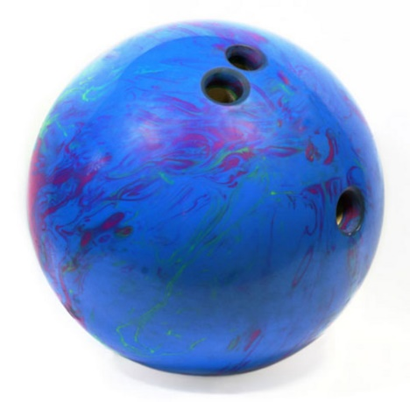
Learning Outcome: Describe how drag forces effect objects and factors that effect this
Drag forces occur in all objects moving through a fluid (liquid or gas) owing to the fluid particles coming in contact with the object and exerting a force as they touch.
The bowling ball will hit the ground first owing to its greater mass, meaning it requires a greater drag force to balance its weight
Notes:
https://www.youtube.com/watch?v=E43-CfukEgs
https://www.youtube.com/watch?v=frZ9dN_ATew
https://www.youtube.com/watch?v=frZ9dN_Atew

Slide 61

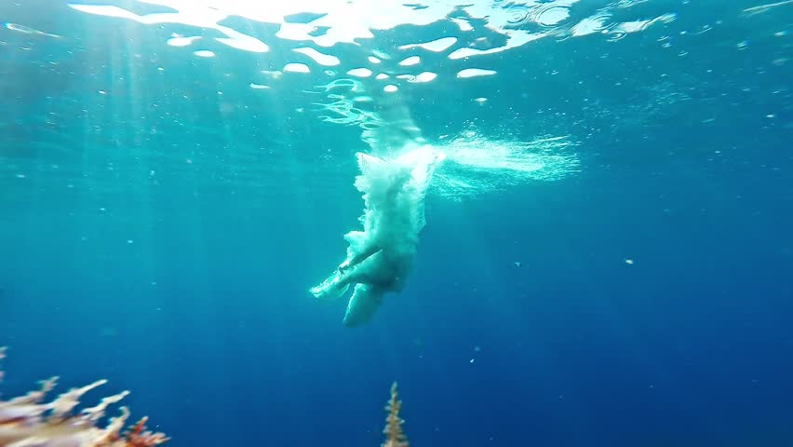
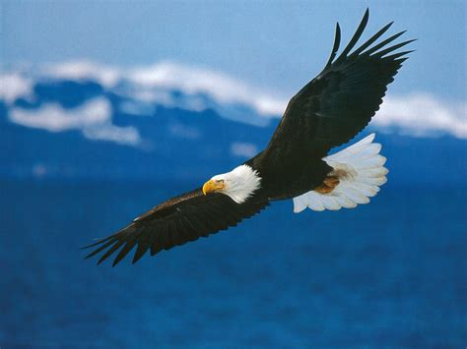
D
Learning Outcome: Describe factors that influence drag force
A drag force (air resistance/water resistance) is a resistive force that occurs in due to the particles in fluids (air/water) opposing the motion of the objects
What factors would influence the size of the drag force?
Surface area, velocity, density of the fluid
Notes:
Speed, shape, roughness, texture, density of fluid

Slide 62
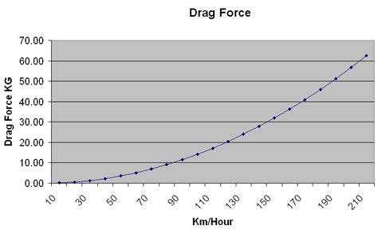
Learning Outcome: Describe factors that influence drag force
Drag force α velocity²
At 10m/s a car experiences a drag force of 1kN, what would it experience at 30m/s and why?
drag force α cross-sectional area

Slide 63
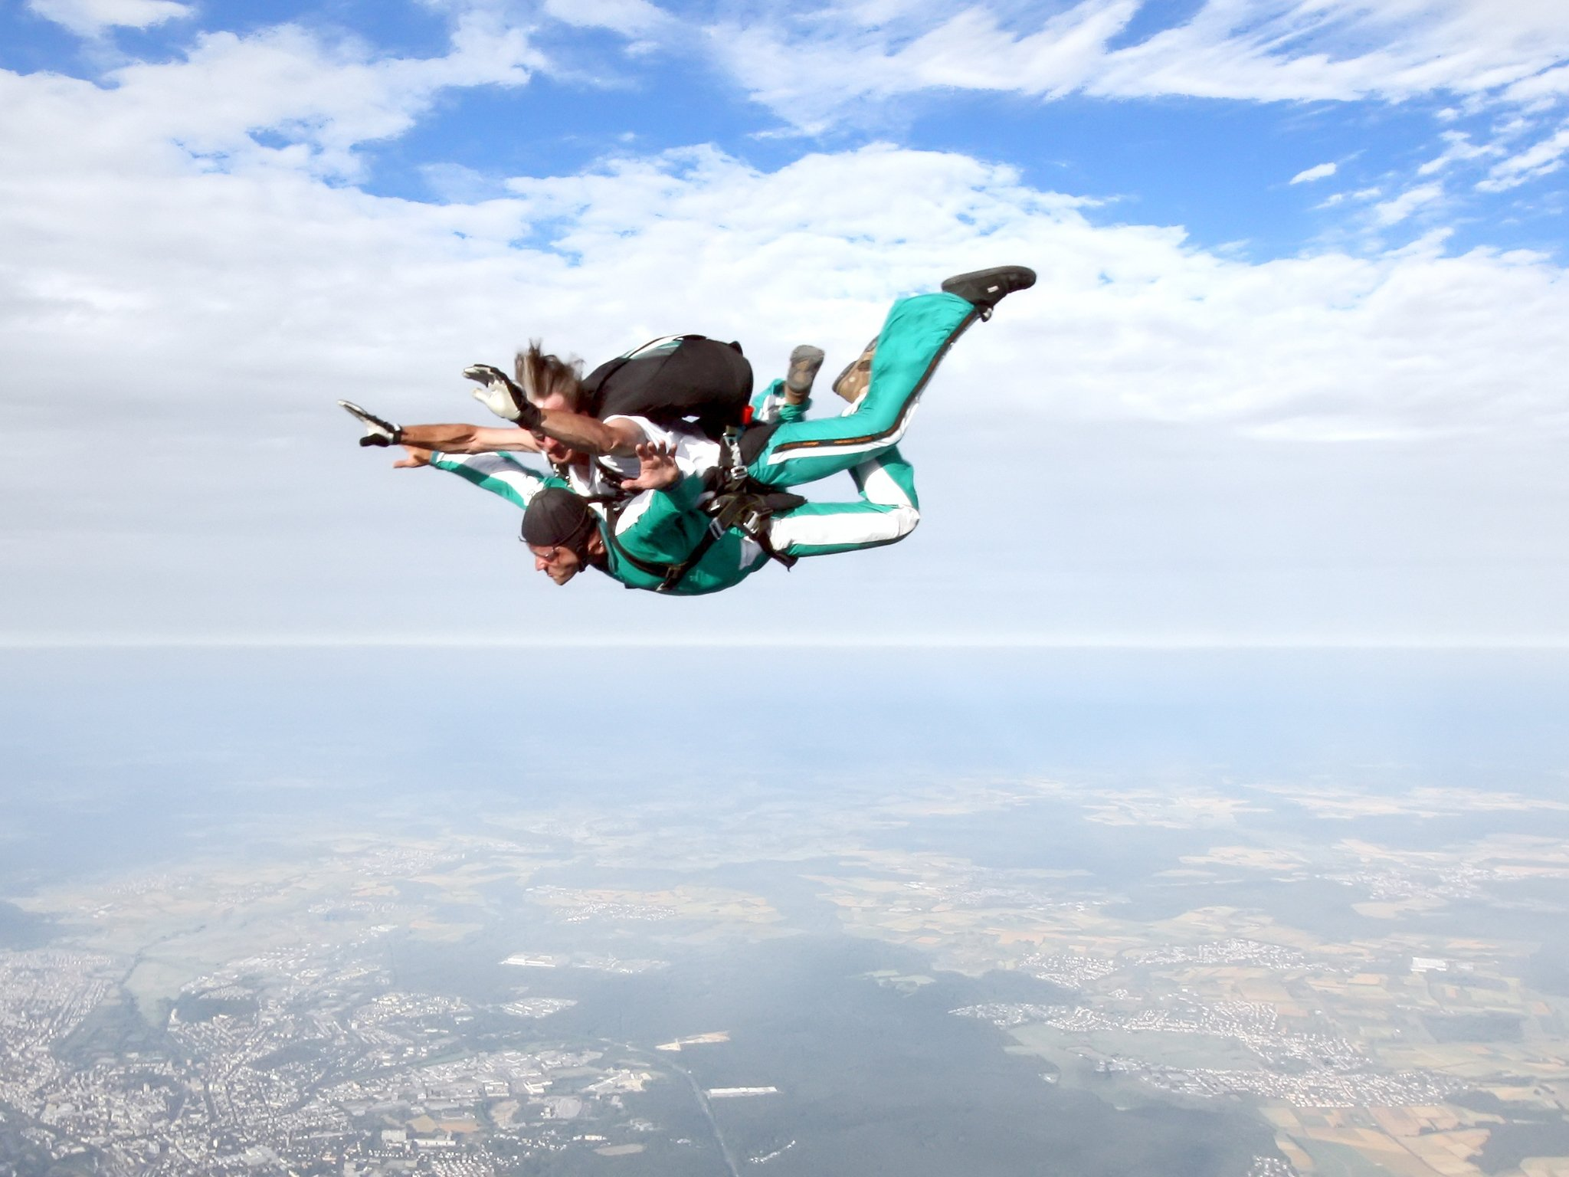
Learning Outcome: Describe what is meant by terminal velocity
What forces act on the skydiver as they fall?
Drag
Weight
How do forces change on the skydiver as they fall?

Slide 64
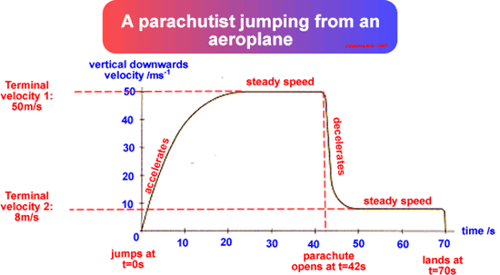
Learning Outcome: Describe what is meant by terminal velocity
C
At each stage- what happens to the acceleration and velocity, explain in terms of changing forces on the parachutist
D
B
E
A

Slide 65
Learning Outcome: Describe what is meant by terminal velocity
A- Acceleration = g (9.81 ms⁻²), no drag force, only weight
B- Drag force increases as velocity increases, decreasing the resultant force and rate of acceleration
C- Drag force = weight, acceleration = 0 ms⁻², terminal velocity
D- Drag force increases because of increased surface area. Drag force>weight. Person decelerates as resultant force is upwards
E- As person decelerates drag force decreases until drag force = weight and a new lower terminal velocity is reached, acceleration = 0 ms⁻²
C
D
B
E
A

Slide 66
Learning Outcome: Describe what is meant by terminal velocity
How could you change your terminal velocity?
Surface area: greater area = greater drag force = lower terminal velocity
Mass: greater mass = greater weight = larger drag force required to equal weight = higher terminal velocity

Slide 67
A-Level Physics
1. Development of practical skills in physics
2. Foundations of Physics
3. Forces and motion
4. Electrons, waves and photons
5. Newtonian world and astrophysics
6. Particles and medical physics
3.1 Motion
3.2 Forces
3.3. Work, Energy and power
3.4. Materials
3.5 Newton’s laws and momentum
3.2.1 Introduction to forces
3.2.2.Resolving forces
3.2.3. Moments and torque
3.2.4.Drag forces and terminal velocity
3.2.5. Density and pressure
3.2.6. Archimedes principle

Slide 68
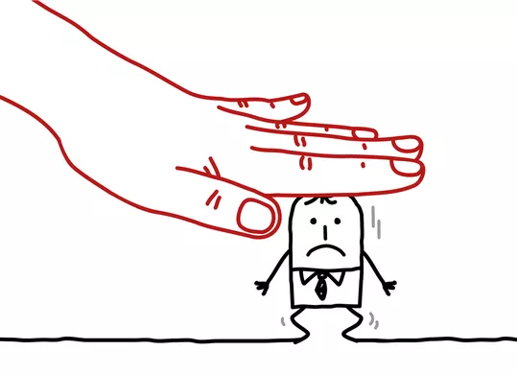
Density and Pressure
Describe what is meant by density and how this is calculated
Compare methods for calculating density
Describe what is meant by pressure and how this is calculated

Slide 69
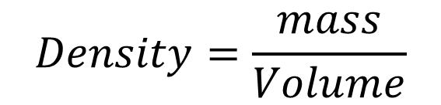
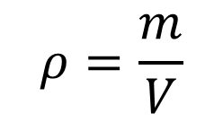
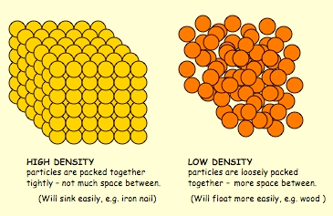
Learning Outcome: Describe what is meant by density and how this is calculated
Density is the mass per unit volume. This means that the density of any solid, liquid or gas can be found by dividing its mass in kilograms by its volume in cubic metres. The unit for density is kg m⁻³.

Slide 70



Density
Learning Outcome: Describe what is meant by density and how this is calculated
A person has a volume of 0.07 m³ and a mass of 70 kg. What would be their density?
m = 70 kg, V = 0.07 m³, Density = ?
70/0.07 = 1000 kg m³

Slide 71
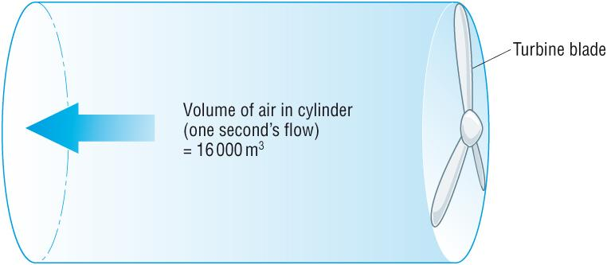







Learning Outcome: Describe what is meant by density and how this is calculated
Air flowing past the blades of a wind turbine in one second has a volume of 16000m³. The density of air is 1.29kg/m³. What is the mass of this volume of air?
Air flowing past the blades of a wind turbine in one second has a volume of 16000m³. The density of air is 1.29kg/m³. What is the mass of this volume of air?
Air flowing past the blades of a wind turbine in one second has a volume of 16000m³. The density of air is 1.29kg/m³. What is the mass of this volume of air?
Air flowing past the blades of a wind turbine in one second has a volume of 16000m³. The density of air is 1.29kg/m³. What is the mass of this volume of air?
Don’t forget to re-arrange the equation to give mass.

Slide 72
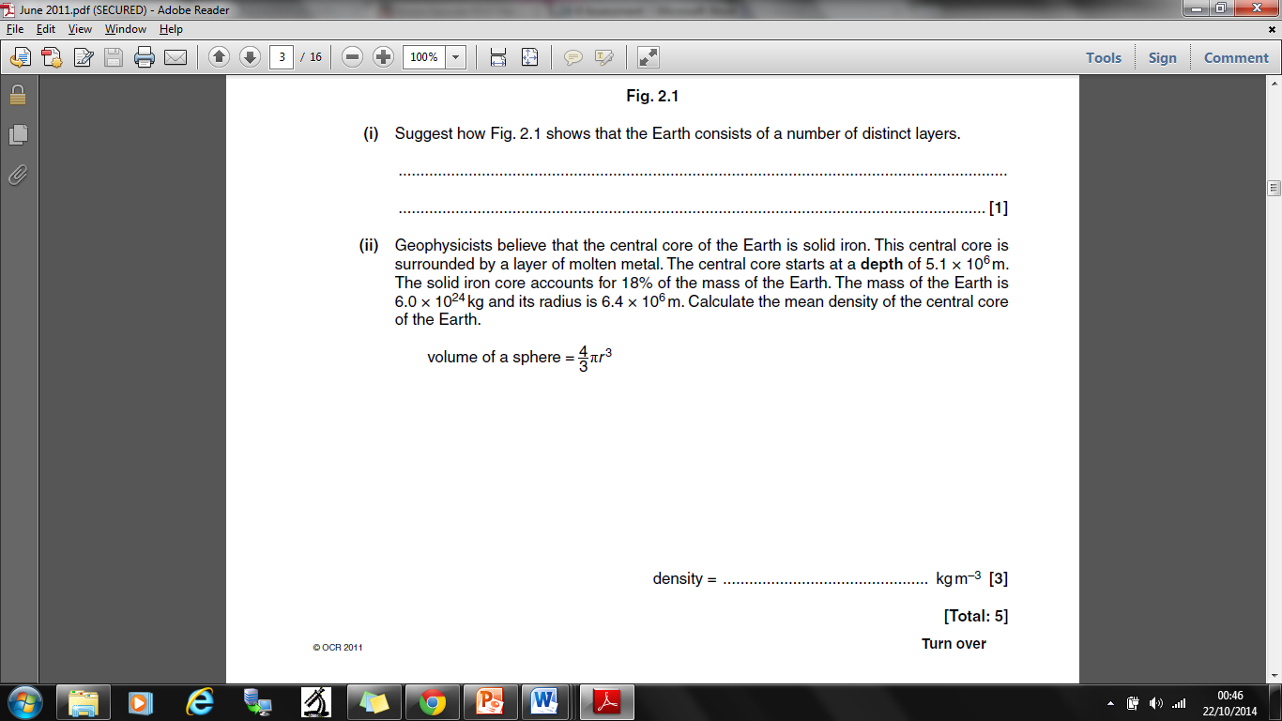
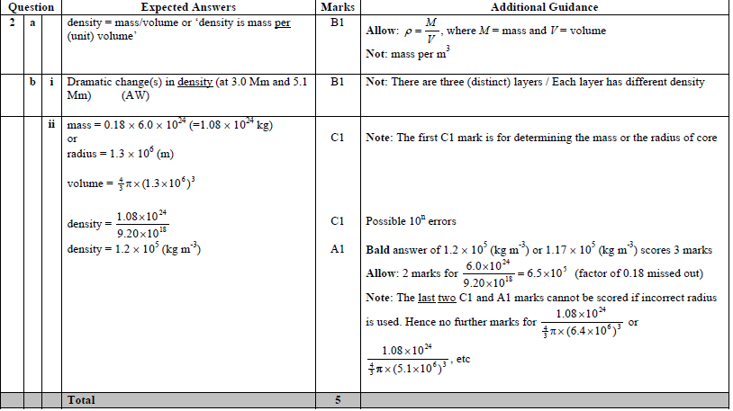
Learning Outcome: Describe what is meant by density and how this is calculated

Slide 73
Learning Outcome: Describe what is meant by pressure and how this is calculated
What is pressure?
Pressure occurs when any objects are in contact
Pressure is the force that an object pushes on another object over the area which the force acts
Pressure (Pa)= | Force (or weight) (N) Area (m²)

Slide 74
A-Level Physics
1. Development of practical skills in physics
2. Foundations of Physics
3. Forces and motion
4. Electrons, waves and photons
5. Newtonian world and astrophysics
6. Particles and medical physics
3.1 Motion
3.2 Forces
3.3. Work, Energy and power
3.4. Materials
3.5 Newton’s laws and momentum
3.2.1 Introduction to forces
3.2.2.Resolving forces
3.2.3. Moments and torque
3.2.4.Drag forces and terminal velocity
3.2.5. Density and pressure
3.2.6. Archimedes principle

Slide 75
Fluid pressure
Describe what fluid pressure is and how this is calculated
Describe why objects in fluids experience upthrust
Describe Archimedes principle

Slide 76
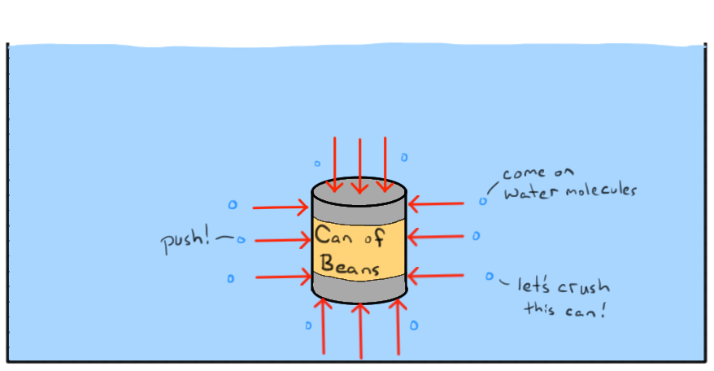
Lesson Title: Describe what fluid pressure is and how this is calculated
Liquids cause pressure from the contact between liquid particles and a submerged object or simply contact between liquid particles
Liquids cause pressure from the contact between liquid particles and a submerged object or simply contact between liquid particles

Slide 77
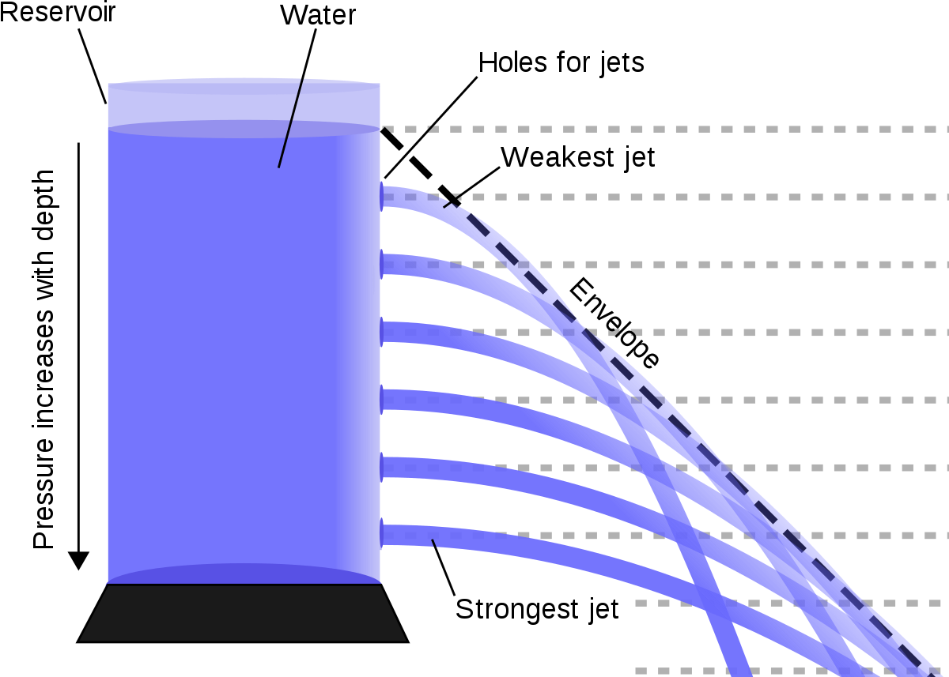
Lesson Title: Describe what fluid pressure is and how this is calculated
The pressure exerted at the bottom of the container is due to the weight of the water above it.
At a greater depth there is more water above, a larger weight and therefore greater pressure.
Pressure in a liquid increases with depth
Notes:
This can be demonstrated from the front

Slide 78
Lesson Title: Describe what fluid pressure is and how this is calculated
The pressure acting in a fluid can be calculated using the equation:
P = ⍴ h g
Pressure = density x depth x g
where g is the strength of the gravitational field and has a value of 9.81 ms⁻²
Result

Slide 79
Lesson Title: Describe what fluid pressure is and how this is calculated
P = F/A
F = W = mg Therefore: P = mg/A
A = V/h Therefore: P = mgh/V
⍴ = m/V Therefore: P = ⍴hg
P = ⍴ h g

Slide 80
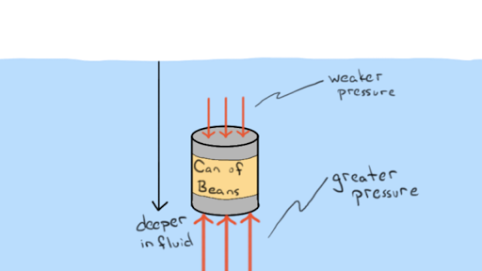
Lesson Title: Describe why objects in fluids experience upthrust
Upthrust in a liquid
Result
The variation of pressure with depth explains why there is an upwards force on a partially submerged object.
The
There is a greater pressure and therefore a greater force per unit area at the bottom of the object and therefore a net upwards force

Slide 81
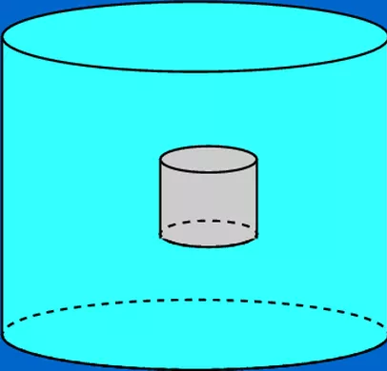
Lesson Title: Describe why objects in fluids experience upthrust
Using the equation for liquid pressure:
P = ⍴ h g and the fact, F =PA
Derive an equation for the force at the top and bottom of the object submerged in water
The
Result
Hence determine an equation for the resultant force- upthrust
h
top
x
bottom
What is your resultant upthrust force equal to?

Slide 82
Lesson Title: Describe why objects in fluids experience upthrust
Top: F = ⍴ h g A
Bottom: F = ⍴ (h + x) g A = ⍴ g A (h + x)
F = ⍴ g A h + ⍴ g A x
Resultant = ⍴ g A h + ⍴ g A x - ⍴ h g A = ⍴ g A x = ⍴ g V
= m g = W
The
Result
h
What is your resultant upthrust force equal to?
top
x
bottom

Slide 83
Learning Outcome: Describe Archimedes principle
When an object is floating what is the connection between the upthrust and weight?
Weight = upthrust
Archimedes principle:
The upthrust exerted on a body immersed in a fluid (whether fully or partially submerged) is equal to the weight of the fluid the body displaces

Slide 84
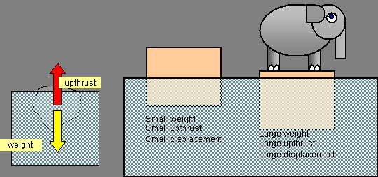
Learning Outcome: Describe Archimedes principle
Upthrust in a liquid
Notes:
Use a newtonmeter to explain how upthrust is equal to weight

Slide 85
Learning Outcome: Describe Archimedes principle
Archimedes principle key points:
Upthrust = ⍴ g A x = ⍴ g V
Upthrust = weight of the fluid the body displaces
For an object to float: Weight of object = upthrust
An object will sink if weight > upthrust
The volume of displaced fluid = volume of object submerged

Slide 86
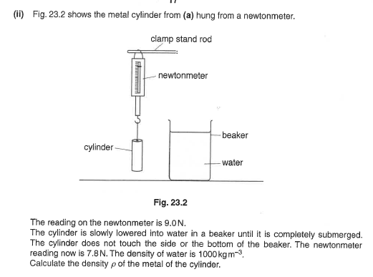
Learning Outcome: Describe Archimedes principle

Slide 87
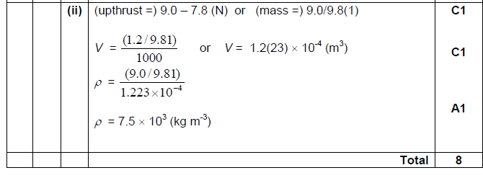
Learning Outcome: Describe Archimedes principle

Slide 88
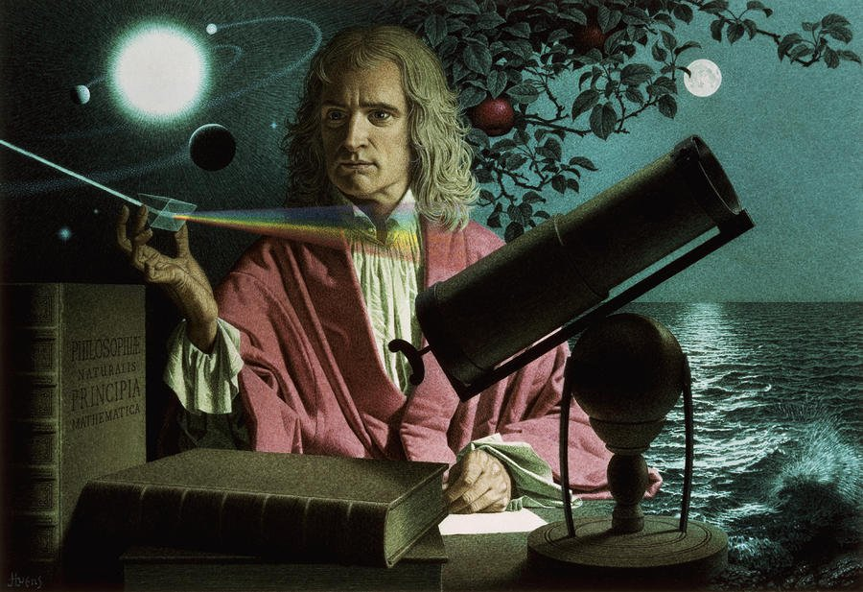
Newton’s laws and momentum

Slide 89

A-Level Physics
1. Development of practical skills in physics
2. Foundations of Physics
3. Forces and motion
4. Electrons, waves and photons
5. Newtonian world and astrophysics
6. Particles and medical physics
3.1 Motion
3.2 Forces in action
3.3. Work, energy and power
3.4. Materials
3.5. Newton’s laws and momentum
3.5.1. Newton’s laws
3.5.2. Momentum
3.5.3. Change in momentum
3.5.4. Impulse
3.5.5. Collisions in multiple dimensions

Slide 90
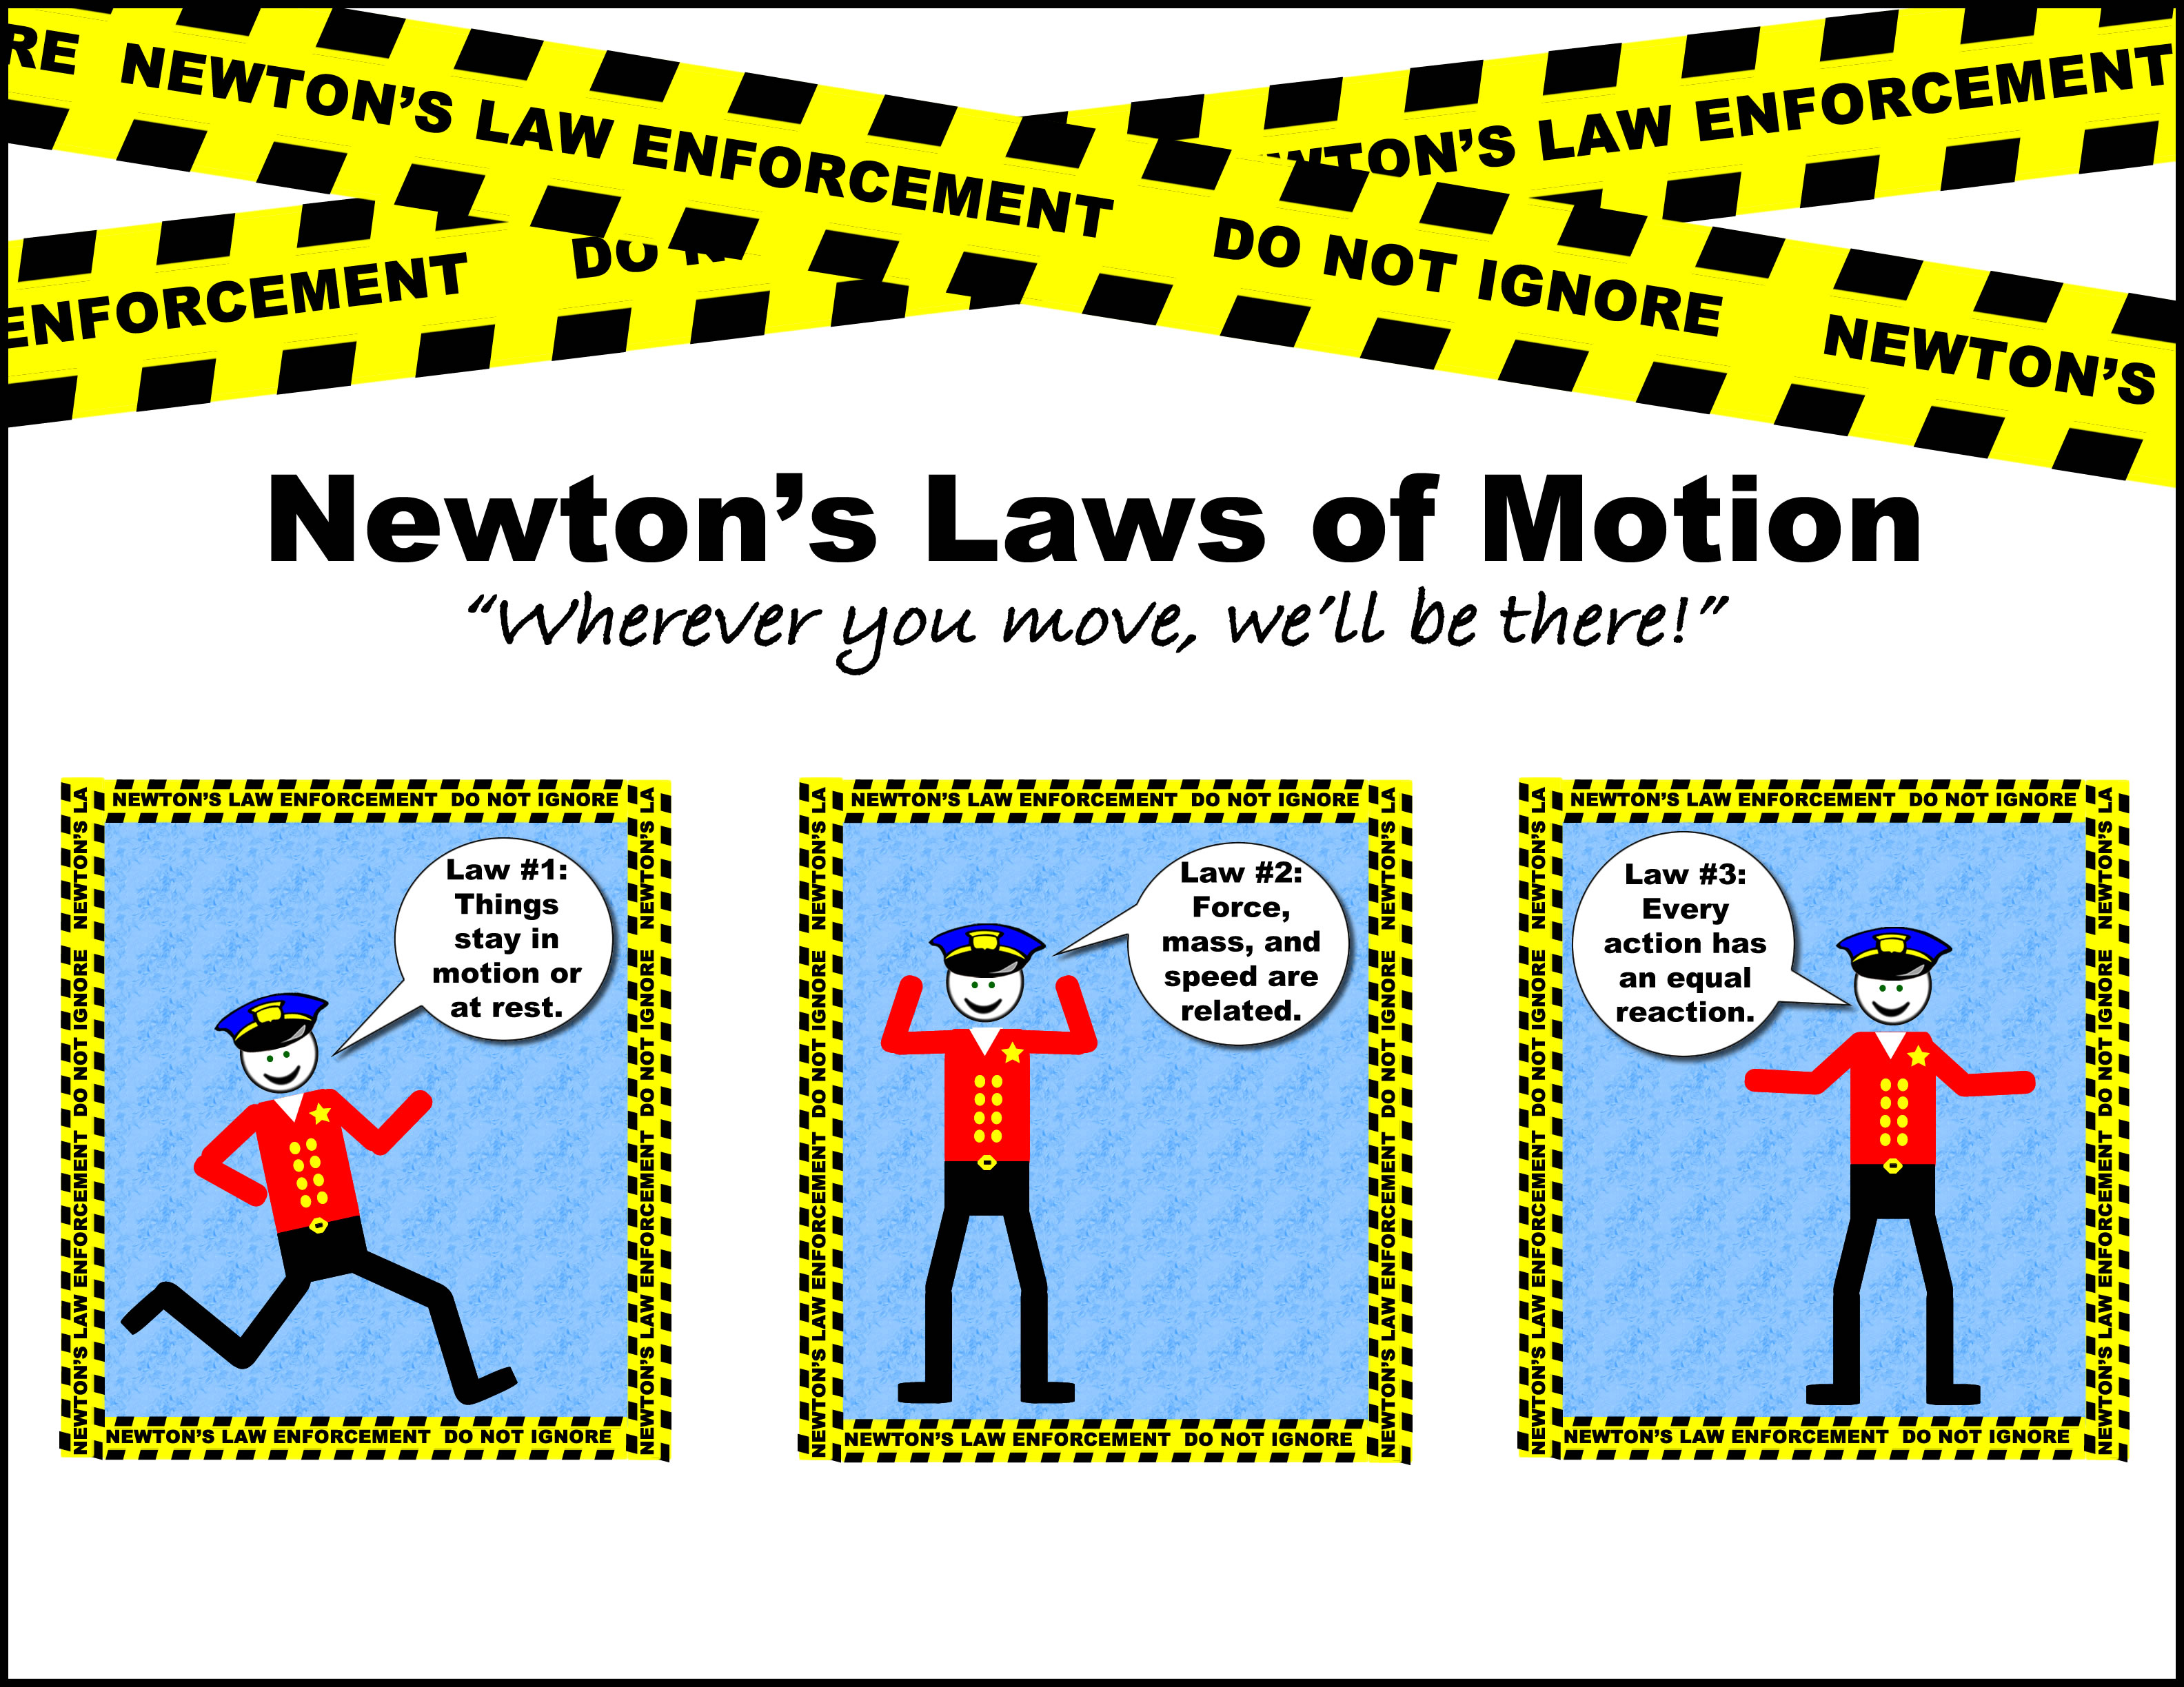
Newton’s laws
Describe Newton’s first law of motion
Describe Newton’s second law of motion
Describe Newton’s third law of motion

Slide 91
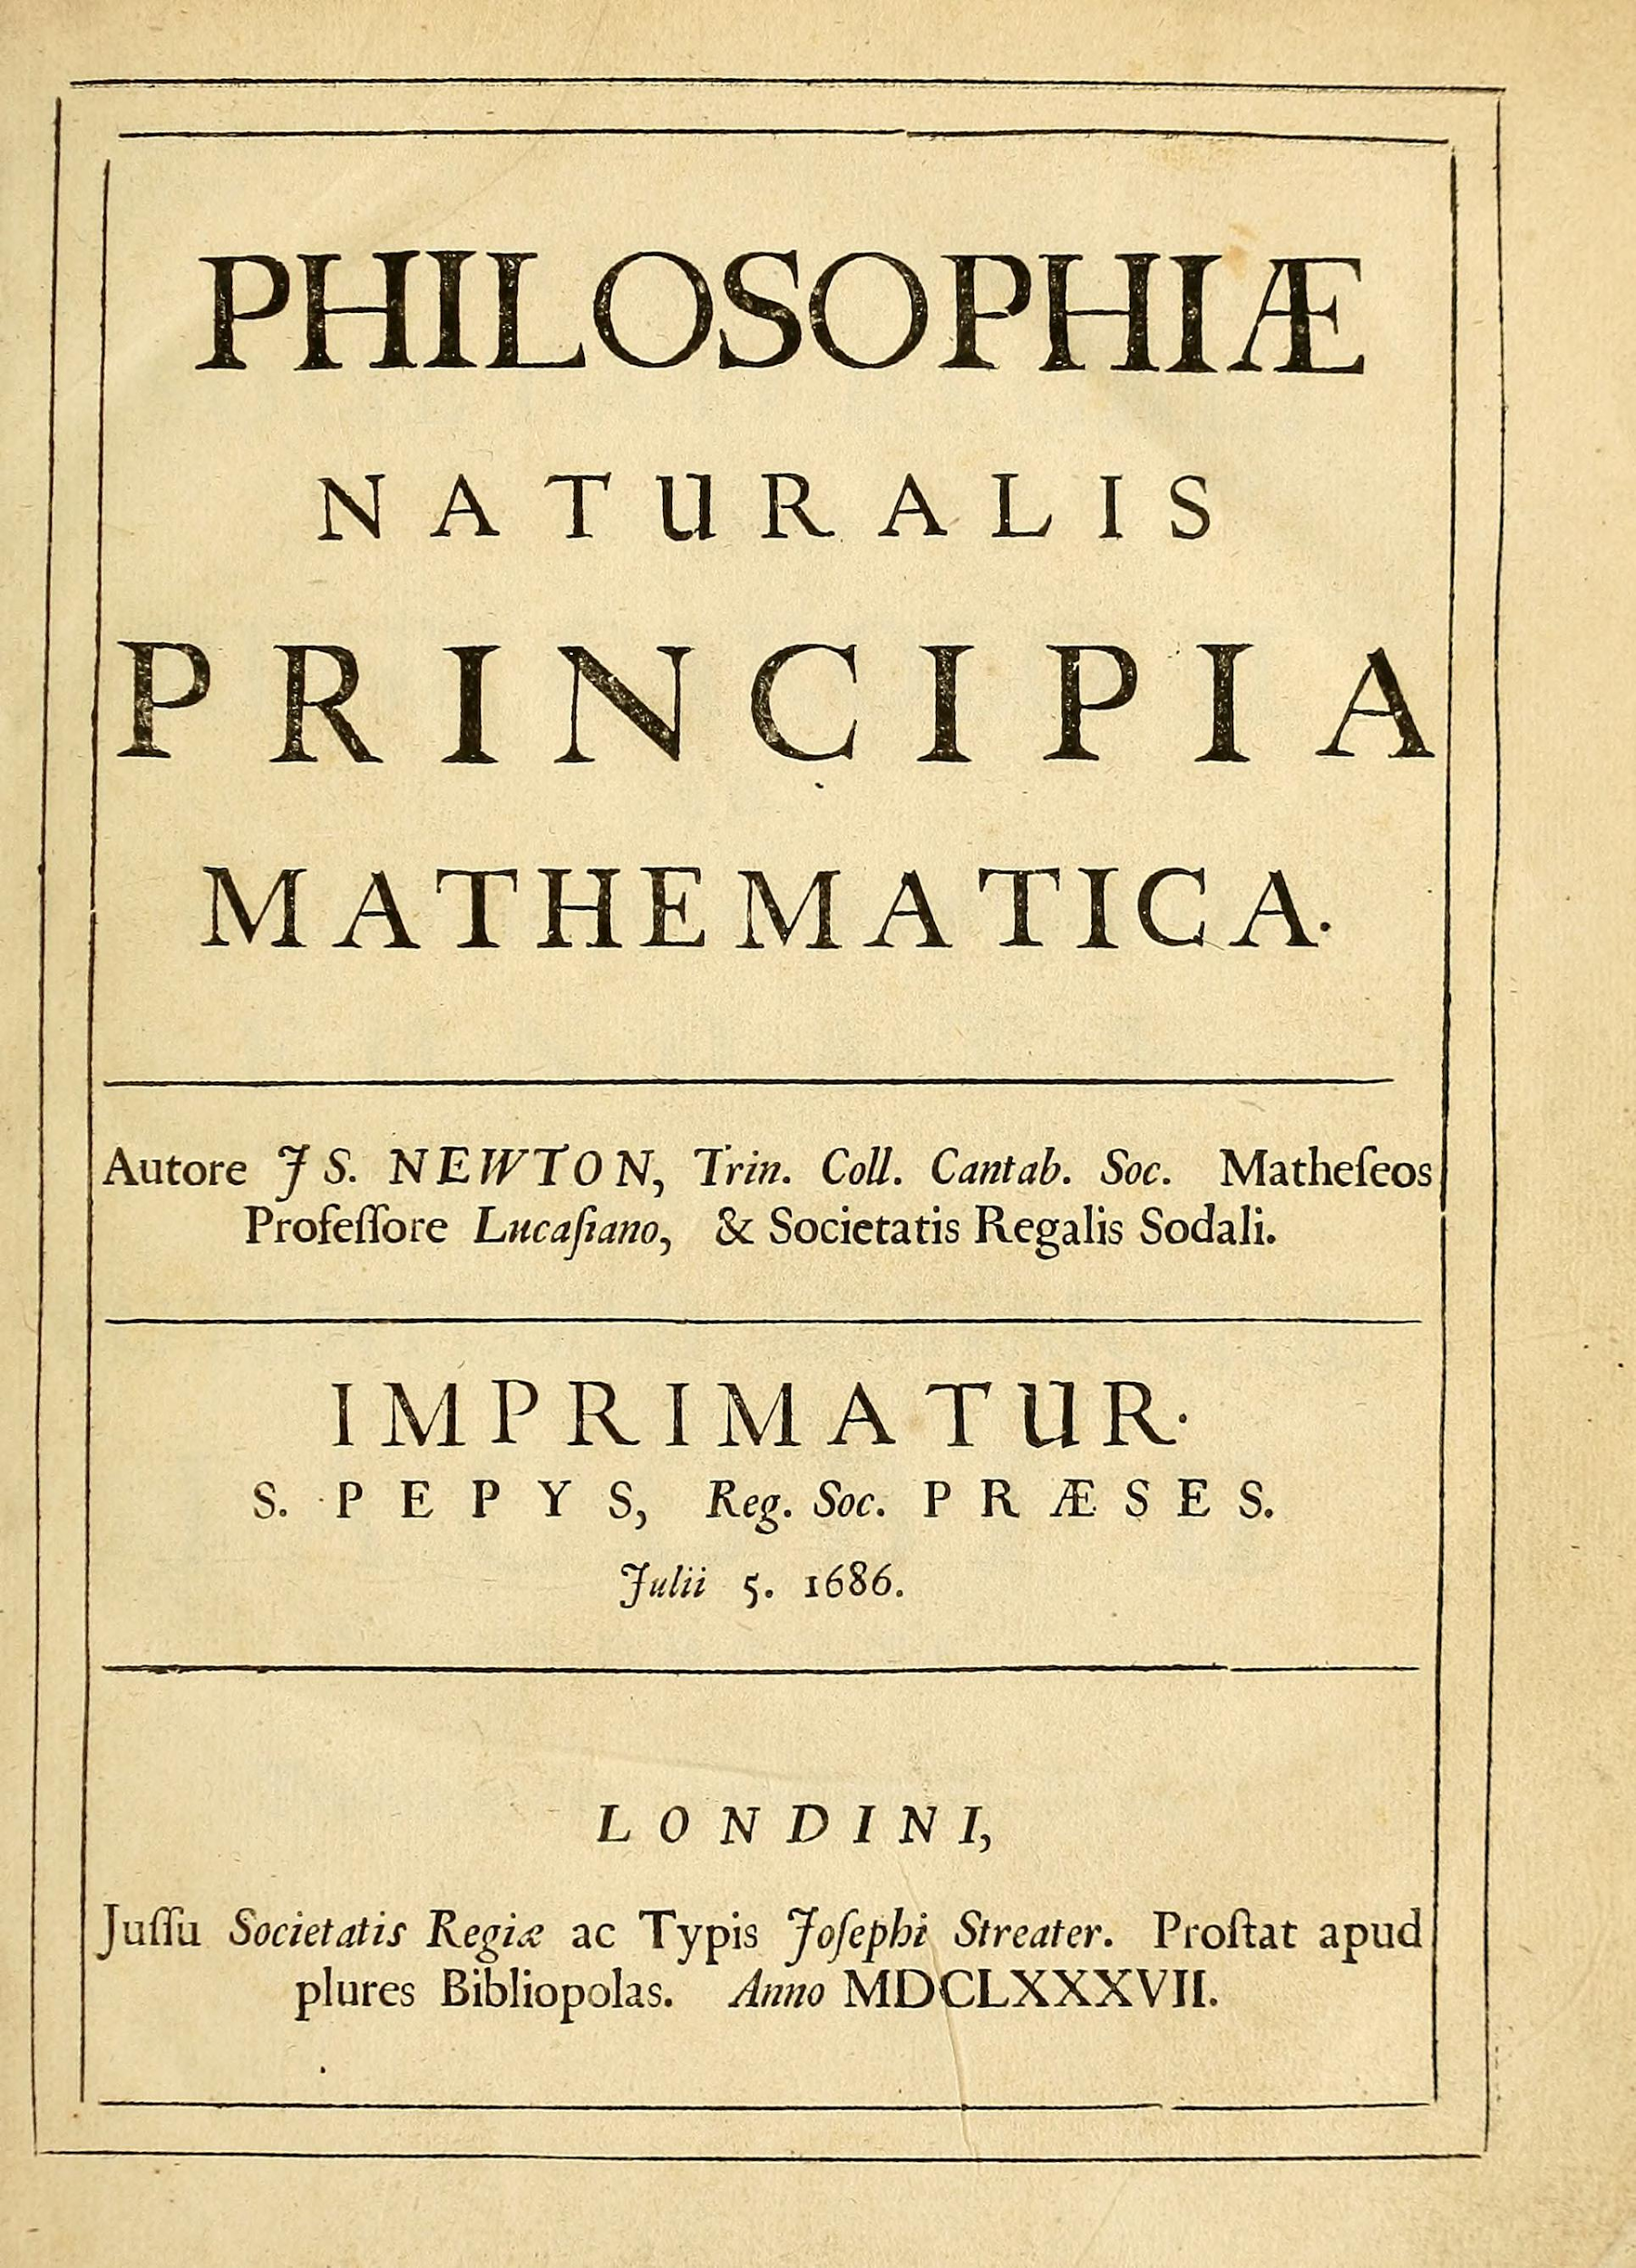
Isaac Newton wrote one of the most important science books in history, Philosophiæ Naturalis Principia Mathematica in 1687.
This book contained Newton’s Laws of Motion.
Newton’s law describe how forces change when the speed or mass of an object changes.
Notes:
All the statements illustrate Newton’s First law

Slide 92
Learning Outcome: Describe Newton’s first law of motion
First law:
An object at a constant velocity will remain at constant velocity unless acted on by an external force
An object at rest will remain at rest unless acted on by a resultant force.
An object in motion continues in motion with the same speed and in the same direction unless acted upon by a resultant force.
Notes:
All the statements illustrate Newton’s First law

Slide 93
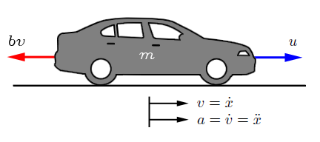
Learning Outcome: Describe Newton’s first law of motion
A car cruises steadily down the highway at 60mph. Wind resistance opposes the car’s motion with a force of 5000 N.
Intuitively is the forward force on the car less than 5000 N, equal to 5000N, or greater than 5000 N? Explain.
5000N
Forward Force = ?
The force must be 5000N if the car is at constant velocity, and therefore the resultant force is zero.
A major misconception is that a resultant forward force is necessary to keep the car travelling.

Slide 94
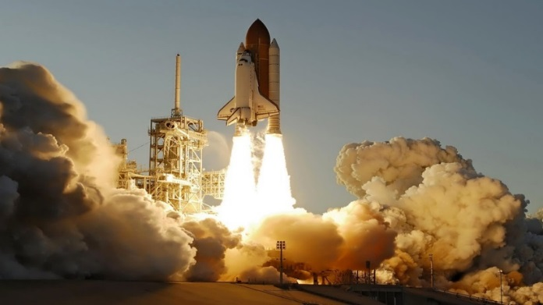
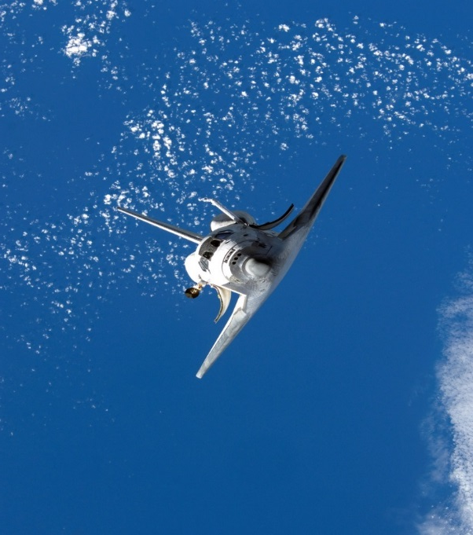
Learning Outcome: Describe Newton’s first law of motion
Space rockets are accelerated to high speed using rocket motors however once it has reached the required speed the motors are switched off. Spacecraft will continue at this constant velocity. Why?
Because there are no frictional forces in space to slow it down, the resultant force is zero, therefore the acceleration is zero and there is no change in velocity.

Slide 95
Learning Outcome: Describe Newton’s first law of motion
The key point of this is the effects of balanced and unbalanced forces.
Balanced Forces
Object at rest
v = 0 ms⁻¹
Object at Constant Velocity
Δv = 0 ms⁻¹
a = 0 ms⁻²
a = 0 ms⁻²
Stay at rest
Stay at Constant Velocity
Zero Resultant Force = Zero Acceleration

Slide 96
Learning Outcome: Describe Newton’s second law
Newton’s 2nd law
Acceleration is produced when a force acts on a mass and unbalances the forces.
The greater the mass (of the object being accelerated) the greater the amount of force needed (to accelerate the object).
Notes:
All the statements illustrate Newton’s First law

Slide 97
Learning Outcome: Describe Newton’s second law
The key point of this is the effects of balanced and unbalanced forces.
Increase in speed (Acceleration)
Change direction
a = +
Unbalanced Forces
a = -
Decrease in speed (Deceleration)
(Change shape)
Unbalanced forces cause acceleration (remember acceleration includes speed and direction)

Slide 98
Learning Outcome: Describe Newton’s second law
Acceleration is produced when a force acts on a mass and unbalances the forces.
The greater the mass (of the object being accelerated) the greater the amount of force needed (to accelerate the object).
F= m x a
Force = mass x acceleration
Notes:
All the statements illustrate Newton’s First law

Slide 99
Learning Outcome: Describe Newton’s third law
Newton’s 3rd law
Every action has an equal (in magnitude) and opposite (in direction) reaction
Must be the same size and type of force and must act on two different objects and two different directions

Slide 100
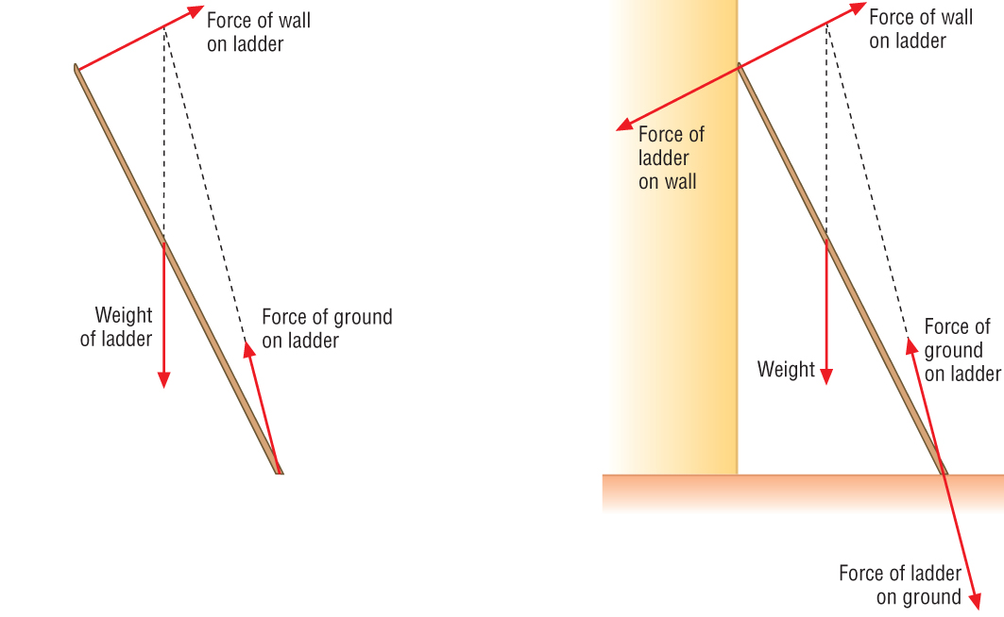
Learning Outcome: Describe Newton’s third law
Force pair on a ladder
Ladder gravitational force pulling up on Earth

Slide 101
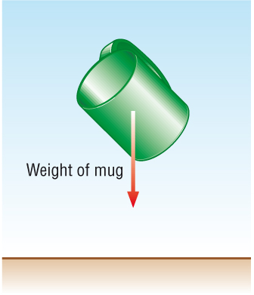
Learning Outcome: Describe Newton’s third law
Does this example conform to Newton’s 3rd Law?
Assume the mass of the cup is 0.2kg. What is the acceleration of the Earth as a result of the interaction between the Mug and Earth?
m_{Earth} a_{Earth} = m_{mug} a_{mug}
6 x 10²⁴ kg x a_{Earth} = 0.2 x 9.81
a_{Earth} = 3.26 x 10⁻²⁵ ms⁻²

Slide 102
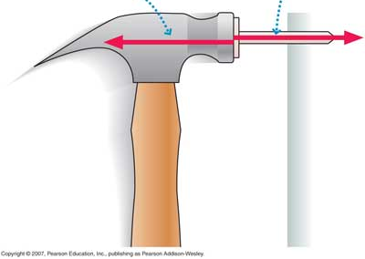
Newton’s 3rd Law
Learning Outcome: Describe Newton’s third law
630N
-75N
75N
-500N
500N
-630N
If every action has an equal (in magnitude) and opposite (in direction) reaction and balanced forces mean that an object stays at the same speed, how does anything ever move?
You need to think about the forces acting on an individual object
Consider that you observe an acceleration which is proportional to mass
From what you have learnt so far, come up with a definition for Newton’s 3rd Law.
Every action has an equal and opposite reaction.

Slide 103
A-Level Physics
1. Development of practical skills in physics
2. Foundations of Physics
3. Forces and motion
4. Electrons, waves and photons
5. Newtonian world and astrophysics
6. Particles and medical physics
3.1 Motion
3.2 Forces in action
3.3. Work, energy and power
3.4. Materials
3.5. Newton’s laws and momentum
3.5.1. Newton’s laws
3.5.2. Linear Momentum
3.5.3. Change in momentum
3.5.4. Impulse
3.5.5. Collisions in multiple dimensions

Slide 104
Linear Momentum
Define linear momentum
Calculate momentum for objects
Explain and calculate how momentum is conserved during collisions

Slide 105
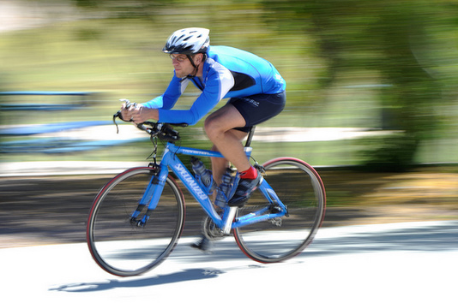

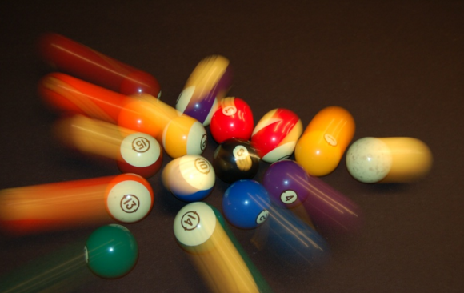
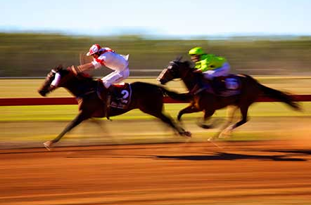
What is momentum?
Learning Outcome: Define momentum of objects
All moving objects with mass have momentum

Slide 106
What is momentum?
Learning Outcome: Define momentum of objects
The momentum of an object is dependent on the mass and velocity of the object
momentum = mass x velocity
kg m/s kg m/s
78%
0.04%
21%
As velocity is a vector quantity, so is momentum

Slide 107


Learning Outcome: Calculate momentum of objects
Which of these objects would have the greater momentum?
0.06%
0.9%
78%
0.04%
4,000 kg elephant moving at 0.25 m/s
50 kg cheetah moving at 20 m/s
21%
momentum = 4,000 x 0.25
= 1000 kg m/s
momentum = 50 x 20
= 1000 kg m/s
Notes:
They would be the same- both would be 1000 kg m/s. Shows that a large mass or large velocity will both give a large momentum

Slide 108




Learning Outcome: Calculate momentum of objects
All these objects are stationary, what is their momentum?
5 kg of books
1000 kg car
0.06%
Momentum of stationary objects is 0 kg m/s
0.9%
78%
0.04%
21%
3 kg kitten
50000 kg house
Notes:
Momentum is 0 as velocity is 0

Slide 109
Momentum and collisions
Learning Outcome: Explain how momentum is conserved during collisions
When objects collide momentum is conserved within a closed system:
“For a closed system of interacting objects, the total momentum in a specified direction remains constant, as long as no external forces act on a system”
Total momentum before = total momentum after
Notes:
Use a newton’s cradle to demonstrate this

Slide 110


Momentum and collisions
Learning Outcome: Explain how momentum is conserved during collisions
When objects collide momentum is always conserved
Total momentum before = total momentum after
Inelastic collisions
Kinetic energy is transferred to other energy sources e.g. sound, heat
e.g. car crashes
Perfectly Elastic collisions
No loss of kinetic energy
e.g. particle collisions
Notes:
Use a newton’s cradle to demonstrate this

Slide 111
Momentum and collisions
Learning Outcome: Explain how momentum is conserved during collisions
Total momentum before = total momentum after
A 800 kg car travelling at 10 m/s crashes into a 800 kg car travelling in the same direction at 5 m/s.
What is the total momentum after the collision?
Car 1 Car 2
momentum = 800 x 10 momentum = 800 x 5
= 8000 kg m/s = 4000 kg m/s
Total momentum = 8000 + 4000
= 12000 kg m/s

Slide 112
Momentum and collisions
Learning Outcome: Explain how momentum is conserved during collisions
Total momentum before = total momentum after
A 800 kg car travelling at 10 m/s west crashes into a 800 kg car travelling in the opposite direction at 5 m/s.
What is the total momentum after the collision and which direction?
Car 1 Car 2
momentum = 800 x 10 momentum = 800 x -5
= 8000 kg m/s = -4000 kg m/s
Total momentum = 8000 - 4000
= 4000 kg m/s west

Slide 113
Learning Outcome: Explain how momentum is conserved during collisions
Answer the following questions:
Two ice hockey players, Bob and Bill, are skating towards the puck. Bob has a mass of 100 kg and is travelling right at 6 m/s. Bill has a mass of 80 kg and is travelling left at 9 m/s.
Calculate the momentum of Bob and Bill
Momentum = mass x velocity
Bob Bill
momentum = 100 x 6 momentum = 80 x 9
momentum = 600 kg m/s momentum = 720 kg m/s
(right) (left)

Slide 114
Learning Outcome: Explain how momentum is conserved during collisions
Answer the following questions:
b) The two players collide and become joined together.
  Calculate the speed of the two joined players just after the collision
Total momentum before = total momentum after
Before: Bill = 720 kg m/s Bob = -600 kg m/s
(taking left as positive)
720 - 600 = 120 kg m/s
120 = mass x velocity total mass = 100 + 80 = 180 kg
120 = 180 x velocity
velocity = 120 ÷ 180= 0.68 m/s to the left

Slide 115
A-Level Physics
1. Development of practical skills in physics
2. Foundations of Physics
3. Forces and motion
4. Electrons, waves and photons
5. Newtonian world and astrophysics
6. Particles and medical physics
3.1 Motion
3.2 Forces in action
3.3. Work, energy and power
3.4. Materials
3.5. Newton’s laws and momentum
3.5.1. Newton’s laws
3.5.2. Linear Momentum
3.5.3. Change in momentum
3.5.4. Impulse
3.5.5. Collisions in multiple dimensions

Slide 116
Change in momentum
Derive an equation linking force and momentum
Calculate forces involved in momentum changes
Calculate impulse for a collision

Slide 117
Learning Outcome: Derive an equation linking force and momentum
momentum = mass x velocity
Force = mass x acceleration
Acceleration = change in velocity
Time taken
Force = change in momentum
Time taken

Slide 118

Change in momentum
Learning Outcome: Derive an equation linking force and momentum
Applying a force to an object will change its velocity and therefore also change its momentum
The change in momentum of an object is dependent on the size of the force and how long the force is applied for
0.06%
0.9%
78%
Force = Change in momentum
Time taken
0.04%
21%
Notes:
https://www.youtube.com/watch?v=R7dG9UlzeFM

Slide 119
Learning Outcome: Calculate forces involved in momentum changes
Force = Change in momentum
Time taken
momentum = mass x velocity
An elephant with a mass of 4000 kg and a velocity of 3 m/s collides with a stationary cheeter with a mass of 90 kg. Following the collision which last for 3 seconds both the cheeter and elephant move together at 2 m/s.
What was the change in momentum for the elephant during the collision?
Before: 4000 x 3 = 12000 kg m/s
After: 4000 x 2 = 8000 kg m/s
Change = 12000 – 8000 = 4000 kg m/s decrease
What was the force of the collision?
4000 / 3 = 1333 N
0.06%
0.9%
78%
0.04%
21%
Notes:
I don’t think this is in the spec any more

Slide 120
Change in momentum
Learning Outcome: Calculate impulse for a collision
Applying a force to an object will change its velocity and therefore also change its momentum
The change in momentum of an object is dependent on the size of the force and how long the force is applied for
0.06%
0.9%
78%
Force = Change in momentum
Time taken
0.04%
21%
Force x Time taken = Change in momentum
Notes:
https://www.youtube.com/watch?v=R7dG9UlzeFM

Slide 121

Learning Outcome: Calculate impulse for a collision
Force x Time taken = Impulse = Change in momentum
Units: Ns or kgms⁻¹
Impulse = area under graph
= 12,000 x 0,0007
= 8.4 Ns
Notes:
Get students to draw each other force-time graphs and work out the impulse

Slide 122
A-Level Physics
1. Development of practical skills in physics
2. Foundations of Physics
3. Forces and motion
4. Electrons, waves and photons
5. Newtonian world and astrophysics
6. Particles and medical physics
3.1 Motion
3.2 Forces in action
3.3. Work, energy and power
3.4. Materials
3.5. Newton’s laws and momentum
3.5.1. Newton’s laws
3.5.2. Linear Momentum
3.5.3. Change in momentum
3.5.4. Impulse
3.5.5. Collisions in multiple dimensions

Slide 123
Collisions in multiple dimensions
Solve collisions using vector triangles for right angled collisions
Solve collisions using vector triangles for non-right angled collisions
Solve collisions using components

Slide 124
Learning Outcome: Solve collisions using vector triangles for right angled collisions
For an oblique collision (non-head on), the objects will move away from each other at 90 degrees as long as they have the same (or very similar) mass
ρ₂
ρ₁
0.06%
0.9%
78%
0.04%
ρ₃
21%
Notes:
https://www.youtube.com/watch?v=JYhuIHQxFVo

Slide 125
Learning Outcome: Solve collisions using vector triangles for right angled collisions
For an oblique collision (non-head on), the objects will move away from each other at 90 degrees as long as they have the same (or very similar) mass
ρ₂
ρ₁
0.06%
0.9%
78%
0.04%
ρ₃
21%
Notes:
https://www.youtube.com/watch?v=JYhuIHQxFVo

Slide 126
Learning Outcome: Solve collisions using vector triangles for right angled collisions
Method 1) Arrange momentums into a vector triangle and use Pythagoras to solve
ρ₁
0.06%
0.9%
78%
0.04%
ρ₃
ρ₂
21%
Notes:
https://www.youtube.com/watch?v=JYhuIHQxFVo

Slide 127
Learning Outcome: Solve collisions using vector triangles for right angled collisions
Right angled collision: Find v
- First find the known momentums
ρ₂
160 g
170 g
v m/s
ρ₁
39°
0.9%
78%
51°
4 m/s
2.5 m/s
0.04%
ρ₃
21%

Slide 128
Learning Outcome: Solve collisions using vector triangles for right angled collisions
Right angled collision- Find v
- First find the known momentums
ρ₂ ₌ 0.17 x v = 0.17v kg m/s
160 g
170 g
v m/s
ρ₁ ₌ 0.16 x 4 = 0.64 kg m/s
78%
4 m/s
2.5 m/s
0.04%
21%
ρ₃ ₌ 0.16 x 2.5 = 0.4 kg m/s
Notes:
https://www.youtube.com/watch?v=JYhuIHQxFVo

Slide 129
Learning Outcome: Solve collisions using vector triangles for right angled collisions
Rearrange into a vector triangle where the initial momentum forms the hypotenuse
ρ₁ =0.64 kg ms⁻¹
0.06%
0.9%
78%
0.04%
21%
ρ₂ = 0.17v kg ms⁻¹
ρ₃ = 0.4 kg ms⁻¹

Slide 130
Learning Outcome: Solve collisions using vector triangles for right angled collisions
Use Pythagoras to solve the missing momentum
ρ₁ =0.64 kg ms⁻¹
0.64² – 0.4² = 0.2496
√0.2496 = 0.5
0.06%
0.9%
78%
0.04%
ρ₂ = 0.17v kg ms⁻¹
21%
ρ₃ = 0.4 kg ms⁻¹
= 0.5 kg ms⁻¹

Slide 131
Learning Outcome: Solve collisions using vector triangles for right angled collisions
Use the momentum to find the velocity
170 g
ρ₁ =0.64 kg ms⁻¹
Momentum = mass x velocity 0.5 = 0.17 v
v = 2.9 m/s
0.06%
0.9%
78%
78%
0.04%
21%
21%
ρ₃ = 0.4 kg ms⁻¹
0.5 kg ms⁻¹
Notes:
https://www.youtube.com/watch?v=JYhuIHQxFVo

Slide 132
Learning Outcome: Solve collisions using vector triangles for non-right angled collisions
Non right angled collision: Find v
- First find the known momentums as before
ρ₂
100 g
170 g
v m/s
ρ₁
28°
0.9%
78%
51°
4 m/s
2.5 m/s
0.04%
ρ₃
21%

Slide 133
Learning Outcome: Solve collisions using vector triangles for non-right angled collisions
Right angled collision- Find v
- First find the known momentums
ρ₂ ₌ 0.17 x v = 0.17v kg m/s
100 g
170 g
v m/s
ρ₁ ₌ 0.1 x 4 =
0.4 kg m/s
28°
78%
51°
4 m/s
2.5 m/s
0.04%
21%
ρ₃ ₌ 0.1 x 2.5 = 0.25 kg m/s

Slide 134
Learning Outcome: Solve collisions using vector triangles for non-right angled collisions
Rearrange into a vector triangle where the initial momentum forms the hypotenuse, and include the angles
ρ₁ =0.4 kg ms⁻¹
0.06%
28°
0.9%
78%
51°
0.04%
21%
ρ₂ = 0.17v kg ms⁻¹
ρ₃ = 0.25 kg ms⁻¹

Slide 135

Learning Outcome: Solve collisions using vector triangles for non-right angled collisions
Use sine and/or cosine rule to solve missing momentum
ρ₁ =0.64 kg ms⁻¹
Sine rule:
0.4 = ρ₂
Sin(28) sin (51)
ρ₂ = 0.66
0.06%
0.9%
78%
51°
28°
0.04%
ρ₂ = 0.17v kg ms⁻¹
21%
ρ₃ = 0.4 kg ms⁻¹
= 0.66 kg ms⁻¹

Slide 136
Learning Outcome: Solve collisions using vector triangles for non-right angled collisions
Use the momentum to find the velocity
170 g
ρ₁ =0.64 kg ms⁻¹
Momentum = mass x velocity 0.66 = 0.17 v
v = 3.88 m/s
0.06%
0.9%
78%
78%
0.04%
21%
21%
0.66 kg ms⁻¹
ρ₃ = 0.4 kg ms⁻¹
Notes:
https://www.youtube.com/watch?v=JYhuIHQxFVo

Slide 137
Learning Outcome: Solve collisions using vector triangles for right angled collisions
Method 2) Split momentums into either horizontal or vertical components as momentum is always conserved in a particular direction
y
ρ₂
θ₁
θ₂
ρ₁
0.06%
x
0.9%
78%
θ₃
θ₄
0.04%
ρ₃
21%

Slide 138
Learning Outcome: Collisions when mass is the same
As before find the known momentums. Then find either the horizontal or vertical components of these. As momentum is conserved use these components to find the missing momentum and velocity
y
v m/s
170 g
ρ₁ =0.64 kg ms⁻¹
39°
x
0.06%
51°
0.9%
78%
0.04%
Total ρ_{before x} = Total ρ_{after x}
0.64 = 0.4 cos 51 + (0.17 x v) cos 39
0.64 = 0.252 + 0.132 v
v = 2.9 m/s
ρ₃ =0.4 kg ms⁻¹
21%

