Slide 1
Exploring Physics- the experiments
Notes:
Electricity
Electro and magnetic fields and magnetism
Waves
Quantum, nuclear and particle physics
Medical physics

Slide 2
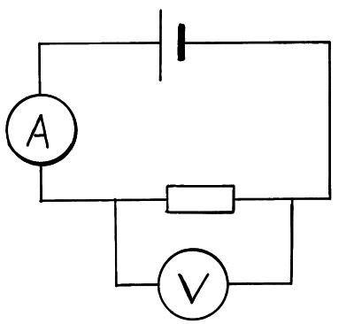
4.2.3 Electrical characteristics for ohmic and non-ohmic devices
Apparatus |  | Analysis | Plot a graph of voltage versus current If the device is ohmic, graph will show a straight line passing through the origin (showing voltage is directly proportional to current/resistance is constant). Otherwise component is non-ohmic
Method | Set up circuit and set voltage using variable power supply Record voltage (volts) and current (amps) then change voltage Record voltage and current for at least 5 different voltages | Reducing error | Repeat readings and average to increase accuracy Normal electricity health and safety

Slide 3
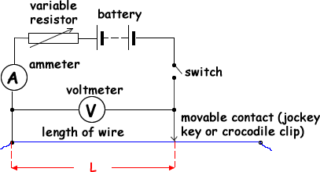
4.2.4 Determining the resistivity of a wire
Apparatus |  | Analysis | Calculate resistance and plot a graph of resistance (y) vs. length (x). Gradient is R/L Multiply gradient by cross-sectional area of wire (A) to give resistivity (ρ) As ρ=RA/l
Method | Take the current and p.d. for different lengths of wire Measure the cross-sectional area of a wire using a micrometer | Reducing error | Measure the diameter at multiple places in case wire is not perfectly cylindrical along length, and do not apply too much pressure with micrometer as this will create egg-shaped wire. Adjust variable resistor to keep low fixed current and minimise heating effect

Slide 4
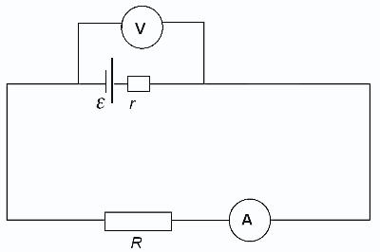
4.3.2 Finding the internal resistance of a cell
Apparatus |  | Analysis | Plot a V_{R} (y) against I (x) graph and draw best fit line: V_{R} = -Ir + ε Y = mx + c Where V_{R}=IR gradient = r (internal resistance) ε= emf (ε = IR + Ir)
Method | Connect a cell in series with a variable resistor Measure the current and terminal p.d. as variable resistor is adjusted. | Reducing error/ H&S | Repeat readings and average to increase accuracy Normal electricity health and safety

Slide 5
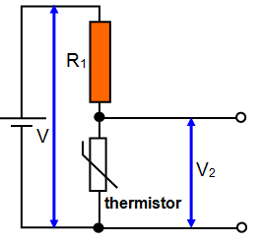
4.3.3 Investigating potential divider circuits including sensors
Apparatus |  | Analysis | Use the equation: To work out change in resistance of sensor with temperature (or other variable)
Method | e.g. for a thermistor (could also be done with a LDR and changing light) Set up circuit and record Vin (V) and Vout (V2). Change temperature of thermistor (e.g. place in temperature controlled water bath) and record Vin and Vout Repeat for 5 different temperatures | Reducing error/ H&S | Repeat readings and average to increase accuracy Normal electricity health and safety

Slide 6
4.4.1 Using an oscilloscope to find the frequency of a wave
Apparatus |  | Analysis | The frequency of the wave on the oscilloscope can be determined knowing the time base on the oscilloscope. The time base is the time taken for the luminous dot on the oscilloscope to move 1cm horizontally. The time period (T)= distance between peaks x time base f = 1/T
Method | Attach a microphone to an oscilloscope displaying a time-voltage signal Expose the microphone to soundwaves | Reducing error/ H&S | Repeat readings and find mean to reduce error The uncertainty in the measured frequency can be reduced by altering the time base so one full wave has the widest possible range in the horizontal direction

Slide 7
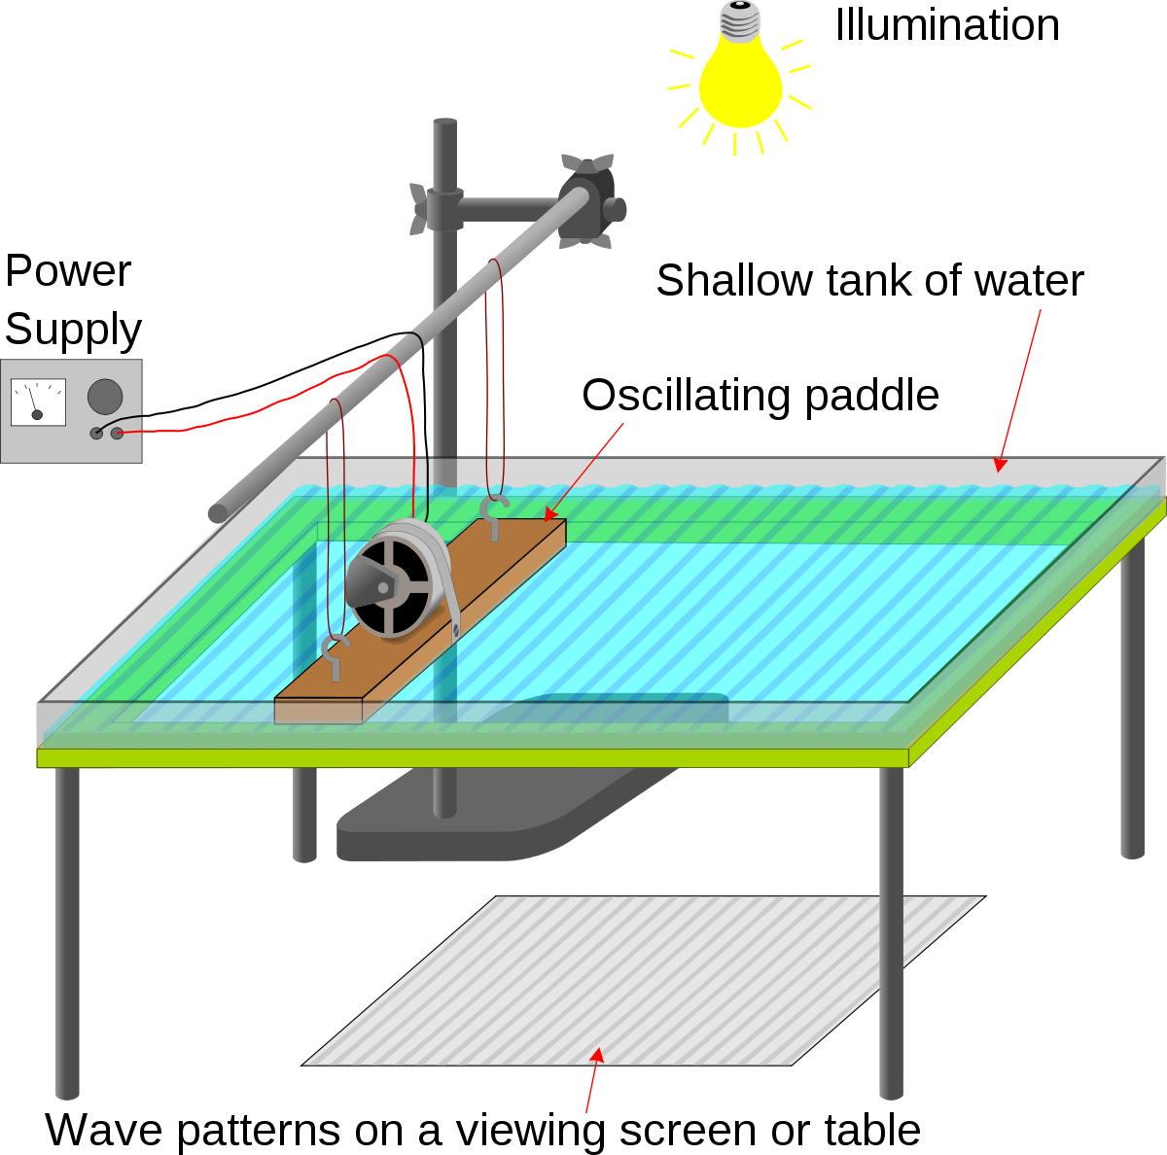
4.4.1 Investigating refraction and reflection in a ripple tank
Apparatus |  | Analysis | Reflection can be investigated by putting a straight or curved barrier in and measuring angles A glass sheet can be used to decrease water depth to change wave speed. Separation of wavefront shows that waves have slow down. If wave hits at an angle refraction occurs Can also investigate interference and diffraction by making wave go through slit(s)
Method | Motorised straight-edged bar produces plane waves while a small dipper produces circular waves Shine a light through waves to view pattern of wave crests below | Reducing error/ H&S | Make sure wave tank is level

Slide 8
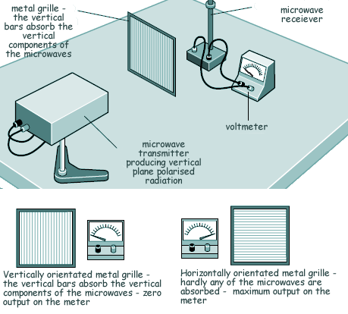
4.4.1 Observing polarisation of microwaves
Apparatus |  | Analysis | As the grille is rotated signal reception with vary and will be zero when metal rods are aligned with the electric field vector of the emitted microwaves, as all microwaves are absorbed.
Method | A microwave transmitter emits naturally polarised waves Microwave transmitter is placed in front of a receiver and rotated until a maximum signal is received by the receiver (detected using an ammeter or audio amplifier and loudspeaker) When receiver is at maximum signal position metal drill is placed between transmitter and receiver | Reducing error/ H&S | None

Slide 9
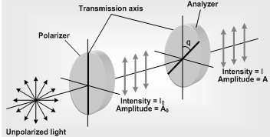
4.4.1 Investigating Maul’s Law
Apparatus |  | Analysis | The amplitude of the output ray should be Acosθ As I ∝ A² I ∝ cos²θ For a perfect filter: Mauls’ Law: I = I _{max}cos²θ I_{max}= light with analyser at 0° No light with analyser at 90° (crossed polaroids)
Method | An unpolarised light source is shone through a polariser (to polarise the light) then a analyser to change the orientation of the wave A calibrated light meter is used to measure intensity of the transmitted light as a function of a polariser angle | Reducing error/ H&S | Repeat readings and average to increase accuracy

Slide 10
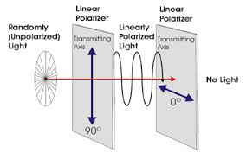
4.4.2 Observing polarisation of light
Apparatus |  | Analysis | As polariser B is rotated through different angles the intensity of transmitted light rises and falls and is a minimum when they are 90° to each other.
Method | Look through two polarising filters (A & B Rotate polariser B with respect to polariser A. | Reducing error/ H&S | None

Slide 11
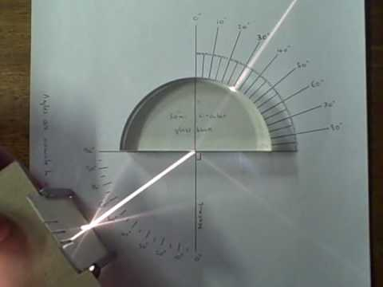
4.4.2 Determining the refractive index of a transparent semi-circular block
Apparatus |  | Analysis | Plot a graph of sinθ₁ (y) versus sinθ₂ (x) gradient = sinθ₁ = n₂ sinθ₂ n₂ As the refractive index of air is close to 1 Refractive index of block= n₂=sinθ₁ sinθ₂
Method | Shine a single light ray through the semi circular block, first going through the straight edge. Measure the angle of incidence, θ₁ and the angle of refraction, θ₂. Light does not refract as it leaves as it hits at 90° Take readings of θ₁ and θ₂over angles of θ₁ 0-80° . | Reducing error/ H&S | You will need to remove the glass block every time to join the points where the ray enters and leaves for most accurate data. Darkened room to be able to see light ray Thin light ray for accurate angles

Slide 12
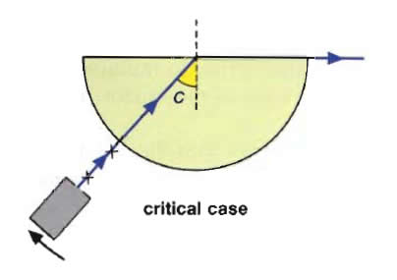
4.4.2 Determining the critical angle for a transparent material
Apparatus |  | Analysis | The angle the ray makes with the normal when it emerges along the surface is the critical angle The critical angle, C, can be used to find the refractive index, n: Sin C = 1/n
Method | Shine light source through a semi-circular block, light enters through curved edge Move the light ray around until it emerges along the surface of the boundary. | Reducing error/ H&S | Darkened room to be able to see light ray

Slide 13
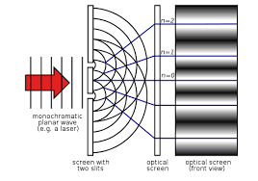
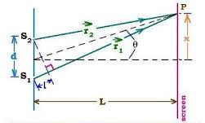
4.4.3 Determining the wavelength of light using the double slit apparatus
Apparatus |  | Analysis | As D must be much larger than a, we can assume θ to be identical and very small, therefore: sin θ = λ/a tan θ = x/D If θ is small enough sin θ = tan θ so: λ/a = x/D λ = ax/D Where x is the separation distance between two adjacent maxima
Method | A Monochromatic (single frequency) light source (or microwaves) with wavelength λ passes through two slits in a screen, distance a apart. The light needs to meet the slits in phrase. The light diffuses from each slit, effectively creating two coherent waves that will interfere with each other A screen placed distance D away will show an interference pattern of repeating bright and dark patches

Slide 14
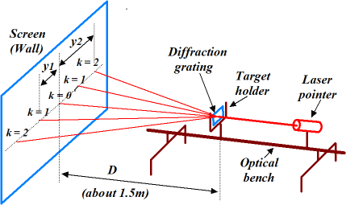
4.4.3 Measuring the wavelength of light using a diffraction grating
Apparatus |  | Analysis | All waves resulting in a maxima must be a whole number of wavelengths apart, nλ, to be in phase Wavelength can be calculated from the slit separation, d: d sin θ = nλ Where n is the order of the maximum and θ is the angle the beam makes with the grating
Method | Pass a monochromatic light source though the diffraction grating- it must arrive at each slit in phase As light passes through the diffraction grating slits it is diffracted Constructive interference occurs as wave fronts overlap causing bright maxima to appear on the screen | Reducing error/ H&S | Multiple slits in a diffraction grating improves the brightness and sharpness of maxima over the Young’s double slit method plus maxima are further apart making angles easier to measure

Slide 15
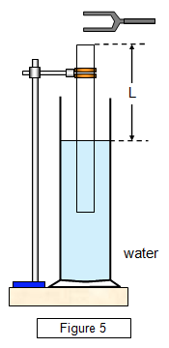
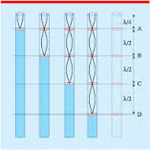
4.4.4 Measuring the speed of sound in air
Apparatus |  | Analysis | The shortest stationary wave occurs at ¼λ, the second at ¾λ the difference between these two is ½λ, so the speed of sound can be determined from multiplying this value by 2, and then by the frequency v=fλ
Method | The tube is held by a clamp and is moveable so the tube length can be altered A tuning fork of known frequency is struck and held over the open end A stationary wave is set up in the tube, as the water acts as a boundary. Listen carefully to find when the sound is loudest at the minimum tuning fork to water distance, measure L Lengthen the tube by loosening the clamp and find a second max loudness, measure L | Reducing error/ H&S | Repeat at multiple harmonics, to improve accuracy

Slide 16
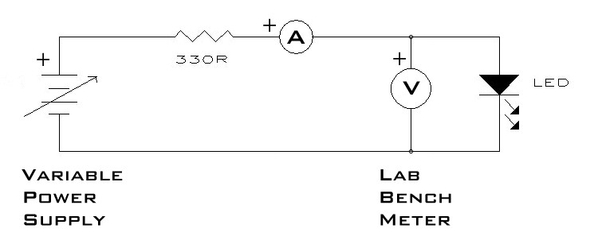
4.5.1 Using light-emitting diodes to determine a value for the Planck constant
Apparatus |  | Analysis | Plot a graph of I versus V for each LED The activation voltage is the max V before I linearly increases and the LED starts to emit photons. Activation V can be determined by extrapolating a straight line till it touches the x-axis. Plot a graph of activation V versus 1/λ. eV= hc/λ V=hc/e x 1/λ gradient = hc/e, to find h (C = speed of light, e = charge on an electron)
Method | Measure I as V is increased by adjusting a variable resistor or power supply, increase V in 0.05 steps. Repeat for other coloured LEDs each of a known wavelength | Reducing error/ H&S | Record at least 6 values for I and V for each colour LED Repeat measurements several times to repeatable result Some current might occur before the LED emits light Monitoring current is a more accurate method of determining when the LED starts light emission

Slide 17
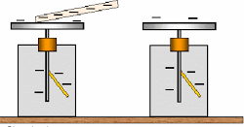
4.5.2 Demonstrating the photoelectric effect with the gold-leaf electroscope
Apparatus |  | Analysis | The metal plate loses its negative charge through emission of electrons (not caused by air ions as electroscope is in vacuum)
Method/ observations | Charged rod is placed on top plate, repelling the gold leaf When visible light or UV light is shone on a positively charged plate nothing happens, or if visible light is shone on a negatively charged plate. But, if UV light is shone on a negatively charged zinc gold plate the gold leaf falls. | Explanation | Electrons are only emitted if the incident radiation is above the threshold frequency (UV light) Emission of electrons starts as soon as the surface starts to be irradiated providing incident irradiation exceeds the threshold frequency- not connected to intensity of light but wavelength

Slide 18
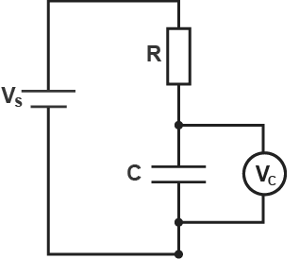
6.1.1 Investigating capacitors in series and parallel
Apparatus |  | Analysis | Check the following equations hold true Capacitors in series: 1 = 1 + 1 + 1 C C₁ C₂ C₃ Capacitors in parallel: C = C₁ + C₂ + C₃
Method | Set up circuits with capacitors in series and parallel Use previous method to obtain capacitance of each capacitor individually and of them combined | Reducing error/ H&S | Make sure the capacitors are discharged safely to avoid electric shocks

Slide 19
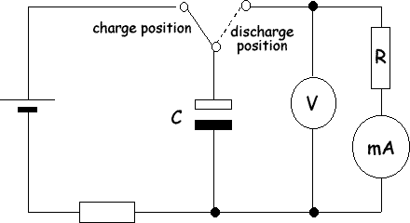
6.1.3 Investigating the way p.d. and current changes as a capacitor charges and discharges
Apparatus |  | Analysis | Plot graphs of how I and V varies as the capacitor charges and discharges
Method | Close the switch to the charge position Record I and V every 15s Switch switch to discharge position and record I and V as the capacitor discharges | Reducing error/ H&S | Using a large valued capacitor and resistor slows down the changes in the circuit so they are more easily observed Depending on C and R values more or less readings may be required to get a good graph

Slide 20
6.3.1 Investigating the magnetic flux density between the poles of a magnet
Apparatus |  | Analysis | The force experienced by the wire is given by F = BIL so B can be found if the force is measured for different values of I The change in reading on the scales gives the magnetic force according to F = mg
Method | Place a wooden spacer between two bar magnets. A uniform magnetic field will be between them Place the magnets on scales Feed a wire between the magnets and fix it in place As a current passes through the wire, measure the change in force exerted by the magnets on the scales | Reducing error/ H&S | Repeat readings and average to increase accuracy Normal electricity health and safety
ammeter
scales
Variable DC supply

Slide 21
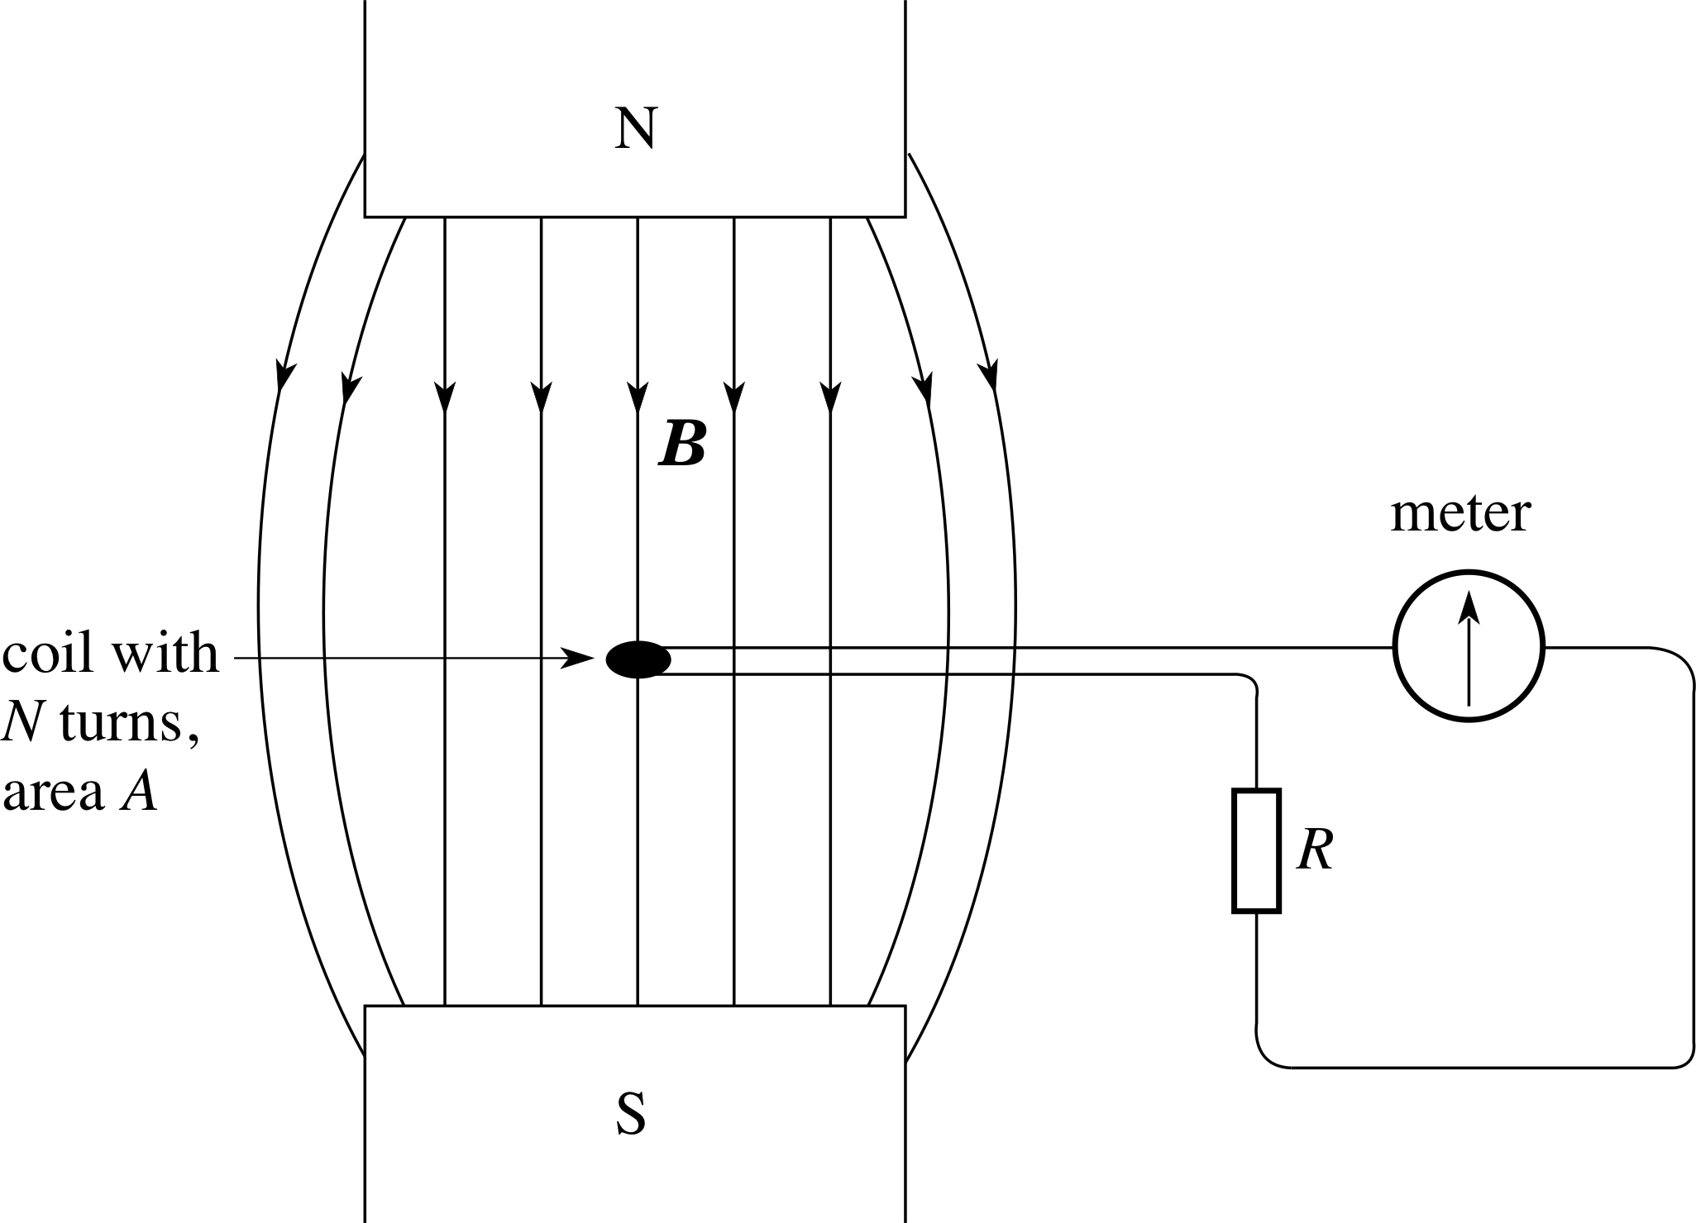
6.3.3 Measuring magnetic field strength using a search coil
Apparatus |  | Analysis | ε = BAN Δt I = ε = BAN R RΔt Q = IΔt Q = BAN R B = AN QR Therefore by measuring Q, B can be found
Method | Place a small, flat coil with a known number of turns N in a magnetic field. Starting at right angles to the field lines, rapidly rotate the coil a quarter turn The magnetic flux linking the coil falls from BAN to zero and an e.m.f. is induced in the coil | Reducing error/ H&S | Repeat readings and average to increase accuracy Normal electricity health and safety The coil must be small enough so that B can be considered constant over the area

Slide 22
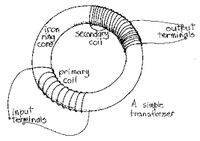
6.3.3 Investigating the action of a transformer
Apparatus |  | Analysis | Plot a graph to see if the following relationship is true: N_{s} = V_{s} N_{p} V_{p}
Method | Make a transformer using two 1m lengths of insulated copper wire and an iron core Wrap 20 coils around for both the primary and secondary coil Connect the primary coil to a 2V a.c. power supply Measure the primary and secondary voltages Change the number of coils on the secondary coil and record the new primary and secondary voltages | Reducing error/ H&S | When you change the number of turns of wire on each coil, the total length should remain constant so its resistance doesn’t change

Slide 23
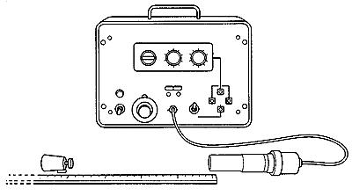
6.4.3 Investigating the absorption of alpha particles, beta particles and gamma rays
Apparatus |  | Analysis | Background count must be subtracted from all recorded count rates
Method | A Geiger-Muller tube and counter can be used to detect radiation passing through sheets of different materials placed between the source and the tube Use paper and aluminium foils and pieces of lead of different thickness to investigate what thickness of each material stops each type of radiation | Reducing error/ H&S | Follow safety precautions for handling radioactive materials. Do not point them at people, store them in a lead lined container until required, do not handle sources with hands

Slide 24
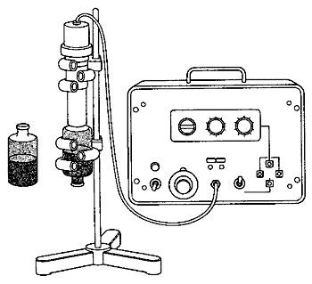
6.4.3 Determining the half-life of protactinium
Apparatus |  | Analysis | Determine the half life of protactinium-234 by monitoring its decay using a Geiger Background count must be subtracted from all recorded count rates
Method | The bottle contains a solution of a uranium salt, and some daughter and granddaughter products (thorium-234 and protactinium-234 respectively). Bottle also contains an immiscible solvent which floats on top- the protactinium is dissolvable in this. When the bottle is shaken the protactinium-234 dissolves in the oily solvent. The decay of a fixed amount of protactinium-234 can be monitored from the beta radiation it emits.(Alpha particles emitted by uranium are absorbed by the plastic) | Reducing error/ H&S | Follow safety precautions for handling radioactive materials. Do not point them at people, store them in a lead lined container until required, do not handle sources with hands Ensure the generator (plastic bottle) is undamaged- do not attempt to open it. Handle it only to gently shake and keep it over the tray at all times

Slide 25
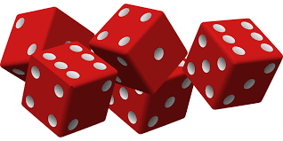
6.4.3 Simulation of radioactive decay using dice
Apparatus |  | Analysis | Plot a graph of time versus number of dice left undecayed - this should be an exponential, the decay constant can then be constant
Method | Each die represents a radioactive atom Rolling a 6 means that atom has decayed Roll all the dice and write down how many have decayed, remove the dice (they can’t decay again!) Continue rolling with each dice rolling representing a time interval Continue until there are not dice or at least 10 throws | Reducing error/ H&S | The larger number of dice the better shaped for the exponential decay (ideally about 100)

