Slide 1
Energy types and transfers summary sheet
Equations
Write down the equations containing the following variables, include the word and the symbol versions and include the standard units
Useful energy, total energy, efficiency
Energy transferred, power, time
Gravitational potential energy, height, gravitational field strength (g) and mass
Kinetic energy, velocity (speed), mass
Elastic energy, spring constant, extension
Types of energy stores and transfers
Write down the eight forms of energy stores and give an example of each
Describe the 4 methods by which energy can be transferred between stores
State the law of conservation of energy
Describe what is meant by the efficiency of an energy transfer and give an example of calculating this
Work and Power
Describe how you can calculate power and give an example

Slide 2
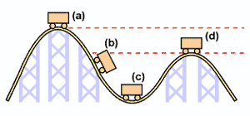
Energy types and transfers summary sheet
Gravitational energy and kinetic energy
Describe what gravitational potential is
Describe what kinetic energy is
On the below diagram label where the gravitational energy is highest and the kinetic energy is highest
Elastic energy
Describe what is meant by elastic energy
Describe what is meant by a spring constant

