Slide 1
GCSE Physics in a nutshell
Magnetism

Slide 2
GCSE Physics in a nutshell
Y11 Magnetism- equations overview
You are given these equations:
Force on a conductor (at right angles to a magnetic field) carrying a current = magnetic flux density x current x length | F=BIL
p.d. across primary coil = number of turns in primary coil p.d. across secondary coil number of turns in secondary coil | Vp = np Vs ns
p.d. across primary coil x current in primary coil = p.d. across secondary coil x current in secondary coil | Vp Ip = Vs Is

Slide 3
GCSE Physics in a nutshell
Y11 magnetism- Revision videos Magnetic fields: https://www.youtube.com/watch?v=3elpPfyHV0E Permanent and induced magnetism: https://www.youtube.com/watch?v=bOZ2Hk2hKLE Electromagnets: https://www.youtube.com/watch?v=79_SF5AZtzo Motors: https://www.youtube.com/watch?v=ltpPhpi-CC4 Generators: https://www.youtube.com/watch?v=pkzY7QfTowM Transformers: https://www.youtube.com/watch?v=7RtBUEZbKmI

Slide 4
GCSE Physics
Physics
1. Energy
2. Electricity
3. Particles
4. Atomic structure and radioactivity
5. Waves
6. Forces
7. Magnetism and electromagnetism
8. Space Physics
7.1. Magnetism
7.2. Electromagnetism
7.1.1 Magnets and magnetic fields

Slide 5
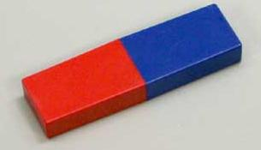
How do magnets interact?
Learning Outcome: Describe the properties of magnets
All magnets have two poles
These poles can attract (if opposite) or repel (if the same)
South
North
Permanent magnets
Once magnetised it will always be magnetic.
Steel is a permanent magnet.
Temporary magnets
Will only be magnetic for a short period of time when it is in a magnetic field.
Iron is a temporary magnet
Notes:
Give students magnets to investigate with at this point

Slide 6
Magnetic Induction
Learning Outcome: Describe the properties of magnets
Permanent Magnets can be used to “induce” a magnetic field in a temporary magnet
“Induction” means to create.
Non-magnetised
Magnetised
Magnetic dipoles randomly aligned
Magnetic dipoles aligned in same direction

Slide 7
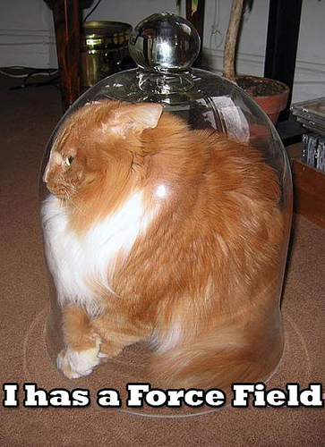
Learning Outcome: Describe and draw the magnetic fields around magnets
What is a magnetic field?
A magnetic field is the area around a magnet where the magnetic force (either repulsion or attraction) from a magnet has an effect

Slide 8
What does a magnetic field look like?
Learning Outcome: Observe and draw the magnetic fields around magnets
You can use a plotting compass or iron filings to detect a magnetic field:
Put a piece of paper over a magnet (this stops the iron filings sticking to the magnet)
Sprinkle iron filings onto the paper
Gently tap the paper to spread the filings out
Draw a sketch of the results

Slide 9
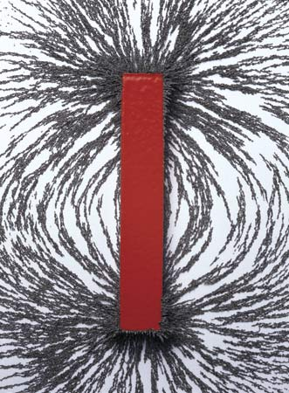
Learning Outcome: Observe and draw the magnetic fields around magnets

Slide 10
Learning Outcome: Observe and draw the magnetic fields around magnets
Use a compass to plot the magnetic field lines around a magnet
Place a compass at the north pole of the magnet (the south end of the compass will point to this) then mark on where the north end of the compass is pointing to.
Move your compass so the south end of your compass is aligned where the north end was pointing and mark on the new position that the north end is pointing

Slide 11
Learning Outcome: Observe and draw the magnetic fields around magnets
Field lines go out of the north and into the south. They are most concentrated at the poles. Closer together lines means the field is stronger.

Slide 12
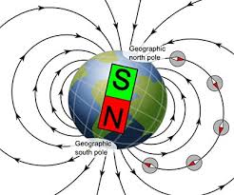
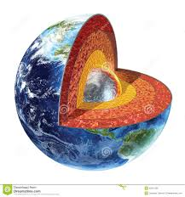
The Earth’s magnetic field is caused by rotation of the Earth’s iron core
The Earth’s magnetic field is important as it protects life from harmful radiation from the sun
Learning Outcome: Describe and draw the magnetic fields around magnets

Slide 13
Learning Outcome: Apply magnetic fields to multiple magnets

Slide 14
Learning Outcome: Apply magnetic fields to multiple magnets

Slide 15
GCSE Physics
Physics
1. Energy
2. Electricity
3. Particles
4. Atomic structure and radioactivity
5. Waves
6. Forces
7. Magnetism and electromagnetism
8. Space Physics
7.2.1 Electromagnetism
7.2.1 Electromagnetic forces
7.2.3 Motors
7.2.5 Electromagnetic induction
7.2.4 Uses of electromagnetism
7.2.5 Transformers and the national grid
7.1. Magnetism
7.2. Electromagnetism

Slide 16
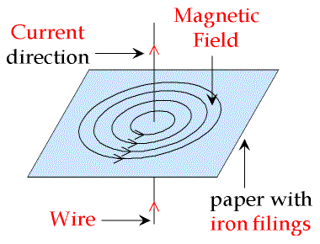
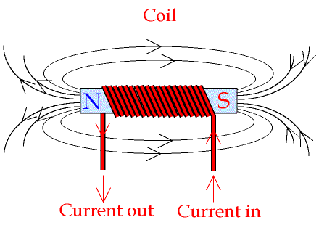
Electromagnetic Induction
Learning Outcome: Describe the magnetic field around a wire carrying a current and a solenoid
Electricity passing through a wire will induce a temporary magnetic field around it.
This is an electromagnet.
The strength of the magnetic field is enhanced by coiling the wire- this is called a solenoid

Slide 17
GCSE Physics
Physics
1. Energy
2. Electricity
3. Particles
4. Atomic structure and radioactivity
5. Waves
6. Forces
7. Magnetism and electromagnetism
8. Space Physics
7.2.1 Electromagnetism
7.2.1 Electromagnetic forces
7.2.3 Motors
7.2.5 Electromagnetic induction
7.2.4 Uses of electromagnetism
7.2.5 Transformers and the national grid
7.1. Magnetism
7.2. Electromagnetism

Slide 18
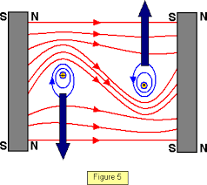
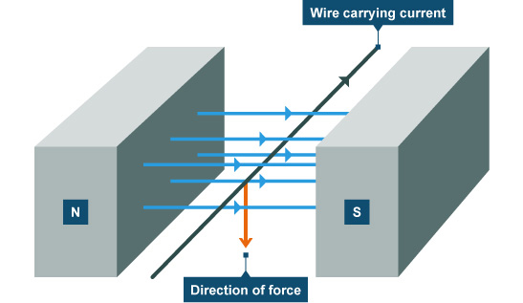
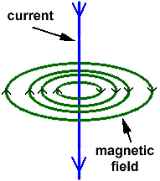
Learning Outcome: Describe how a magnet and a wire carrying a current (electromagnet) exert a force on each other
Magnetic forces
As a wire carrying a current creates a magnetic field around it.
A wire carrying a current placed in a magnetic field will also experience a force as the fields interact
This creates a catapult field
+
Notes:
Include a demo of how a force is created when an electromagnet is placed into a magnetic field. Video showing this effect: https://www.youtube.com/watch?v=F1PWnu01IQg

Slide 19
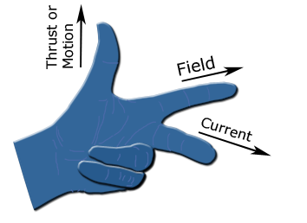
Fleming’s left hand rule
Learning Outcome: Use Fleming’s left hand rule to represent the direction of the force, current and magnetic field
Fleming’s left hand rule can be used to predict the direction of the motion of the wire caused by the force
First finger
ThuMb
SeCond finger

Slide 20
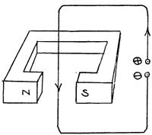
Fleming’s left hand rule
Learning Outcome: Use Fleming’s left hand rule to represent the direction of the force, current and magnetic field
Fleming’s left hand rule can be used to predict the direction of the motion of the wire caused by the force
What would be the direction of motion for this wire
Notes:
Do this one together as a class

Slide 21
Calculating the force
Learning Outcome: Apply an equation linking force, magnetic flux density, current and wire length
The force (N) experienced by a current carrying wire placed in a magnetic field depends on:
The strength of the magnetic field (magnetic flux density)
The current (A) the wire is carrying
The length (m) of the wire in the field
Force on = Magnetic flux x current (A) x length (m)
wire (N) density (T)

Slide 22
Calculating the force
Learning Outcome: Apply an equation linking force, magnetic flux density, current and wire length
Force on = Magnetic flux x current (A) x length (m)
wire (N) density (T)
If this wire is carrying a current of 2 A, through a magnetic flux density of 0.2 T over 0.1 m. What would be the force experienced by the wire?
0.04 N

Slide 23
GCSE Physics
Physics
1. Energy
2. Electricity
3. Particles
4. Atomic structure and radioactivity
5. Waves
6. Forces
7. Magnetism and electromagnetism
8. Space Physics
7.2.1 Electromagnetism
7.2.1 Electromagnetic forces
7.2.3 Motors
7.2.5 Electromagnetic induction
7.2.4 Uses of electromagnetism
7.2.5 Transformers and the national grid
7.1. Magnetism
7.2. Electromagnetism

Slide 24
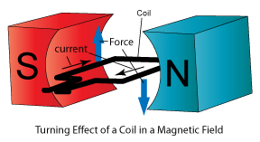
Learning Outcome: Describe why a coil of wire in a magnetic field will rotate
If a coil of wire with a current flowing through it is place in a magnetic field one side will move down while the other side will move up
First finger
ThuMb
SeCond finger
Notes:
Activity to review all magnetic fields learnt so far- useful as students will need this to understand “catapult fields”. Could alternatively just get students to draw different fields on whiteboards- depends how well starter activity goes

Slide 25
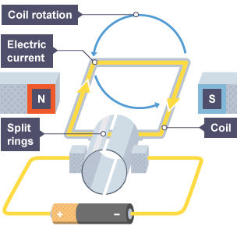
Learning Outcome: Explain how a motor rotates
Explain how an electric motor works?
-A current flows through a coil of wire in between two magnets
-A magnetic field is created around the coil
-The magnetic field interacts with the magnetic field of the permanent magnets
-This creates a force that is in opposite directions on either side of the coil making the coil spin according to Flemings left hand rule
-The split ring keeps the current going in the same direction
-So the direction of force remains the same and the coil keeps rotating

Slide 26
GCSE Physics
Physics
1. Energy
2. Electricity
3. Particles
4. Atomic structure and radioactivity
5. Waves
6. Forces
7. Magnetism and electromagnetism
8. Space Physics
7.2.1 Electromagnetism
7.2.1 Electromagnetic forces
7.2.3 Motors
7.2.5 Electromagnetic induction
7.2.4 Uses of electromagnetism
7.2.5 Transformers and the national grid
7.1. Magnetism
7.2. Electromagnetism

Slide 27
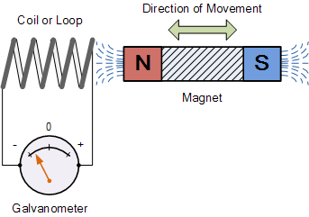
Learning Outcome: Describe what electromagnetic induction is
c
What is electromagnetic induction
When a wire is moved through a magnetic field or a magnetic field changes around a wire a potential difference is induced which causes a current to flow through the wire
Notes:
Demo of this with Helmholtz coils and Galvanometer, student practical using neodynium magnets, voltmeters and copper coiled wire

Slide 28
Learning Outcome: Explain how you could increase the induced potential difference
What is electromagnetic induction
How do you think you could increase the induced potential difference?
Moving the magnet quicker
Use a stronger magnet
Use more coils
Notes:
Practical to show this?

Slide 29
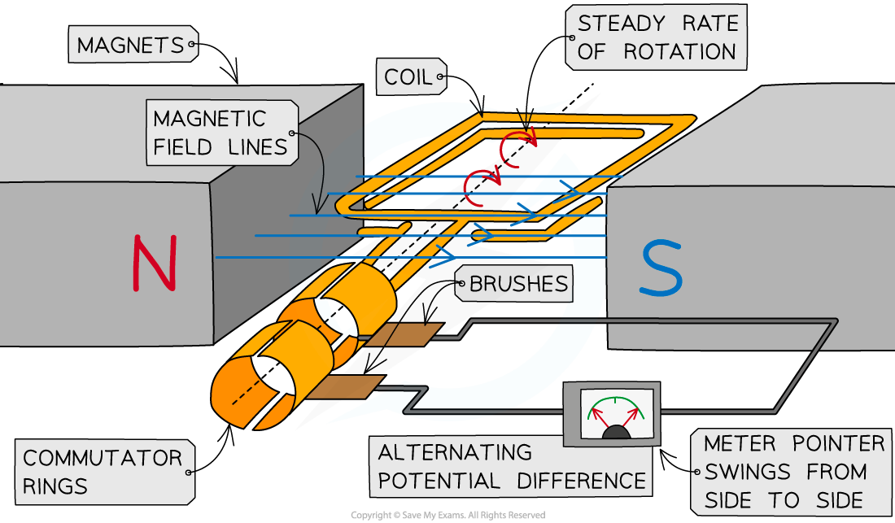
Generators- alternator
Learning Outcome: Describe how types of generator work
The coil moves through the magnetic field cutting magnetic field lines
A potential difference is induced (across the coil)
There is a complete circuit, so a current is induced (in the coil)
Every half turn the potential difference reverses direction as the coil cuts through the magnetic field in the opposite direction
So (every half turn) the current changes direction creating an alternating current
1
Notes:
Give students magnets to investigate with at this point

Slide 30
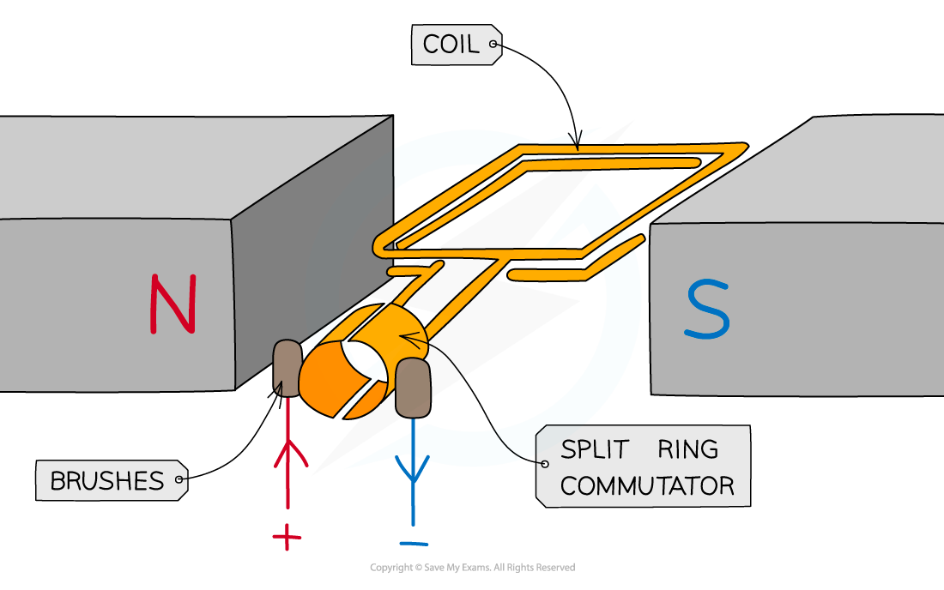
Generators- dynamo
Learning Outcome: Describe how types of generator work
The coil moves through the magnetic field cutting magnetic field lines
A potential difference is induced (across the coil)
There is a complete circuit, so a current is induced (in the coil)
Every half turn the potential difference reverses direction as the coil cuts through the magnetic field in the opposite direction
But the split ring keeps the current always flowing in the same direction on the same side creating a direct current
Notes:
Give students magnets to investigate with at this point

Slide 31
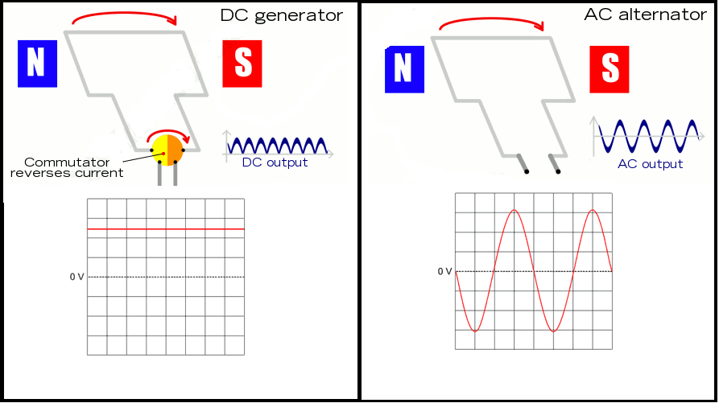
Learning Outcome: Describe how types of generator work

Slide 32
GCSE Physics
Physics
7.2.1 Electromagnetism
7.2.1 Electromagnetic forces
7.2.3 Motors
7.2.5 Electromagnetic induction
7.2.4 Uses of electromagnetism
7.2.5 Transformers and the national grid
1. Energy
2. Electricity
3. Particles
4. Atomic structure and radioactivity
5. Waves
6. Forces
7. Magnetism and electromagnetism
8. Space Physics
7.2.1 Electromagnetism
7.2.2 Electromagnetic forces
7.2.3 Electromagnetic induction
7.2.4 Uses of electromagnetism
7.2.5 Magnets and the national grid
7.1. Magnetism
7.2. Electromagnetism

Slide 33
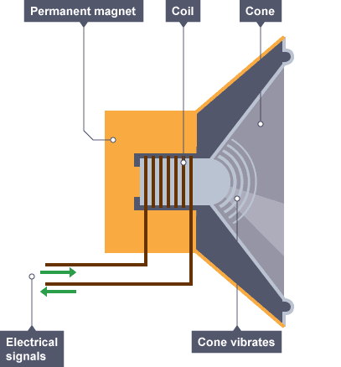
Loudspeakers
Learning Outcome: Use the motor effect to explain how a loudspeaker works
An alternating current through the wire coil creates a magnetic field (around the coil)
The induced magnetic field around the coil interacts with the permanent magnet field
This produces a (resultant) force causing the coil/cone to move
As the direction of the current reverses, the direction of the (resultant) force reverses
As this happens multiple times a second the cone vibrates producing pressure variations in the air and therefore a sound wave
Notes:
Give students magnets to investigate with at this point

Slide 34
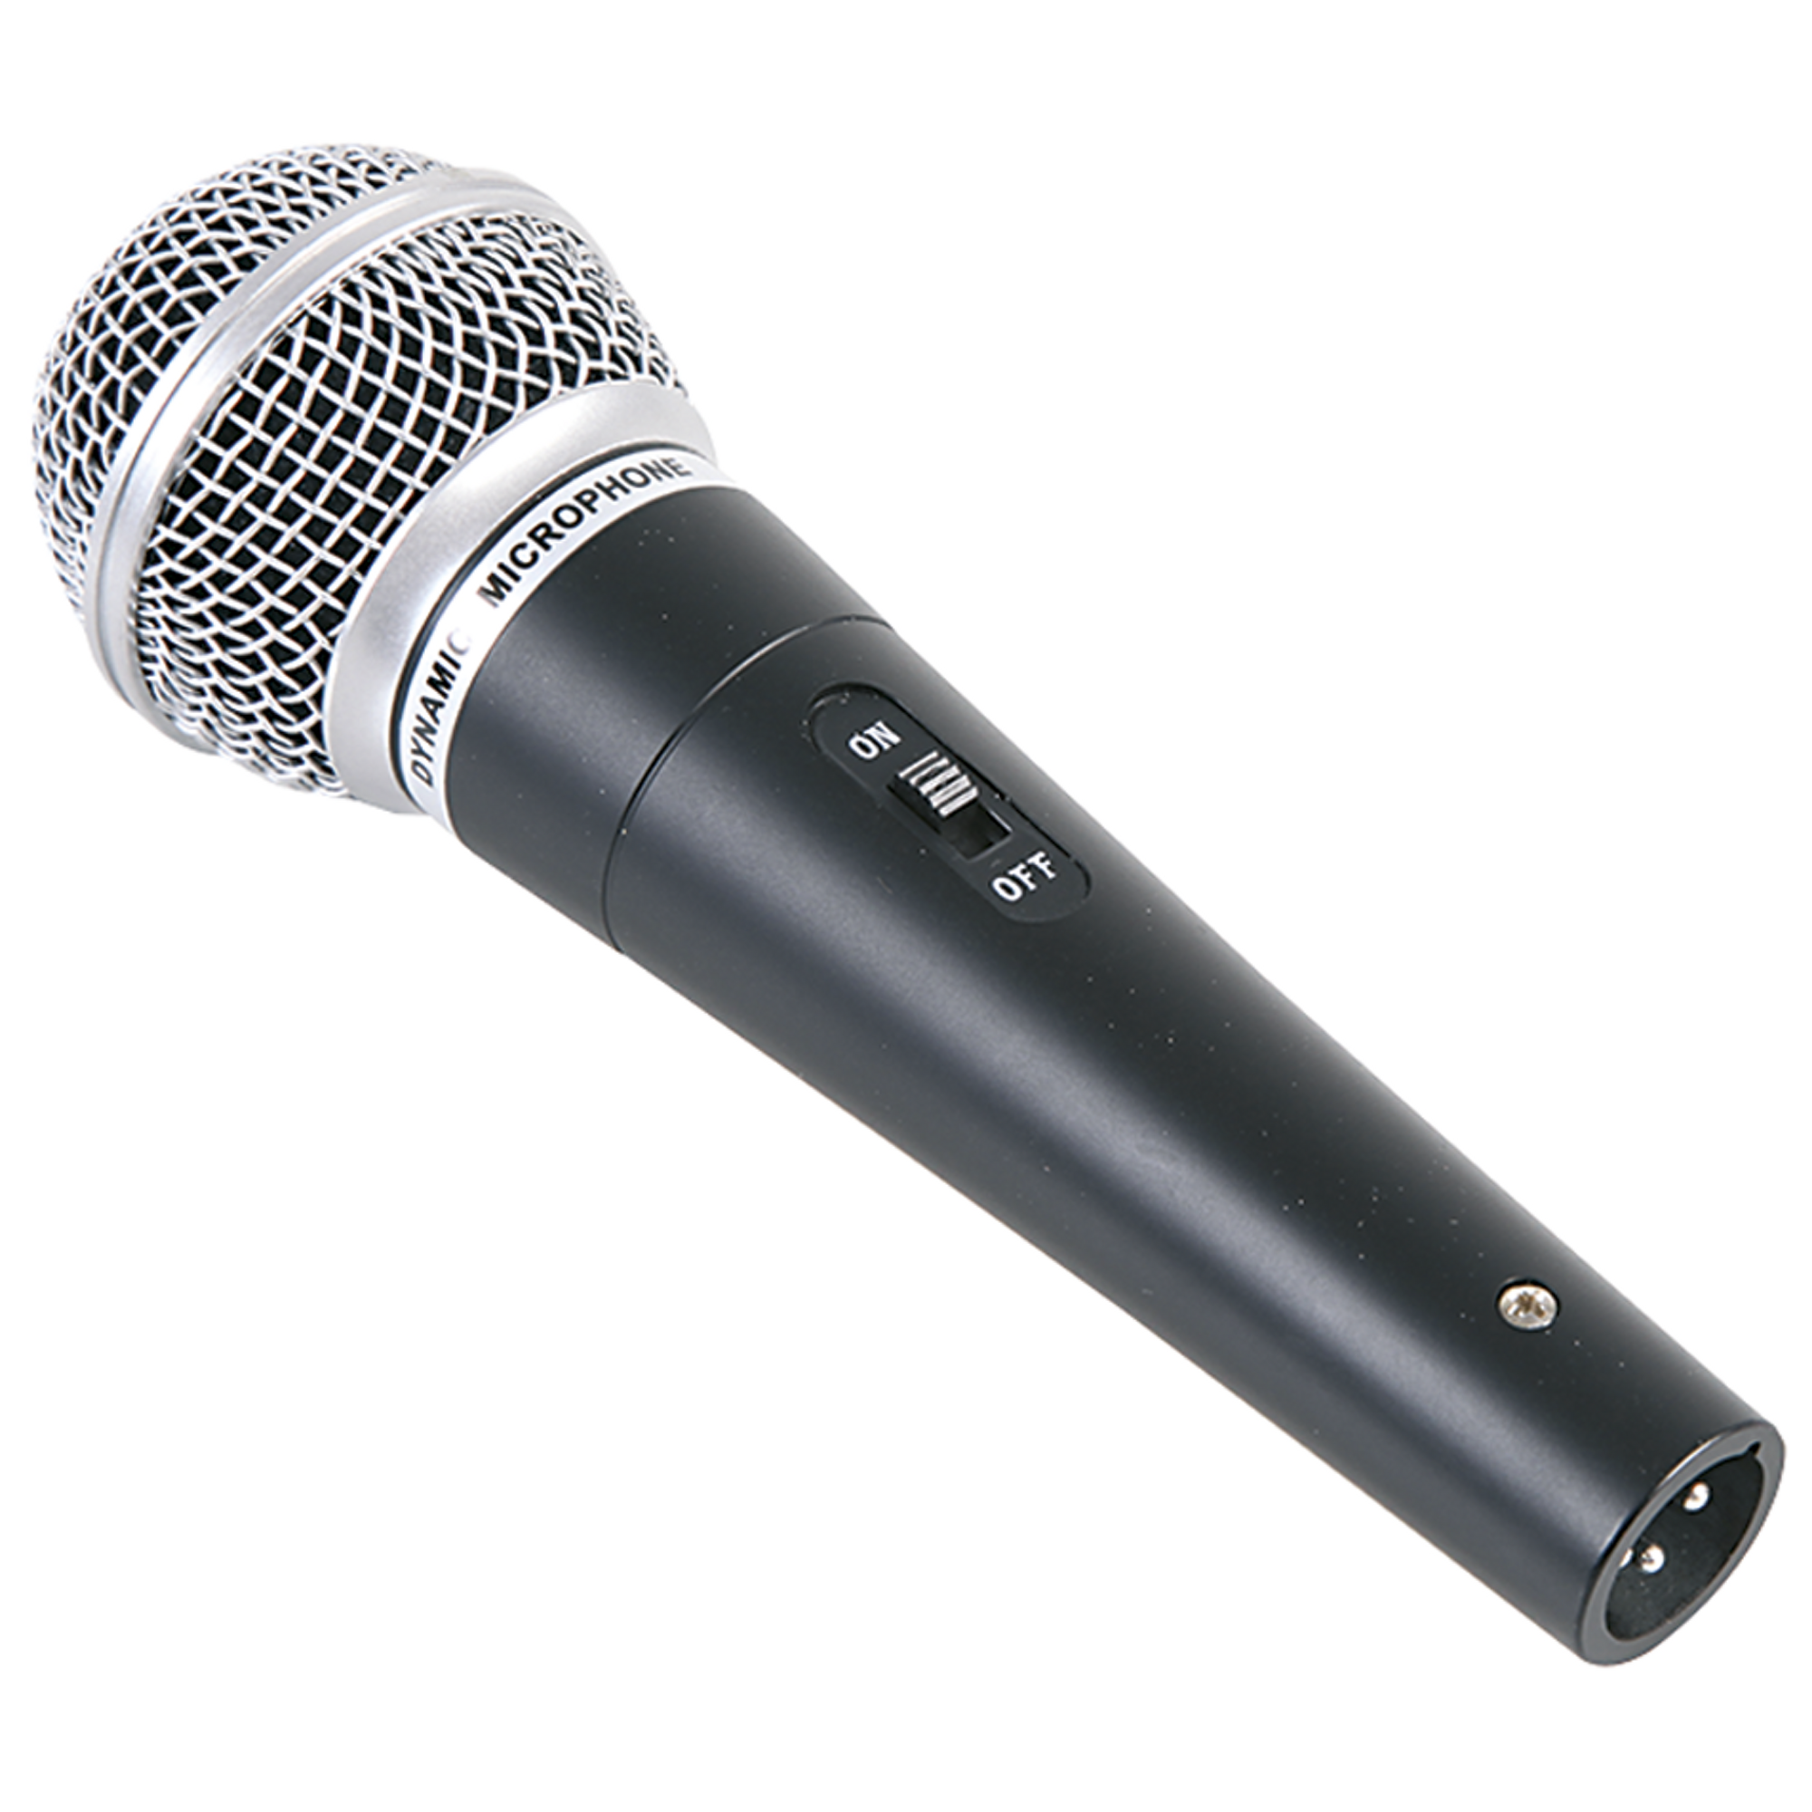
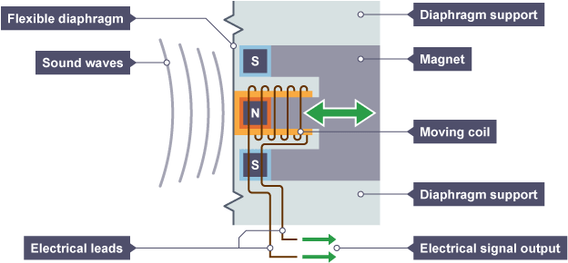
Microphones
Learning Outcome: Use the generator effect to describe how a microphone works
Sound (waves) cause the diaphragm to vibrate
The diaphragm causes the coil / wire to vibrate
The coil / wire moves through the magnetic field and cuts magnetic field lines
A potential difference is induced (across the ends of the coil / wire) causing an electrical signal output
Notes:
Give students magnets to investigate with at this point

Slide 35
GCSE Physics
Physics
1. Energy
2. Electricity
3. Particles
4. Atomic structure and radioactivity
5. Waves
6. Forces
7. Magnetism and electromagnetism
8. Space Physics
7.2.1 Electromagnetism
7.2.1 Electromagnetic forces
7.2.3 Motors
7.2.5 Electromagnetic induction
7.2.4 Uses of electromagnetism
7.2.5 Transformers and the national grid
7.1. Magnetism
7.2. Electromagnetism

Slide 36
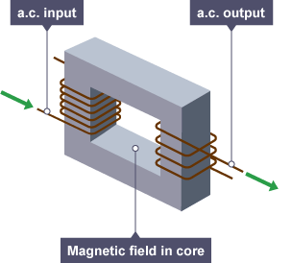
Learning Outcome: Describe how a transformer works
Transformers
1) Alternating current is put into a primary coil of wire
3) The cores magnetic field induces a current into a secondary coil
2)A magnetic field is induced into an iron core
Why do you need an alternating current? – To induce magnetic field
Why is iron used in the core?- Easily magnetised
Notes:
Demo of this with Helmholtz coils and Galvanometer, student practical using neodynium magnets, voltmeters and copper coiled wire

Slide 37
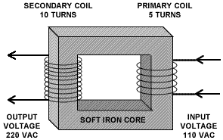
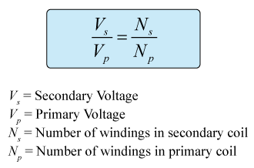
Learning Outcome: Complete transformer calculations
Transformers are used to:
Increase voltage (Step-up transformer)
Decrease voltage (Step-down transformer)
This is determined by the number of primary and secondary turns on the transformer.
If the electrical energy transfer is 100% efficient all the electrical power is conserved so that:
V_{p} I_{p} = V_{s} I_{s}
Notes:
Demo of this with Helmholtz coils and Galvanometer, student practical using neodynium magnets, voltmeters and copper coiled wire

Slide 38
Learning Outcome: The national grid
Wires have low resistance, therefore little heating and energy loss
Voltage is decreased to safe levels (230 V)
Voltage is increased

