Slide 1
GCSE Physics in a nutshell
Space Physics

Slide 2
GCSE Physics
Physics
1. Energy
2. Electricity
3. Particles
4. Atomic structure and radioactivity
5. Waves
6. Forces
7. Magnetism and electromagnetism
8. Space Physics
8.1 What is the universe?
8.2 The solar system and orbits
8.3 Life cycle of a star
8.4 The expanding universe
8.5 The big bang theory

Slide 3
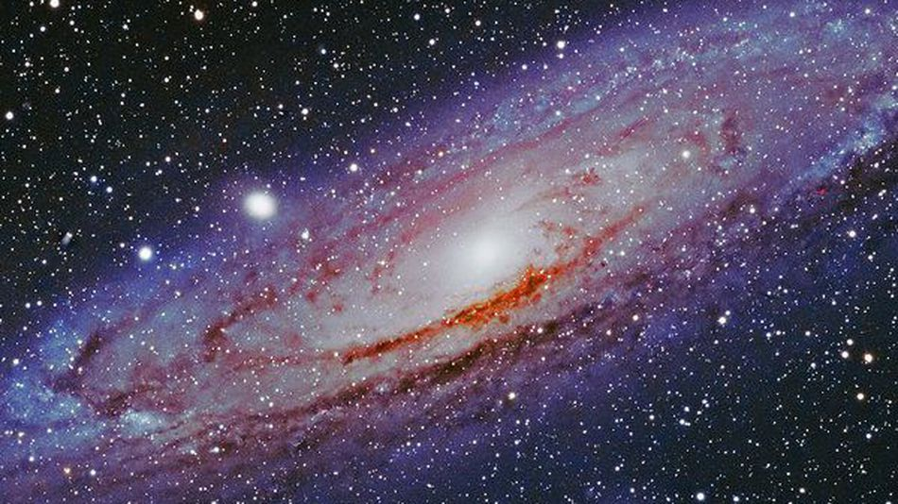
How would you define “the universe”? The universe is everything- all energy and all matter
What is the Universe?
Notes:
Buzzfeed
https://www.youtube.com/watch?v=1Eh5BpSnBBw
Morgan freeman
https://www.youtube.com/watch?v=qxXf7AJZ73A

Slide 4
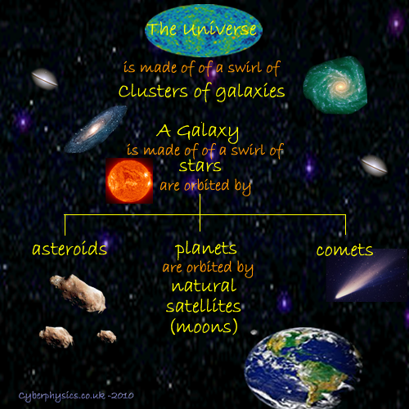
What is the Universe?
Notes:
Buzzfeed
https://www.youtube.com/watch?v=1Eh5BpSnBBw
Morgan freeman
https://www.youtube.com/watch?v=qxXf7AJZ73A

Slide 5
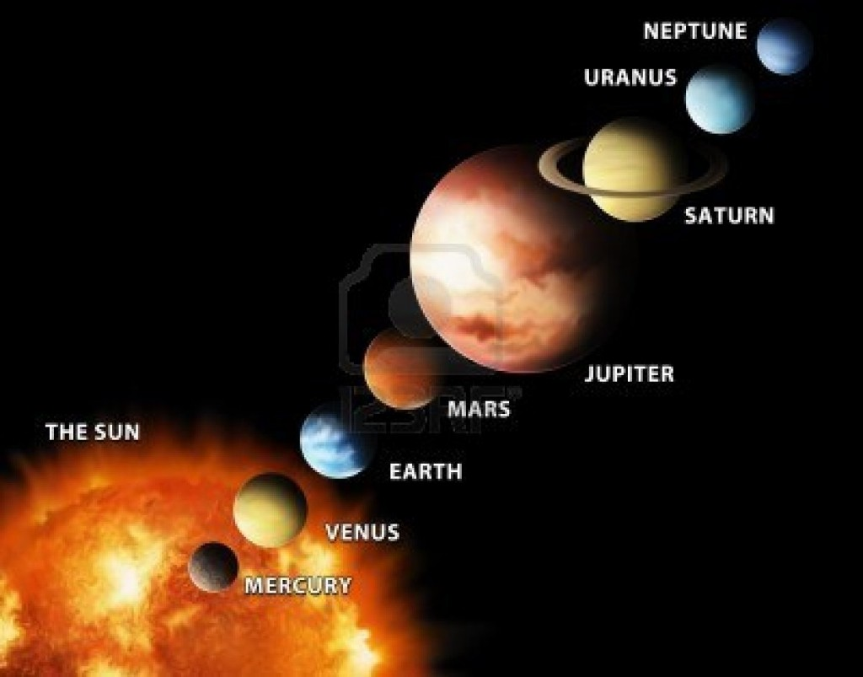
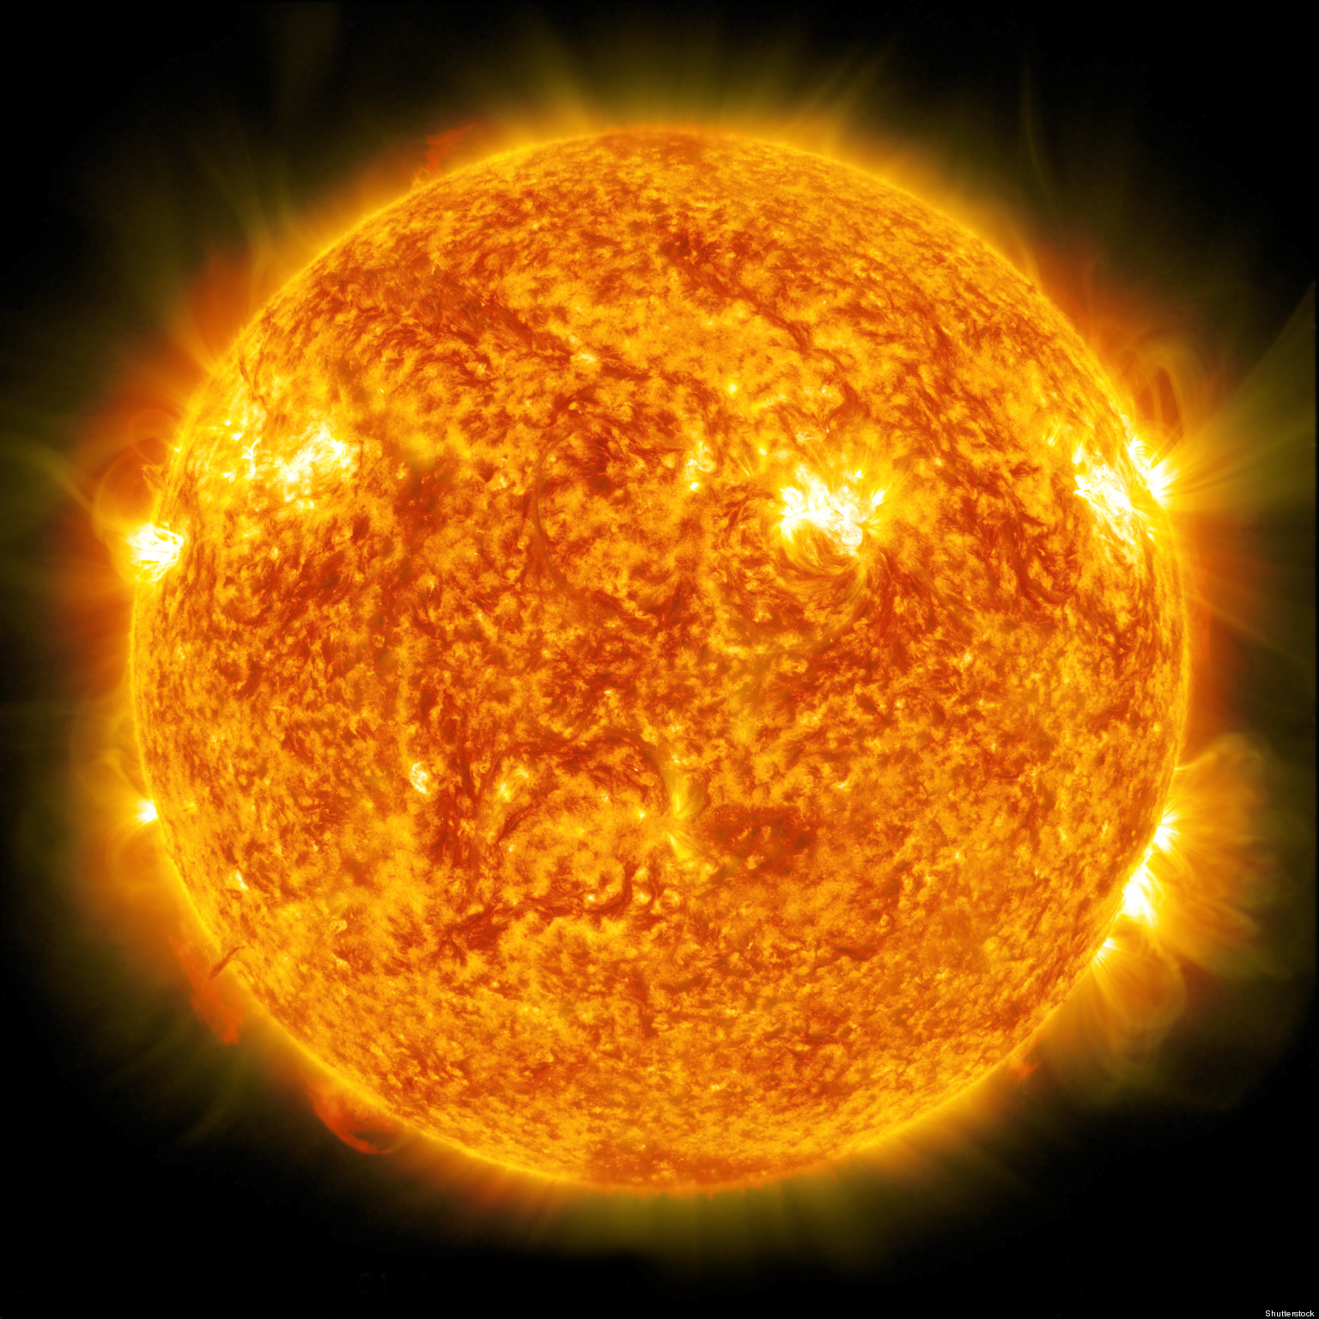
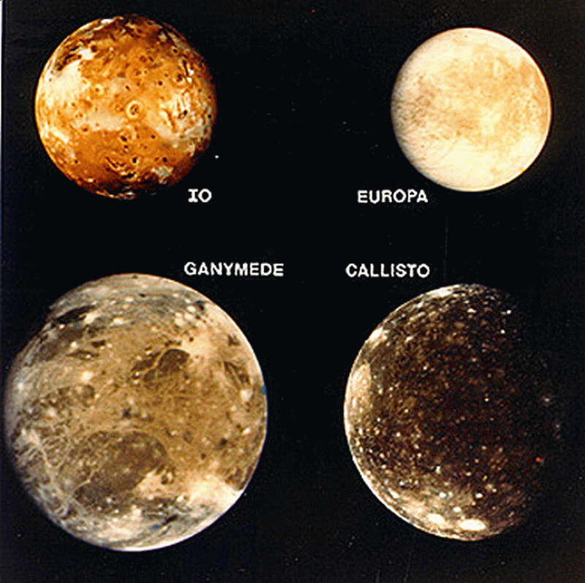
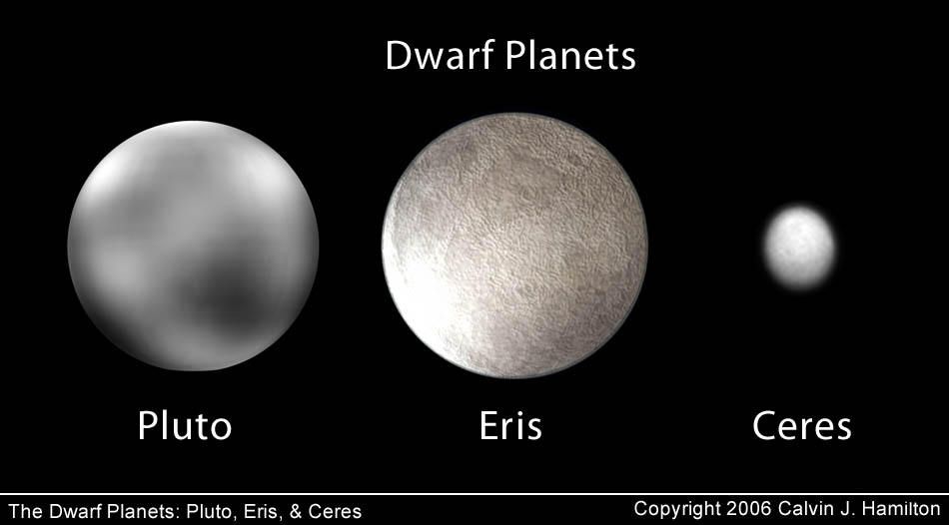
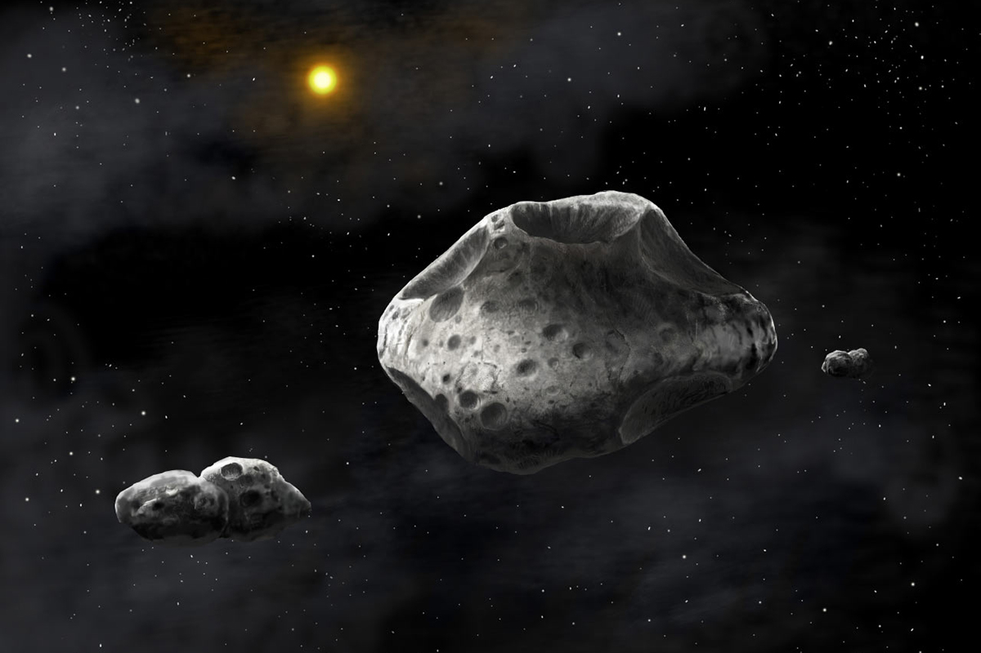
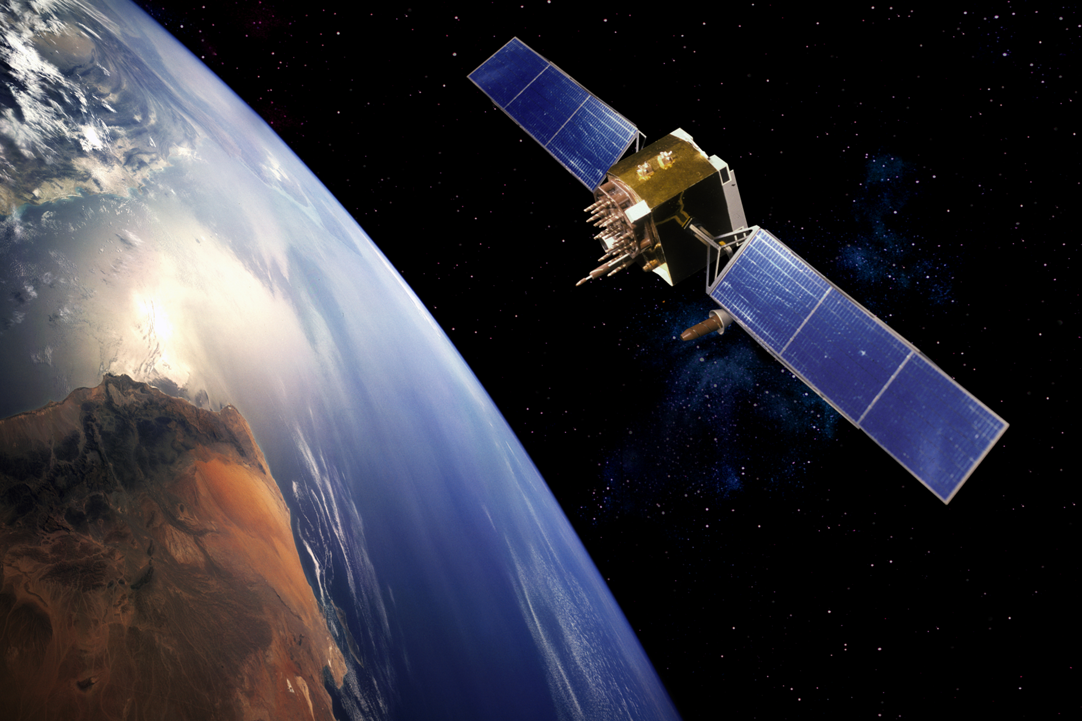
The sun
Natural satellites
The 8 planets
Our solar system
Artificial satellites
Dwarf planets
Asteroids

Slide 6
Our solar system – the planets

Slide 7
Our solar system – the planets
Notes:
Buzzfeed
https://www.youtube.com/watch?v=1Eh5BpSnBBw

Slide 8
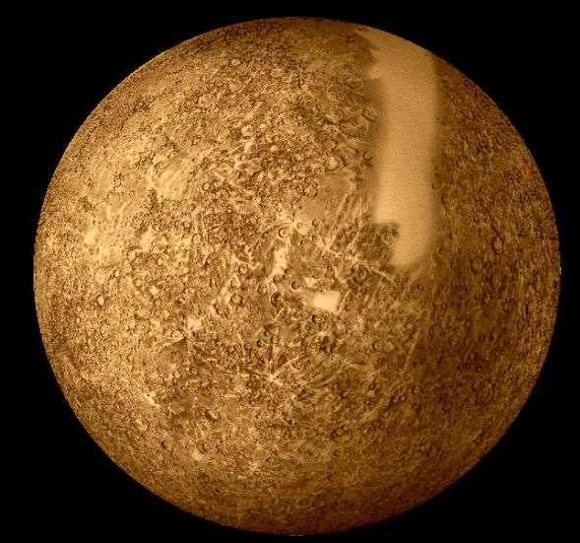
MERCURY Inner rocky planet
Mass Compared to the Earth: 5%
Diameter (km): 4880
Distance from the Sun (million km): 58
Orbital Time: 88 Days
Rotational Time: 59 hours
Average Surface Temperature (°C): 350
Mercury is the 2nd Hottest planet in the solar system. Despite being closer to the sun than Venus it is too small and therefore has insufficient gravitational attraction to maintain its own atmosphere. Any thin atmosphere it would have is pulled away by the Sun’s massive gravitational field.

Slide 9
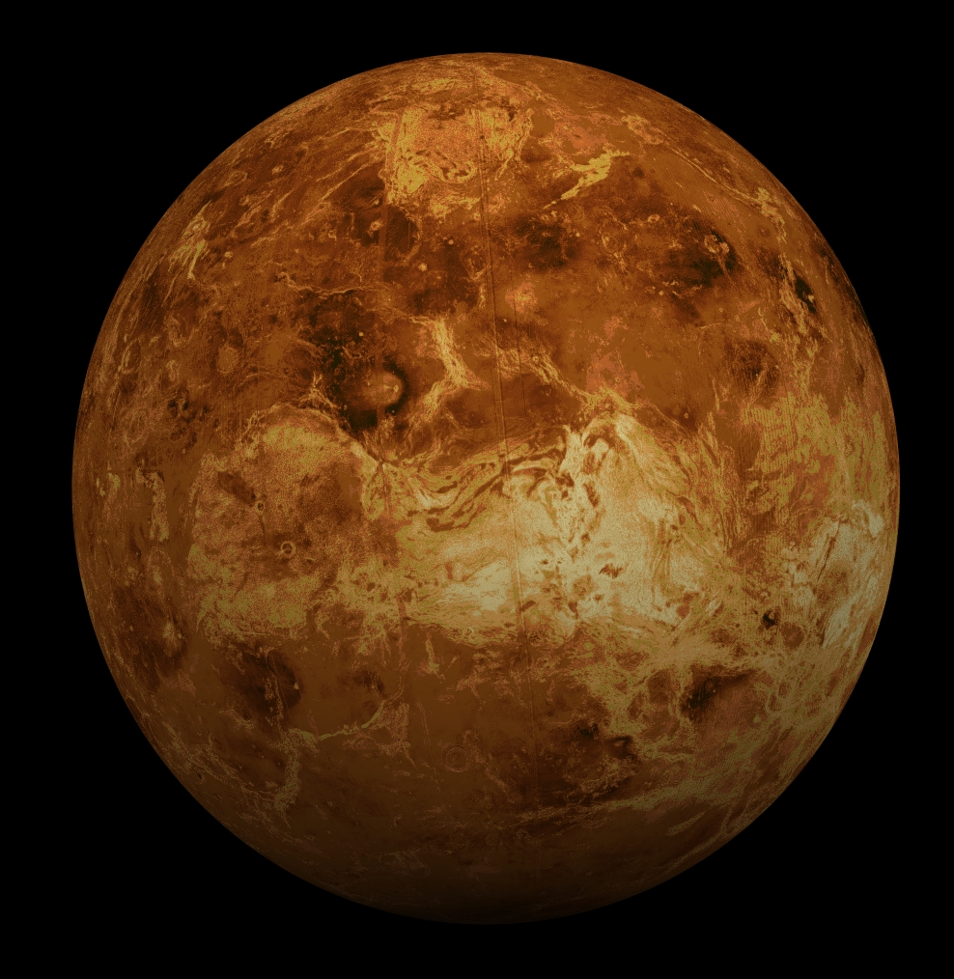
Mass Compared to the Earth: 81%
Diameter (km): 12112
Distance from the Sun (million km): 107.5
Orbital Time: 224 Days
Rotational Time: 243 hours
Average Surface Temperature (°C): 460
VENUS
Inner rocky planet
Venus is the hottest planet in the solar system. Despite being further away from the sun than Mercury it is nearly the same size as Earth so therefore has sufficient gravitational attraction to maintain its own atmosphere. This thick, dense atmosphere acts a trap for the Sun’s heat due to the greenhouse effect.

Slide 10
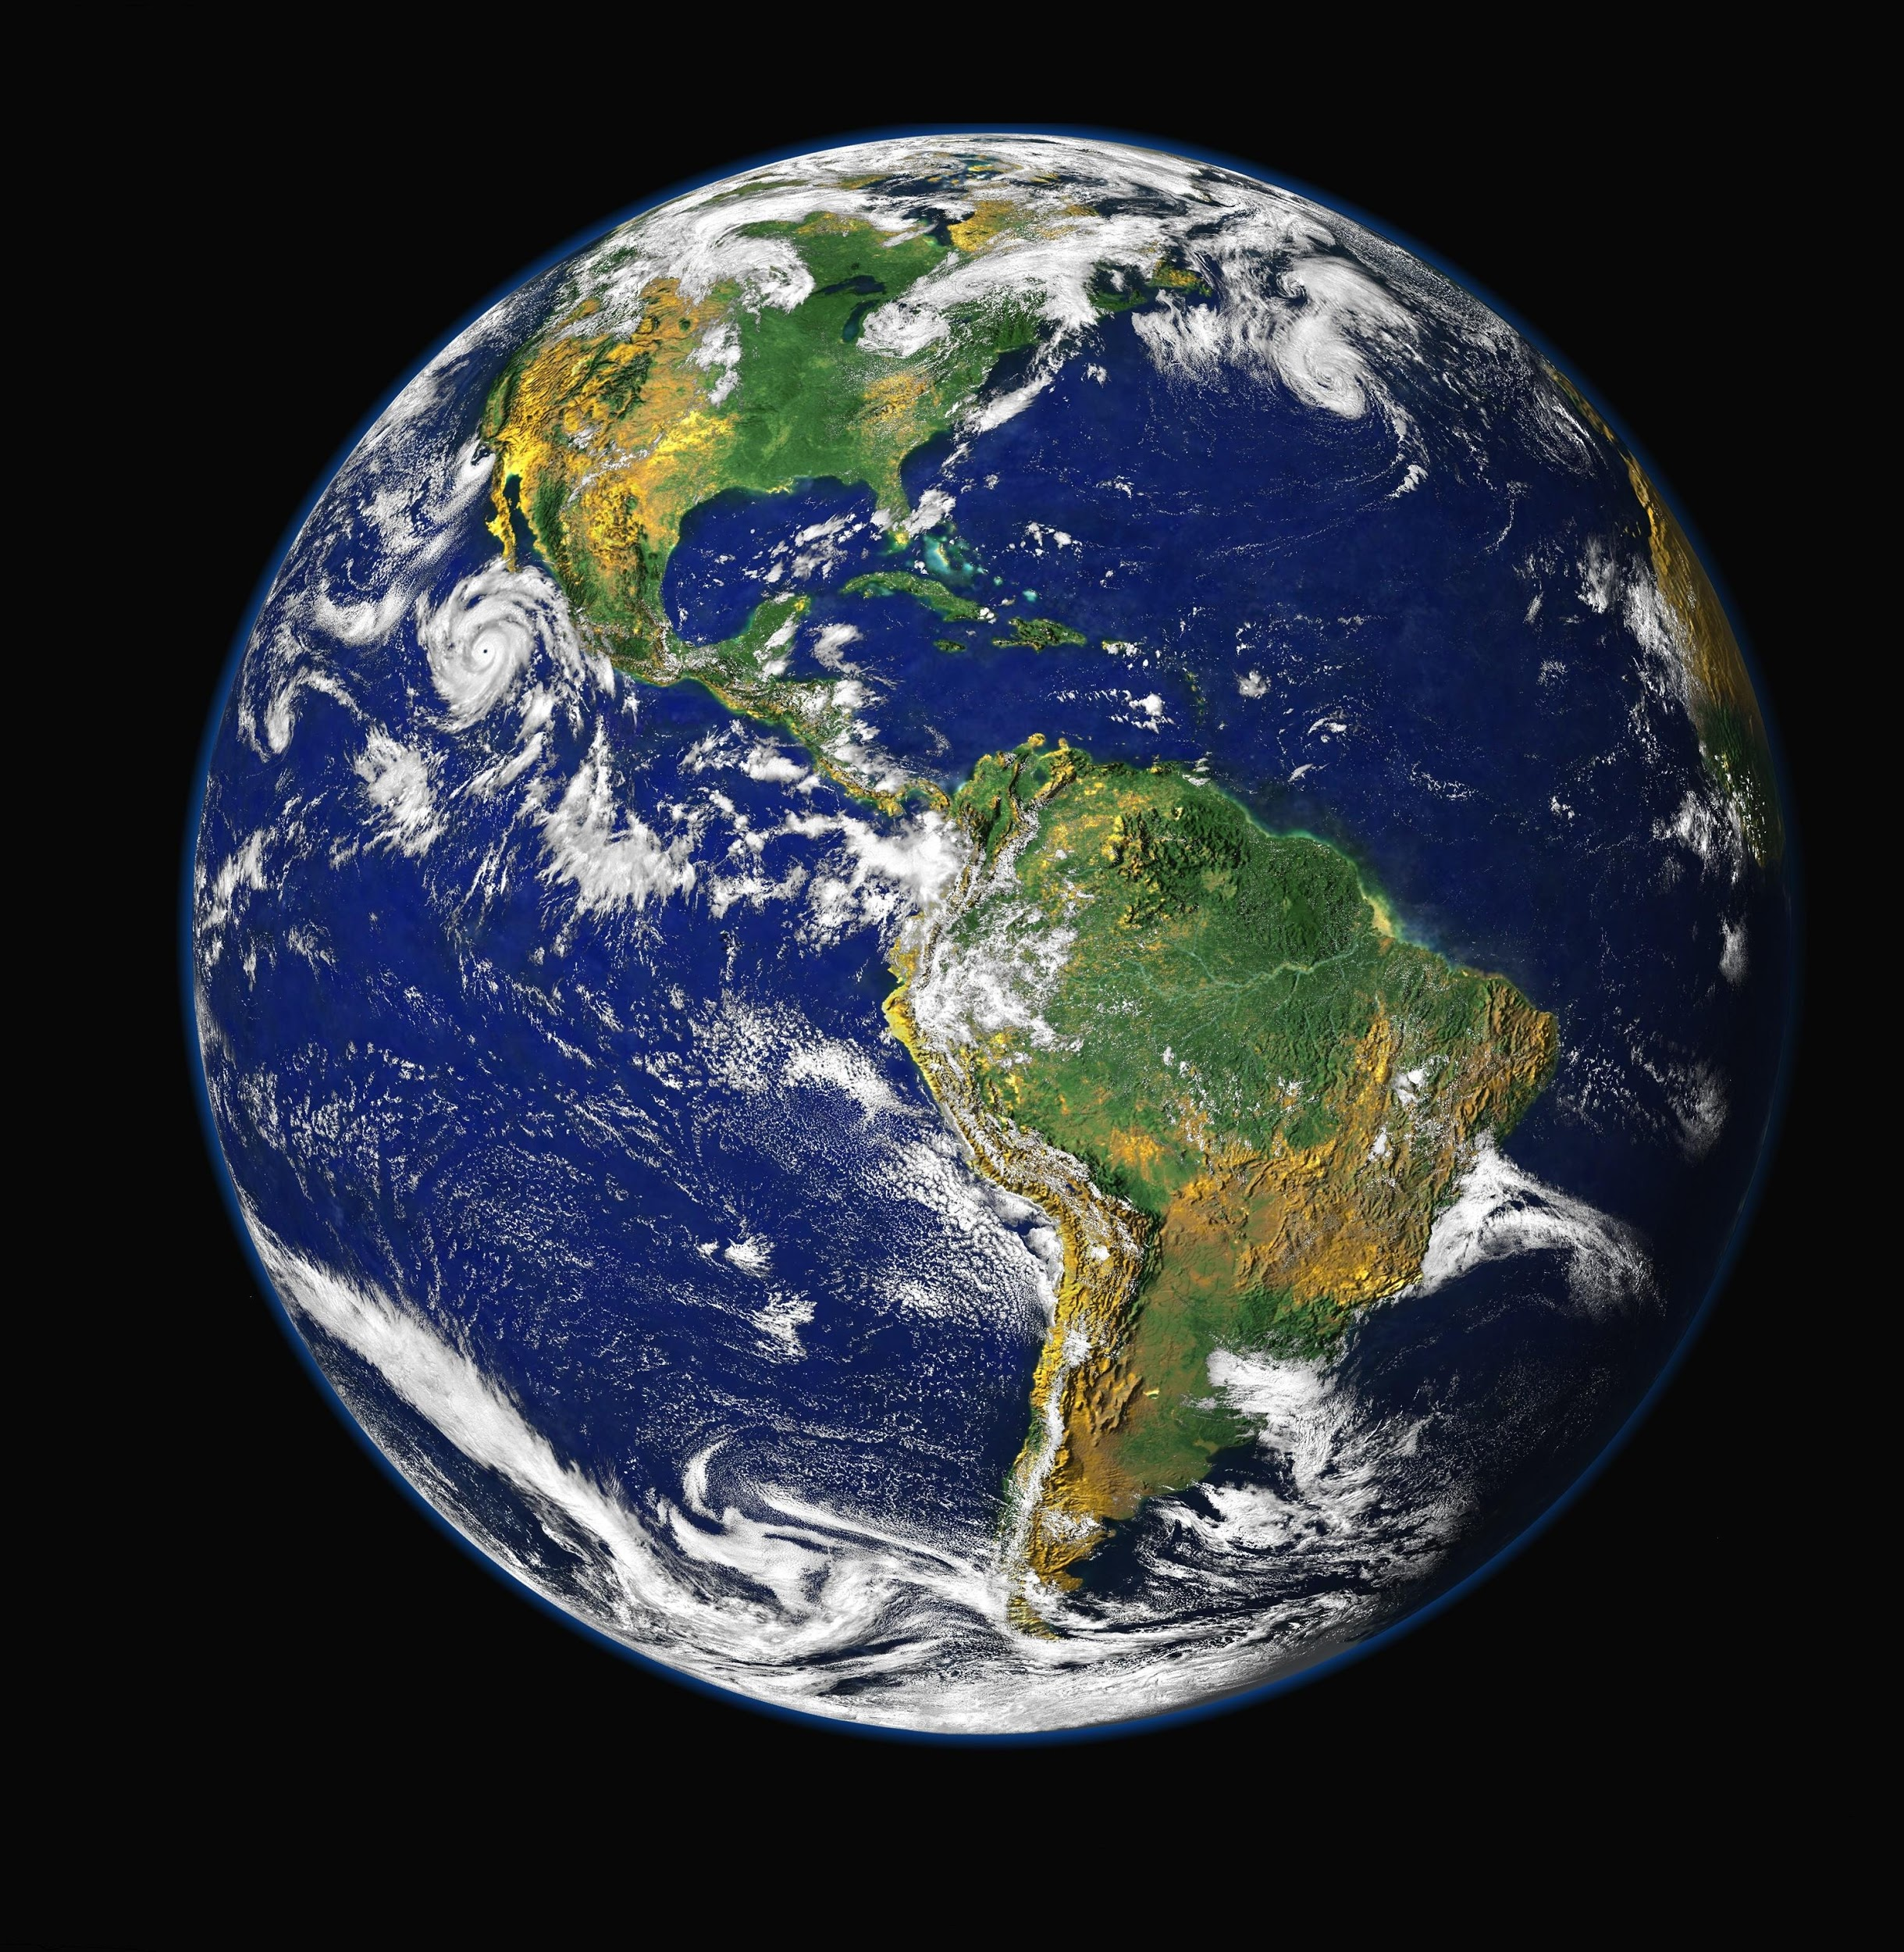
Mass Compared to the Earth: 100%
Diameter (km): 12742
Distance from the Sun (million km): 149.6
Orbital Time: 365.25 Days
Rotational Time: 24 hours
Average Surface Temperature (°C): 20
EARTH
Inner rocky planet
Earth is the largest rocky planet in the solar system. It is our home and is the only planet which we currently are aware of which can sustain life.
It exists in the “Goldilocks Region” of space where it is not too hot or too cold for life to exist.
It is the optimum temperature for water to exist as a liquid, which is key ingredient for life.

Slide 11
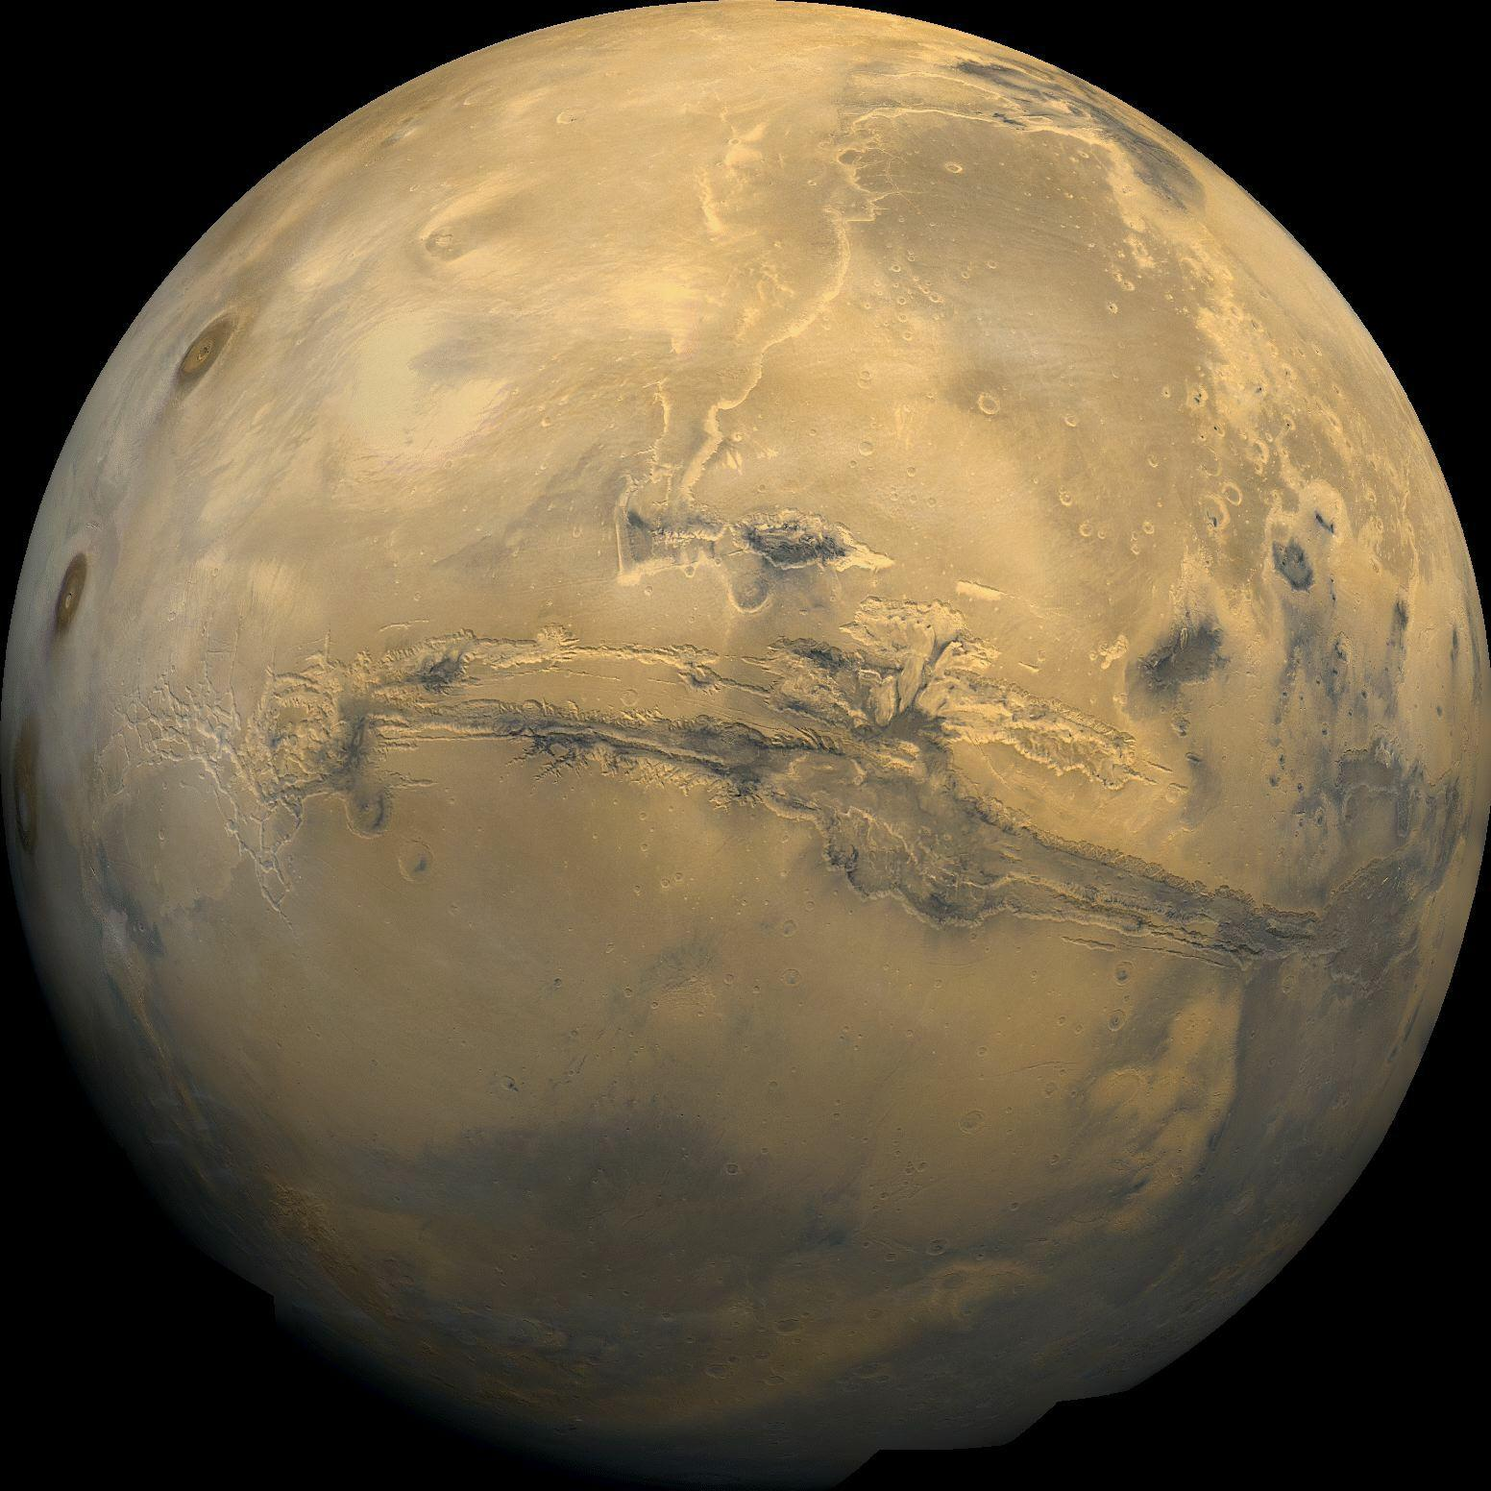
Mass Compared to the Earth: 11%
Diameter (km): 6790
Distance from the Sun (million km): 228
Orbital Time: 687 Days
Rotational Time: 24 hours and 37 mins
Average Surface Temperature (°C): -23
MARS
Inner rocky planet
Mars is known as the red planet. This is because on the surface the rock is rich in iron which gives it a characteristic red colour.
Mars is covered in evidence of erosion and weathering similar to an environment covered in water.
We have landed rovers on Mars and proven there is trace amounts of water on the Martian surface.

Slide 12
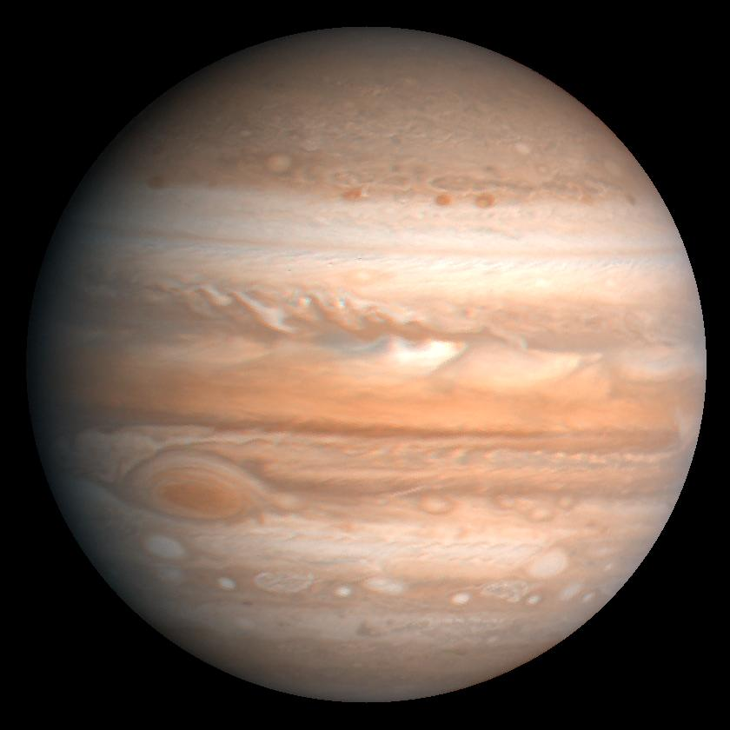
JUPITER Outer gas planet
Mass Compared to the Earth: 3180%
Diameter (km): 142600
Distance from the Sun (million km): 778
Orbital Time: 11.9 Years
Rotational Time: 9 hours and 50 mins
Average Surface Temperature (°C): -120
Jupiter is the largest planet in our solar system and is the first gas planet. It is large enough to fit every other planet inside and still have room to spare.
It is also home to the largest storm in the solar system; the infamous “Great Red Spot”, so large it could fit Earth and Mars inside.
Jupiter also has at least 67 moons.
Great Red Spot

Slide 13
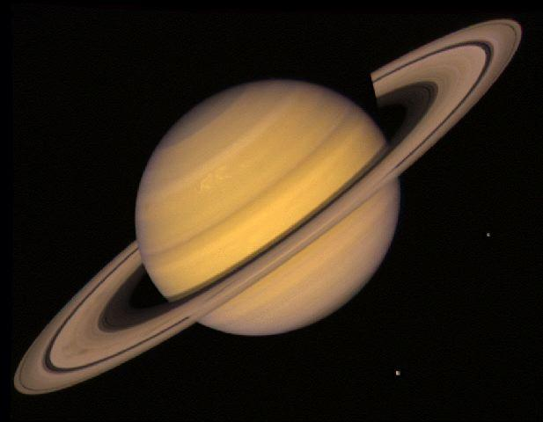
Mass Compared to the Earth: 950%
Diameter (km): 120200
Distance from the Sun (million km): 1427
Orbital Time: 29.5 Years
Rotational Time: 10 hours and 14 mins
Average Surface Temperature (°C): -180
SATURN
Outer gas planet
Saturn is the 2nd largest planet of our solar system with at least 46 moons, including the largest moon of our solar system, Titan.
Saturn is also famous for its unique ring system, the largest in our solar system, made of ice and dust. The ring system is heavily influenced by Saturn’s many moons.

Slide 14
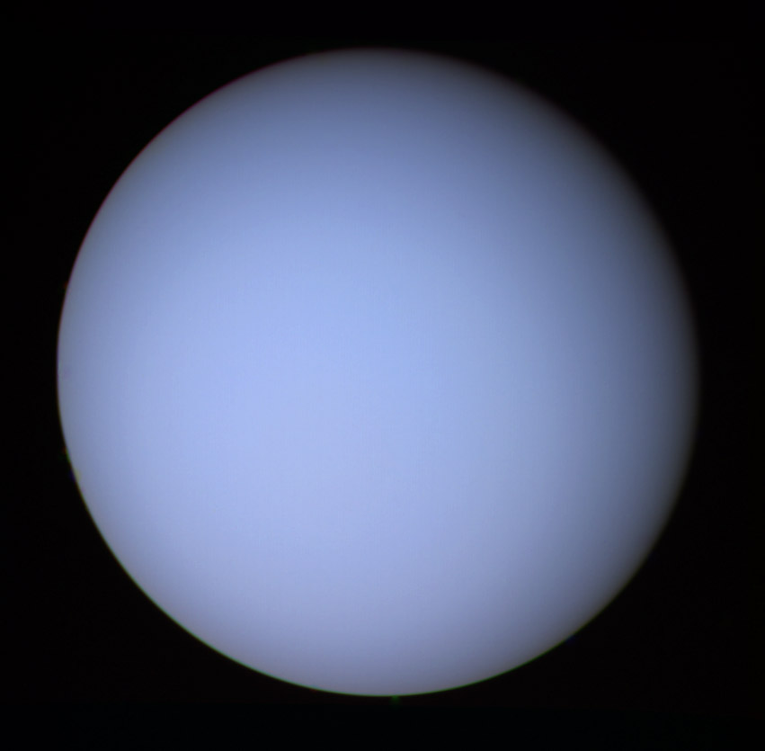
Mass Compared to the Earth: 14.5%
Diameter (km): 49000
Distance from the Sun (million km): 2870
Orbital Time: 84 Years
Rotational Time: 10 hours and 49 mins
Average Surface Temperature (°C): -210
URANUS
Outer gas planet
Uranus is the 7th planet from the sun in our solar system. Uranus like Saturn has rings, however they are much smaller in comparison.
Uranus' blue colour is the result of absorption of red light by methane in the upper atmosphere.

Slide 15
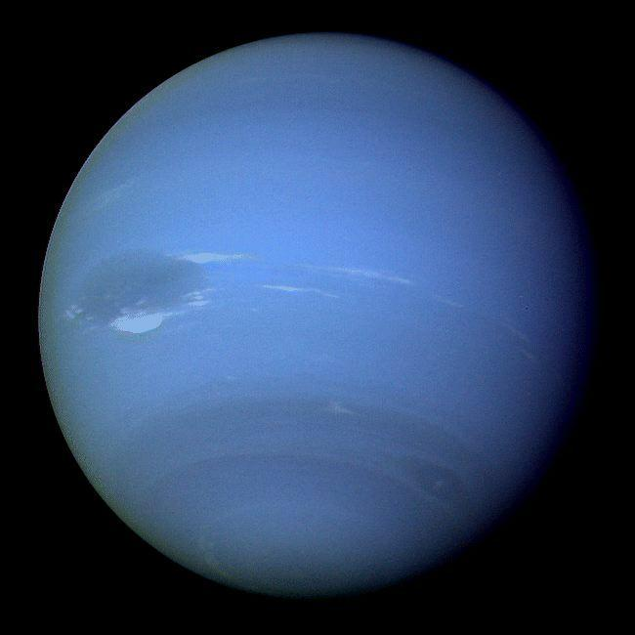
Mass Compared to the Earth: 17.5%
Diameter (km): 50000
Distance from the Sun (million km): 4497
Orbital Time: 165 Years
Rotational Time: 15 hours and 48 mins
Average Surface Temperature (°C): -220
NEPTUNE
Outer gas planet
Neptune is the 8th and final planet and has 13 moons.
Like the other gas planets Neptune has very rapid winds. Neptune has the fastest winds in the solar system of speeds up to 2000 km/hour!

Slide 16
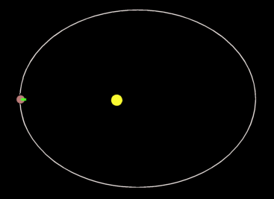
Our solar system – orbits
Gravitational force pulls orbiting body constantly inwards (a force pulling an object inward in circular motion is called the “centripetal force”)
Speed is constant
But change in direction = change in velocity (vector)
Change in velocity = acceleration
Original direction of travel
New resultant direction of travel due to gravitational force

Slide 17
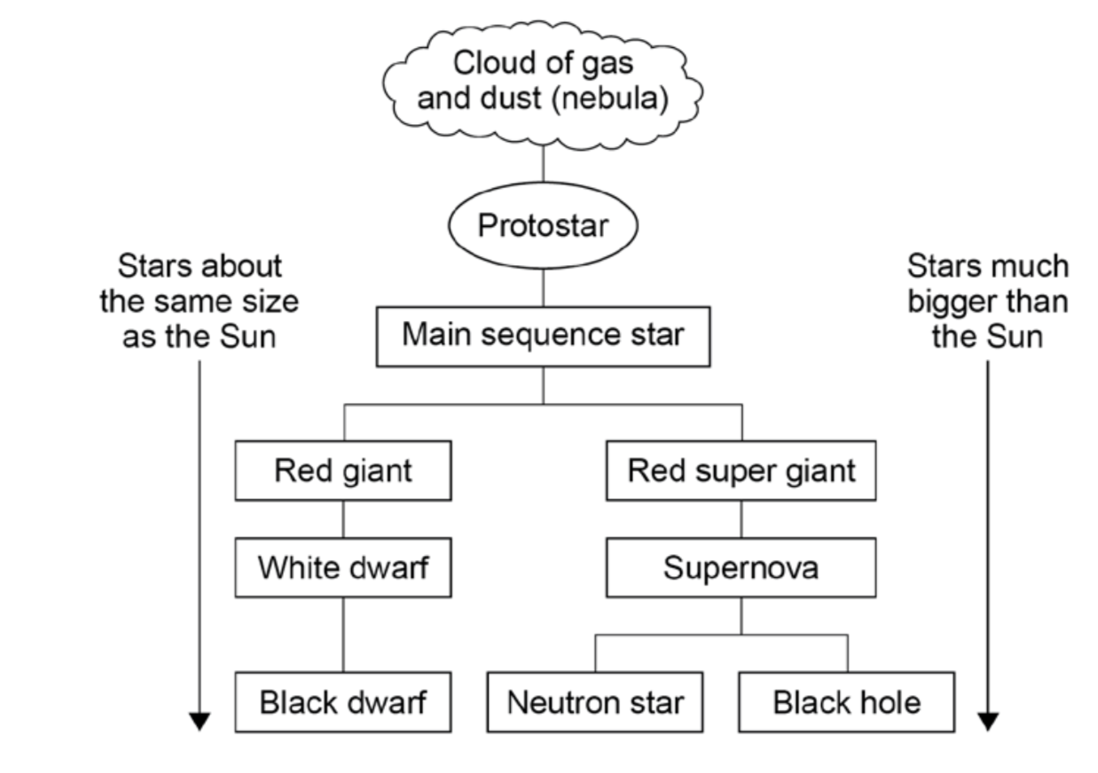
Life cycle of a star

Slide 18
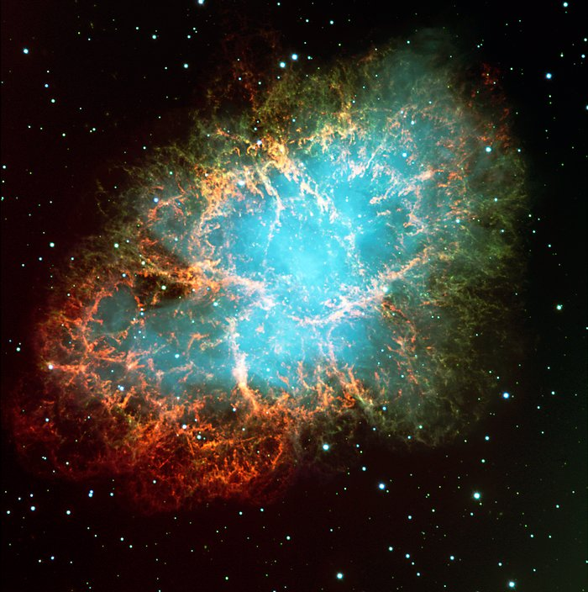
Stellar nebular
The birth place of stars, a cloud of gas and dust. Where regions of higher density begin collapsing in on themselves under gravity a star will form

Slide 19
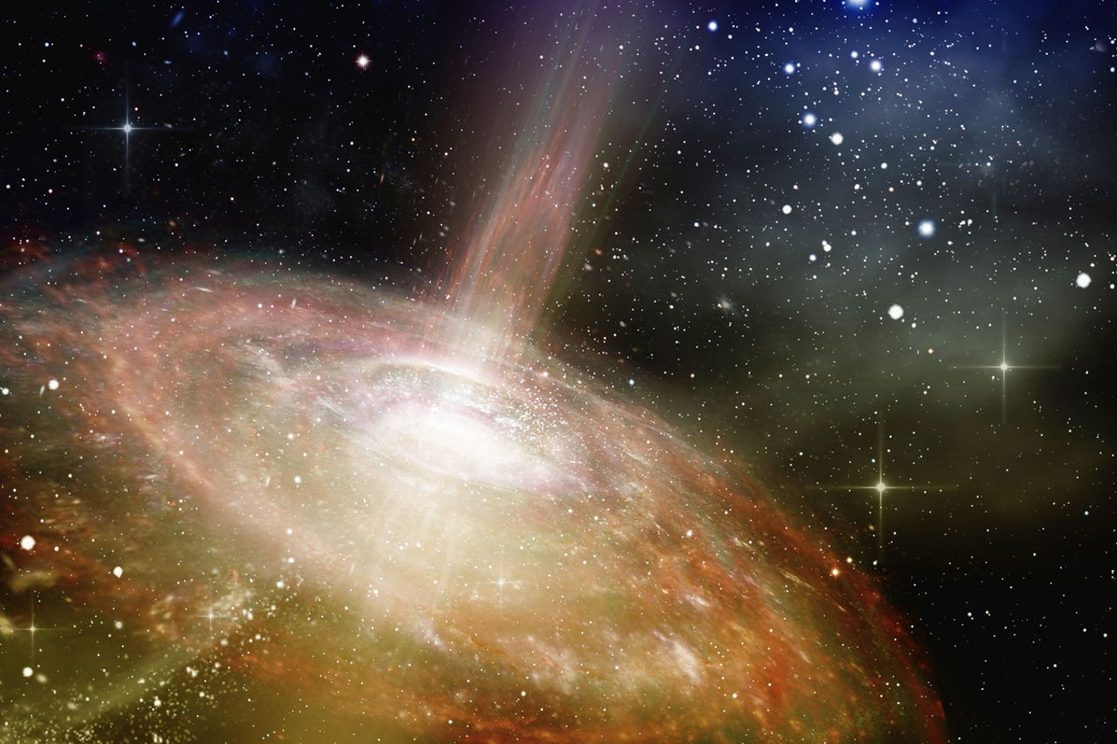
Protostar
Under gravity the centre of the star is under intense pressure and its temperature greatly increases. Eventually pressure and temperature will be high enough for hydrogen atoms to combine to form helium creating huge amounts of energy is this nuclear fusion process

Slide 20
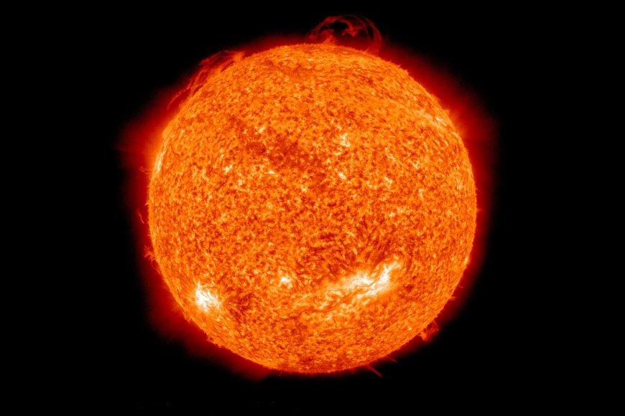
Main sequence star
This is the main part of a stars life where it is stable as the inwards pressure from gravity matches the outwards pressure created from nuclear fusion of hydrogen to helium (radiation pressure)
The star will remain stable until it runs out of hydrogen for fusion

Slide 21
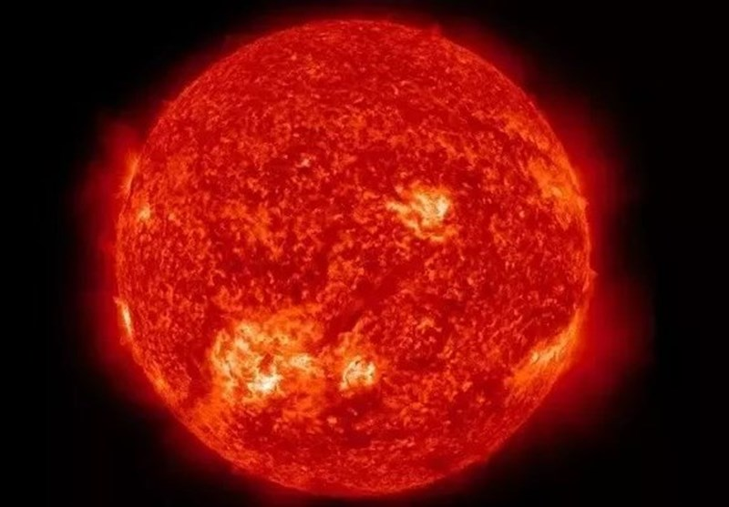
Red giants and super red giants
When the star runs out of hydrogen nuclear fusion suddenly stops. Now the pressure from gravity causes the star to collapse in on itself (as there is no longer radiation pressure to balance this)
The pressure and temperature at the centre of the star greatly increase meaning the star is now able to fuse helium into heavier elements up to iron. This now causes the radiation pressure to greatly increase and the star expands outwards
As the star expands the outer layers cool, resulting in the cooler red colour. A super red giant is just much larger than a red giant

Slide 22
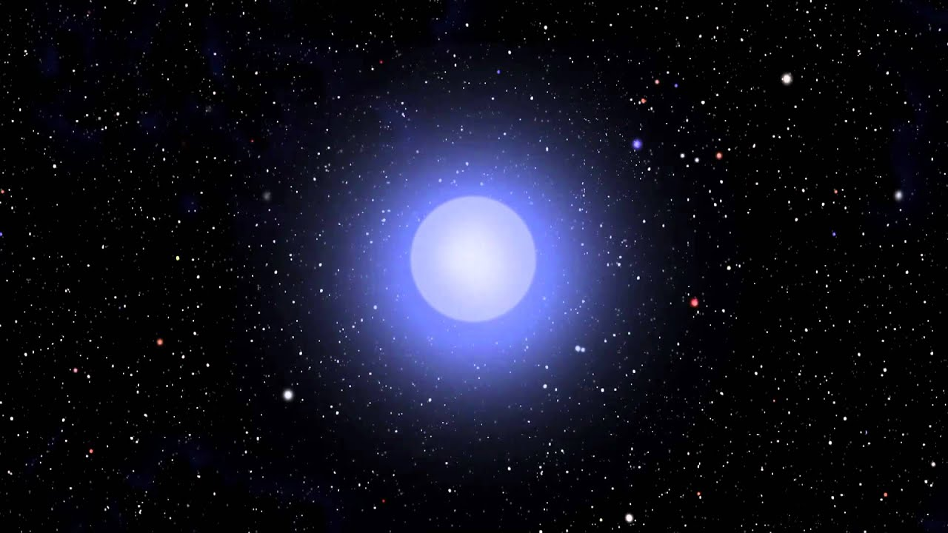
White and black dwarfs
When a star of similar size to our sun runs out of helium to fuse in the red giant stage it will become unstable and ejects its outer layers leaving behind a hot, dense core- a white dwarf
Over time this white dwarf will cool down and emit less radiation eventually becoming a black dwarf when it is no longer visible

Slide 23
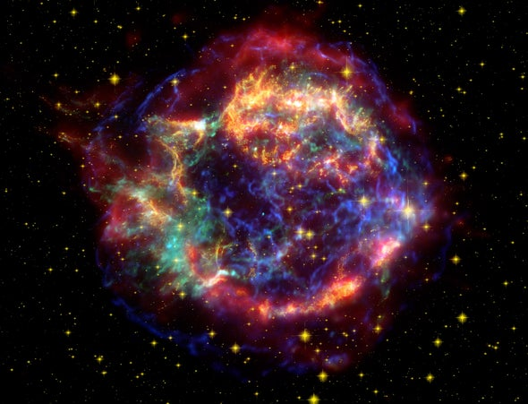
Supernova
For a red giant star much larger than our sun when they run out of elements to fuse they become very unstable resulting in a supernova explosion in which elements heavier than iron are formed and ejected out into the universe

Slide 24
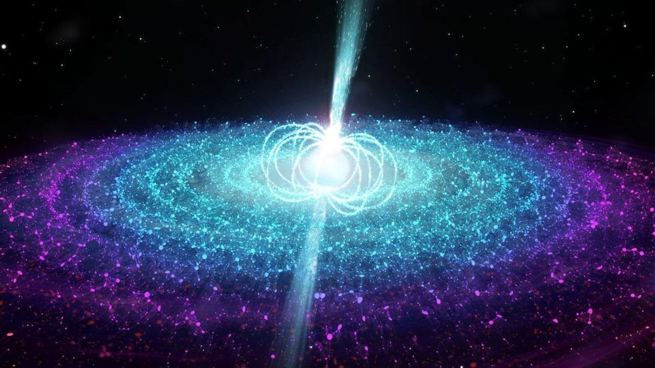
Neutron star
Following on from a supernova explosion a very dense core will be left behind. This star is so dense and therefore under such great pressure that the atoms themselves are forced together.

Slide 25
A black hole
Following on from a supernova explosion if a star has enough mass the core left behind can become a black hole. In this case the core is so dense that the pressure it exerts upon itself because of its own gravity causes the atoms within it to be pressed and combined together. At this point the star becomes a black hole. A star with so much gravity that light can not escape, hence the name. A black hole with the mass of Earth would be just a little under 1 cm in radius!

Slide 26
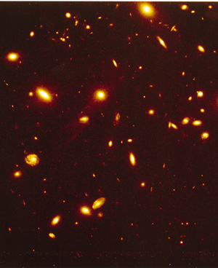
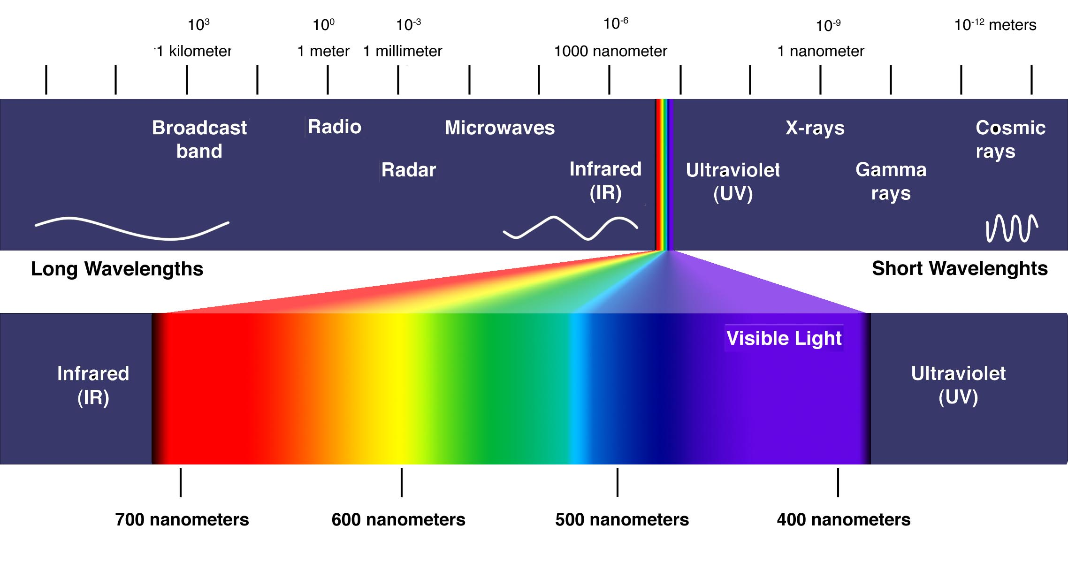
Doppler effect- apparent change in frequency and wavelength of any wave due to relative motion between wave source and observer Moving away = smaller frequency/elongated wavelength Moving towards = higher frequency/shortened wavelength Galaxies appear red shifted (small frequency/longer wavelength) suggesting that they are moving away from us
The expanding universe- red shift

Slide 27
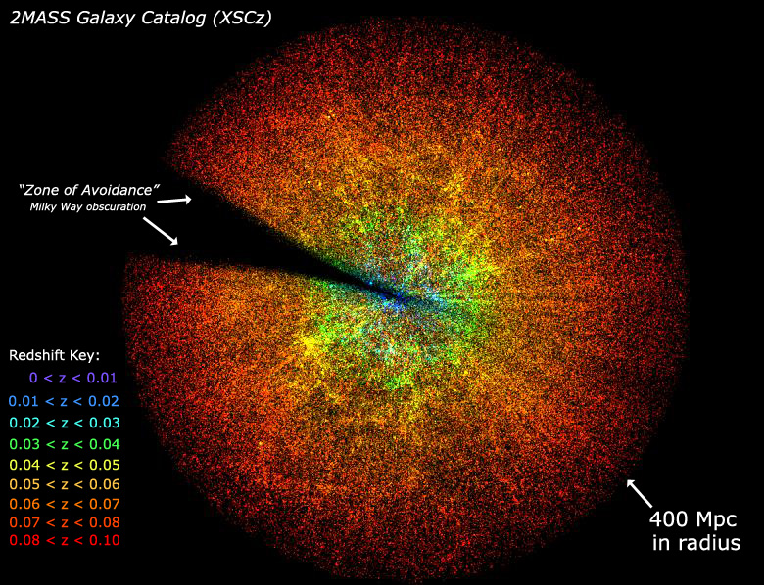
Hubble confirmed with measurements that galaxies further away from us are moving more quickly away from us (are more red shifted). This means the universe is expanding
The expanding universe- red shift

Slide 28
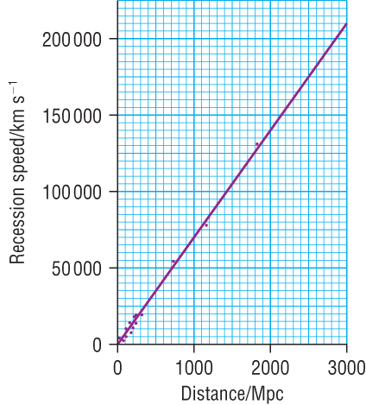
The big bang theory- Hubble’s law
If galaxies are now all moving away from us they must have once been closer together, and if we go back long enough they must have all been together, as a “singularity”
Hubble plotted the speed at which a galaxy is moving away from the redshift against the distance away . The speed of the recession of a galaxy is directly proportional to its distance from the Earth. If we know distance and speed we can work out time (the age of the universe).
Time = 1 ÷ 2.3 x 10⁻¹⁸ = 4.35 x 10¹⁷ s = 1.38 x 10¹⁰ years
or about 14 billion years
The universe thus started from a very hot, very dense singularity which rapidly expanded and cooled. This is the big bang theory

Slide 29
Hubble’s Law doesn’t actually work… The expansion of the universe is actually accelerating
The big bang theory- Hubble’s law
Notes:
https://www.youtube.com/watch?v=tXkBfkeJJ5c

Slide 30
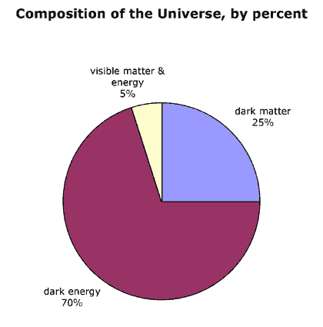
The big bang theory-dark matter and dark energy
In the 1990s it was observed that galaxies were accelerating away.
This means a repulsive force must be driving this acceleration.
Dark energy is the name given to the unknown material that has this repulsive property

