Slide 1
Materials

Slide 2
A-Level Physics
1. Development of practical skills in physics
2. Foundations of Physics
3. Forces and motion
4. Electrons, waves and photons
5. Newtonian world and astrophysics
6. Particles and medical physics
3.1 Motion
3.2 Forces
3.3. Work, Energy and power
3.4. Materials
3.5 Newton’s laws and momentum
3.4.1 Hooke’s Law
3.4.2. Types of deformation and elastic potential energy
3.4.3. Stress, strain and Young’s modulus
3.4.4 Deforming various materials

Slide 3
Types of deformation and elastic potential energy
Describe Hooke’s law
Describe Hooke’s law for two springs in parallel
Describe Hooke’s law for two springs in series

Slide 4
Learning Outcome: Describe Hooke’s law
Hooke’s Law
Hookes law states that: the extension of an elastic object is directly proportional to the force applied to it
Shown by the straight line that passes through the origin
Notes:
The force can be calculated using mass x 10 ie mass in kg x gravitational field strength to get the weight. The extension will be the new length less the original length

Slide 5
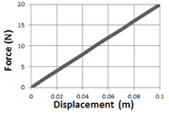
Learning Outcome: Describe Hooke’s law
The spring constant
The spring constant can be found by measuring the gradient of the straight-line part of a force-extension graph
In the example above, the gradient is found by ΔF/Δx
ΔF/Δx = 20/0.1 = 200 N/m
Once we know the spring constant, we can calculate the force required to extend a material by a given amount, using the equation F = kx
F is the force causing the extension
x is the extension
k is known as the spring constant in N/m

Slide 6
Learning Outcome: Describe Hookes Law for parallel springs
Parallel springs
Extension for each spring is halved
(if k₁ = k₂) as force is shared between springs
k₁
k₂
If force remains constant and F = kx
If extension (x) halves the spring constant must double
For parallel springs: k_{total} = k₁ + k₂

Slide 7
Learning Outcome: Describe Hooke’s law for springs in series
Series springs
k₁
Each spring shows the same amount of extension, so overall extension is doubled
k₂
If force remains constant and F = kx
If extension (x) doubles the spring constant must half
For series springs: 1/k_{total} = 1/k₁ + 1/k₂

Slide 8
k_{total} = k₁ + k₂
F = kx
Force
1/k_{total} =
1/k₁ + 1/k₂
Extension

Slide 9
A-Level Physics
1. Development of practical skills in physics
2. Foundations of Physics
3. Forces and motion
4. Electrons, waves and photons
5. Newtonian world and astrophysics
6. Particles and medical physics
3.1 Motion
3.2 Forces
3.3. Work, Energy and power
3.4. Materials
3.5 Newton’s laws and momentum
3.4.1 Hooke’s Law
3.4.2. . Types of deformation and elastic potential energy
3.4.3. Stress, strain and Young’s modulus
3.4.4 Deforming various materials

Slide 10
Types of deformation and elastic potential energy
Describe elastic deformation and Hooke’s law
Describe plastic deformation
Calculate elastic potential energy

Slide 11
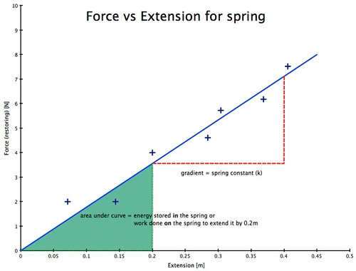
Learning Outcome: Describe elastic deformation and Hooke’s law
Springs or metal wire
Hooke’s Law:
Force is directly proportional to extension
F = kE
K = Spring constant

Slide 12
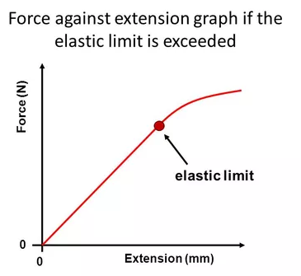
Learning Outcome: Describe elastic deformation and Hooke’s law
Springs or metal wire
Behave elastically up to “limit of proportionality” (also known as the elastic limit)
This is the point at which force and extension are no longer directly proportional (no longer follows Hooke’s law)

Slide 13
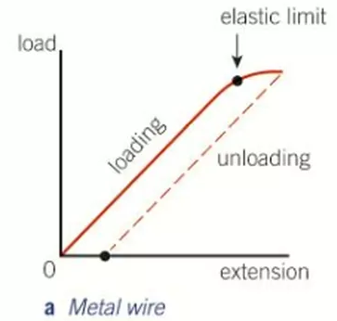
Learning Outcome: Describe plastic deformation
Springs or metal wire
Behave elastically up to “limit of proportionality”
Elastic- Returns to original size/shape once the load is removed
After the limit behaves plastically
Plastic- Doesn’t return to same size/shape after load is removed

Slide 14
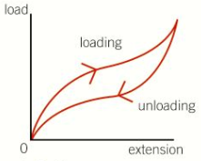
Learning Outcome: Describe plastic deformation
Rubber
Does not follow Hooke’s law (force is not directly proportional to extension)
Shows elastic deformation
Curve is known as a hysteresis loop. More work is done to load than released by unloading- the difference is thermal energy

Slide 15
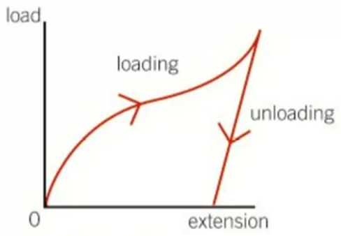
Learning Outcome: Describe plastic deformation
Polythene/blu tack
Does not follow Hooke’s law (force is not directly proportional to extension)
Shows plastic deformation- material does not return to its original shape when the load is removed

Slide 16
Learning Outcome: Calculate elastic potential energy
Given the fact that:
Work done = Force x distance
Show that:
1) The area under a force vs. extension graph is equal to work done to deform the object
2) Elastic potential energy =
0.5 x spring constant x extension²
Ep = ½ ke²

Slide 17
Learning Outcome: Calculate elastic potential energy
Given the fact that:
Work done = Force x distance
Show that:
1) The area under a force vs. extension graph is equal to work done to deform the object
Area under graph = 0.5 x force x extension (extension is equivalent to distance)
Work done (W) = 0.5 x force (f) x distance (d)
(0.5 because it is a triangle, this gives avg. work done)
2) Ep = ½ ke²
Area under graph = W = 0.5Fd, as distance = extension this can be written: W= 0.5Fe
Hookes law: F=ke
Therefore W = 0.5 kee or ke²
Work done is equal to Elastic potential energy (Ep), so:
Ep = ½ ke²

Slide 18
A-Level Physics
1. Development of practical skills in physics
2. Foundations of Physics
3. Forces and motion
4. Electrons, waves and photons
5. Newtonian world and astrophysics
6. Particles and medical physics
3.1 Motion
3.2 Forces
3.3. Work, Energy and power
3.4. Materials
3.5 Newton’s laws and momentum
3.4.1 Hooke’s Law
3.4.2. Elastic versus plastic deformation and potential energy
3.4.3. Stress, strain and Young’s modulus
3.4.4. Deforming materials

Slide 19
Stress, strain and Young’s modulus
Define and calculate stress
Define and calculate strain
Calculate Young’s modulus

Slide 20
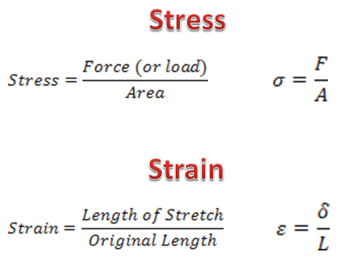
Stress – Force applied per unit cross-sectional area of a material
Learning Outcome: Define stress and strain
Strain- fractional change from the original material length
Extension
x

Slide 21
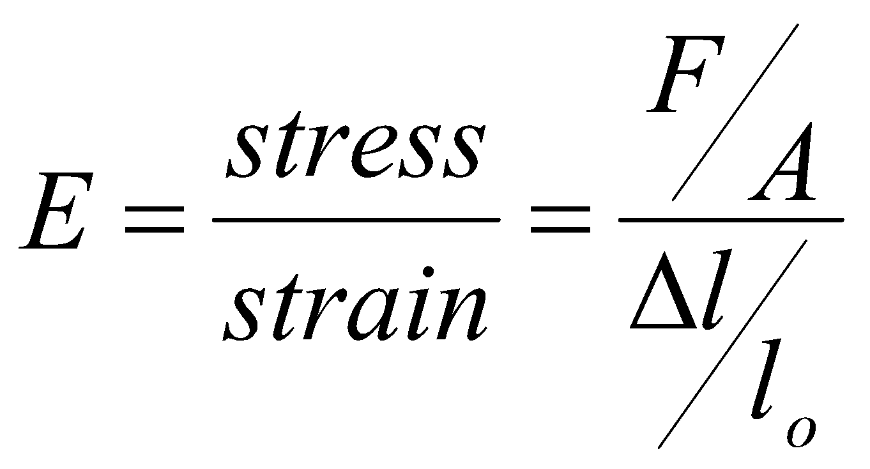
Learning Outcome: Calculate Young modulus
The ratio of stress to strain is known as Young Modulus (E)

Slide 22
A-Level Physics
1. Development of practical skills in physics
2. Foundations of Physics
3. Forces and motion
4. Electrons, waves and photons
5. Newtonian world and astrophysics
6. Particles and medical physics
3.1 Motion
3.2 Forces
3.3. Work, Energy and power
3.4. Materials
3.5 Newton’s laws and momentum
3.4.1 Hooke’s Law
3.4.2. Types of deformation and elastic potential energy
3.4.3. Stress, strain and Young’s modulus
3.4.4 Deforming various materials

Slide 23
Deforming various materials
Describe the stress-strain relationship for a ductile metal
Describe the difference between brittle and ductile materials
Describe stress-strain relationships for polymetric materials

Slide 24
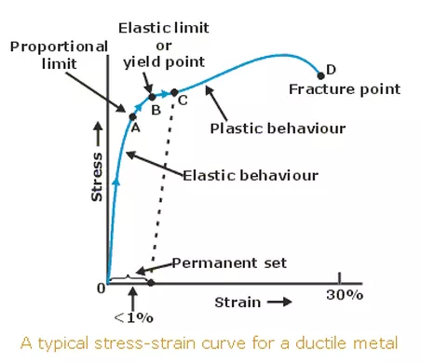
Ductile* Metal
Learning Outcome: stress-strain relationship for a ductile metal
*Ductile- can easily be drawn into a wire or hammered into sheets
D
E
A- limit of proportionality, before this stress is directly proportional to strain, obeys Hooke’s law
B- Elastic limit- beyond this deformation is permanent
C- Yield point- region where material expands rapidly (often shown as an upper and lower point). Typical of mild steel, not seen in all materials
D- Ultimate tensile strength, max stress a material can withstand when being stretched before it breaks. Beyond this point necking may occur (it will become longer and thinner at its weakest point)
E- Fracture point- material breaks here. Stress value= breaking strength

Slide 25
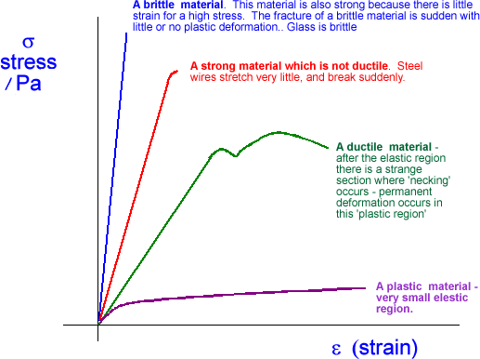
Learning Outcome: The difference between brittle and ductile materials
Notes:
Brittle versus ductile materials

Slide 26
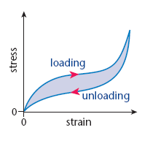
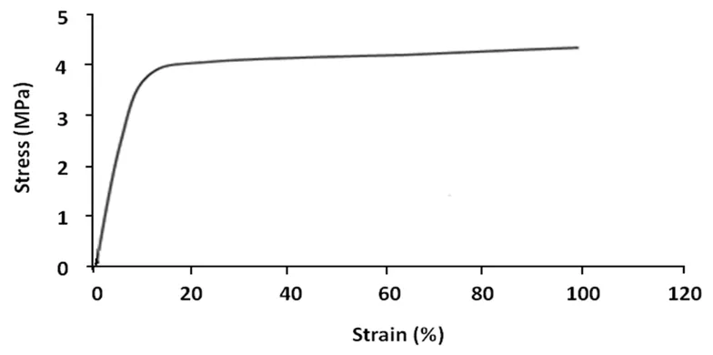
Polymeric materials - Consist of long molecular chains, both typically stretch a lot before breaking but this is dependent on their temperature
Learning Outcome: Stress-strain relationships for polymeric materials
Rubber
Polythene
Elastic behaviour
Plastic behaviour

