Slide 1
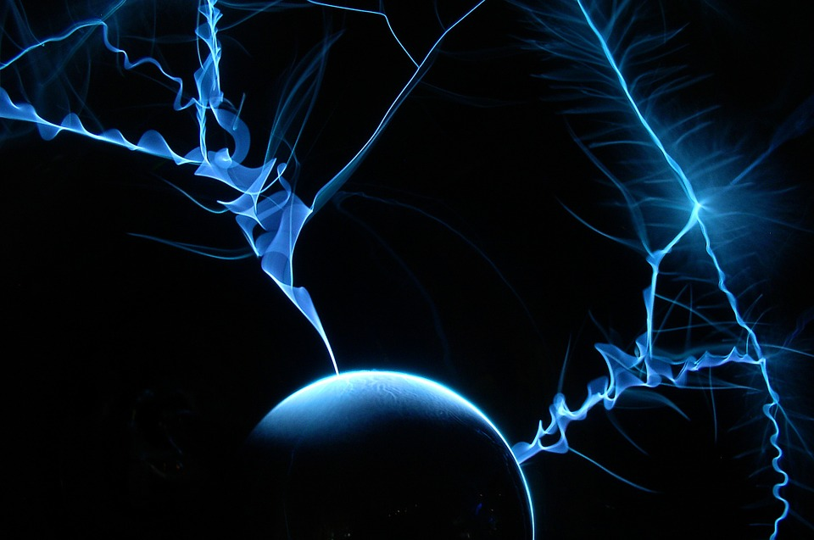
Exploring Physics- Possible long answer questions
Notes:
Electricity
Electro and magnetic fields and magnetism
Waves
Quantum, nuclear and particle physics
Medical physics

Slide 2
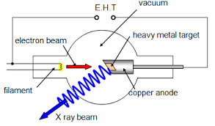
6.5.1 How are x-rays generated?
High speed electrons fired from a cathode
Towards a metal anode
X-rays are then produced in two ways:
Electrons decelerate as they interact with electric field around the nucleus of metal atoms
X-rays emitted due to conservation of energy. Kinetic energy lost = energy of photon
Or
Fast moving electron ejects inner electron .
Electron from higher energy level fills gap, releasing energy related to energy of an x-ray photon

Slide 3
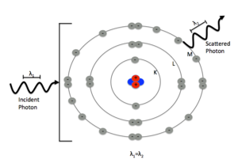
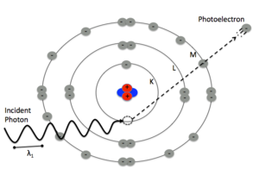
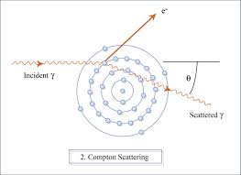
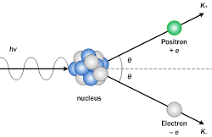
6.5.2 Explain how x-rays can be attenuated
Attenuation method | Diagram | What happens to the x-ray photon? | Ionisation occurs? | Final X-ray energy | Initial X-ray energy/ frequency
Simple scattering |  | Photon is scattered (changes direction), but there is no change in energy and no absorption. Causes noise in image | No- insufficient energy | Same | Low
Photoelectric effect |  | X-ray photons interact with an atom and cause electron to be emitted with a max K_{E} equal to the energy of the x-ray | Yes | Zero | Medium
Compton scattering |  | X-rays interact with an atom causing an electron to be ejected with a small fraction of the kinetic energy lost by the X-ray photon. A photon is also emitted with the remaining energy. The electron and photon are emitted in different directions owing to the conservation of momentum | Yes | Reduced | High
Pair production |  | X-ray photon interacts with the nucleus of an atom causing the photon to vanish and a positron and electron pair to be produced | Yes? | Zero | Very high

Slide 4
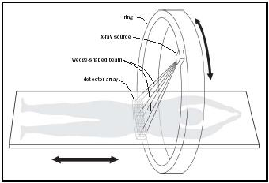
6.5.1 Explain how CAT scans work
Ring of detectors around person
X-ray source emits thin fan-shaped wedge of x-rays through person which are detected by person.
Source moves around person to cover 360° and build up image of slice through person
Whole ring of detector and source can be moved vertically along person to build up 3D images
Computer puts together slices to form 3D image

Slide 5
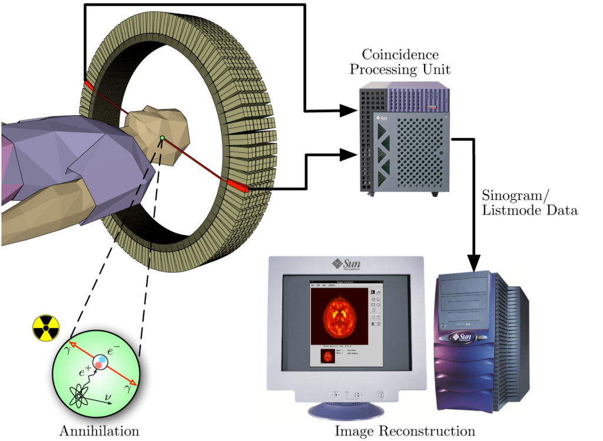
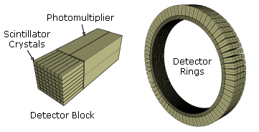
6.5.1 Explain how PET scans work
Ring of detectors around person
Person has been injected/ingested radioactive tracer emitting gamma radiation
Tracer emits positrons
A positron and electron (from the body) annihilate producing two gamma photons in opposite directions
Small difference in arrival times of gamma photons is recorded allowing accurate pinpointing of where decay occurs
Scintillator crystals in detector ring turn gamma photons into visible light
Photomultiplier amplifies signal
Computer turns data into 3D image

Slide 6
6.5.1 Explain the difference between an A and B ultrasound scan
A-scan | B-scan
Amplitude scan Short pulse of ultrasound sent into body at the same time an electron beam travels across a cathode ray oscilloscope screen (CRO). When transducer receives reflected pulses vertical spikes are seen on the CRO screen X-axis of graph shows time echo detected by the transducer which can be used to work out depths of reflecting tissue No photo produced | Brightness scan More common Real time 2D or 3D image of scanned area is built up from multiple returning echos from either several transducers in an array or one transducer moved around to different angles Greater amplitude of reflected pulse= brighter dot Range of brightnesses will be shown from boundaries between bone/liquid/soft tissue. (A B-scan is multiple A-scans)

Slide 7
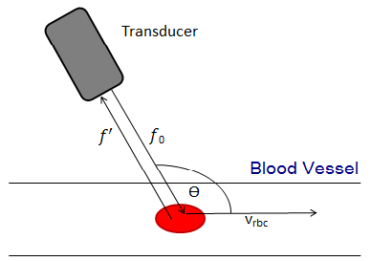
6.5.1 Explain how blood flow speed can be measured
The double doppler effect is the apparent change in frequency of a wave being reflected off a moving object and back to the transmitter
The double doppler effect can be used with ultrasound and a transducer to measure the speed of blood in a person (or other animal)
Information you need to know to calculate the speed:
Original frequency, f
New (returned) frequency, f’
Speed of ultrasound in medium, c
Angle between transducer and blood flow direction, Ө
v= c(f’-f)
2f’
V_{rbc}=vcosӨ
V_{rbc} = c(f’-f)
2f’cosӨ

