Slide 1
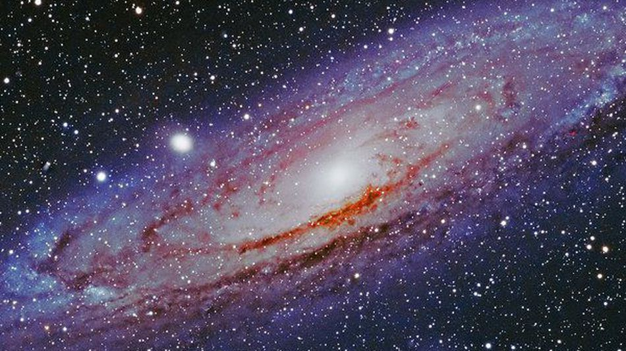
Astrophysics
Notes:
https://www.youtube.com/watch?v=fT5Me0ElOE8

Slide 2
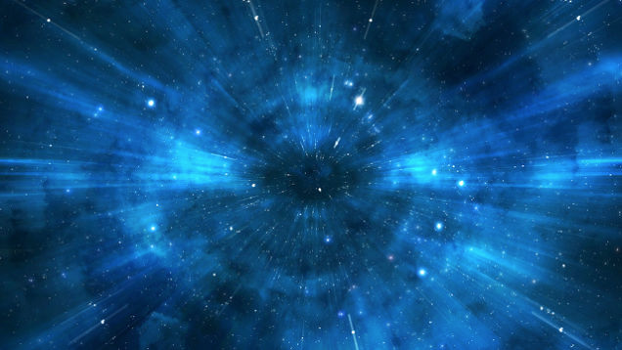
A-Level Physics
1. Development of practical skills in physics
2. Foundations of Physics
3. Forces and motion
4. Electrons, waves and photons
5. Newtonian world and astrophysics
6. Particles and medical physics
5.1 Thermal Physics
5.2 Circular motion
5.3. Oscillations
5.4. Gravitational fields
5.5 Astrophysics
1. Universe structure
2. Star formation
3. Star’s radiation
4. Wien and Stefan’s law
5. Astronomical distances
6. Doppler effect & red shift
7. CMBR and the cosmological principle
8. Universe evolution and expansion
9. Dark matter and dark energy

Slide 3
Your place in the universe
Understand the scale of the universe
State features of the universe
Explain the properties and scale of features of the universe

Slide 4
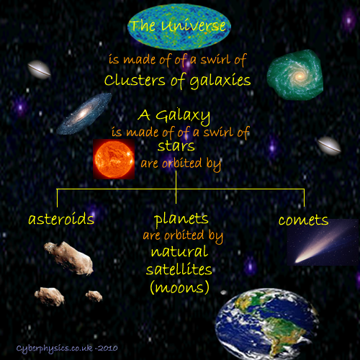
Notes:
Buzzfeed
https://www.youtube.com/watch?v=1Eh5BpSnBBw
Morgan freeman
https://www.youtube.com/watch?v=qxXf7AJZ73A

Slide 5
A-Level Physics
1. Development of practical skills in physics
2. Foundations of Physics
3. Forces and motion
4. Electrons, waves and photons
5. Newtonian world and astrophysics
6. Particles and medical physics
5.1 Thermal Physics
5.2 Circular motion
5.3. Oscillations
5.4. Gravitational fields
5.5 Astrophysics
1. Universe structure
2. Star formation
3. Star’s radiation
4. Wien and Stefan’s law
5. Astronomical distances
6. Doppler effect & red shift
7. CMBR and the cosmological principle
8. Universe evolution and expansion
9. Dark matter and dark energy

Slide 6
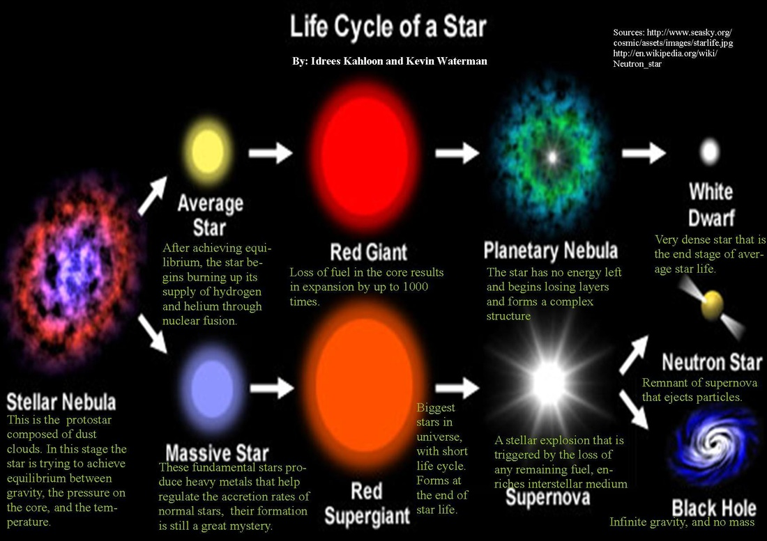
5.5.2 Describe the development of a star from formation to death

Slide 7
5.5.2 Describe the development of a star from formation to death- key points for long answer questions- LEARN THESE!!
Protostars- gravity greater than radiation pressure- collapse inwards increases kinetic energy and temperature
Main sequence star (when gas pressure in (gravity) =radiation pressure out (caused by fusion)
Hydrogen to helium fusion in main sequence stars (4 protons = 1 helium+ 2 gamma rays + 2 neutrinos + 2 positrons)
Next step depends on mass (Chandrasekhar limit):
Less than 1.4 x mass of sun- red giant route:
Runs out of hydrogen to fuse = no radiation pressure = collapse inwards= increased temp - outer layers expand due to heating but core contracts = helium fusion to heavier elements
When helium runs out star collapses again- outer layers ejected forming planetary nebula, core left behind forms white dwarf- no more fusion but still hot- cools down over time
- More than 1.4 x mass of sun
- Similar to previous but becomes red supergiant- multiple stages of fusion, to Fe
- In each stable fusion phase degeneracy pressure of electrons (repulsive
force between electrons) and radiation pressure stop gravitational collapse
Supernovae explosion due to immense gravitational pressure - protons and electrons combine to form neutrons- triggers explosion of outer shell
Neutron star- remnants of core- very dense
Black hole- very very dense neutron star- light itself can’t escape its gravity
Notes:
Gas and radiation pressure equal in main phase

Slide 8
A-Level Physics
1. Development of practical skills in physics
2. Foundations of Physics
3. Forces and motion
4. Electrons, waves and photons
5. Newtonian world and astrophysics
6. Particles and medical physics
5.1 Thermal Physics
5.2 Circular motion
5.3. Oscillations
5.4. Gravitational fields
5.5 Astrophysics
1. Universe structure
2. Star formation
3. Wien and Stefan’s law
4. Radiation from stars
5. Astronomical distances
6. Doppler effect & red shift
7. CMBR and the cosmological principle
8. Universe evolution and expansion
9. Dark matter and dark energy

Slide 9
Wein and Stefan’s laws
Describe and explain features of a Hertzsprung-Russell diagram
Describe how the temperature is linked to wavelength of light using Wein’s displacement law
Explain how Stefan’s law explains the luminosity of stars

Slide 10
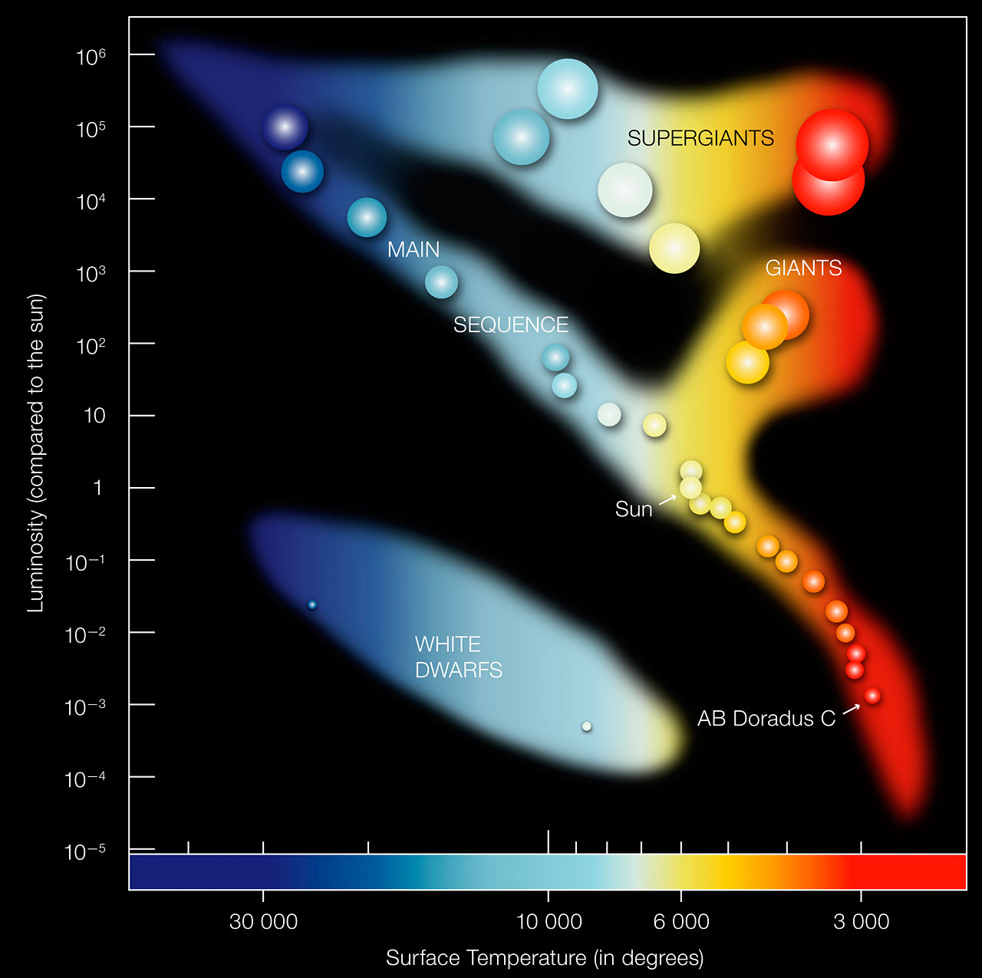
Learning Outcome: Describe and explain features of a Hertzsprung-Russell diagram
Hertzsprung-Russell diagram
How does a star evolve through the Hertzsprung-Russell diagram- what properties change?
What is the relationship between luminosity and surface temperature
Why are giants and supergiants so luminous?
1= 3.85 x 10²⁶ W
Notes:
1L = 3.85 x 10^26 W

Slide 11
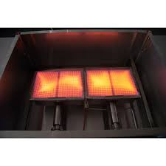
Learning Outcome: Describe how the temperature is linked to wavelength of light using Wein’s displacement law
Colour-temperature relationship
The wavelength, and therefore the colour, of electromagnetic radiation emitted by an object depends on its temperature.
This can be seen on a grill, where lower temperatures glow a dull red colour, and higher temperatures are more orange.
White hot areas emit all wavelengths of visible light.

Slide 12
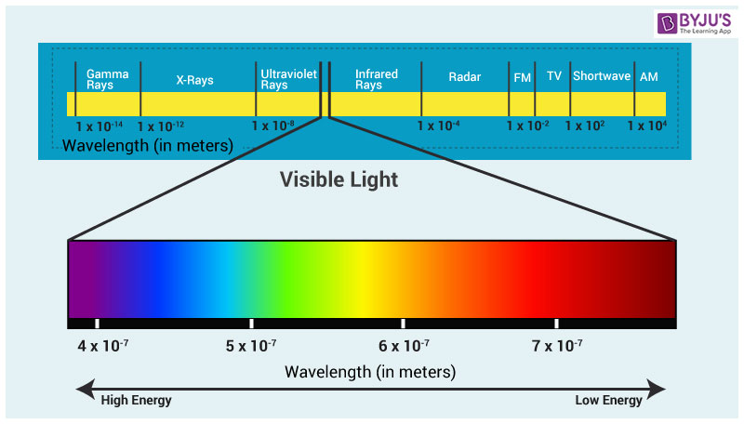
Learning Outcome: Describe how the temperature is linked to wavelength of light using Wein’s displacement law
Colour-temperature relationship

Slide 13
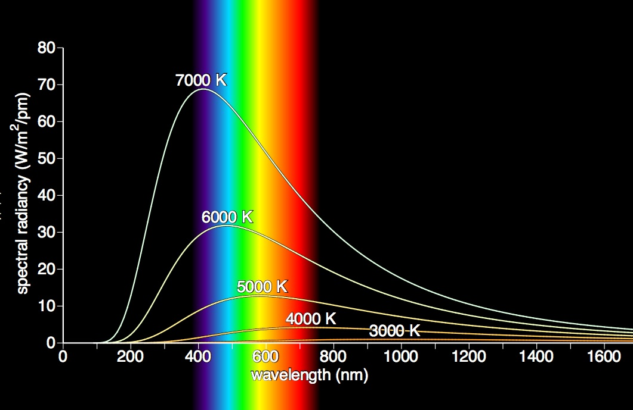
Learning Outcome: Describe how the temperature is linked to wavelength of light using Wein’s displacement law
Black-body radiation
A black body is an idealised object that absorbs all electromagnetic radiation that shines into it and emits a characteristic distribution of wavelengths at a particular temperature

Slide 14
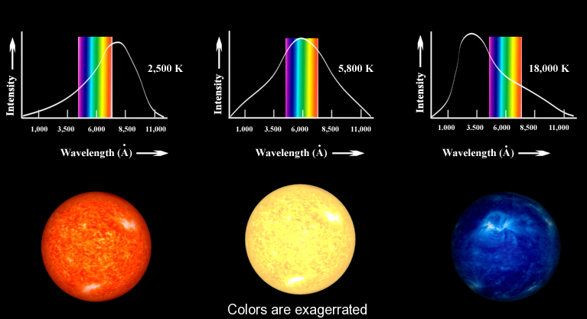
Learning Outcome: Describe how the temperature is linked to wavelength of light using Wein’s displacement law

Slide 15
Learning Outcome: Describe how the temperature is linked to wavelength of light using Wein’s displacement law
The spectrum for any hot body is continuous in nature and has a peak that corresponds to a particular wavelength
We call this wavelength 𝞴_{max}.
Note this is NOT the maximum wavelength given off by the star, it is the wavelength that corresponds to the peak intensity.
The relationship between 𝞴_{max} and temperature is given by Wein’s displacement law:
𝞴_{max} ∝ 1/T
or 𝞴_{max} T = constant (Wein’s constant: 2.89 x 10⁻³ m K)

Slide 16
Learning Outcome: Describe how the temperature is linked to wavelength of light using Wein’s displacement law
𝞴_{max} ∝ 1/T or 𝞴_{max} T = constant (2.89 x 10⁻³ m K)
Object | 𝞴_{max} (m) | T (K)
A cow | 9.4 x 10⁻⁶ | 310
Wood fire | 1.9 x 10⁻⁶ | 1500
The sun | 5 x 10⁻⁷ | 5800
A white dwarf | 1.2 x 10⁻⁷ | 25,000
A red giant | 8.5 x 10⁻⁷ | 3400

Slide 17
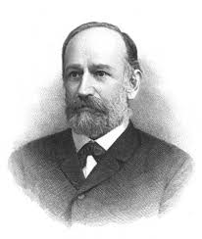
Learning Outcome: Explain luminosity of a star and Stefan’s law
Luminosity and Stefan’s law
The luminosity of a star is the total power that it emits.
Luminosity is related to temperature and surface area, and is given by the equation:
L = 4πr²𝝈T⁴
L is luminosity (W)
T is the star’s surface temperature (K)
r is the radius of the star (m)
𝝈 is the Stefan constant and has a value of 5.67 x 10⁻⁸ W m⁻²K⁻⁴

Slide 18
Learning Outcome: Explain luminosity of a star and Stefan’s law
L = 4πr²𝝈T⁴
L is luminosity (W), T is the star’s surface temperature (K)
r is radius (m), 𝝈 is the Stefan constant (5.67 x 10⁻⁸ W m⁻²K⁻⁴)
1) A star, Twinkle, has a radius of 1500 km and a surface temperature of 7200 K. What would be it’s luminosity?
2) If the surface temperature of Twinkle was doubled what would be the new luminosity?
3) A star, Bob, in the same galaxy, has half the mass but the same density and three times the original surface temperature. Derive an expression for the luminosity of Bob in terms of the luminosity of Twinkle

Slide 19
Learning Outcome: Explain luminosity of a star and Stefan’s law
L = 4πr²𝝈T⁴
L is luminosity (W), T is the star’s surface temperature (K)
r is radius (m), 𝝈 is the Stefan constant (5.67 x 10⁻⁸ W m⁻²K⁻⁴)
1) A star, twinkle, has a radius of 1500 km and a surface temperature of 7200 K. What would be it’s luminosity? 4.3x10²¹W
2) If the surface temperature of twinkle was doubled what would be the new luminosity? 6.9x10²²W
3) A star, bob, in the same galaxy, has half the mass but the same density and three times the original surface temperature. Derive an expression for the luminosity of bob in terms of the luminosity of twinkle. L_{Bob} = 51 L_{Twinkle}

Slide 20
Learning Outcome: Explain luminosity of a star and Stefan’s law
The peak wavelength of radiation emitted by our sun is about 500 nm, its surface temperature is 5800 K, and its luminosity is 3.85 x 10²⁶ W. The peak wavelength emitted by a nearby star with a luminosity 10 times our sun is 310 nm, what is the radius of this star?
840, 000 km

Slide 21
A-Level Physics
1. Development of practical skills in physics
2. Foundations of Physics
3. Forces and motion
4. Electrons, waves and photons
5. Newtonian world and astrophysics
6. Particles and medical physics
5.1 Thermal Physics
5.2 Circular motion
5.3. Oscillations
5.4. Gravitational fields
5.5 Astrophysics
1. Universe structure
2. Star formation
3. Wien and Stefan’s law
4. Star’s radiation
5. Astronomical distances
6. Doppler effect & red shift
7. CMBR and the cosmological principle
8. Universe evolution and expansion
9. Dark matter and dark energy

Slide 22
How do we know what stars are made of?
Describe energy levels in atoms
Apply energy levels to explain emission and absorption spectra
Explain how elements can be detected from emission and absorption spectra

Slide 23
Learning Outcome: Describe energy levels in atoms
Properties of electrons
Orbit the nucleus of an atom
Can occupy certain orbits- associated with quantised energies- energy levels
The energy levels are negative because energy is required for electrons to move away from the nucleus.
An electron energy is 0 at a very long distance from the atom.
To completely escape an atom of hydrogen (ionisation), an electron requires -13.6 eV
n =4
n =3
n =2
n =1
-13.6 eV
-3.41 eV
-1.51 eV
-0.85 eV

Slide 24
Learning Outcome: Describe energy levels in atoms
What happens when electrons move?
For an electron to go up energy levels they need to be given (absorbed) the exact amount of energy required.
e.g. To go from 1 to 2 requires 10.19 eV
If an electron drops down an energy level energy is emitted of the exact difference in the energy levels
E.g. dropping from 4 to 3 would give out 0.66 eV
E =4
E =3
E =2
E =1
-13.6 eV
-3.41 eV
-1.51 eV
-0.85 eV

Slide 25
Learning Outcome: Describe energy levels in atoms
Calculate the energy changes to the electron for the following energy transitions in a hydrogen atom:
An electron drops from E4 to E2
An electron rises from E2 to E3
An electron drops from E4 to E1
An electron rises from E1 to E3
An electron rises from E1 to E4
An electron drops from E3 to E2
E =4
E =3
E =2
E =1
-13.6 eV
-3.41 eV
-1.51 eV
-0.85 eV

Slide 26
Learning Outcome: Describe energy levels in atoms
Calculate the energy changes to the electron for the following energy transitions in a hydrogen atom:
An electron drops from E4 to E2 | 2.56 eV
An electron rises from E2 to E3 | 1.9 eV
An electron drops from E4 to E1 | 12.75 eV
An electron rises from E1 to E3 | 12.09 eV
An electron rises from E1 to E4 | 12.75 eV
An electron drops from E3 to E2 | 1.9 eV
E =4
E =3
E =2
E =1
-13.6 eV
-3.41 eV
-1.51 eV
-0.85 eV

Slide 27
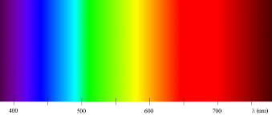
Emission and absorption spectra
Learning Outcome: Apply energy levels to explain emission and absorption spectra
Normal electromagnetic radiation will form a continuous spectrum of radiation at different wavelengths

Slide 28
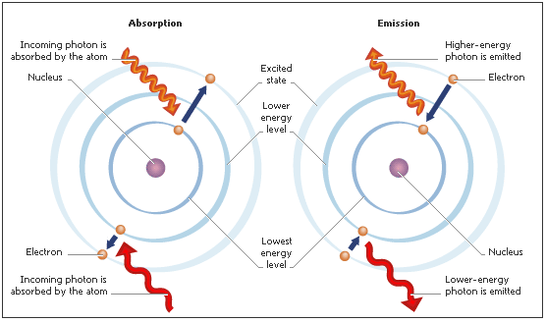
Emission and absorption spectra
Learning Outcome: Apply energy levels to explain emission and absorption spectra
Electrons absorb energy in the form of photons which cause them to go up energy levels.
Energy emitted when electrons drop down energy levels is emitted as photons

Slide 29
Emission and absorption spectra
Learning Outcome: Apply energy levels to explain emission and absorption spectra
As the energy of a photon is related to a wavelength of electromagnetic radiation this leads to absorption and emission spectra where particular wavelengths of light are absorbed and emitted
E = hc (E = hf, f= c)
λ λ

Slide 30
Emission spectra
Learning Outcome: Apply energy levels to explain emission and absorption spectra
A cooling hot gas will emit photons of electromagnetic radiation with a particular energy corresponding to the energy levels in the gas atoms
The energy emitted is related to a particular wavelength of radiation appearing as coloured lines on an emission spectra
Notes:
Produced in labs

Slide 31
Absorption spectra
Learning Outcome: Apply energy levels to explain emission and absorption spectra
As white light travels through a cool gas (e.g. light from a star core travelling through a hydrogen atmosphere). The gas will absorb particular wavelengths of light that correspond to energy required to raise up energy levels. This leads to black lines appearing on a spectrum where particular wavelengths have been absorbed
Notes:
Stars

Slide 32
Learning Outcome: Explain how elements can be detected from emission and absorption spectra
Absorption and emission lines for hydrogen occur at the following visible wavelengths:
656.3 nm
2) 486.1 nm
3) 434.0 nm
4) 410.2 nm
What energy level changes must be happening in the atom to generate each wavelength?
E =6
E =5
E =4
E =3
E =2
E =1
-13.6 eV
-3.4 eV
-1.51 eV
-0.85 eV
-0.54 eV
-0.38 eV
Notes:
Planks constant= 6.63 x 10^-34 Js
1J = 6.242 x 10^18 eV

Slide 33
Learning Outcome: Explain how elements can be detected from emission and absorption spectra
Absorption and emission lines for hydrogen occur at the following visible wavelengths:
656.3 nm E = 1.89 eV E2 – E3
2) 486.1 nm E = 2.55 eV E2 - E4
3) 434.0 nm E = 2.86 eV E2 - E5
4) 410.2 nm E = 3.03 eV E2 - E6
5) 397.0 nm, E2 - E7, E7 = ?
What energy level changes must be happening in the atom to generate each wavelength?
E =6
E =5
E =4
E =3
E =2
E =1
-13.6 eV
-3.4 eV
-1.51 eV
-0.85 eV
-0.54 eV
-0.38 eV

Slide 34
Learning Outcome: Explain how elements can be detected from emission and absorption spectra
Absorption and emission lines for hydrogen occur at the following visible wavelengths:
656.3 nm E = 1.89 eV E2 - E3
2) 486.1 nm E = 2.55 eV E2 - E4
3) 434.0 nm E = 2.86 eV E2 - E5
4) 410.2 nm E = 3.03 eV E2 - E6
5) 397.0 nm E = 3.13 eV E7 = -0.27
What energy level changes must be happening in the atom to generate each wavelength?
E =6
E =5
E =4
E =3
E =2
E =1
-13.6 eV
-3.4 eV
-1.51 eV
-0.85 eV
-0.54 eV
-0.38 eV

Slide 35
Learning Outcome: Explain how elements can be detected from emission and absorption spectra
An absorption spectra from a distant star shows absorption lines at wavelengths of 430 nm, 560 nm and 670 nm. Tom thinks that element X must be present in the star’s atmosphere, while Tina thinks element Y must be present. Who is correct and why?
X
E =4
Y
E =3
E =3
E =2
E =2
E =1
E =1
-6.52 eV
-10.2 eV
-4.31 eV
-7.99 eV
-3.63 eV
-7.31 eV
-2.46 eV
Notes:
Energy changes are 2.89, 2.21 and 1.85. X is correct.

Slide 36
Learning Outcome: Explain how elements can be detected from emission and absorption spectra

Slide 37
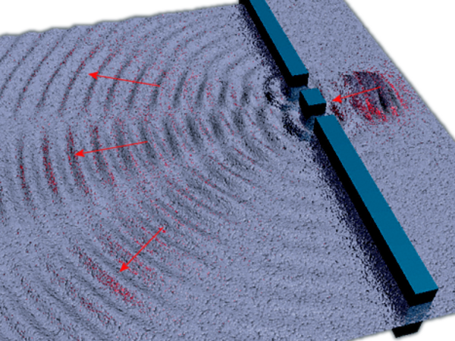
Measuring wavelengths of starlight
What can you remember about Young’s double slit experiment?
Notes:
Give out prepare for learning and get to complete first task

Slide 38
Measuring wavelengths of starlight
Review Young’s double slit experiment
Derive the grating equation to calculate wavelength
Calculate wavelengths of starlight

Slide 39
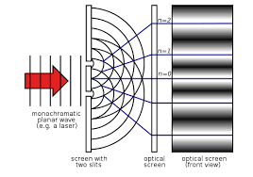
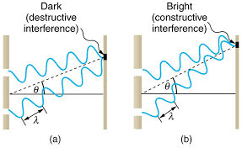
Young’s Double Slit Experiment
Learning Outcome: Review Young’s double slit experiment
A Monochromatic (single frequency) light source with wavelength λ spreads out from a point and passes through two slits in a screen, distance a apart
The light diffuses from each slit, creating two coherent wave sources that will interfere with each other
A screen placed distance D away will show an interference pattern of repeating bright and dark patches

Slide 40
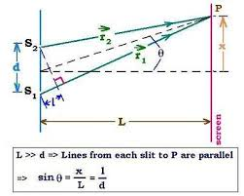
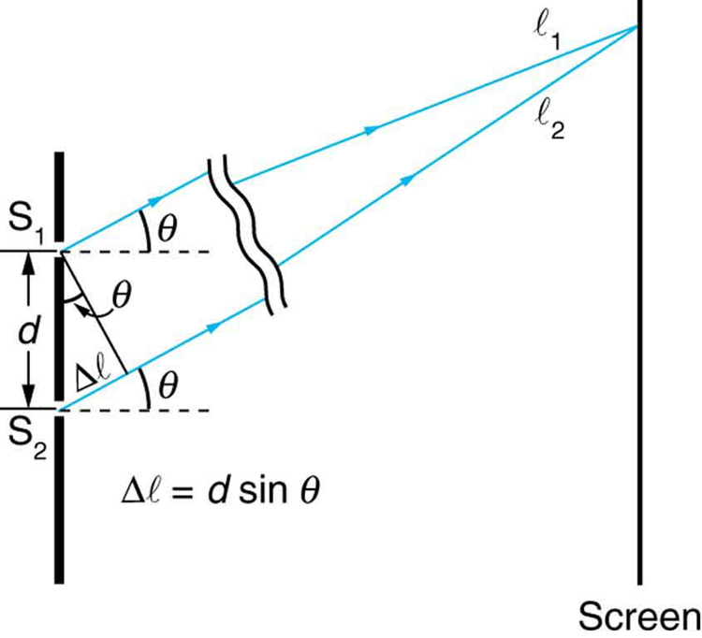
Young’s Double Slit Experiment
Learning Outcome: Review Young’s double slit experiment
As D must be much larger than a, we can assume θ to be identical and very small, therefore: sin θ = λ/a tan θ = x/D
If θ is small enough sin θ = tan θ so:
λ/a = x/D λ = ax/D
Where x is the separation distance between two adjacent maxima
a
a
λ
D

Slide 41
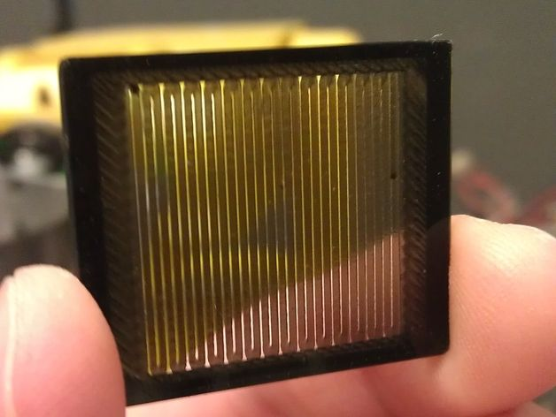
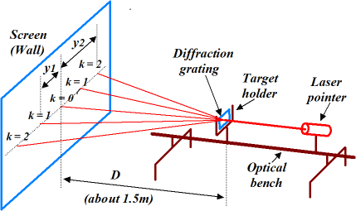
The diffraction grating
Learning Outcome: Derive the grating equation to calculate wavelength
A diffraction grating is a piece of optical equipment with many equally spaced grooves which can be used to determine the wavelength of light.
Multiple slits improves the brightness and sharpness of maxima over the Young’s double slit method plus maxima are further apart making angles easier to measure

Slide 42
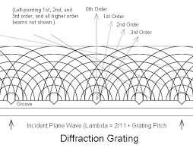
The diffraction grating
Learning Outcome: Derive the grating equation to calculate wavelength
As light passes through the slits it is diffracted
Constructive interference occurs as wave fronts overlap causing bright maxima to appear on the screen
Notes:
String wave reflected off tied down end
Air pipe- wave reflected off closed end

Slide 43
The diffraction grating
Learning Outcome: Derive the grating equation to calculate wavelength
For this to work the wavelengths must hit the slits in phase.
All waves resulting in a maxima must be a whole number of wavelengths apart, nλ, to be in phase.
The zero-order maximum occurs where they are 0 wavelengths apart, the first-order maximum occurs when they are 1 wavelength apart, the second-order occurs when they are 2 wavelengths apart and so on
Notes:
String wave reflected off tied down end
Air pipe- wave reflected off closed end

Slide 44
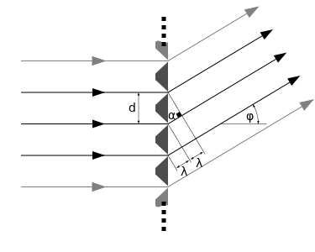
The diffraction grating
Learning Outcome: Derive the grating equation to calculate wavelength
Wavelength can be calculated from the slit separation, d:
d sin θ = nλ
Where n is the order of the maximum or number of wavelengths difference and θ is the angle the beam makes with the grating (relative to the normal)
Notes:
String wave reflected off tied down end
Air pipe- wave reflected off closed end

Slide 45
Learning Outcome: Calculate wavelengths of starlight
A diffraction grating with grating spacing of 3.3 x 10⁻⁶ m is used to observe light from a star. The spectral line produces a first-order image at a diffraction angle of 8.6°. Calculate the wavelength of this spectral line. 490 nm
Calculate the angle of the third-order maximum when light of wavelength 450 nm is incident on a diffraction grating with 350 lines/mm. 28 degrees
A spectral line from a distant star is analysed using a diffraction grating with a grating spacing of 2.5 x 10⁻⁶ m. An absorption line in the first-order spectrum is observed at an angle of 13.4°. Calculate the energy in eV of the photons responsible for this spectral line. 2.1 eV
Notes:
String wave reflected off tied down end
Air pipe- wave reflected off closed end

Slide 46
A-Level Physics
1. Development of practical skills in physics
2. Foundations of Physics
3. Forces and motion
4. Electrons, waves and photons
5. Newtonian world and astrophysics
6. Particles and medical physics
5.1 Thermal Physics
5.2 Circular motion
5.3. Oscillations
5.4. Gravitational fields
5.5 Astrophysics
1. Universe structure
2. Star formation
3. Wien and Stefan’s law
4. Star’s radiation
5. Astronomical distances
6. Doppler effect & red shift
7. CMBR and the cosmological principle
8. Universe evolution and expansion
9. Dark matter and dark energy

Slide 47
Astronomical distances
Define units for astronomical distances
Explain what is meant by parallax and the unit parsec
Use parallax to calculate distance

Slide 48
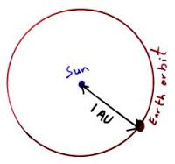
Learning Outcome: Define units for astronomical distances
The Astronomical Unit (AU)
The ASTRONOMICAL UNIT of distance is the mean distance from the centre of the earth to the centre of the sun.

Slide 49
Learning Outcome: Define units for astronomical distances
The Astronomical Unit (AU)
Used for studies of the solar system. Its value has been measured to 8 significant figures and is given in standard form as:
1 astronomical unit (AU) = 1.496 x 10¹¹ m

Slide 50
Learning Outcome: Define units for astronomical distances
The light year
The light-year is the distance that light will travel in one year. It is a measure of distance and not time.
Use the equation s = d/t to calculate how long a light year is in metres

Slide 51
Learning Outcome: Define units for astronomical distances
The light year
The light-year is the distance that light will travel in one year. It is a measure of distance and not time.
Use the equation s = d/t to calculate how long a light year is in metres
9.46 x 10¹⁵ m

Slide 52
Learning Outcome: Explain what is meant by parallax and the unit parsec
The parsec (pc)
How long did it take Han Solo to do the Kessel Run?
Notes:
https://www.youtube.com/watch?v=bosSsgzgenA

Slide 53
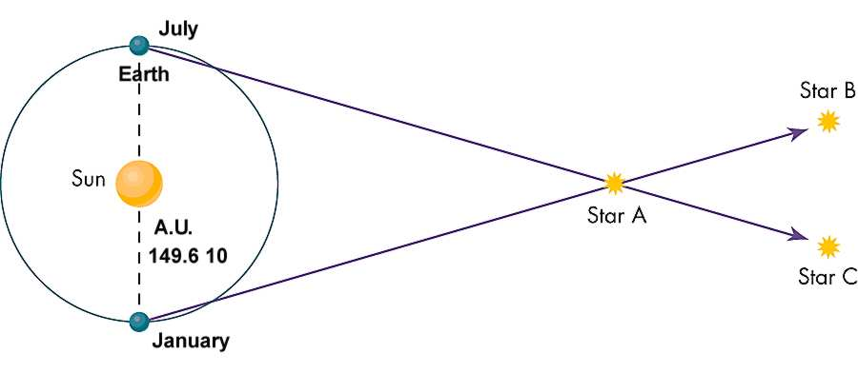
Learning Outcome: Explain what is meant by parallax and the unit parsec
The principle of parallax is based on how the position of an object appears to change depending on where it is observed from.
The distance to a star can be calculated with the stellar parallax method by observing how its position against a fixed background of stars changes when viewed from different positions.
Notes:
https://www.youtube.com/watch?v=bosSsgzgenA

Slide 54
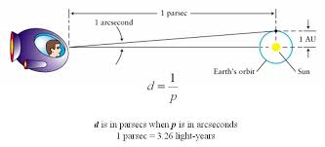
Learning Outcome: Explain what is meant by parallax and the unit parsec
The parsec (pc)
A star will be exactly (1 pc) away from Earth when the angle of parallax subtended by the radius of the earth’s orbit (1AU) is one arcsecond (or 1/3600 of a degree)

Slide 55
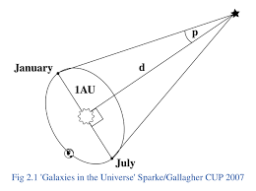
Learning Outcome: Explain what is meant by parallax and the unit parsec
Defining the parsec
Use trigonometry to find the value of a parsec

Slide 56
Learning Outcome: Explain what is meant by parallax and the unit parsec
Defining the parsec
tan p = 1 AU
d
tan (1/3600) = 1.496 x 10¹¹ m
d
d = 1.496 x 10¹¹ m
tan (1/3600)
or d = 3.1 x 10¹⁶ m

Slide 57
Learning Outcome: Use parallax to calculate distance
For the right angled triangle below, tan p = r/d.
For small angles expressed in radians, tan p ≅ p.
Using this approximation, it can be shown that the relationship between the distance to a star from the earth, and the angle of stellar parallax, is given by p = 1/d
d = distance in parsecs, p is the stellar parallax measured in arcseconds (1/3600 degrees)

Slide 59
A-Level Physics
1. Development of practical skills in physics
2. Foundations of Physics
3. Forces and motion
4. Electrons, waves and photons
5. Newtonian world and astrophysics
6. Particles and medical physics
5.1 Thermal Physics
5.2 Circular motion
5.3. Oscillations
5.4. Gravitational fields
5.5 Astrophysics
1. Universe structure
2. Star formation
3. Star’s radiation
4. Wien and Stefan’s law
5. Astronomical distances
6. Doppler effect & red shift
7. CMBR and the cosmological principle
8. Universe evolution and expansion
9. Dark matter and dark energy

Slide 60
Doppler effect and redshift
Explain the Doppler effect
Describe the redshift of galaxies from spectral data
Interpret Hubble’s Law

Slide 61
Learning Outcome: Explain the Doppler effect
4m
2m
t=0s
t=1s
t=2s
t=3s

Slide 62
Learning Outcome: Explain the Doppler effect
4m
2m
t=0s
t=1s
t=2s
t=3s

Slide 63
Learning Outcome: Explain the Doppler effect
4m
2m
t=0s
t=1s
t=2s
The original frequency, f, of a wave from a source moving towards an observer has an apparent higher frequency at the observer.
t=3s

Slide 64
Doppler Effect
Learning Outcome: Explain the Doppler effect
The apparent change in the frequency of a wave caused by relative motion between the source of the wave and an observer
For an approaching source, the frequency rises and the wavelength decreases. The opposite is true for a receding source - in this case, the wavelength increases and the frequency decreases.

Slide 65
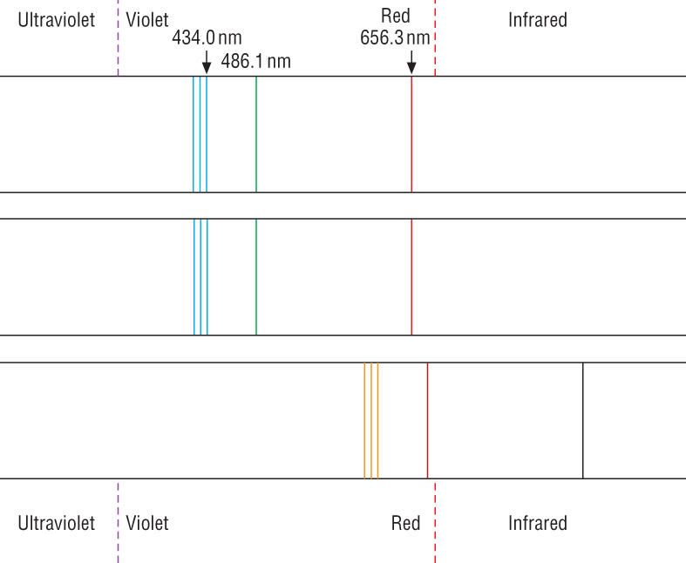
Redshift of stars
Learning Outcome: Describe the redshift of galaxies from spectral data
(a) Shows the spectrum of hydrogen as seen in a laboratory;
(b) shows the same spectrum from a star in the Milky Way, our own galaxy;
(c) shows a large redshift in the same spectrum from a distant galaxy.

Slide 66
Learning Outcome: Describe the redshift of galaxies from spectral data
In the laboratory the wavelength of the blue line in the hydrogen spectrum is 434.0nm. The light from a distant quasar shows that the corresponding line has a wavelength of 616.3nm. How fast is the quasar receding?

Slide 67
Learning Outcome: Describe the redshift of galaxies from spectral data
In the laboratory the wavelength of the blue line in the hydrogen spectrum is 434.0nm. The light from a distant quasar shows that the corresponding line has a wavelength of 616.3nm. How fast is the quasar receding?
Δλ is 616.3-434.0 = 182.3 nm
Δλ/λ is 182.3nm / 434.0nm = 0.420
v/c = 0.420 x 3.00x10⁸ms⁻¹ = 1.26 x10⁸ms⁻¹.

Slide 68
Learning Outcome: Describe the redshift of galaxies from spectral data
Each of the following galaxies originally show a Hydrogen absorption line at 434.0 nm.
For each galaxy calculate its recessional speed using the observed wavelength.
Plot a graph of recessional speed in kms⁻¹ (y-axis) versus distance in Mpc (x-axis)
Galaxy | Distance from Earth (Mpc) | Observed wavelength (nm) | Recessional speed (kms⁻¹)
NGC-5357 | 3.5 | 434.3038 | 210
NGC-3627 | 7 | 434.9548 | 660
NGC-5236 | 6 | 434.7378 | 510
NGC-4151 | 12 | 435.3888 | 960
NGC-4472 | 14 | 435.2152 | 840
NGC-4486 | 12 | 435.1718 | 810
NGC-4649 | 15 | 435.5624 | 1080

Slide 69
Hubble’s Law
Learning Outcome: Interpret Hubble’s Law
Hubble knew the distances to some comparatively close galaxies. He found the small redshift for these galaxies and calculated their corresponding speed of recession.
When he plotted a graph of speed of recession against distance from the earth, he obtained a straight line graph.
Hubble’s law states:
The speed of the recession of a galaxy is directly proportional to its distance from the Earth.
H₀ is a constant known as Hubble’s Constant

Slide 70
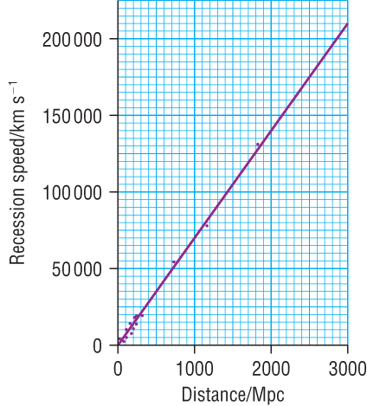
Hubble’s Law
Learning Outcome: Interpret Hubble’s Law
The speed of the recession of a galaxy is directly proportional to its distance from the Earth.

Slide 71
Hubble’s Law problems
Learning Outcome: Interpret Hubble’s Law
It is very difficult to obtain an accurate value of Hubble’s constant.
The problem is that the most accurate values of distance and recession speeds are those obtained from close stars and galaxies.
Even here the problem is complicated by the fact that both stars and galaxies are rotating as well as receding.
The value of the Hubble constant above is the latest value, but over the last 50 years, values between 50 and 100 km s⁻¹ Mpc⁻¹ have also been given.

Slide 72
Age of the universe from Hubble’s Law
Learning Outcome: Interpret Hubble’s Law
Hubble’s constant is given the units of km s⁻¹ Mpc⁻¹, that is, kilometres per second (the unit of speed of recession) per Megaparsec (the unit of distance from Earth).
If this is converted into seconds, then years, an age since the start of expansion can be determined (from the big bang)
= 4.35 x 10¹⁷ s = 1.38 x 10¹⁰ years or ~ 14 billion years

Slide 73
A-Level Physics
1. Development of practical skills in physics
2. Foundations of Physics
3. Forces and motion
4. Electrons, waves and photons
5. Newtonian world and astrophysics
6. Particles and medical physics
5.1 Thermal Physics
5.2 Circular motion
5.3. Oscillations
5.4. Gravitational fields
5.5 Astrophysics
1. Universe structure
2. Star formation
3. Star’s radiation
4. Wien and Stefan’s law
5. Astronomical distances
6. Doppler effect & red shift
7. CMBR and the cosmological principle
8. Universe evolution and expansion
9. Dark matter and dark energy

Slide 74
CMBR and the cosmological principle
Explain what cosmic microwave background radiation is
Apply CMBR to support the big bang theory
Apply CMBR to the cosmological principle

Slide 75
Cosmic Microwave Background Radiation (CMBR)
Learning Outcome: Explain what cosmic microwave background radiation is
Notes:
https://www.youtube.com/watch?v=3tCMd1ytvWg

Slide 76
Cosmic Microwave Background Radiation (CMBR)
Learning Outcome: Explain what cosmic microwave background radiation is
In 1965, Penzias and Wilson used a radio telescope to examine the radio spectrum of various parts of the sky.
Wherever their radio telescope pointed, they picked up unwanted noise. This “noise”:
- Had the same frequency peak and amplitude from all points in the sky wherever there seemed to be nothing (it pervaded all of space)
- It did not vary from day to night or winter to summer
- Had a maximum intensity at a wavelength of 1.063 mm

Slide 77
Cosmic Microwave Background Radiation (CMBR)
Learning Outcome: Explain what cosmic microwave background radiation is
The peak intensity of the radiation was found to be 1.063 mm.
Using Wein’s law, what would the temperature of the radiation be?
λ_{max}T = 2.89 x 10⁻³ m K
T = 2.89 x 10⁻³
1.063 x 10⁻³
Found it to be 2.72 K.

Slide 78
Cosmic Microwave Background Radiation (CMBR)
Learning Outcome: Explain what cosmic microwave background radiation is
What Penzias and Wilson were observing was radiation present at the big bang.
These photons would originally have had a high temperature and energy and would have had a shorter wavelength
Owing to expansion of the universe since the big bang the radiation has been extremely red shifted
This makes the wavelength longer and decreases frequency, which has the effect of decreasing temperature (think of Wein’s law)

Slide 79
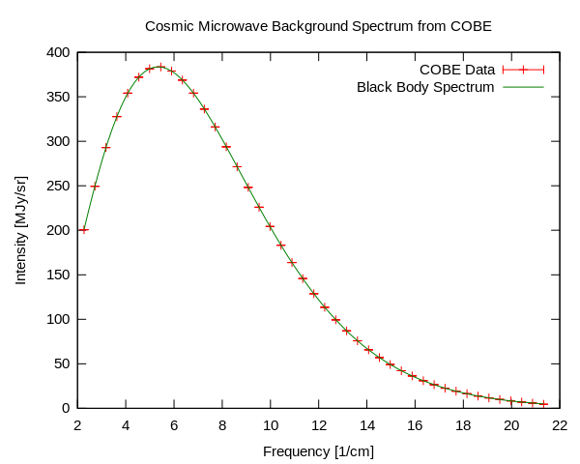
Learning Outcome: Explain what cosmic microwave background radiation is

Slide 80
Universe theory’s
Learning Outcome: Apply CMBR to support the big bang theory
Steady state theory versus the Big Bang theory

Slide 81
Universe expansion theory’s
Learning Outcome: Apply CMBR to support the big bang theory
Some astrophysicists thought that the universe was static and had existed for ever and that matter was continually being generated from nothing to account for the expansion of the universe. This is the steady-state theory.
Other astrophysicists proposed the 'big bang' theory. They calculated that from the big bang, the universe would expand and cool and that a background radiation would exist at a few degrees kelvin.
A steady-state universe would be cold, and there would be no background radiation.
Penzias and Wilson's discovery of cosmic microwave background radiation, at just the right temperature, therefore supported the big bang theory.

Slide 82
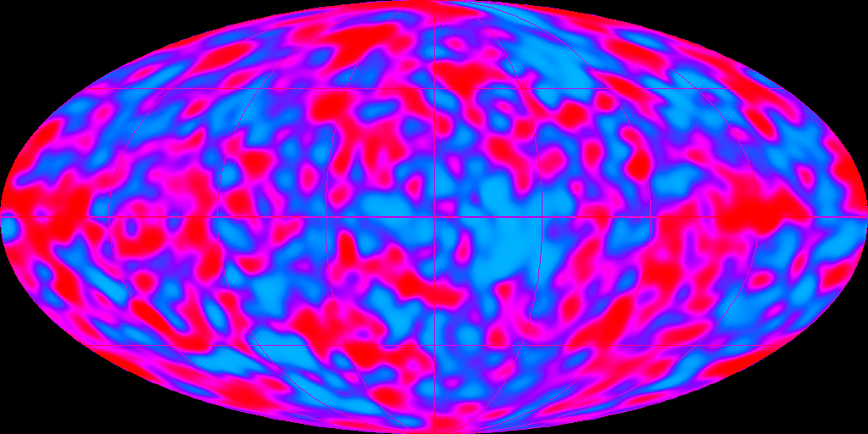
Learning Outcome: Apply CMBR to the cosmological principle
COBE (Cosmic Background explorer)

Slide 83
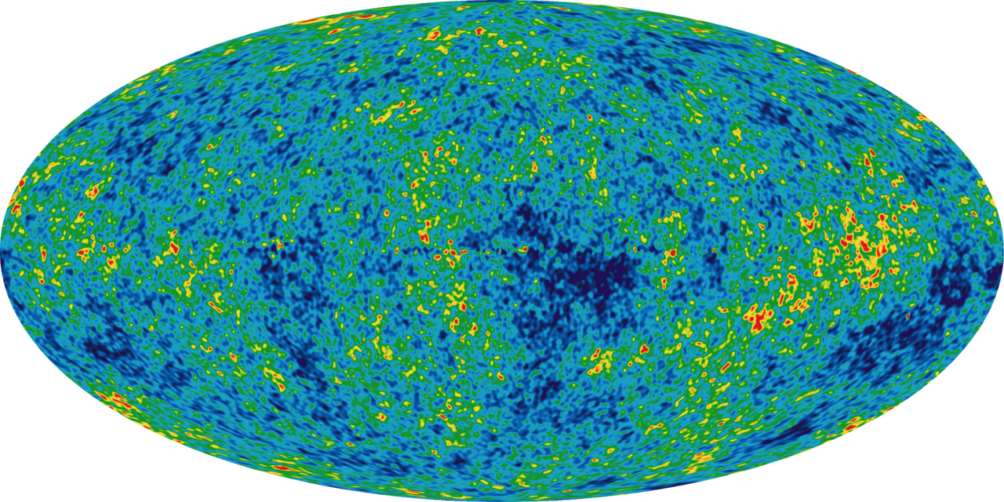
Learning Outcome: Apply CMBR to the cosmological principle
WMAP (Wilkinson Microwave Anisotropy Probe

Slide 84
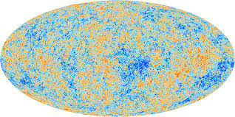
Learning Outcome: Apply CMBR to the cosmological principle
Planck

Slide 85
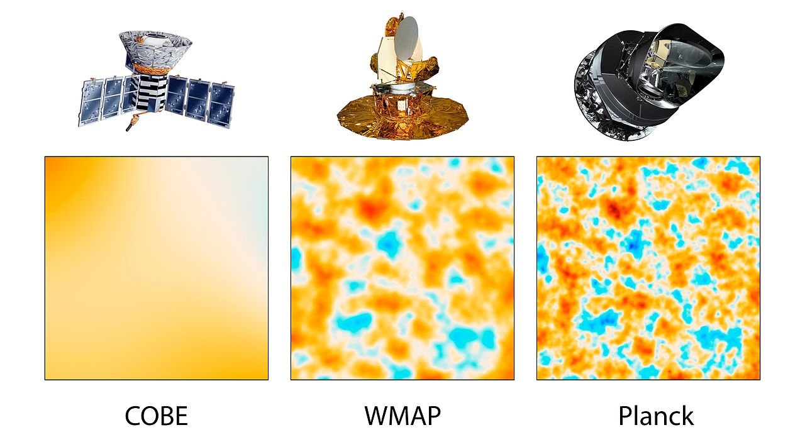
Learning Outcome: Apply CMBR to the cosmological principle

Slide 86
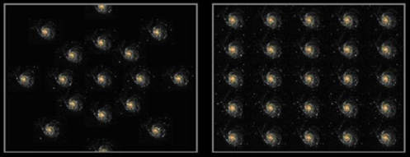
The cosmological principle
Learning Outcome: Apply CMBR to the cosmological principle
Our view of the universe is, basically, exactly the same as it would be from anywhere else in the universe.
The density of the universe is constant everywhere, provided you use a large enough unit of volume.
The cosmological principle states that: the universe is isotropic and homogenous.
Isotropic – same in all directions
Homogenous – of uniform density

Slide 87
5.5.9 Explain evidence for the big bang theory and that the universe is still expanding
Hubble noticed the red-shifting of galaxies suggesting all galaxies are moving away from us, which would occur if the universe started from a point.
Galaxies further away from us are more red-shifted- moving more quickly away from us
Penzias and Wilson discovered CMBR that pervaded all of space and had a temperature of 2.7 K.
These photons would originally have had a high temperature and energy and would have had a shorter wavelength.
Owing to expansion of the universe since the big bang the radiation has been extremely red shifted.
In an eternally old steady-state universe it would be cold, and there would be no background radiation. Penzias and Wilson's discovery of cosmic microwave background radiation (CMBR), at just the right temperature, therefore confirmed the big bang theory.

Slide 88
A-Level Physics
1. Development of practical skills in physics
2. Foundations of Physics
3. Forces and motion
4. Electrons, waves and photons
5. Newtonian world and astrophysics
6. Particles and medical physics
5.1 Thermal Physics
5.2 Circular motion
5.3. Oscillations
5.4. Gravitational fields
5.5 Astrophysics
1. Universe structure
2. Star formation
3. Star’s radiation
4. Wien and Stefan’s law
5. Astronomical distances
6. Doppler effect & red shift
7. CMBR and the cosmological principle
8. Universe evolution and expansion
9. Dark matter and dark energy

Slide 89
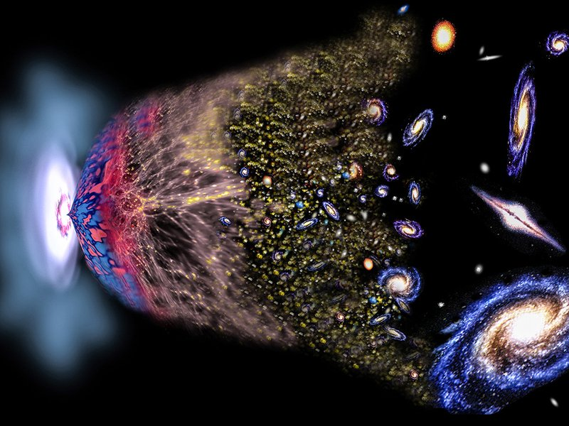
Notes:
https://www.youtube.com/watch?v=wNDGgL73ihY

Slide 90
5.5.9 Explain the evolution of the universe from the big bang to the present day
Temperature infinite; time zero
The big bang. All matter and energy concentrated at a single point.
Within first second:
Forces:
All four types of force (gravitational, electromagnetic, strong and weak) are unified and rapid expansion and cooling occurs.
Gravitation force separates from the other three forces
Strong force separates from electromagnetic force and weak force
The weak and the electromagnetic forces separate
Matter:
Initially a quark “soup” plus photons
leptons form from photons.
Quarks combine into protons and neutrons
Much combination of matter and antimatter occurring, increasing the ratio of matter to antimatter still further, until all antimatter disappears
By 100 s
Helium and Lithium nuclei being formed, temperature is becoming too low for other fusion to occur. Matter in the universe is in plasma form- protons and electrons are not bound to one another

Slide 91
After 100,000 years The temperature is now low enough for atoms to form (100,000 K).
Photons travel freely, the universe is transparent. This is when CMBR was formed.
After 1 million years
Density fluctuations result in the first structure in the universe.
After 1 billion years More structures formed: heavy elements formed as a result of the gravitational collapse
Temperature 2.7K; time 13 billion years At the present day, the ratio of protons to neutrons is still 4:1.

Slide 92
A-Level Physics
1. Development of practical skills in physics
2. Foundations of Physics
3. Forces and motion
4. Electrons, waves and photons
5. Newtonian world and astrophysics
6. Particles and medical physics
5.1 Thermal Physics
5.2 Circular motion
5.3. Oscillations
5.4. Gravitational fields
5.5 Astrophysics
1. Universe structure
2. Star formation
3. Star’s radiation
4. Wien and Stefan’s law
5. Astronomical distances
6. Doppler effect & red shift
7. CMBR and the cosmological principle
8. Universe evolution and expansion
9. Dark matter and dark energy

Slide 93
Calculating the mass of the universe
Learning Outcome: Explain evidence for dark matter
There are two methods for calculating the mass of the universe:
Estimate mass of galaxies from luminosity
Estimate mass of galaxies from how quickly they rotate
These two do not match- the size of centripetal acceleration required to match a galaxies luminous mass is far too low compared to the observed rotational acceleration.
Galaxies must contain more matter than can be detected- this is called dark matter and is thought to account for 27% of all matter and energy in the universe

Slide 94
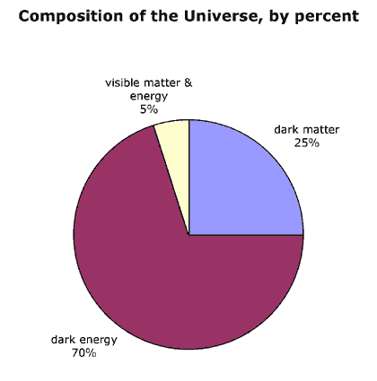
What’s the matter?
Learning Outcome: Explain evidence of dark energy
In the 1990s it was observed that galaxies were accelerating away.
This means a repulsive force must be driving this acceleration.
Dark energy is the name given to the unknown material that has this repulsive property
Notes:
https://www.youtube.com/watch?v=tXkBfkeJJ5c
https://www.youtube.com/watch?v=QAa2O_8wBUQ

