Slide 1
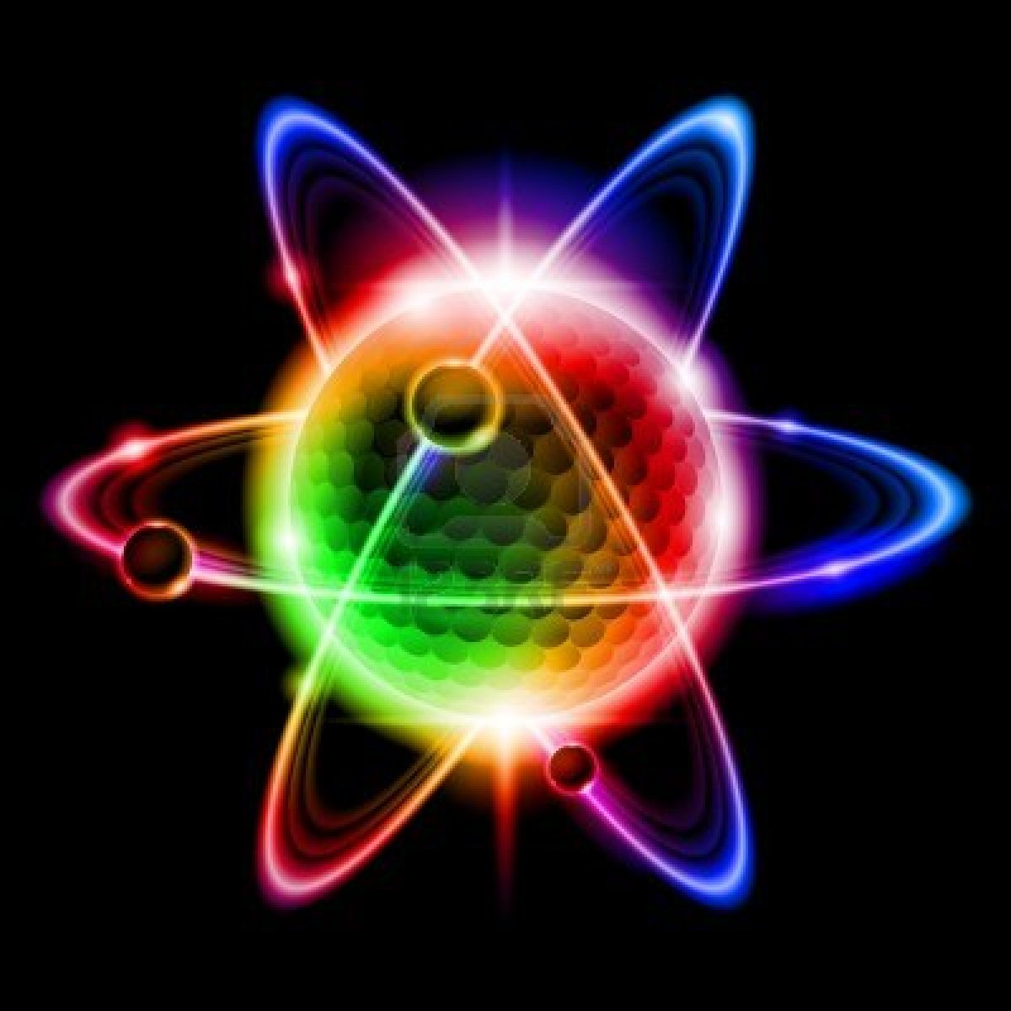
Nuclear and particle physics

Slide 2


A-Level Physics
6.4.1 Radioactive decay
6.4.2 Properties of radiation
6.4.3 Investigating radiation
6.4.4 Nuclear decay equations
6.4.5 Half lives
6.4.6 Radioactive decay calculations
6.4.7 Simulating and modelling radioactive decay
6.4.8 Radioactive dating
6.4.9 Mass-energy and binding energy
6.4.10 Fission and fusion
1. Development of practical skills in physics
2. Foundations of Physics
3. Forces and motion
4. Electrons, waves and photons
5. Newtonian world and astrophysics
6. Particles and medical physics
6.1 Capacitors
6.2 Electric fields
6.3. Magnetic fields
6.4. Nuclear and particle physics
6.5 Medical Physics

Slide 3
Field Particles
(or force carrying particles)
Leptons
Quarks
FERMIONS
Affected by strong force
Experience electromagnetic force if charged
Decay by the weak force
Particles not affected by the strong nuclear force
Neutrinos
Electrons
Muons
Tau
Fundamental forces:
Gravity (graviton?)
Electromagnetic (photon)
Weak (W bosons)
Strong (gluon, meson)
6 types of quark:
Up, down, strange, charm, top, bottom
A Hadron is a group of quarks
Baryons- 3 quarks (e.g. protons and neutrons)
Mesons- 2 quarks (A quark and an antiquark)
BOSONS

Slide 4
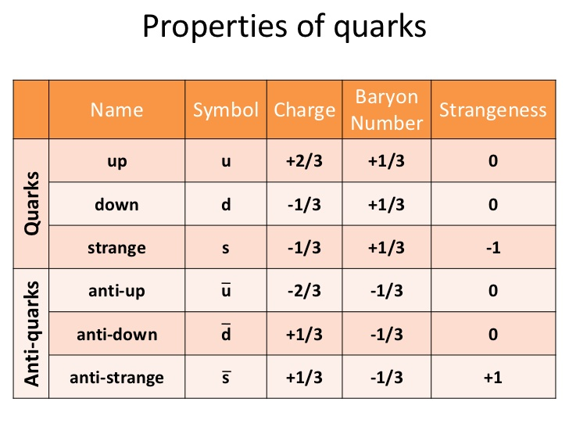

Slide 5
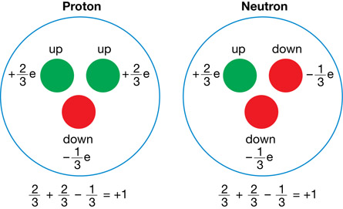
Baryons- 3 quarks
(e.g. protons and neutrons)
How would you make protons and neutrons?
Proton: uud
Neutron: udd

Slide 6
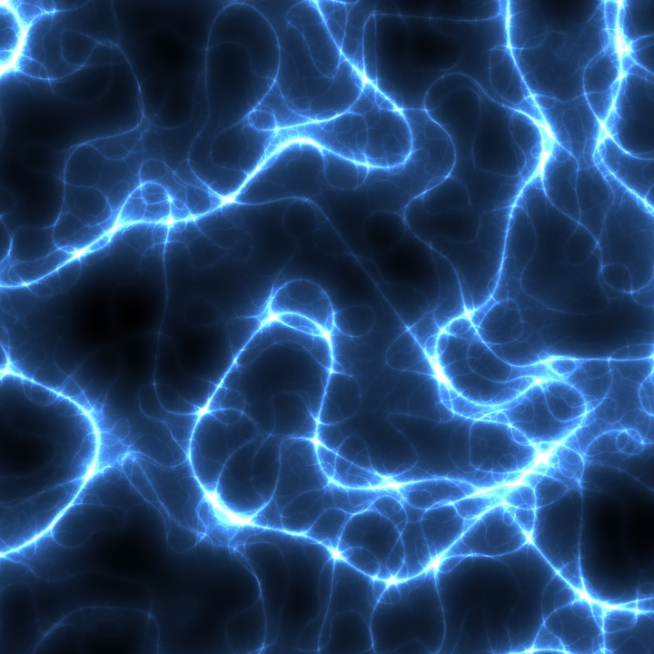
Radioactive decay
Explain why radioactive decay occurs
Describe the process of alpha and gamma decay
Describe beta decay in terms of the quark model

Slide 7
The Atomic Model
Learning Outcome: Explain why radioactive decay occurs
Why can you not have a nucleus only made of protons?
What would all the protons do to each other?
+
+
+
+
Notes:
Some basic things they should know about protons, neutrons and electrons to use as a stimulus for discuss after the semantic map.

Slide 8
The Atomic Model
Learning Outcome: Explain why radioactive decay occurs
Why can you not have a nucleus only made of protons?
What would all the protons do to each other?
Because they all have the same positive charge the protons repel each other just like magnets.
This is a repulsive electrical force.
Why do we have to have neutrons and how do they keep the nucleus together?
+
+
+
+
Notes:
Some basic things they should know about protons, neutrons and electrons to use as a stimulus for discuss after the semantic map.

Slide 9
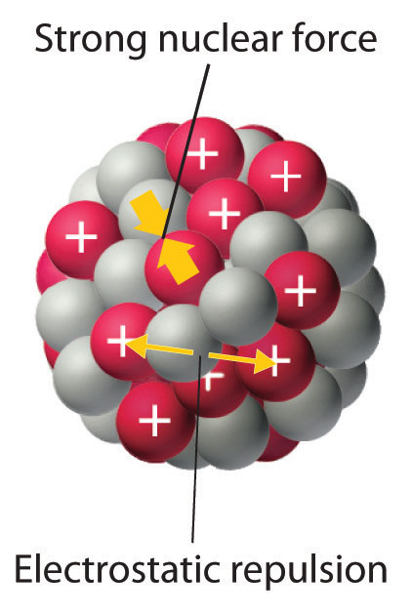
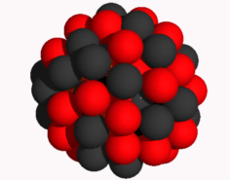
The Atomic Model
Learning Outcome: Explain why radioactive decay occurs
Why do we have to have neutrons?
They provide an additional attractive force to hold the nucleus together.
This is called the Strong Nuclear force.
+
+
+
+
+
+
+
+
+
+
+
Notes:
Some basic things they should know about protons, neutrons and electrons to use as a stimulus for discuss after the semantic map.

Slide 10
Learning Outcome: Explain why radioactive decay occurs
Repulsive electrical force
+
Attractive strong nuclear force
+
These two forces inside the nucleus are balanced.
This means:
- There is no resultant force inside the nucleus.
- The density of the nucleus remain constant.
- The nucleus is stable.
Notes:
Students should appreciate the forces inside the a small and large nucleus

Slide 11
Learning Outcome: Explain why radioactive decay occurs
For a very large nucleus eventually there aren’t enough neutrons to bind the protons together.
This causes the nucleus to be unstable.
This then causes radioactive decay until the nucleus is stable again.
Notes:
Students should appreciate the forces inside the a small and large nucleus

Slide 12
Radioactivity
Learning Outcome: Explain why radioactive decay occurs
Radioactivity is a process where a radioactive substance decays emitting ionising radiation from an unstable nuclei

Slide 13
Radioactivity
Learning Outcome: Explain why radioactive decay occurs
Radioactivity is a process where a radioactive substance decays emitting ionising radiation from an unstable nuclei
Ionising radiation has the ability to remove electrons from atoms creating positive ions

Slide 14
Radioactivity
Learning Outcome: Explain why radioactive decay occurs
Radioactivity is a process where a radioactive substance decays emitting ionising radiation from an unstable nuclei
Ionising radiation has the ability to remove electrons from atoms creating positive ions
3/4 types of ionising radiation:
alpha, beta (+ and -), gamma

Slide 15
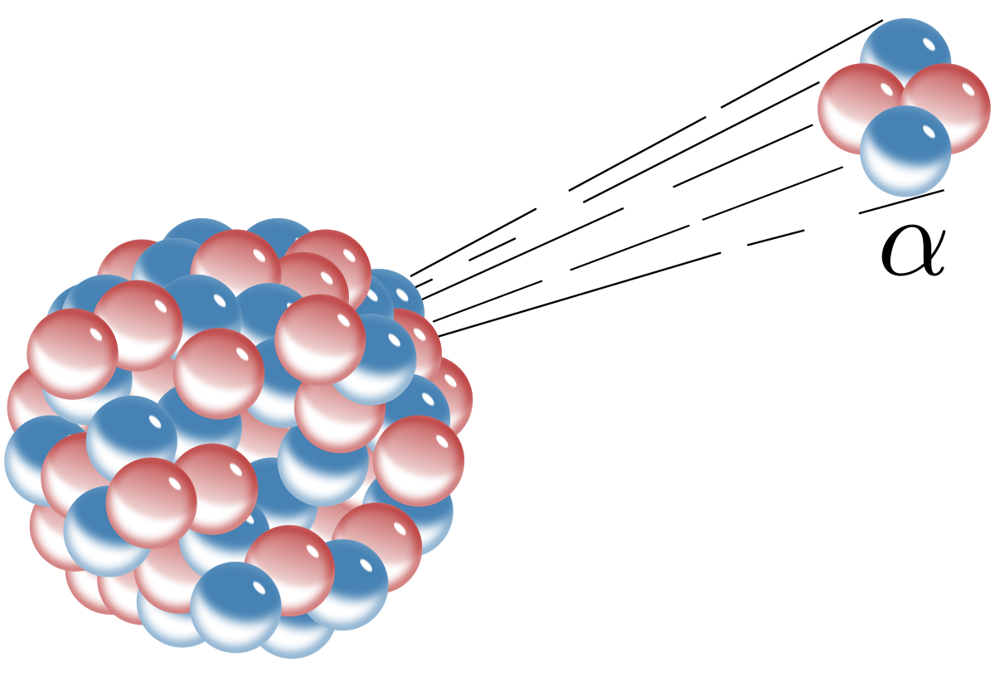
Alpha decay
Learning Outcome: Describe the process of alpha and gamma decay
Alpha decay involves the removal of 2 protons and 2 neutrons (a helium nucleus) from the nucleus of an atom

Slide 16
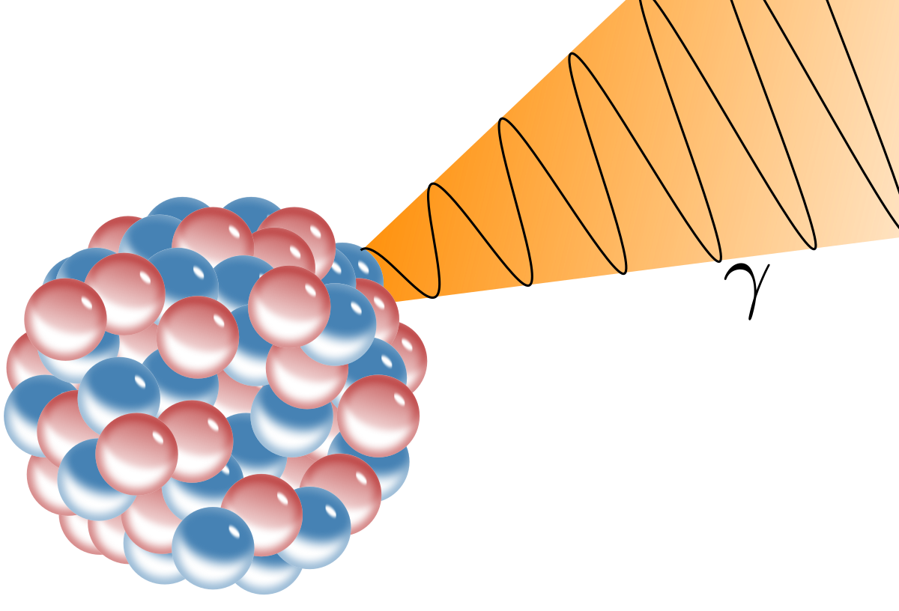
Gamma decay
Learning Outcome: Describe the process of alpha and gamma decay
Gamma decay involves the emission of energy in the form of gamma photons from a nucleus – it generally accompanies alpha or beta decay

Slide 17
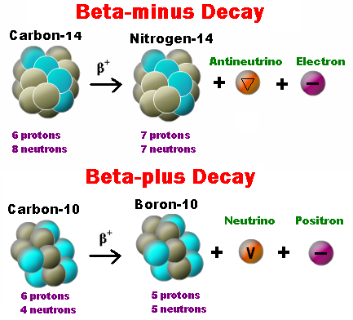
Beta Decay
Learning Outcome: Describe the process of beta decay
Beta-minus decay is a neutron to a proton, releasing an antineutrino and an electron
A beta-minus particle is an electron
Beta-plus decay is a proton to a neutron, releasing a neutrino and a positron
A beta-plus particle is a positron

Slide 18
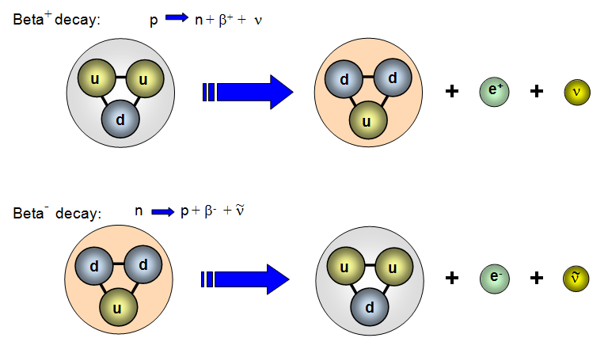
Quark Transformation
Learning Outcome: Describe the process of beta decay
Charge is always conserved!

Slide 19
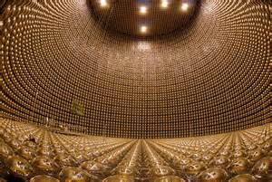
Neutrinos
Learning Outcome: Describe the process of beta decay
No Charge
Tiny Mass (< millionth mass of electron)
Leptons
Up to 100 million per m³
Very difficult to detect as they barely interact with matter
3 types (+ 3 antiparticles):
Electron ν_{e}
Muon ν_{μ}
Tau ν_{τ}

Slide 20
A-Level Physics
6.4.1 Radioactive decay
6.4.2 Properties of radiation
6.4.3 Investigating radiation
6.4.4 Nuclear decay equations
6.4.5 Half lives
6.4.6 Radioactive decay calculations
6.4.7 Simulating and modelling radioactive decay
6.4.8 Radioactive dating
6.4.9 Mass-energy and binding energy
6.4.11 Fission and fusion
1. Development of practical skills in physics
2. Foundations of Physics
3. Forces and motion
4. Electrons, waves and photons
5. Newtonian world and astrophysics
6. Particles and medical physics
6.1 Capacitors
6.2 Electric fields
6.3. Magnetic fields
6.4. Nuclear and particle physics
6.5 Medical Physics

Slide 21
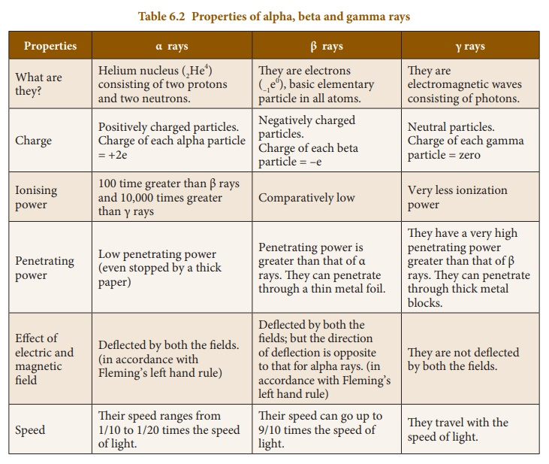

Slide 22
A-Level Physics
6.4.1 Radioactive decay
6.4.2 Properties of radiation
6.4.3 Investigating radiation
6.4.4 Nuclear decay equations
6.4.5 Half lives
6.4.6 Radioactive decay calculations
6.4.7 Simulating and modelling radioactive decay
6.4.8 Radioactive dating
6.4.9 Mass-energy
6.4.10 Binding energy
6.4.11 Fission and fusion
1. Development of practical skills in physics
2. Foundations of Physics
3. Forces and motion
4. Electrons, waves and photons
5. Newtonian world and astrophysics
6. Particles and medical physics
6.1 Capacitors
6.2 Electric fields
6.3. Magnetic fields
6.4. Nuclear and particle physics
6.5 Medical Physics

Slide 23
Nuclear decay equations
Derive decay equations for each radiation type
Apply decay equations to radioactive elements
Describe chains of decay

Slide 24
An Atom always has the same number of protons and electrons!
Learning Outcome: Derive decay equations for each radiation type
Using the Periodic Table
Mass Number – A
C
14
Number of
Protons + Neutrons
(Relative Atomic mass)
Number of
Protons or electrons
6
Atomic Number – Z

Slide 25
Represent an alpha and beta particle and gamma ray as formula with an atomic number and mass
- An alpha particle is a helium nucleus
- In beta minus decay a neutron turns into a proton releasing an electron
- In beta plus decay a proton turns into a neutron releasing a positron
- A gamma ray is an electromagnetic wave
Learning Outcome: Derive decay equations for each radiation type

Slide 26
Represent an alpha and beta particle and gamma ray as formula with an atomic number and mass
Learning Outcome: Derive decay equations for each radiation type
α
β
-
β
+
4
0
0
0
ϒ
2
0
-1
1

Slide 27
Learning Outcome: Derive decay equations for each radiation type
Alpha decay equations
What would these be?
64
4
α
+
?
Y
X
32
2
?

Slide 28
Learning Outcome: Derive decay equations for each radiation type
Alpha decay equations
64
4
α
+
64
Y
X
32
2
30

Slide 29
Learning Outcome: Derive decay equations for each radiation type
Beta decay equations
64
0
β
-
+
Y
X
32
-1

Slide 30
Learning Outcome: Derive decay equations for each radiation type
Beta decay equations
64
β
+
64
X
0
-
Y
32
-1
33

Slide 31
Learning Outcome: Derive decay equations for each radiation type
Beta decay equations
64
0
β
+
+
Y
X
32
1

Slide 32
Learning Outcome: Derive decay equations for each radiation type
Beta decay equations
64
β
+
64
Y
X
0
+
32
1
31

Slide 33
Beta Decay
Beta-minus decay is a neutron to a proton, releasing an antineutrino and an electron
A beta-minus particle is an electron
Beta-plus decay is a proton to a neutron, releasing a neutrino and a positron
A beta-plus particle is a positron

Slide 34
Learning Outcome: Derive decay equations for each radiation type
Gamma decay equations
64
ϒ
+
64
Y
X
0
32
0
32

Slide 35
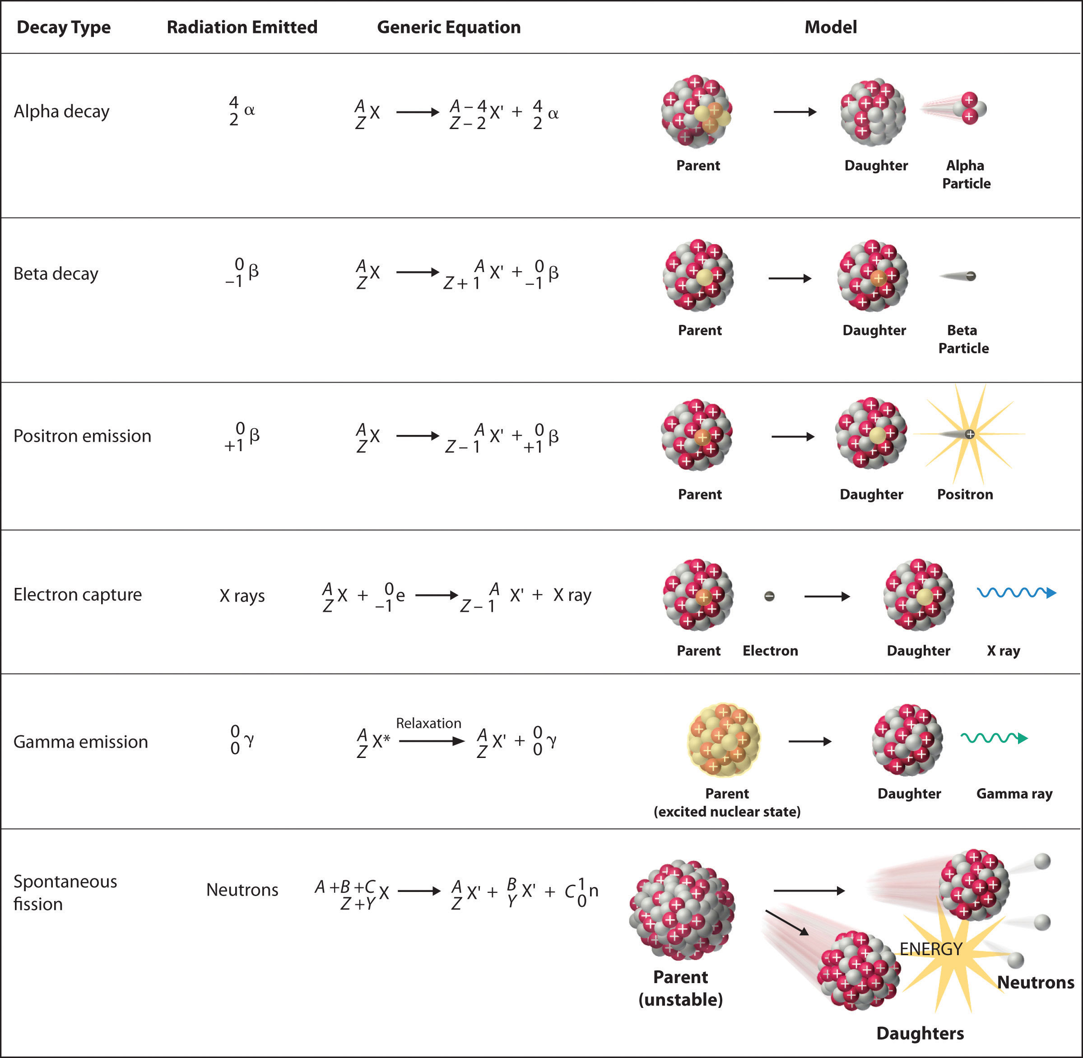
Learning Outcome: Derive decay equations for each radiation type

Slide 36
A-Level Physics
6.4.1 Radioactive decay
6.4.2 Properties of radiation
6.4.3 Investigating radiation
6.4.4 Nuclear decay equations
6.4.5 Half lives
6.4.6 Radioactive decay calculations
6.4.7 Simulating and modelling radioactive decay
6.4.8 Radioactive dating
6.4.9 Mass-energy
6.4.10 Binding energy
6.4.11 Fission and fusion
1. Development of practical skills in physics
2. Foundations of Physics
3. Forces and motion
4. Electrons, waves and photons
5. Newtonian world and astrophysics
6. Particles and medical physics
6.1 Capacitors
6.2 Electric fields
6.3. Magnetic fields
6.4. Nuclear and particle physics
6.5 Medical Physics

Slide 37
Half lives
Explain what is meant by a half life
Describe how to find the half life of elements
Describe how to model radioactive decay

Slide 38
Learning Outcome: Explain what is meant by a half life
Half life- the average time taken for half the number of active nuclei in a sample to decay
This is unique to an isotope of an element and can vary from seconds to thousands of years

Slide 39
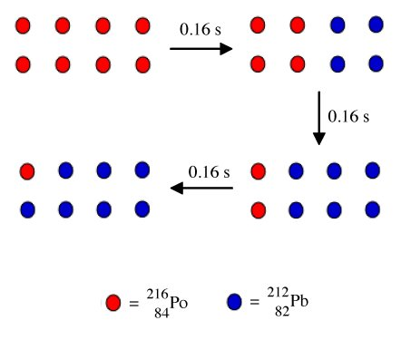
Learning Outcome: Explain what is meant by a half life

Slide 40
Learning Outcome: Explain what is meant by a half life
Half life- the average time taken for half the number of active nuclei in a sample to decay
Decay is random and spontaneous
Random as can’t be predicted and each nucleus has same chance of decay
Spontaneous as not affected by other nuclei in sample or external factors

Slide 41
Learning Outcome: Describe how to find the half life of elements
Answer the following questions:
A sample has 40,000 atoms left after one half life, how many did it start with?
A sample starts with 120,000 atoms left, it has 100,000 atoms after 1 month, 60,000 atoms left after 9 weeks and 10,000 left after a year. What is its half life?
A sample starts with 800,000 atoms and takes 12 days to reduce to 200,000 atoms. What would the half life be?
If the counts of radiation per minute started at 100 and reduced to 25 after 4 days, what would the half life be?
A sample has a count rate of 2.40 a minute, what would the count rate be after 4 half lives
+
Notes:
h/l = 2 days,
2 days 100/25 = ¼ 4 days = ¼ 2 days =½

Slide 42
Learning Outcome: Describe how to find the half life of elements
Answer the following questions:
A sample has 40,000 atoms left after one half life, how many did it start with? 80,000
A sample starts with 120,000 atoms left, it has 100,000 atoms after 1 month, 60,000 atoms left after 9 weeks and 10,000 left after a year. What is its half life? 9 weeks
A sample starts with 800,000 atoms and takes 12 days to reduce to 200,000 atoms. What would the half life be? 6 day
If the counts of radiation per minute started at 100 and reduced to 25 after 4 days, what would the half life be?
2 days
A sample has a count rate of 2.40 a minute, what would the count rate be after 4 half lives? 0.15
+
Notes:
h/l = 2 days,
2 days 100/25 = ¼ 4 days = ¼ 2 days =½

Slide 43
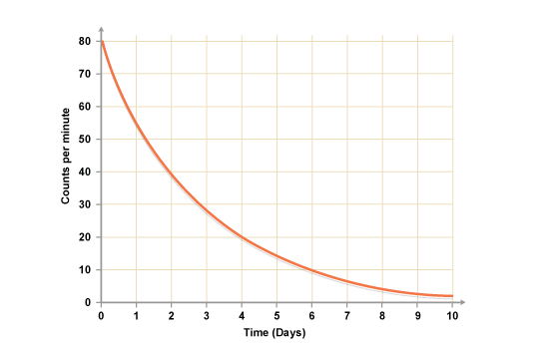
Learning Outcome: Describe how to find the half life of elements
+
What would the half life be for the above decay?
Notes:
h/l = 2 days,
2 days 100/25 = ¼ 4 days = ¼ 2 days =½

Slide 44
Method - Role the dice and remove all 5s and 6s. These represent your “decayed” atoms
Results- Draw a table of results:
Analysis - Graph of number of “original atoms” left versus time and work out the “half life”
Conclusion – what is good about this model, what isn’t?
Learning Outcome: Describe how to model radioactive decay
Number of rolls | Number of original dice
0 | 40
1
2
3
4

Slide 45
A-Level Physics
6.4.1 Radioactive decay
6.4.2 Properties of radiation
6.4.3 Investigating radiation
6.4.4 Nuclear decay equations
6.4.5 Half lives
6.4.6 Radioactive decay calculations
6.4.7 Simulating and modelling radioactive decay
6.4.8 Radioactive dating
6.4.9 Mass-energy and binding energy
6.4.10 Fission and fusion
1. Development of practical skills in physics
2. Foundations of Physics
3. Forces and motion
4. Electrons, waves and photons
5. Newtonian world and astrophysics
6. Particles and medical physics
6.1 Capacitors
6.2 Electric fields
6.3. Magnetic fields
6.4. Nuclear and particle physics
6.5 Medical Physics

Slide 46
Radioactive decay calculations
Describe what activity is and how this links to the “decay constant”
Use decay equations
Derive an equation for half life and find this from graphs

Slide 47
Learning Outcome: Describe what activity is and how this links to the “decay constant”
The activity (A) of a radioactive source is measured in Becquerel (Bq) and is the number of deays per second
1 Bq = 1 decay per second/1 radioactive emission per second

Slide 48
The Decay Constant
Learning Outcome: Describe what activity is and how this links to the “decay constant”
The Decay Constant, λ relates the Activity A to the number of undecayed nuclei, N.
A =λN
The Decay Constant, represents the fraction on nuclei which will undergo decay in the next unit of time.
λ= A/N

Slide 49
The Decay Constant
Learning Outcome: Describe what activity is and how this links to the “decay constant”
The Decay Constant, λ relates the Activity A to the number of undecayed nuclei, N.
The Decay Constant, represents the fraction on nuclei which will undergo decay in the next unit of time.
A =λN
λ= A/N
e.g. A sample has 5000 undecayed nuclei and an activity of 50 Bq,
so its decay constant = 50/5000 = 0.01 s⁻¹
After 2 minutes the number of undecayed nuclei is 2500, with an activity of 25 Bq
so its decay constant = 25/2500 = 0.01 s⁻¹

Slide 50
Learning Outcome: Use the decay equations

Slide 51
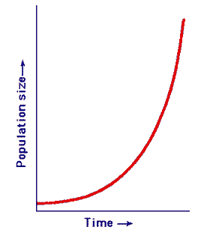
Learning Outcome: Use the decay equations
Exponential growth or decay occurs where an object grows or decays at a constant rate, e.g. radioactive decay
The growth or decay of an object is dependent on the rate and the time it grows/decays
By how many times an object increases or decreases can be calculated by:
e^{kt}=x Where k = rate, t = time, x = growth factor
e is the base rate of growth shared by all continually growing processes (=2.718).
This means in a certain amount of time growth will be times 2.718

Slide 52

Learning Outcome: Use the decay equations
Lets assume we start with 1 bacteria in a colony reproducing now at a rate of x 1 a minute
This means after one minute we should have:
2.718 bacteria (as a statistical average)
If you put £1 in the bank with 100% (x 1) annual interest, you would expect £2 by the end of the year. But if the annual interest was added per second, you would have £2.718 by the end of the year

Slide 53
Learning Outcome: Use the decay equations
e.g. Bacteria reproduce at a rate of 500% (x 5) a day
If you start with 1 bacteria in your colony The factor by which the population will have increased after 4 days could be found using the exponential:
e^{kt}= e ^{5x4} = e²⁰= 485,165,195
(remember that the new bacteria will start reproducing as soon as they are created)
Notes:
Students to discuss in their groups which ones they think will have a direction and list them on paper or on a whiteboard

Slide 54
Learning Outcome: Use the decay equations
All exponential equations have the general equation:
Y = Y₀ e^{kt}
Where k is a rate of growth or decay and t is time,
Y₀ is the initial “population” and Y is the current “population”

Slide 55
Learning Outcome: Use the decay equations
For radioactive decay there are two forms of this equation:
A = A₀ e^{-λt}
Where λ is the decay constant (negative as decaying), t is time,
A₀ is the initial activity and Y is the current activity

Slide 56
Learning Outcome: Use the decay equations
For radioactive decay there are two forms of this equation:
N = N₀ e^{-λt}
Where λ is the decay constant (negative as decaying), t is time,
N₀ is the initial activity and N is the current activity
A = A₀ e^{-λt}
Where λ is the decay constant (negative as decaying), t is time,
A₀ is the initial activity and Y is the current activity

Slide 57
Learning Outcome: Use the decay equations
A radioactive sample started with an activity of 50 Bq, it has a decay constant of 0.05 s⁻¹ and has been decaying for 120 s. What would be its activity now?
A = A₀ e^{-λt}
A = 50 e ^{-0.05 x 120}
A = 50 x 0.0025
A = 0.124 Bq

Slide 58
Learning Outcome: Use the decay equations
Given an initial activity of 5000 Bq, how long would it take to reduce to 350 Bq, given a decay constant of 0.4 s⁻¹
A = A₀ e^{-λt}

Slide 59
Learning Outcome: Use the decay equations
Given an initial activity of 5000 Bq, how long would it take to reduce to 350 Bq, given a decay constant of 0.4 s⁻¹
A = A₀ e^{-λt}
350 = 5000 e ^{-0.4 x t}

Slide 60

Learning Outcome: Use the decay equations
The natural log is essentially the opposite of the exponential
Where x is the growth factor by which the population has increased
y = rate x time (kt)

Slide 61
Learning Outcome: Use the decay equations
e.g. Bacteria reproduce at a rate of 500% a day
In reverse, the time to get to 485,165,195 times growth can be calculated by:
ln(485,165,195) = 20
20 = rate x time, rate = x 5
Time = 20/5 = 4 days
Notes:
Students to discuss in their groups which ones they think will have a direction and list them on paper or on a whiteboard

Slide 62
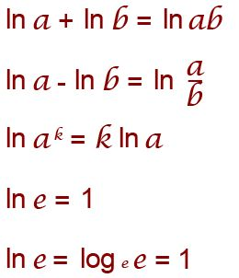
Learning Outcome: Use the decay equations
Some problems involving natural logs and exponentials are not possible to solve immediately with a calculator
ln (e^{x}) = x
e ^{ln(x)} = x

Slide 63
Learning Outcome: Use the decay equations
Given an initial activity of 5000 Bq, how long would it take to reduce to 350 Bq, given a decay constant of 0.4 s⁻¹
350 = A₀ e^{-λt}
350 = 5000 e ^{-0.4 x t}
ln (e^{x}) = x
e ^{ln(x)} = x

Slide 64
Learning Outcome: Use the decay equations
Given an initial activity of 5000 Bq, how long would it take to reduce to 350 Bq, given a decay constant of 0.4 s⁻¹
350 = A₀ e^{-λt}
350 = 5000 e ^{-0.4 x t}
350/5000 = e ^{-0.4 x t}
0.07 = e ^{-0.4 x t}
ln (0.07) = ln (e ^{-0.4 x t})
-2.66 = -0.4 t
t = 6.65 s
ln (e^{x}) = x
e ^{ln(x)} = x

Slide 65
Learning Outcome: Derive an equation for half life and find this from graphs
For radioactive decay we use the term “half life”- which is the time for the variable (A or N) to halve
A = A₀ e^{-λt} N = N₀ e^{-λt}
Derive an expression for half life t_{½} in terms of the decay constant
Remember at a half life A = 0.5 A₀ or N = 0.5 N₀

Slide 66
Learning Outcome: Derive an equation for half life and find this from graphs
For radioactive decay we use the term “half life”- which is the time for the variable (A or N) to halve
A = A₀ e^{-λt} N = N₀ e^{-λt}
Derive an expression for half life t_{½} in terms of the decay constant
0.5 A₀ = A₀ e^{-λt½} 0.5 = e^{-λt½} ln 0.5 = -λt_{½} ln 2 = λt_{½}
t_{½} = ln (2)
λ

Slide 67
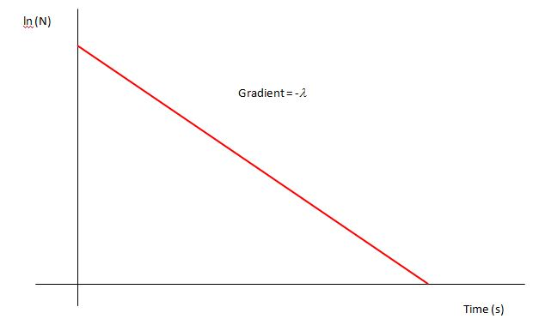
Learning Outcome: Derive an equation for half life and find this from graphs
A = A₀ e^{-λt}
Ln (A/Ao) = Ln e^{-λt}
Ln(A/Ao) = -λt
LnA – LnAo = -λt
LnA = -λt + LnAo
y = mx + c
N = N₀ e^{-λt}
Ln (N/No) = Ln e^{-λt}
Ln(N/No) = -λt
LnN – LnNo = -λt
LnN = -λt + LnNo
y = mx + c

Slide 68
A-Level Physics
6.4.1 Radioactive decay
6.4.2 Properties of radiation
6.4.3 Investigating radiation
6.4.4 Nuclear decay equations
6.4.5 Half lives
6.4.6 Radioactive decay calculations
6.4.7 Simulating and modelling radioactive decay
6.4.8 Radioactive dating
6.4.9 Mass-energy and binding energy
6.4.11 Fission and fusion
1. Development of practical skills in physics
2. Foundations of Physics
3. Forces and motion
4. Electrons, waves and photons
5. Newtonian world and astrophysics
6. Particles and medical physics
6.1 Capacitors
6.2 Electric fields
6.3. Magnetic fields
6.4. Nuclear and particle physics
6.5 Medical Physics

Slide 69
Radioactive dating
Describe the process of carbon dating
Explain limitations of carbon dating
Describe alternative dating methods

Slide 70
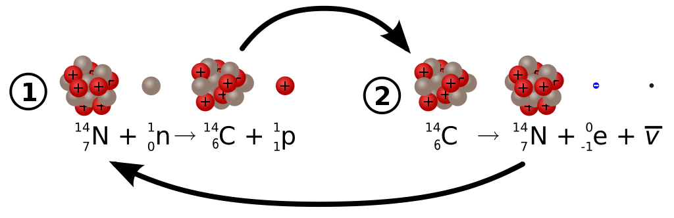
Learning Outcome: Describe the process of carbon dating
Carbon 14 is produced in the upper atmosphere from high speed cosmic rays colliding with atoms and producing neutrons which combine with a nitrogen nucleus producing carbon 14 and a proton
Carbon 14 undergoes beta decay converting back to nitrogen

Slide 71
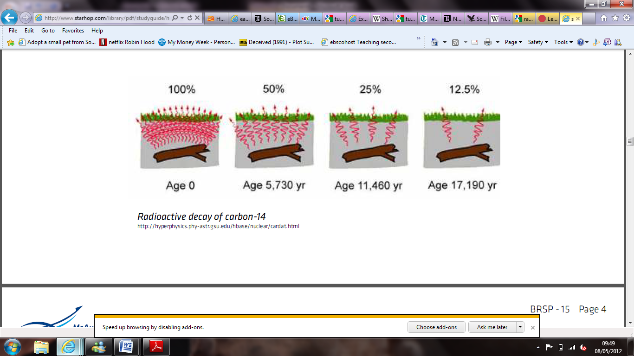
Learning Outcome: Describe the process of carbon dating
Carbon dating
All living things contain isotopes of carbon including carbon 14. The ratio of carbon 12 to 14 in living things is 1:1.3 x 10⁻¹²
Upon death the carbon-14 begins to decay as it is no longer being replenished
Using the half life of carbon-14 the age of the object can be determined

Slide 72
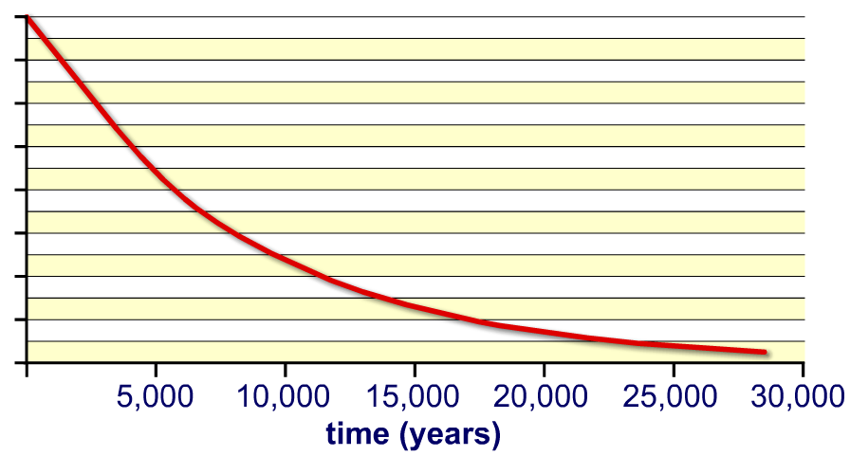
Learning Outcome: Describe the process of carbon dating
Carbon dating
Percentage
of Carbon 14 (%)
100
75
50
25
0

Slide 73
Learning Outcome: Describe the process of carbon dating
Carbon dating
Percentage
of Carbon 14 (%)
Carbon 14 half life = 5700 years
100
75
50
25
0

Slide 74








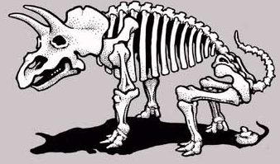
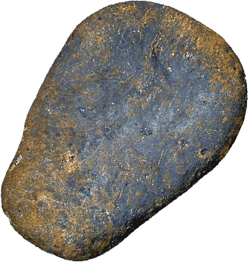
Calculate the ages of the objects from the %C-14 , then complete the questions. N = N₀ e^{-λt} t_{½} = ln (2)/ λ
93%
b) 88%
c) 15%
d) 11%
e) 0%, why? And why does this make aging the bones difficult?
f) Carbon-14 dating cannot be used to date this rock, why? What could be used instead

Slide 75
Calculate the ages of the objects from the %C-14 , then complete the questions
597 y
b) 1050 y
c) 15600 y
d) 18200 y
e) 0%, why? And why does this make aging the bones difficult?
f) Carbon-14 dating cannot be used to date this rock, why? What could be used instead
Notes:
Carbon dating can only be used on obkects upto 60,000 years old

Slide 76
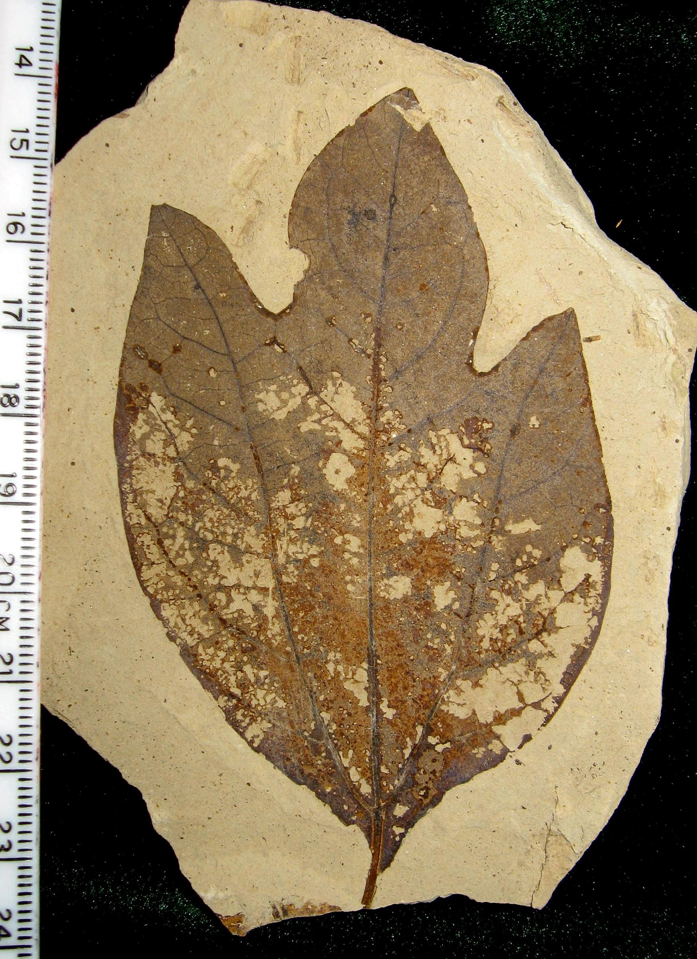
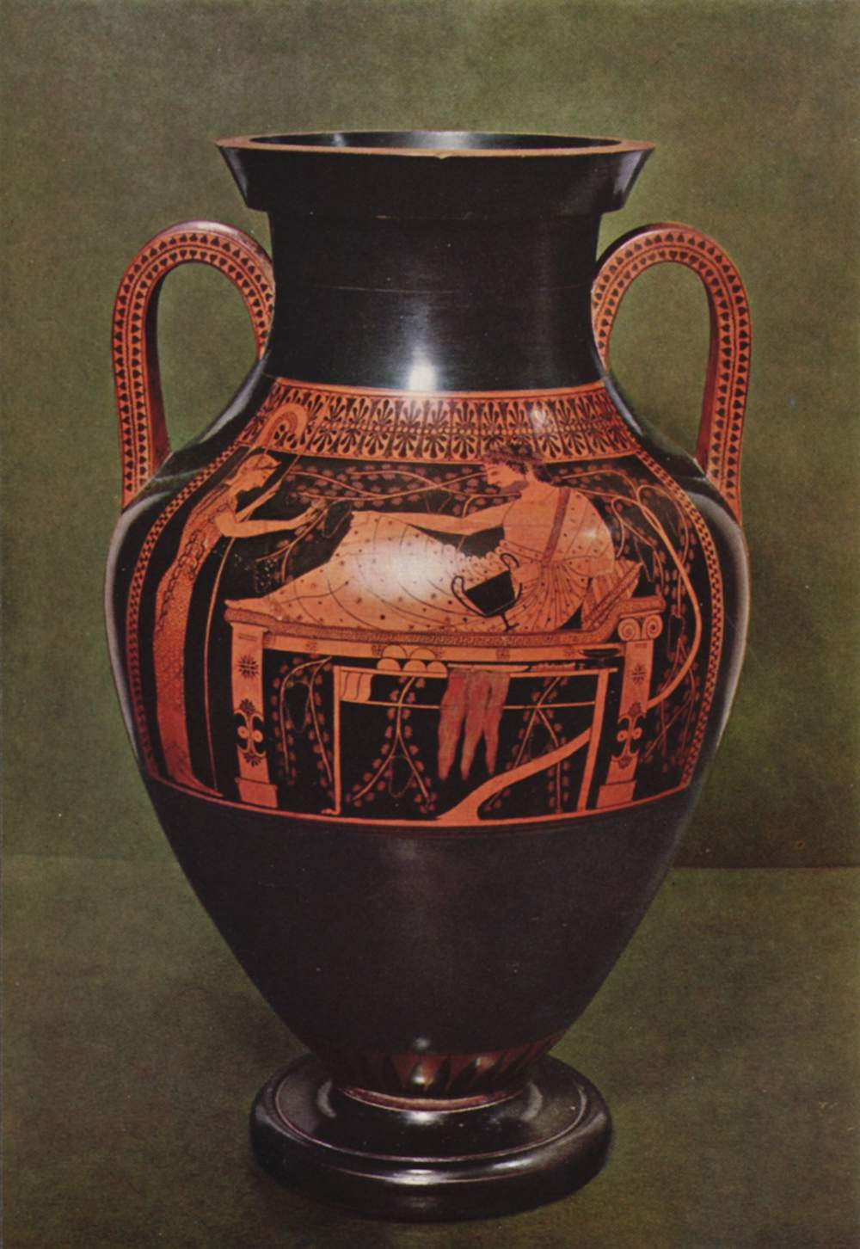
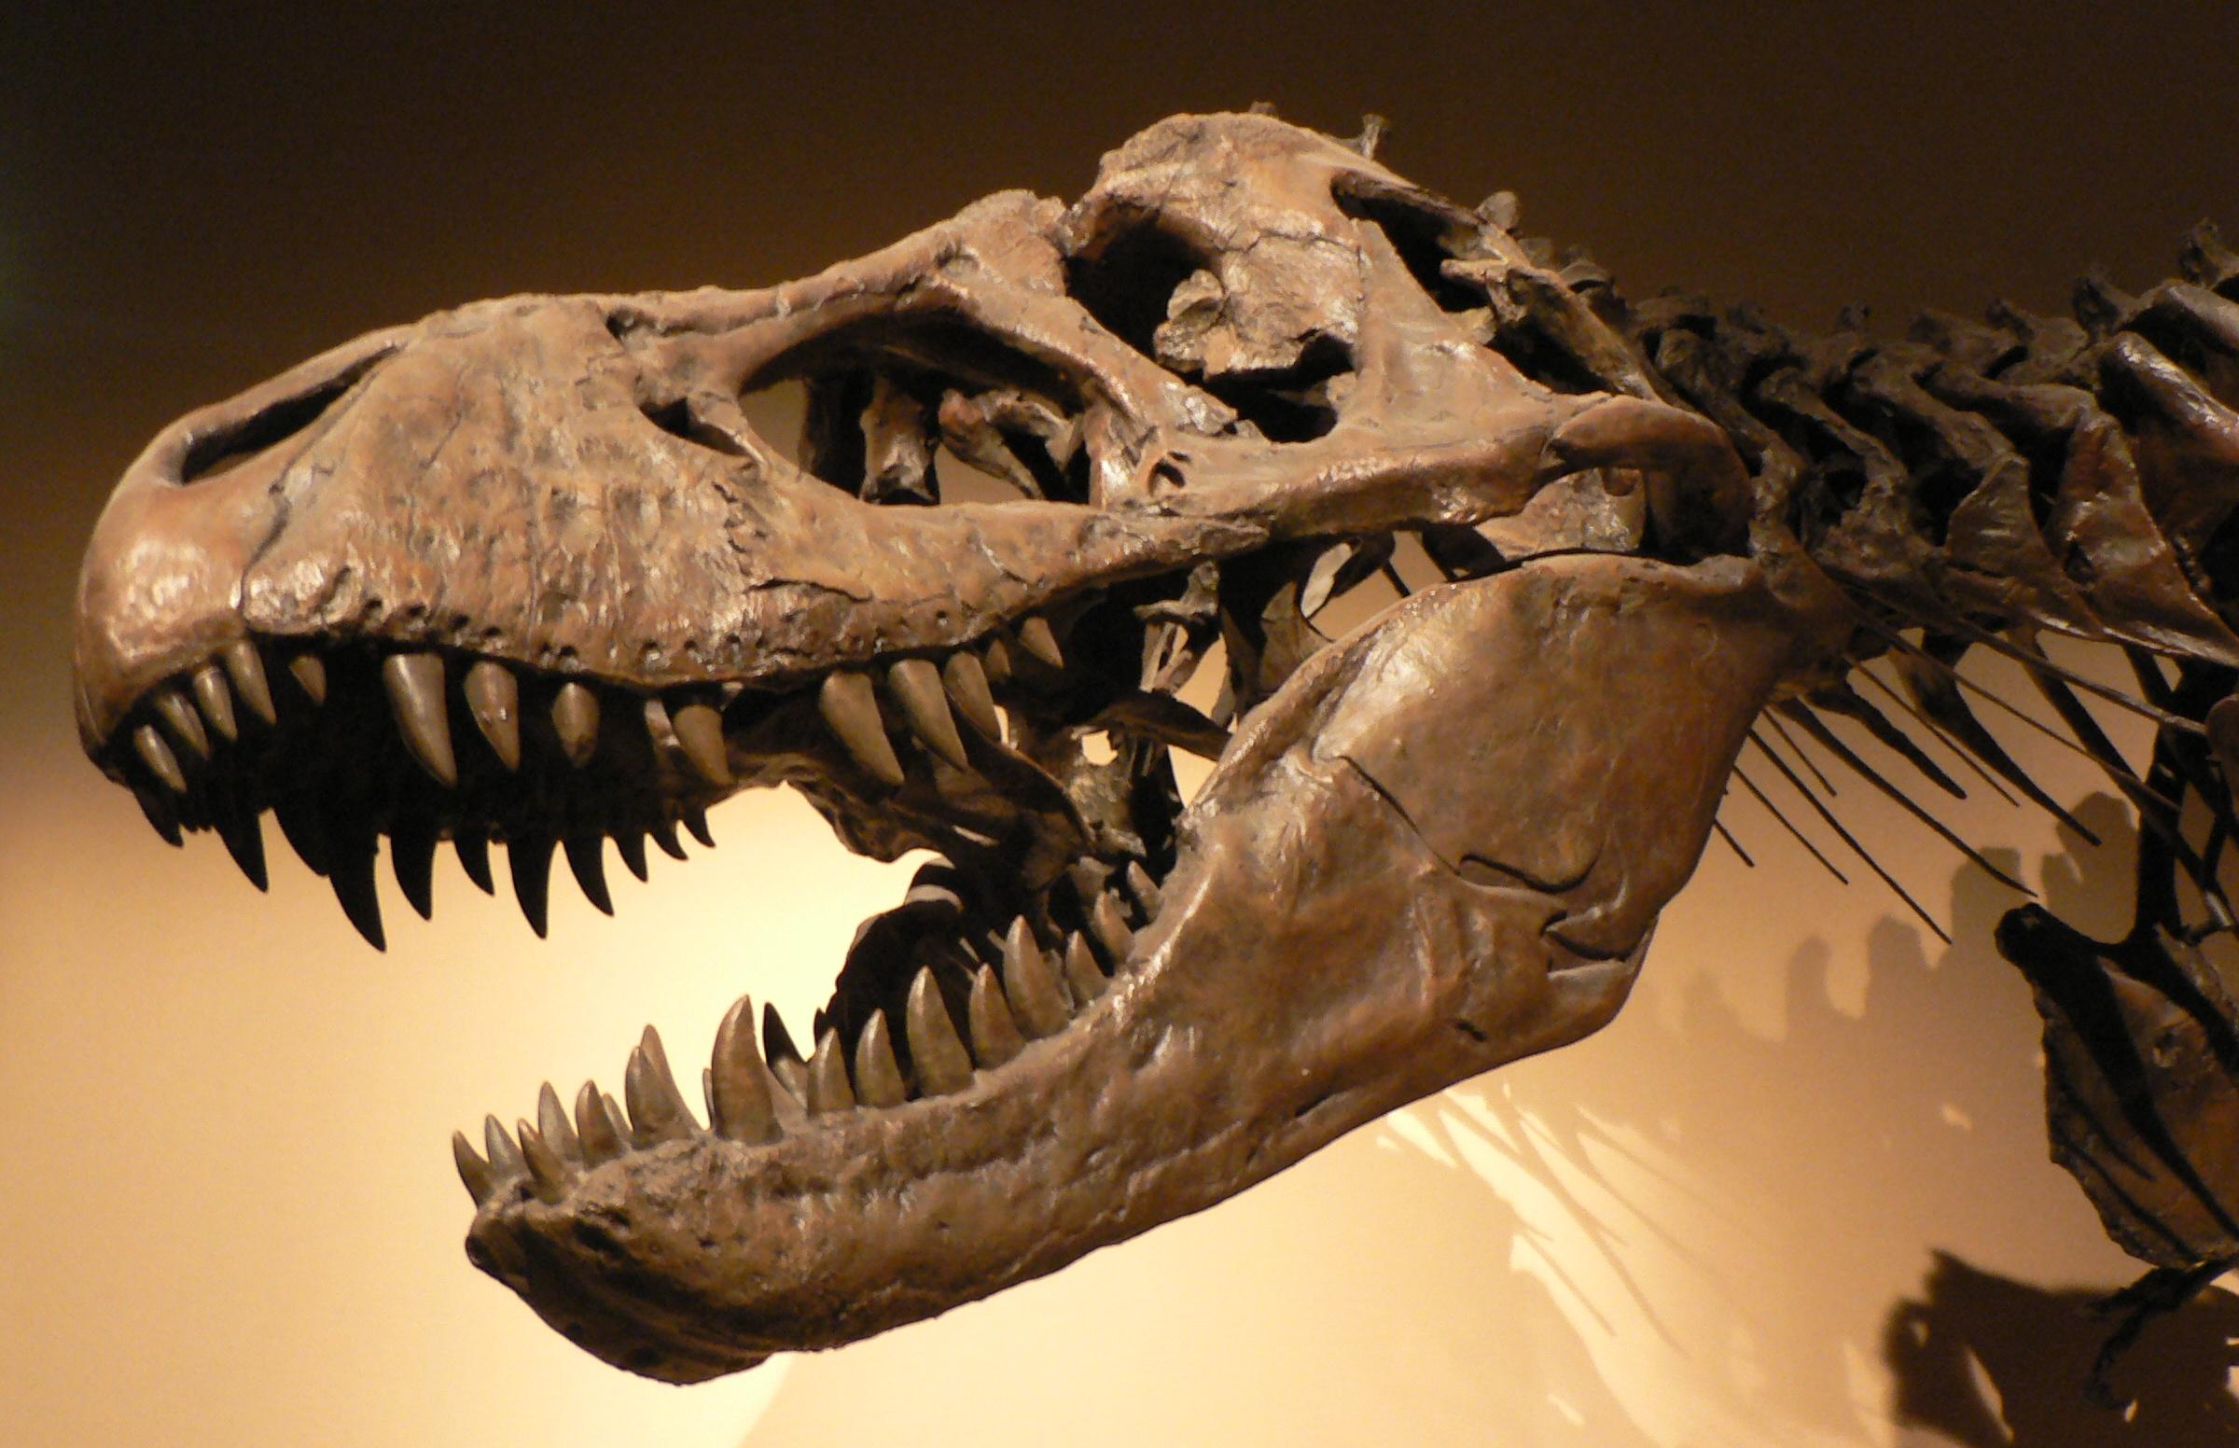
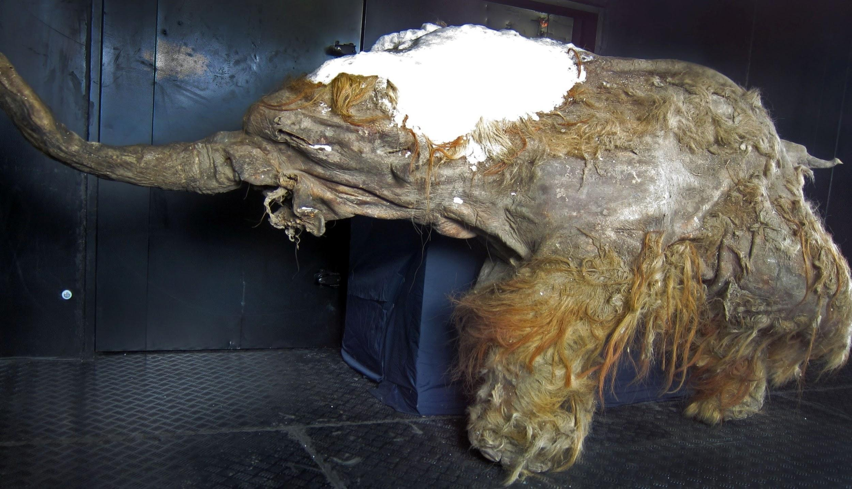


Learning Outcome: Explain limitations of carbon dating
Which of the following items could be carbon dated?
2000 year old leaf
1000 year old pot
70 million year old dinosaur bones
30,000 year old woolly mammoth
A 1500 year old sword
A living cat

Slide 77
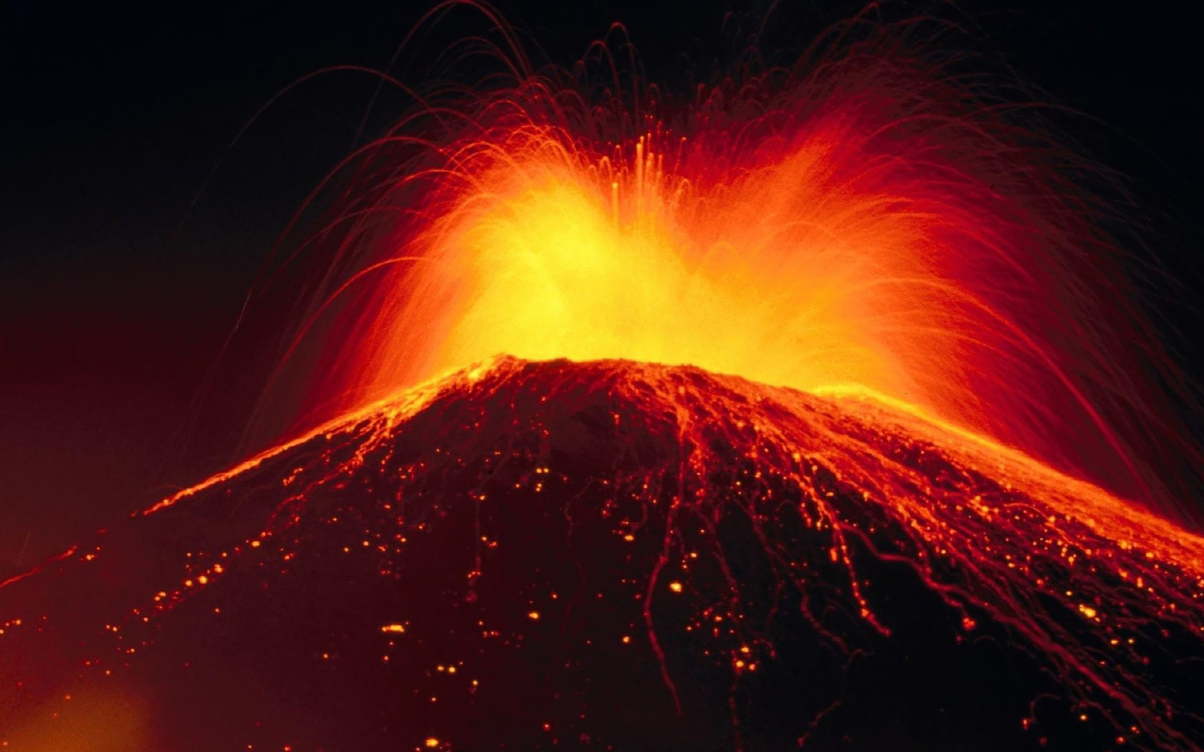
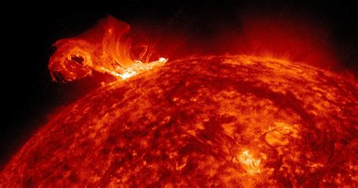
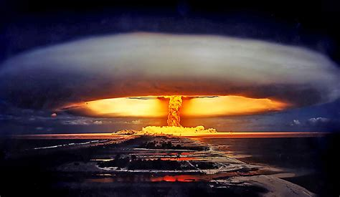
Learning Outcome: Explain limitations of carbon dating
Carbon 14: carbon 12 ratio may not be constant:
Volcanic eruptions
Solar flares
Nuclear bombs
Notes:
1 g of C has an activity of about 15 counts per second

Slide 78
Learning Outcome: Describe alternative dating methods
For the following radioactive elements:
Potassium 40- Argon 40
Thorium 232 – Lead 208
Uranium 238 – Lead 206
What is their half life?
What are they typically used to date?
What age range are they used to date?
Notes:
1 g of C has an activity of about 15 counts per second

Slide 79
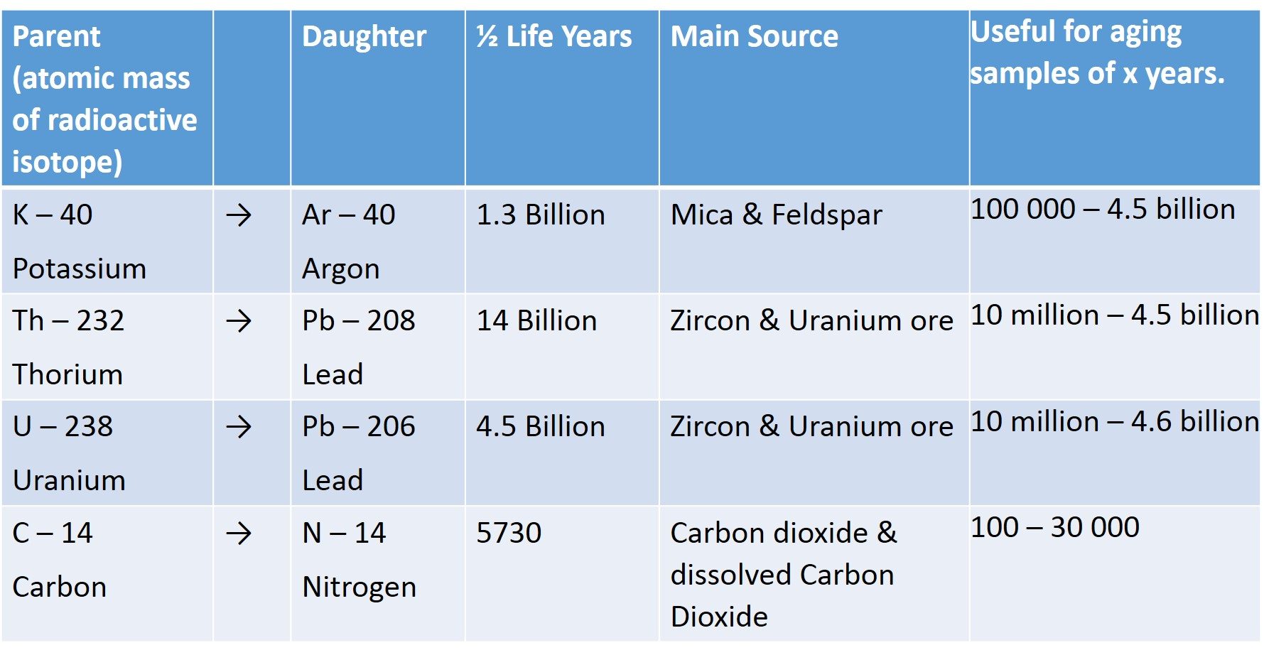
Learning Outcome: Describe alternative dating methods

Slide 80
A-Level Physics
6.4.1 Radioactive decay
6.4.2 Properties of radiation
6.4.3 Investigating radiation
6.4.4 Nuclear decay equations
6.4.5 Half lives
6.4.6 Radioactive decay calculations
6.4.7 Simulating and modelling radioactive decay
6.4.8 Radioactive dating
6.4.9 Mass-energy and binding energy
6.4.11 Fission and fusion
1. Development of practical skills in physics
2. Foundations of Physics
3. Forces and motion
4. Electrons, waves and photons
5. Newtonian world and astrophysics
6. Particles and medical physics
6.1 Capacitors
6.2 Electric fields
6.3. Magnetic fields
6.4. Nuclear and particle physics
6.5 Medical Physics

Slide 81
Binding Energy
Einstein’s mass-energy equation
Explain the concept of binding energy
Explain how binding energy varies with nucleon number

Slide 82
Learning Outcome: Einstein’s mass-energy equation
Mass can never be created or destroyed
Energy can never be created or destroyed

Slide 83
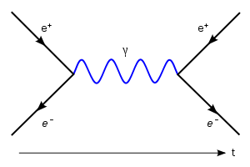
Mass can never be created or destroyed
Energy can never be created or destroyed
But… how do you explain this:
Learning Outcome: Einstein’s mass-energy equation

Slide 84
Learning Outcome: Einstein’s mass-energy equation
E = mc²

Slide 85
Learning Outcome: Einstein’s mass-energy equation
E = mc²
The total mass-energy in a system is constant

Slide 86
Learning Outcome: Einstein’s mass-energy equation
Annihilation
E = mc²
2 gamma rays are created when an electron and positron annihilate, what would be the minimum energy of the gamma rays?
Electron mass = 9.11 x 10⁻³¹kg

Slide 87
Learning Outcome: Einstein’s mass-energy equation
Annihilation
2 gamma rays are created when an electron and positron annihilate, what would be the minimum energy of the gamma rays?
Electron rest mass = 9.11 x 10⁻³¹ kg
E = 2 x 9.11 x 10⁻³¹ x c² /2 = 8.2 x 10⁻¹⁴ J (0.51 MeV)

Slide 88
Learning Outcome: Explain the concept of binding energy
Particle | Mass (u)
Neutron | 1.008665
Proton | 1.007276
α particle (2p⁺ + 2 n) | 4.00153
Calculate the mass of an Alpha Particle

Slide 89
Learning Outcome: Explain the concept of binding energy
Particle | Mass (u)
Neutron | 1.008665
Proton | 1.007276
α particle (2p⁺ + 2 n) | 4.00153
Calculate the mass of an Alpha Particle

Slide 90
Learning Outcome: Explain the concept of binding energy
Particle | Mass (u)
Neutron | 1.008665
Proton | 1.007276
α particle (2p⁺ + 2 n) | 4.00153
Calculate the mass of an Alpha Particle?
Mass of individual nucleons (2p + 2n) = 4.03188 u
Mass of alpha particle = 4.00153 u

Slide 91
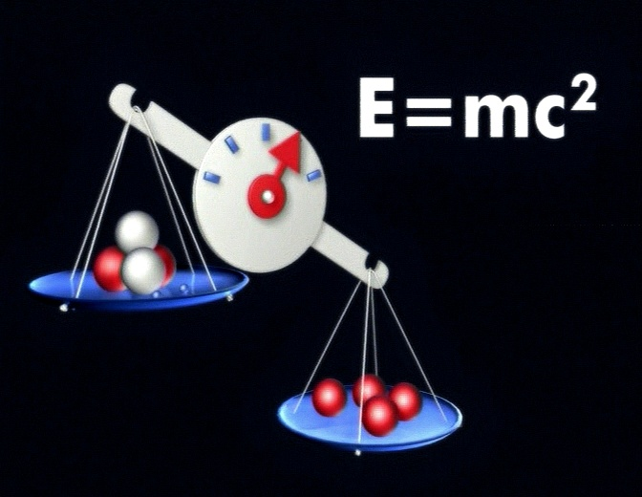
Learning Outcome: Explain the concept of binding energy
Mass is converted into potential energy stored in bonds between particles (binding energy)

Slide 92
Learning Outcome: Explain the concept of binding energy
Mass is converted into potential energy stored in bonds between particles
Binding energy of a nucleus is the minimum energy required to completely separate a nucleus into its constituent neutrons and protons.

Slide 93
Learning Outcome: Explain the concept of binding energy
You can calculate the binding energy for a nucleus using
E = mc²
Where m = the mass defect (difference between mass of the nucleus and mass of individual nucleons)

Slide 94
Learning Outcome: Explain the concept of binding energy
You can calculate the binding energy (E) for a nucleus using
E = mc²
Where m = the mass defect (mass of the nucleus - mass of individual nucleons)
For example for an alpha particle:
Mass of individual nucleons (2p + 2n) = 4.03188 u
Mass of alpha particle = 4.00153 u
Mass defect = 0.03035 u = 5.0441 x 10⁻²⁹ kg (1 u = 1.661 x 10⁻²⁷ kg)

Slide 95
Learning Outcome: Explain the concept of binding energy
You can calculate the binding energy for a nucleus using
E = mc²
Where m = the mass defect (difference between mass of the nucleus and mass of individual nucleons)
For example for an alpha particle:
Mass of individual nucleons (2p + 2n) = 4.03188 u
Mass of alpha particle = 4.00153 u
Mass defect = 0.03035 u = 5.0441 x 10⁻²⁹ kg (1 u = 1.661 x 10⁻²⁷ kg)
Binding energy = 5.0441 x 10⁻²⁹ x (3 x 10⁸) ² = 4.537 x 10⁻¹² J
Binding energy per nucleon = 4.537 x 10⁻¹² J / 4 = 1.134 x 10⁻¹² J

Slide 96
Learning Outcome: Explain the concept of binding energy
You can calculate the binding energy for a nucleus using
E = mc²
Where m = the mass defect (difference between mass of the nucleus and mass of individual nucleons)
For example for an alpha particle:
Mass of individual nucleons (2p + 2n) = 4.03188 u
Mass of alpha particle = 4.00153 u
Mass defect = 0.03035 u = 5.0441 x 10⁻²⁹ kg (1 u = 1.661 x 10⁻²⁷ kg)
Binding energy = 5.0441 x 10⁻²⁹ x (3 x 10⁸) ² = 4.537 x 10⁻¹² J
Binding energy per nucleon = 4.537 x 10⁻¹² J / 4 = 1.134 x 10⁻¹² J
In eV: 1.134 x 10⁻¹²/1.6 x 10⁻¹⁹ = 7089096 eV or - 7.09 MeV

Slide 97
Learning Outcome: Explain the concept of binding energy
Find the binding energy per Nucleon for carbon 12
1) Find total mass of individual protons and neutrons (e.g. for carbon: 6 p + 6 n)
2) Find mass of nucleus. Note: the atomic mass (e.g. 12 u for carbon) is the mass of an atom complete with its electrons. The nuclear mass is the mass of the nucleus alone. To get the nuclear mass we need to take away the mass of all the electrons. Mass of 1 electron = 9. 1095 x 10⁻³¹ kg
3) Find mass defect in kg (1 u = 1.661 x 10⁻²⁷ kg); the difference between 1 and 2
4) Calculate binding energy: E = mc²
Where m is your mass defect, E is your binding energy, c = 3 x 10⁸
5) Find your energy per nucleon by dividing by total number of protons and neutrons
6) Convert to eV. 1 eV = 1.6 x 10⁻¹⁹ J
Particle | Mass (u)
Neutron | 1.008665
Proton | 1.007276

Slide 100
Negative energy shows work must be done to break apart the bonds between particles to separate them

Slide 101
Learning Outcome: Explain how binding energy varies with nucleon number
Nuclide | Proton number | Mass (u)
⁴He | 2 | 4.002 603
¹²C | 6 | 12.000000
¹⁶O | 8 | 15.994 914
⁴⁰Ca | 20 | 39.962 591
⁵⁶Fe | 26 | 55.934 942
⁶³Cu | 29 | 62.929 601
¹⁷⁶Hf | 72 | 175.941 402
²³⁵U | 90 | 235.043 923
Particle | Mass (u)
Neutron | 1.008665
Proton | 1.007276
Electron | 0.000549
1 eV = 1.6 x 10⁻¹⁹
1 u = 1.661 x 10⁻²⁷ kg
J
Notes:
Get students to plot a graph of results as shown on next slide

Slide 102
A-Level Physics
6.4.1 Radioactive decay
6.4.2 Properties of radiation
6.4.3 Investigating radiation
6.4.4 Nuclear decay equations
6.4.5 Half lives
6.4.6 Radioactive decay calculations
6.4.7 Simulating and modelling radioactive decay
6.4.8 Radioactive dating
6.4.9 Mass-energy and binding energy
6.4.10 Fission and fusion
1. Development of practical skills in physics
2. Foundations of Physics
3. Forces and motion
4. Electrons, waves and photons
5. Newtonian world and astrophysics
6. Particles and medical physics
6.1 Capacitors
6.2 Electric fields
6.3. Magnetic fields
6.4. Nuclear and particle physics
6.5 Medical Physics

Slide 103
Fission and fussion
Describe how energy is created through fission and fusion
Describe nuclear fission and explain the use of fission to create energy
Explain nuclear fusion in stars

Slide 104
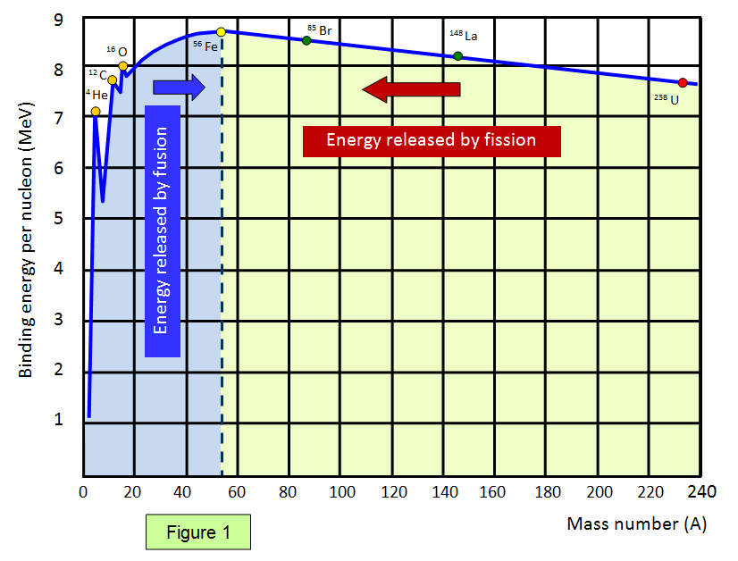
Learning Outcome: Describe how energy is created through fission and fusion

Slide 105
Learning Outcome: Describe how energy is created through fission and fusion
Mass is greater for 2 smaller nuclei than larger combined nuclei
Mass is greater for larger combined nuclei than two smaller nuclei

Slide 106
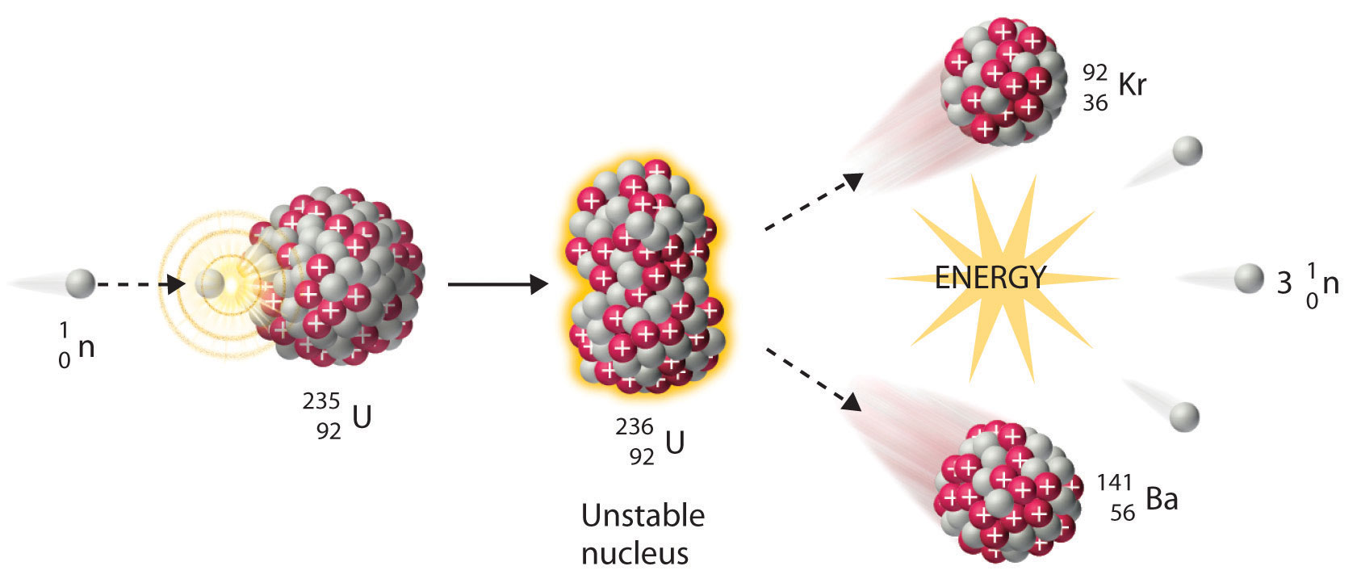
Learning Outcome: Explain the use of fission to create energy in nuclear reactors
Nuclear fission in nuclear reactors

Slide 107
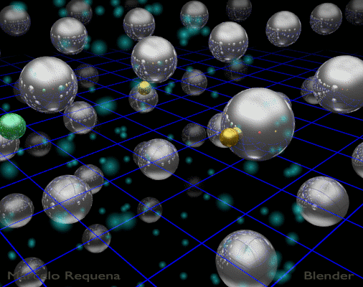
Learning Outcome: Fission to create energy
Nuclear fission in nuclear reactors

Slide 108
Learning Outcome: Explain the use of fission to create energy in nuclear reactors
Nuclear fission in nuclear reactors
Total number of nucleons are conserved, as is mass-energy
1 + 235 = 236 92 + 141 + 1 + 1 + 1 =236
Mass before is more than mass after, how much energy is released? 0.185 u mass defect, 1 u = 1.661 x 10⁻²⁷ kg

Slide 109
Learning Outcome: Explain the use of fission to create energy in nuclear reactors
Nuclear fission in nuclear reactors
Total number of nucleons are conserved, as is mass-energy
1 + 235 = 236 92 + 141 + 1 + 1 + 1 =236
Mass before is more than mass after (0.185 u mass defect)
E = mc² = 3.07 x 10⁻²⁸ x (3 x 10⁸)² = 2.77 x 10⁻¹¹ J

Slide 110
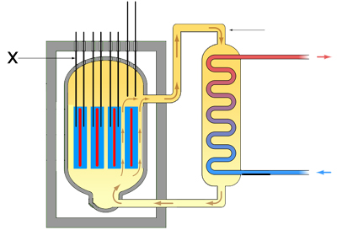
Learning Outcome: Explain the use of fission to create energy in nuclear reactors
Nuclear reactors
Hot gas
Control rods (Boron or cadmium), absorb excess neutrons to slow down the reaction
Steam
Moderator- slows down neutrons to enable fission to occur
Fuel rod (99.3% U-238, 0.7%U-235)
Cold water
Concrete shielding
Cold gas
Notes:
Moderator- slows down neutrons to enable fission to occur
Control rods –absorb excess neutrons
https://www.youtube.com/watch?v=rcOFV4y5z8c
https://www.youtube.com/watch?v=jBwSuSuGhyk

Slide 111
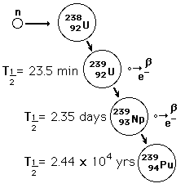
Learning Outcome: Explain the use of fission to create energy in nuclear reactors
Dangers from radioactivity
Notes:
Plutonium is toxic and radioactive

Slide 112
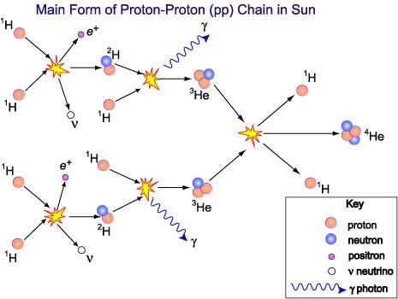
Learning Outcome: Explain nuclear fusion in stars

Slide 113
Learning Outcome: Explain nuclear fusion in stars
Occurs at temperatures around 1.4 x 10⁷ K and high pressures causing densities around 1.5 x 10⁵ kg m⁻³
Large amount of energy released as individual protons have no binding energy- initial fusion reaction releases 2.2 MeV of energy
Fusion cycle occurs 9 x 10³⁷ times a second in the sun
Hot gas
Concrete shielding
Cold gas
Notes:
https://www.youtube.com/watch?v=mZsaaturR6E

