Slide 1
Modelling Physics- Possible long answer questions
Notes:
Electricity
Electro and magnetic fields and magnetism
Waves
Quantum, nuclear and particle physics
Medical physics

Slide 2
5.1.8 Explain how gas exerts a pressure and the assumptions made
Force = change in momentum/time taken
Assumptions are ideal gas assumptions:
Gases consist of a large number of molecules in continuous rapid, random motion
Collisions are perfectly elastic
The gravitational force on the molecules is negligible.
No intermolecular force exists except during collisions.
5. The total volume of the molecules is negligible compared with the volume of the container.
6. The gas has a large number of particles
Notes:
Gas and radiation pressure equal in main phase

Slide 3
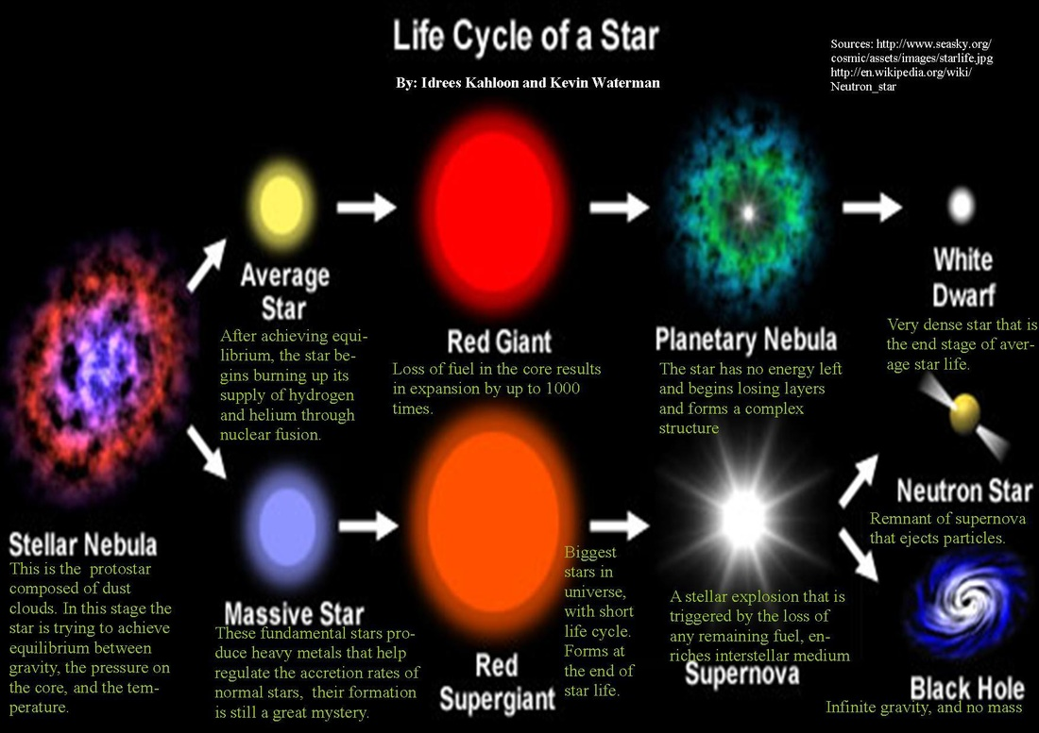
5.5.2 Describe the development of a star from formation to death

Slide 4
5.5.2 Describe the development of a star from formation to death
Protostars- gravity greater than radiation pressure- collapse inwards increases kinetic energy and temperature
Main sequence star (when gas pressure in (gravity) =radiation pressure out (caused by fusion)
Hydrogen to helium fusion in main sequence stars (4 protons = 1 helium+ 2 gamma rays + 2 neutrinos + 2 positrons)
Next step depends on mass (Chandrasekhar limit):
Less than 1.4 x mass of sun- red giant route:
Runs out of hydrogen to fuse = no radiation pressure = collapse inwards= increased temp - outer layers expand due to heating but core contracts = helium fusion to heavier elements
When helium runs out star collapses again- outer layers ejected forming planetary nebula, core left behind forms white dwarf- no more fusion but still hot- cools down over time
- More than 1.4 x mass of sun
- Similar to previous but becomes red supergiant- multiple stages of fusion, to Fe
- In each stable fusion phase degeneracy pressure of electrons (repulsive
force between electrons) and radiation pressure stop gravitational collapse
Supernovae explosion due to immense gravitational pressure - protons and electrons combine to form neutrons- triggers explosion of outer shell
Neutron star- remnants of core- very dense
Black hole- very very dense neutron star- light itself can’t escape its gravity
Notes:
Gas and radiation pressure equal in main phase

Slide 5
5.5.9 Explain the evolution of the universe from the big bang to the present day
Temperature infinite; time zero
The big bang. All matter and energy concentrated at a single point.
Within first second:
All four types of force (gravitational, electromagnetic, strong and weak) are unified and rapid expansion and cooling occurs.
Gravitation force separates from the other three forces; the primordial quark soup stage plus photons.
Strong force separates from electromagnetic force and weak force: leptons form from photons.
The weak and the electromagnetic forces separate
Much combination of matter and antimatter occurring, increasing the ratio of matter to antimatter still further, until all antimatter disappears
By 100 s
Helium and Lithium nuclei being formed, temperature is becoming too low for other fusion to occur. Matter in the universe is in plasma form- protons and electrons are not bound to one another

Slide 6
After 100,000 years The temperature is now low enough for atoms to form (100,000 K).
Photons travel freely, the universe is transparent. This is when CMBR was formed.
After 1 million years
Density fluctuations result in the first structure in the universe.
After 1 billion years More structures formed: heavy elements formed as a result of the gravitational collapse
Temperature 2.7K; time 13 billion years At the present day, the ratio of protons to neutrons is still 4:1.

Slide 7
5.5.9 Explain evidence for the big bang theory and that the universe is still expanding
Hubble noticed the red-shifting of galaxies suggesting all galaxies are moving away from us, which would occur if the universe started from a point.
Galaxies further away from us are more red-shifted- moving more quickly away from us
Penzias and Wilson discovered CMBR that pervaded all of space and had a temperature of 2.7 K.
These photons would originally have had a high temperature and energy and would have had a shorter wavelength. O
wing to expansion of the universe since the big bang the radiation has been extremely red shifted.
In an eternally old steady-state universe it would be cold, and there would be no background radiation. Penzias and Wilson's discovery of cosmic microwave background radiation (CMBR), at just the right temperature, therefore confirmed the big bang theory.
Olber’s paradox can only be solved if the universe is expanding -light takes time

Slide 8
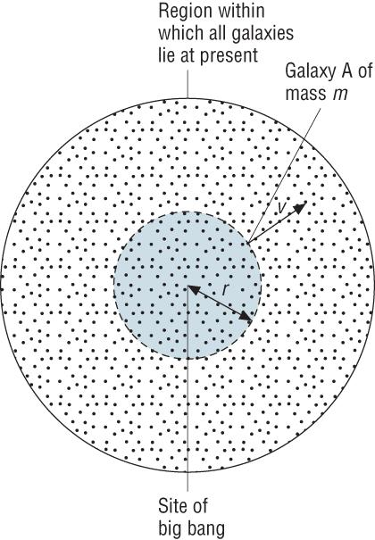
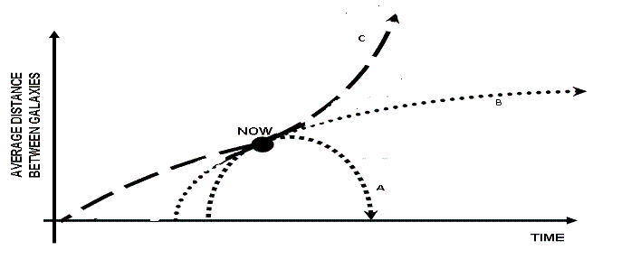
5.5.9 Describe and explain predictions for the possible future of the universe
If the density of the universe is larger than a critical density then there will be too much gravitational force between galaxies so it will end in a big crunch
If the density of the universe is less than the critical density it will go on expanding forever.
If the universe is at the critical density it will eventually stop expanding
If the kinetic energy is greater than the potential energy, it will travel on forever. If it is less than the potential energy, it will stop and fall back into a big crunch.

Slide 9
5.5.9 Explain the evidence for dark matter in the universe
Evidence:
There are two methods for calculating the mass of the universe:
Estimate mass of galaxies from luminosity
Estimate mass of galaxies from how quickly they rotate
These two do not match- the size of centripetal acceleration required to match a galaxies luminous mass is far too low compared to the observed rotational acceleration.
Galaxies must contain more matter than can be detected- this is called dark matter and is thought to account for 27% of matter in the universe
Theories
WIMPS- Created in big bang, very difficult to detect
MACHOS- Concentrated areas of matter (black holes)
Axions- theoretical particle produced in supernova explosions
Neutrinos- 3 already exist- 4 hypothesised as dark matter

