Slide 1
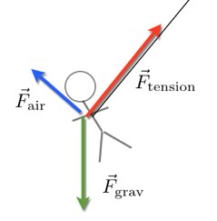
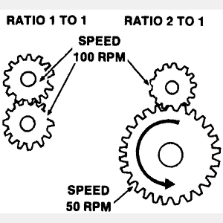
Experiments
Describe an experiment to demonstrate Hooke’s law (relationship between force and extension on a spring)
Describe an experiment to investigate the relationship between force and acceleration and mass and acceleration
Forces and motion summary sheet
Theory – Forces
Draw a free body diagram for a book on a table
A force of 6N is applied to the right of the book against a friction force of 4N, what is the resultant force? Add this force to your diagram
Draw a scale diagram to work out the resultant force acting on the swing below
Explain the difference between elastic and plastic deformation
Explain how a lever, like the one below, acts as a force multiplier to lift the rock
Describe which gear set below would be useful for cycling up hill on a bike
Definitions
Complete the following definitions:
Scalar quantity
Vector quantity
Hooke’s law
Principal of moments
Pressure
Newton’s first law
Newton’s second law
Newtons third law
5 N
40 °
8 N

Slide 2
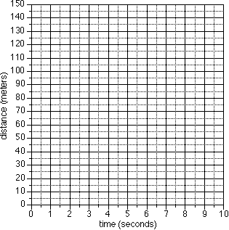
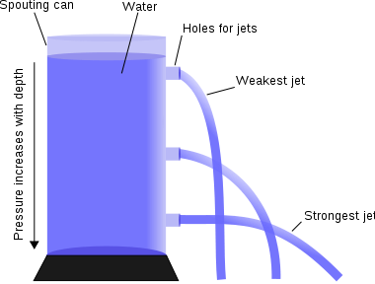
Forces and motion revision
Distance-time graphs
On the distance-time graph below draw lines to represent an object that is:
Stationary (not moving)
Moving at constant speed
Speeding up
Write down steps that you would take to work out the speed an object is travelling at from a distance-time graph
Vehicle safety
Describe the difference between braking distance, thinking distance and stopping distance
Give three factors that affect braking distance and three factors that affect thinking distance
Describe, using the idea of momentum why seat belts are important in cars
Speed-time graphs
On the -time graph below draw lines to represent an object that is:
Stationary (not moving)
Moving at constant speed
Speeding up
Speeding up its speeding up
Write down steps that you would take to work out the acceleration of an object from the speed-time graph
Write down steps to work out the total distance travelled from a speed-time graph
Theory- Pressure
Explain, using the diagram below, how liquid pressure varies with depth
Why does the rubber duck float on the water, you need to mention the idea of upthrust and density?
Draw a diagram to show how atmospheric pressure varies with height and explain this
Speed (m/s)

