Slide 1
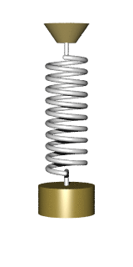
Simple Harmonic Motion
Notes:
Take example see if any one has labelled radians, if not talk about degree and what does degrees mean?- get to do this as prepare for learning?

Slide 2
A-Level Physics
1. Development of practical skills in physics
2. Foundations of Physics
3. Forces and motion
4. Electrons, waves and photons
5. Newtonian world and astrophysics
6. Particles and medical physics
5.1 Thermal Physics
5.2 Circular motion
5.3. Oscillations
5.4. Gravitational fields
5.5 Astrophysics
5.3.1. Simple harmonic motion
5.3.2. Analysing simple harmonic motion
5.3.3. Energy and simple harmonic motion
5.3.4. Damping and resonance

Slide 3
Simple harmonic motion
Describe oscillating motion
Define simple harmonic motion
Describe an experiment to prove the simple harmonic motion equation

Slide 4
Learning Outcome: Describe oscillating motion

Slide 5
On whiteboards draw a displacement-time graph for the oscillating spring (look at the motion carefully). Start with the spring in the equilibrium position
Learning Outcome: Describe oscillating motion
Nuclear
Notes:
Take example see if any one has labelled radians, if not talk about degree and what does degrees mean?- get to do this as prepare for learning?

Slide 6
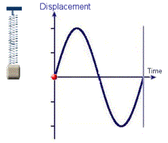
Learning Outcome: Describe oscillating motion

Slide 7
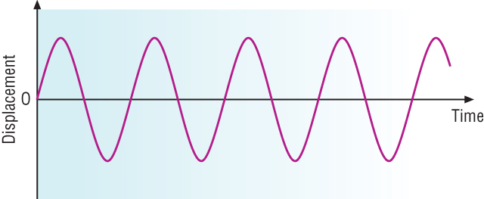
Learning Outcome: Describe oscillating motion

Slide 8
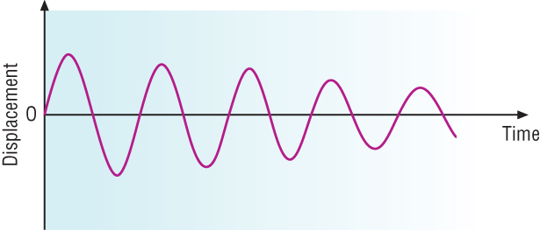
Learning Outcome: Describe oscillating motion

Slide 9
Learning Outcome: Describe oscillating motion
Waves versus oscillations
Displacement-
Amplitude -

Slide 10
Learning Outcome: Describe oscillating motion
Waves versus oscillations
Displacement- Distance from undisturbed (equilibrium) position
Amplitude – Maximum distance from undisturbed (equilibrium) position

Slide 11
Learning Outcome: Describe oscillating motion
Waves versus circular motion versus oscillations
Period- The time taken to complete one…
Frequency- The number of complete…

Slide 12
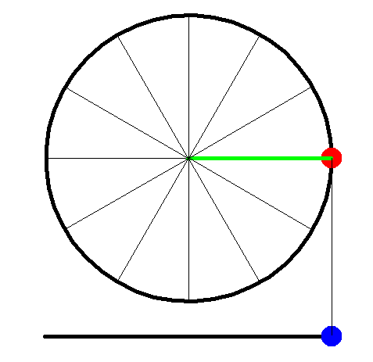
Learning Outcome: Describe oscillating motion
circular motion versus oscillations

Slide 13
Learning Outcome: Describe oscillating motion
circular motion versus oscillations
3/2π
2π
π
1/2π
Angular frequency= radians per second ω = 2πf = 2π/T

Slide 14
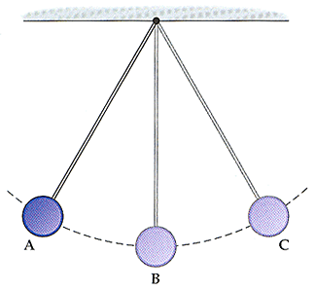
What is the phase difference between A, B and C (assuming A and C are at their amplitude), if all pendulums complete 2π in 2 s what is their angular frequency
Learning Outcome: Describe oscillating motion
Nuclear
Notes:
Take example see if any one has labelled radians, if not talk about degree and what does degrees mean?- get to do this as prepare for learning?

Slide 15
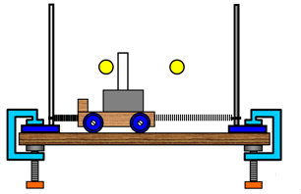
On whiteboards draw a force-time graph for the oscillating trolley (look at the motion carefully). Start with the trolley in the equilibrium position
Learning Outcome: Define simple harmonic motion
Nuclear
Notes:
Take example see if any one has labelled radians, if not talk about degree and what does degrees mean?- get to do this as prepare for learning?

Slide 16
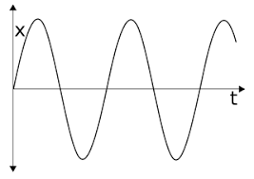
How would this compare to acceleration versus time?
Learning Outcome: Define simple harmonic motion
Nuclear
Notes:
Take example see if any one has labelled radians, if not talk about degree and what does degrees mean?- get to do this as prepare for learning?

Slide 17
How would this compare to acceleration versus time?
Learning Outcome: Define simple harmonic motion
Nuclear
Notes:
Take example see if any one has labelled radians, if not talk about degree and what does degrees mean?- get to do this as prepare for learning?

Slide 18
Learning Outcome: Define simple harmonic motion
a α x
Notes:
Take example see if any one has labelled radians, if not talk about degree and what does degrees mean?- get to do this as prepare for learning?

Slide 19
Learning Outcome: Define simple harmonic motion
a α -x
Notes:
Take example see if any one has labelled radians, if not talk about degree and what does degrees mean?- get to do this as prepare for learning?

Slide 20
Simple harmonic motion
Learning Outcome: Define simple harmonic motion
a = -ω²x
Acceleration (a) is directly proportional to displacement (x)
Acceleration is in the opposite direction to displacement (shown by negative sign)
Notes:
Go through how to get mass from graph

Slide 21
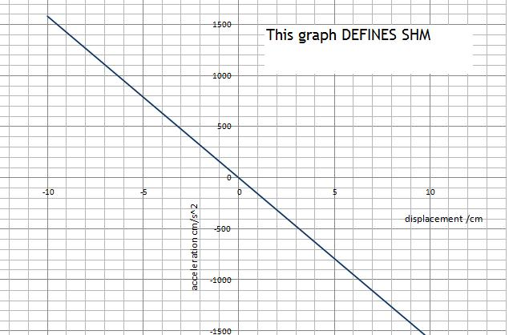
Learning Outcome: Define simple harmonic motion

Slide 22
Simple harmonic motion
Learning Outcome: Define simple harmonic motion
a = -ω²x
-ω² is the gradient of a displacement-acceleration graph
As ω is constant so will be the time period as:
ω = 2πf = 2π/T

Slide 23
Learning Outcome: Describe an experiment to prove the simple harmonic motion equation
a = -ω²x
Using a pendulum show that this equation holds true by testing if the period (T) is independent of initial displacement.
Remember you are looking at horizontal displacement

Slide 24
Learning Outcome: Describe an experiment to prove the simple harmonic motion equation
a = -ω²x
Describe an experiment to investigate whether the period of oscillation (time taken for one oscillation) for a pendulum is constant for all initial displacements.
Labelled Sketch of apparatus
- Think about the equipment you will use and the reason for choosing it
Method - What measurements will you take - What Limitations/ Source of error will there be, how will they may be overcome?
Results table

Slide 25
Learning Outcome: Describe an experiment to prove the simple harmonic motion equation
Measurements + Equipment
– Angle measured with protractor
- Time measured with stop-watch/data logger
Conclusion/Analysis
Compare the period for different angles/Plot period against angle
Source of Error
Angle of swing decreases during the timing of the swing
Solution
Time for ¼, ½ or 1 swing accurately (using electronic timer/datalogger)
OR
Use data logger with motion sensor to record many swings and analyse how the period changes with time
OR
Video the motion with onscreen timer and analyse.

Slide 26
A-Level Physics
1. Development of practical skills in physics
2. Foundations of Physics
3. Forces and motion
4. Electrons, waves and photons
5. Newtonian world and astrophysics
6. Particles and medical physics
5.1 Thermal Physics
5.2 Circular motion
5.3. Oscillations
5.4. Gravitational fields
5.5 Astrophysics
5.3.1. Simple harmonic motion
5.3.2. Analysing simple harmonic motion
5.3.3. Energy and simple harmonic motion
5.3.4. Damping and resonance

Slide 27
Analysing simple harmonic motion
Plot graphs of displacement, velocity and acceleration graphs for SHM
Derive equations for SHM
Calculate variables in SHM

Slide 28
Learning Outcome: Plot displacement, velocity and acceleration graphs for SHM

Slide 29
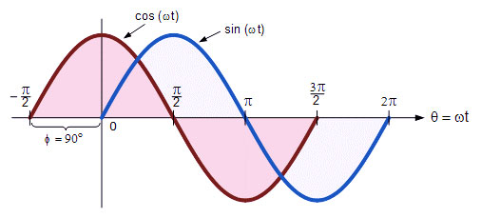
What mathematical functions do these graphs represent
Learning Outcome: Derive equations for SHM
Displacement-time graphs starting at amplitude or equilibrium position
Nuclear
Notes:
Take example see if any one has labelled radians, if not talk about degree and what does degrees mean?- get to do this as prepare for learning?

Slide 30
Learning Outcome: Derive equations for SHM
Notes:
Take example see if any one has labelled radians, if not talk about degree and what does degrees mean?- get to do this as prepare for learning?

Slide 31
Learning Outcome: Derive equations for SHM
x = A cos ω t
x = A sin ω t
Starting at amplitude
Starting at equilibrium

Slide 32
Learning Outcome: Derive equations for SHM
v = ω √A² – x²
V_{max} = ωA

Slide 33
Learning Outcome: Derive equations for SHM
Amplitude:
x = A cos ω t
Equilibrium:
x = A sin ω t
v = ω √A² – x²
v_{max} = ωA
a = -ω²x

Slide 34
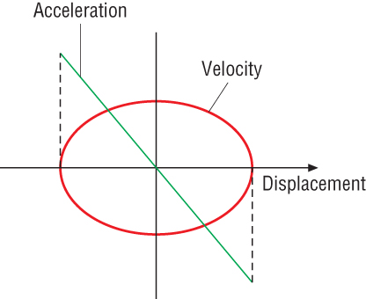
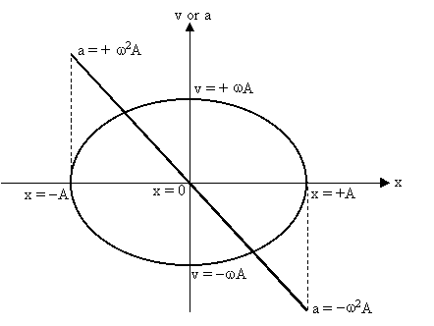
Acceleration and Velocity -Displacement graphs
Learning Outcome: Derive equations for SHM

Slide 35
A-Level Physics
1. Development of practical skills in physics
2. Foundations of Physics
3. Forces and motion
4. Electrons, waves and photons
5. Newtonian world and astrophysics
6. Particles and medical physics
5.1 Thermal Physics
5.2 Circular motion
5.3. Oscillations
5.4. Gravitational fields
5.5 Astrophysics
5.3.1. Simple harmonic motion
5.3.2. Analysing simple harmonic motion
5.3.3. Energy and simple harmonic motion
5.3.4. Damping and resonance

Slide 36
Analysing simple harmonic motion
Describe the energy changes taking place during simple harmonic motion
Evaluate the impact of elastic potential in a spring mass system
Calculate the potential and kinetic energy of an oscillating system

Slide 37
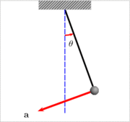
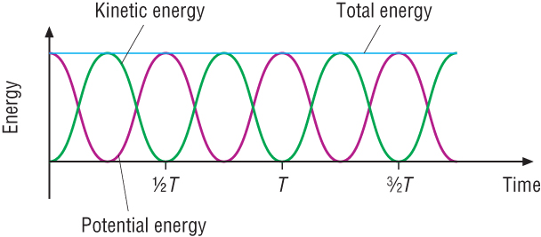
Energy in SHM
Learning Outcome: Describe the energy changes taking place during simple harmonic motion

Slide 38
Learning Outcome: Evaluate the impact of elastic potential in a spring mass system
What would the kinetic and elastic potential energy look like for this example?

Slide 39
Learning Outcome: Evaluate the impact of elastic potential in a spring mass system
What would the kinetic and elastic potential energy look like for this example?

Slide 40
Energy in SHM
Learning Outcome: Calculate the potential and kinetic energy of an oscillating system
How does the potential energy varies with displacement?
How does this link to the equation for elastic potential energy?

Slide 41
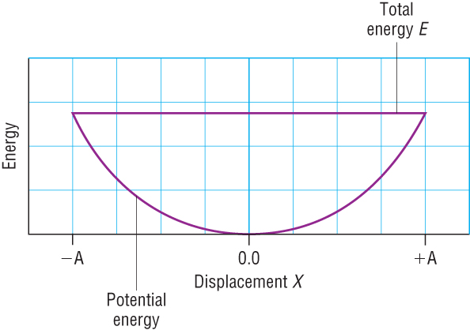
Energy in SHM
Learning Outcome: Calculate the potential and kinetic energy of an oscillating system
How does the potential energy varies with displacement?
How does link to the equation for elastic potential energy?
E = ½kx²

Slide 42
Energy in SHM
Learning Outcome: Calculate the potential and kinetic energy of an oscillating system
The diagram shows how the total energy of an oscillator of mass, m, varies with displacement and how the potential energy varies with displacement.
Potential energy varies from
E = 0 to E = ½kA²
Total energy = = ½kA²
What would be an expression for kinetic energy?

Slide 43
Energy in SHM
Learning Outcome: Calculate the potential and kinetic energy of an oscillating system
The diagram shows how the total energy of an oscillator of mass m varies with displacement and how the potential energy varies with displacement.
Potential energy varies from
E = 0 to E = ½kA²
Total energy = = ½kA²
E_{k} = ½ kA² – ½ kx² = ½ k(A²-x²)

Slide 44
Energy in SHM
Learning Outcome: Calculate the potential and kinetic energy of an oscillating system
What would the energy changes look like for this example, what energy changes are taking place?

Slide 45
Energy in SHM
Learning Outcome: Calculate the potential and kinetic energy of an oscillating system
A mass rests on a smooth surface. It is attached by an open-wound spring that can be stretched or compressed to a fixed support.
The mass is pulled to the right and released at t=0. The equation for its displacement x in m from the equilibrium position is
x = 0.040 cos (πt). The spring constant is 5 Nm⁻¹.
Q. Calculate the a) potential and b) the kinetic energy in mJ of the system at t= 0, 0.50s, 0.75s and 1.25s.
Q. If the amplitude above was halved. By what factor are the answers changed? Explain why they change by this amount?

Slide 46
Energy in SHM
Learning Outcome: Calculate the potential and kinetic energy of an oscillating system
The mass is pulled to the right and released at t=0. The equation for its displacement x in m from the equilibrium position is
x = 0.040 cos πt. The spring constant is 5 Nm⁻¹.
Q. Calculate the a) potential and b) the kinetic energy in mJ of the system at t= 0, 0.50s, 0.75s and 1.25s.
Q. If the amplitude above was halved. By what factor are the answers changed? Explain why they change by this amount?
E α A²
Time/s | X/m | Ek/mJ | Ep/mJ
0 | 0.04 | 0 | 4
0.5 | 0 | 4 | 0
0.75 | -0.03 | 2 | 2
1.25 | -0.03 | 2 | 2

Slide 47
A-Level Physics
1. Development of practical skills in physics
2. Foundations of Physics
3. Forces and motion
4. Electrons, waves and photons
5. Newtonian world and astrophysics
6. Particles and medical physics
5.1 Thermal Physics
5.2 Circular motion
5.3. Oscillations
5.4. Gravitational fields
5.5 Astrophysics
5.3.1. Simple harmonic motion
5.3.2. Analysing simple harmonic motion
5.3.3. Energy and simple harmonic motion
5.3.4. Damping and resonance

Slide 48
Damping and resonance
Describe the effects of damping on an oscillatory system
Describe resonance
Descibe the effects of damping on resonance

Slide 49
Learning Outcome: Describe the effects of damping on an oscillatory system
The amplitude of free oscillations will always decrease with time owing to friction and air resistance- this is known as damping
To keep a system oscillating it must be “driven” (a forced oscillation)

Slide 50
Damping
Learning Outcome: Describe the effects of damping on an oscillatory system
Light damping – the period of oscillation is almost unchanged, the amplitude decreases gradually.
Heavy Damping – there is a noticable reduction in amplitude and change in period
Critical Damping – No oscillation occurs and the body returns to equilibrium.

Slide 51
Damping
Learning Outcome: Describe the effects of damping on an oscillatory system
Examples of Heavy damping are:
Car suspension – without damping the bounce from the springs would be unpleasant after going over a bump.
Shock absorbers are used for approximate critical damping so that equilibrium is quickly re-established.

Slide 52
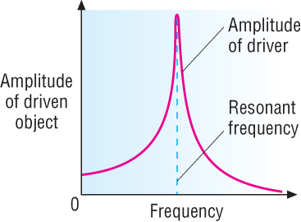
Resonance
Learning Outcome: Describe resonance and the effect of damping on resonance
The object causing the effect is the driver frequency.
The other object is driven and has a natural frequency of oscillation.
A large amplitude oscillation is built up when the two frequencies are the same – this is Resonance.
Resonance: driving frequency = natural frequency
Notes:
https://www.youtube.com/watch?v=6_PLnInsh7E
https://www.youtube.com/watch?v=zopGLYB_MNw
https://www.youtube.com/watch?v=3mclp9QmCGs

Slide 53
Resonance
Learning Outcome: Describe resonance
For each of these examples which is the driver and what is being oscillated?
Notes:
https://www.youtube.com/watch?v=6_PLnInsh7E
https://www.youtube.com/watch?v=zopGLYB_MNw
https://www.youtube.com/watch?v=3mclp9QmCGs

Slide 54
Resonance
Learning Outcome: Describe resonance
Other examples include:
The ratter in the bodywork of a car at a particular speed
A radio or PA system which suddenly makes a very loud squeal
MRI scanning
Watches containing quartz crystals

Slide 55
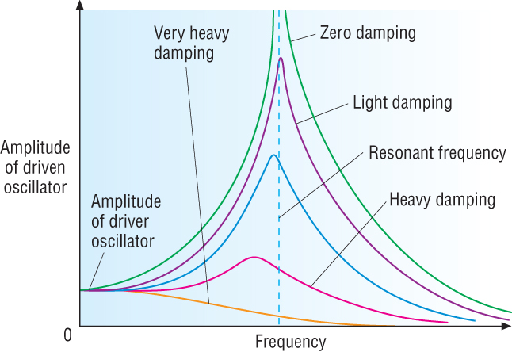
Effect of damping on resonance
Learning Outcome: Describe the effect of damping on resonance
Resonance frequency decreases with damping

