Slide 1
GCSE Physics in a nutshell
Y9 Energy types and transfers

Slide 2
GCSE Physics
Physics
1. Energy
2. Electricity
3. Particles
4. Atomic structure and radioactivity
5. Waves
6. Forces
7. Magnetism and electromagnetism
1.1 Energy types and transfers
1.2. Resources
1.1.1. Energy types and transfers
1.1.2. Conservation of energy
1.1.3. Efficiency
1.1.4. Power
1.1.5. Gravitational potential energy
1.1.6 Kinetic energy
1.1.7 Elastic energy

Slide 3
GCSE Physics in a nutshell
Y9 Energy types and transfers- equations overview Equations in bold you are given, the others you must learn
Equation (written) | Equation (symbols)
Elastic potential energy = 0.5 x spring constant x extension² | E_{e} = ½ ke²
Kinetic energy = 0.5 x mass x velocity² | E_{k} = ½mv²
Gravitational potential energy = mass x gravitational field strength x height | E_{GPE} = mgh
Power = energy transferred ÷ time taken | P = E ÷ t
Efficiency = useful output energy (or power) ÷ total output energy (or power)

Slide 4
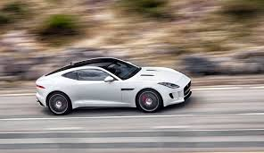
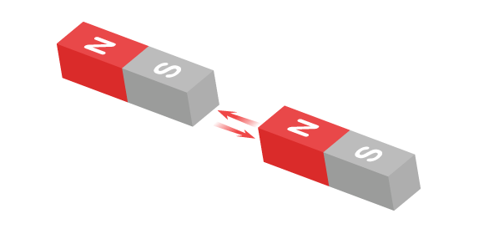
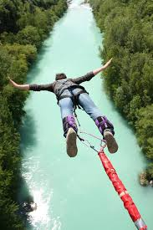
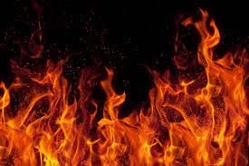
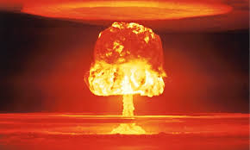
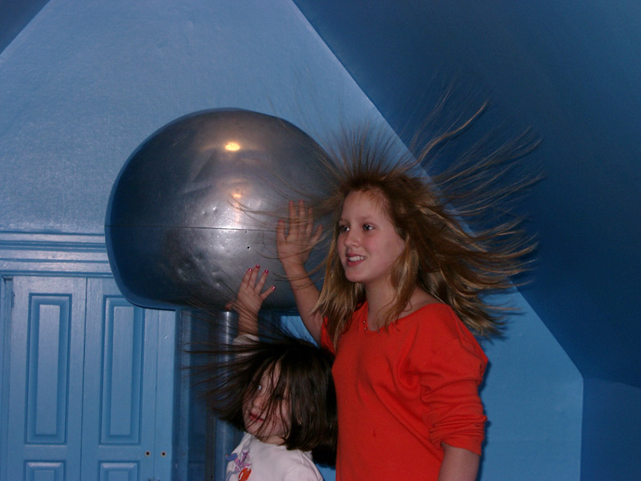
What types of energy stores are there?
Kinetic
Magnetic
Chemical
Gravitational
Thermal
Nuclear
Elastic
Electrostatic
Notes:
Explain that when students want to say the word “store” they should replace it with the word “potential”

Slide 5
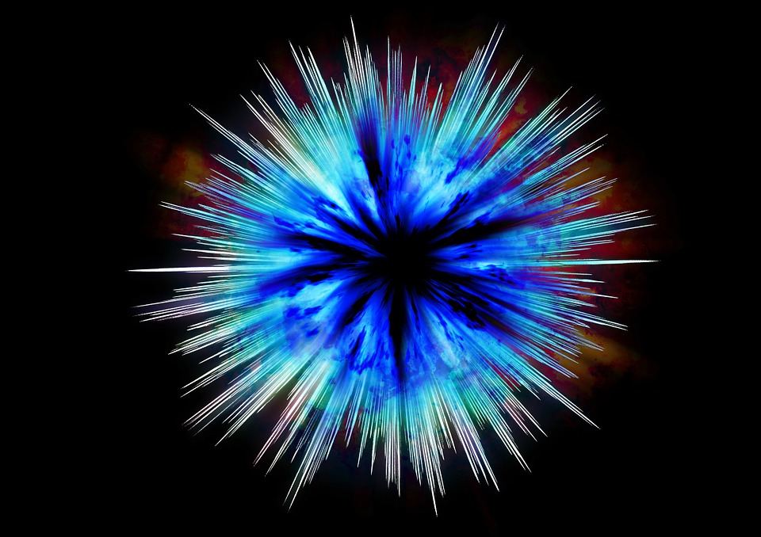
The principle of Conservation of Energy.
Energy cannot be created or destroyed
only transferred .
Amount of Energy at the start
Amount of Energy at the end
All of the energy in the universe was created in the moment of the big bang and will be the same energy when the universe dies.

Slide 6
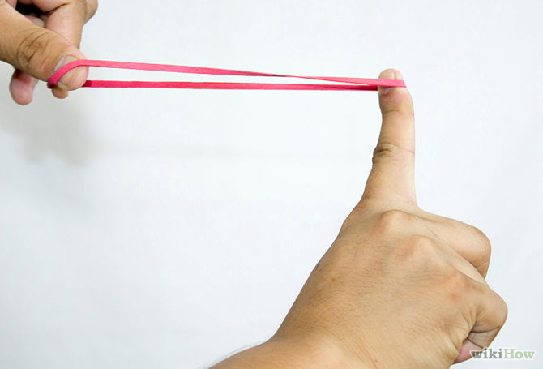
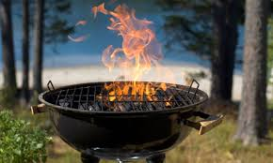
The principle of Conservation of Energy and energy transfers.
Amount of Energy at the start
Amount of Energy at the end
Energy is measured in Joules (J)
Elastic energy -----> kinetic energy
10 J 10 J
Chemical energy ---> Heat + Light
12 J 10 J + 2 J

Slide 7
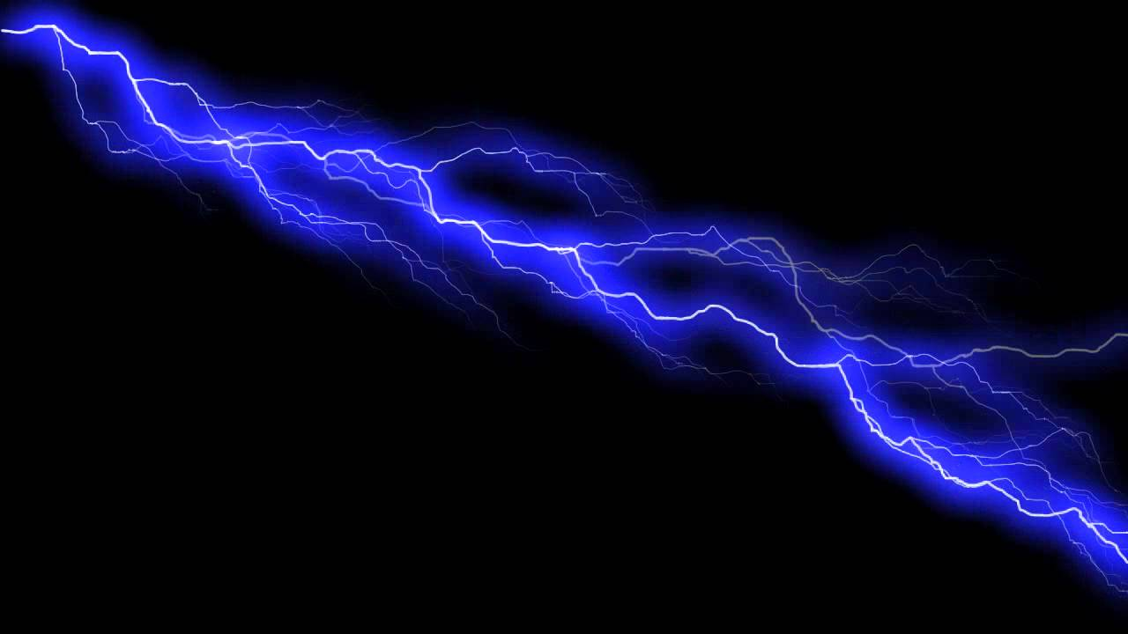
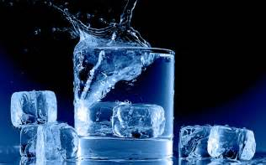
Energy can be transferred between stores by 4 methods: Mechanically- A force moving through a distance Electrically- electric current Heating- due to a temperature difference Radiation – e.g. light, microwaves, sound
Notes:
Explain that when students want to say the word “store” they should replace it with the word “potential”

Slide 8
Efficiency
Efficiency is a percentage of how much of the energy transferred is useful.
Total Energy
Input
=
Useful Energy
Output
Wasted Energy
Output
+

Slide 9
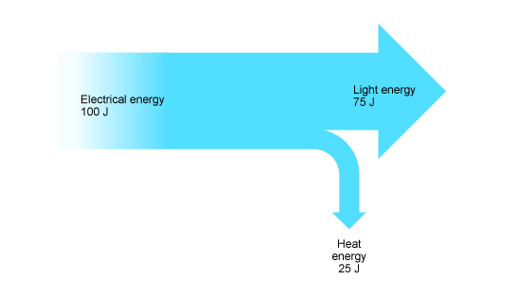
Sankey diagrams: e.g. A lamp
Useful energy goes on the right
90J
are transferred as useful light energy
Input electrical energy:
100J
10J
are wasted as heat.
Input energy goes on the left
Size of the arrows is related to the amount of energy
Wasted energy goes on the right and downwards (or upwards)

Slide 10
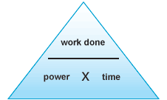
Power
“Work done” is another way of saying how much energy has been transferred
Power is the rate at which work is done or energy is transferred
Power = work done
time taken
0.06%
0.9%
0.04%
Power is measured in Watts (W)

Slide 11
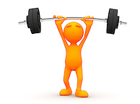
Gravitational potential energy
It requires 400 J of work done or energy to lift the 20 kg mass against gravity
When you lift up an object against gravity you are doing work
The energy required to do this work is stored in the object as gravitational potential energy
Gravitational potential energy is the energy stored in an object as the result of its vertical position or height.

Slide 12
Calculating gravitational potential energy
Calculating gravitational potential energy for lifting objects:
Gravitational = mass (kg) x gravity (N kg⁻¹) x height (m)
Potential energy (J)
Where “gravity” is the force (in Newtons) per kilogram that an object experiences owing to the gravitational field of another object
On Earth all objects experience a force of 9.81 N/kg due to the Earth’s gravitational force

Slide 13
Kinetic energy
Kinetic energy = ½ x mass x velocity²
E_{k} = ½ mv²
Calculate the kinetic energy for the following objects:
A man on a bicyle with a combined mass of 100 kg traveling at 8 m/s
0.5 x 100 x (8²) = 3200 J
2) A duck with a mass of 5 kg waddling through water with a speed of 0.5 m/s
0.5 x 5 x (0.5²) = 0.625 J
3) A paper aeroplane with a mass of 10g thrown at a speed of 3 m/s
0.5 x 0.01 x (3²) = 0.045 J

Slide 14
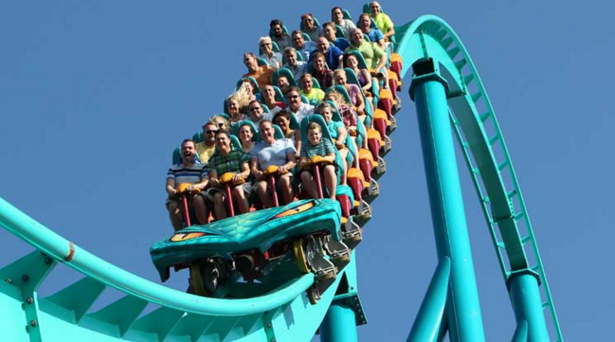
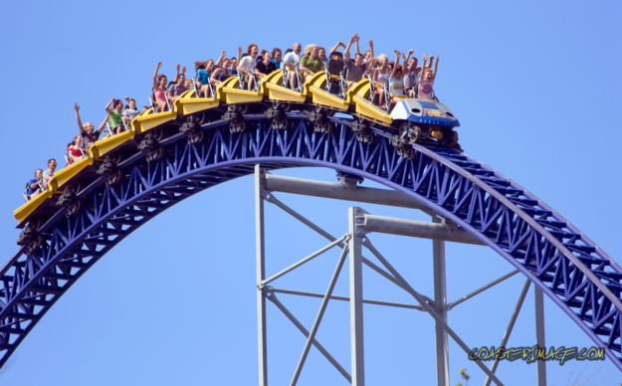
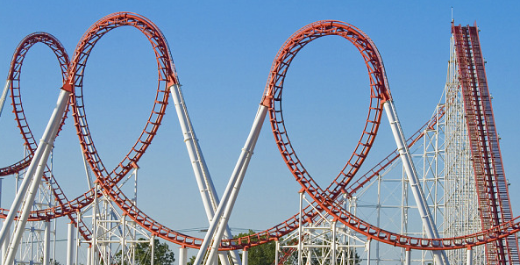
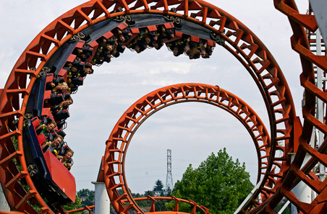
Converting Gravitational potential energy to kinetic energy
All roller coasters work by converting gravitational potential energy to kinetic energy

Slide 15
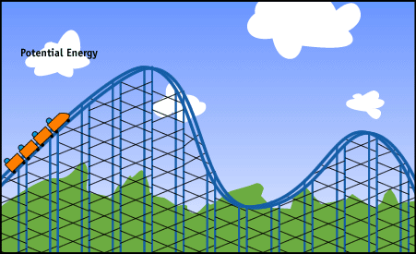
Converting Gravitational potential energy to kinetic energy

Slide 16
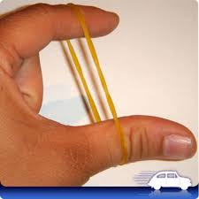
Calculating Elastic Potential energy
When objects are stretched work is done to stretch the object
The energy is stored as ELASTIC potential energy
Notes:
Tray provided for small groups with elastic band, plasticine, pipe cleaner, strawberry laces.

Slide 17
Calculating Elastic Potential energy
The work or energy required to stretch a material is given by the equation:
Work done = ½kx²
k is the spring constant
x is the extension
The spring constant, k, tells you how much force, in Newtons, is required to stretch a material by 1m. Measured in N/m
If we know the spring constant, we can calculate the work required to extend a material by a given amount using the equation Work done = ½kx²

