Slide 1
Modelling Physics- the experiments
Notes:
Electricity
Electro and magnetic fields and magnetism
Waves
Quantum, nuclear and particle physics
Medical physics

Slide 2
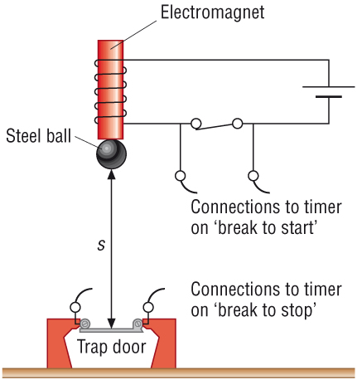
3.1.5 The trap door and electromagnet method for determining g
Apparatus |  | Analysis | Use s = ut + ½at² (u =0, a=g) ∴ g = 2s T² Substitute values of s and t in to get g. Or plot a graph of s (y-axis) versus t² (x-axis) and the gradient is g/2
Method | Steel ball is attracted to electromagnet, when current is switched off ball falls and timer starts When ball hits the trap door timer stops Distance, s, ball falls is measured with ruler Time, t, is taken from timer | Reducing error | Repeat experiment several times and get mean value Take readings at different heights The electromagnet should have a current that just holds the ball so there is no delay when it turns off If the distance is too large or ball small air resistance will have an effect and effect speed Distance should be measured from the bottom of the ball accurately

Slide 3
3.1.5 The light gates method for determining g
Apparatus |  | Analysis | Average card velocity can be found by: v=L/t Where L is the card length, and t is the time for the card to travel through the light gate Acceleration, g, can be found from: v² = u² + 2as (u = 0, a =g) g = v²/s Or plot a graph of v² (y=axis) versus s (x-axis) - gradient is 2g
Method | Drop a piece of card through a lightgate connected to a data logger. Measure the length of card and the height of the card above the light gate | Reducing error | Add bluetack to the card to improve card stability Method assumes card velocity is constant through light gate, to minimise error from this measure height fallen to the middle of the card

Slide 4
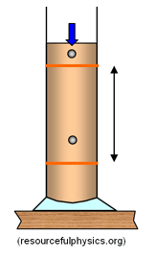
3.2.3 Measuring terminal velocity of a body falling through a liquid
Ball bearing
Apparatus |  | Analysis | Velocity, v can be calculated between each elastic band from the time and distance (v=s/t) Plot a graph of v (y-axis) versus cumulative time from ball release (x-axis) Connect points with smooth curve and find terminal velocity
Method | Suitable viscous liquids include wallpaper paste, heavy oil or liquid detergent Ball bearing is dropped into liquid and timer started Elastic bands are placed where the ball has fallen to in a given time period Distance between elastic bands is measured when ball reaches bottom Magnet is used to get ball bearing out | Reducing error | Repeat experiment multiple times and find average velocity for each time period
Elastic bands mark depth
Cylinder filled with viscous liquid

Slide 5
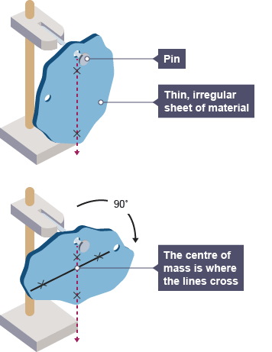
3.2.3 Finding the centre of mass/centre of gravity of an object
Apparatus |  | Analysis | Where the three lines cross is the centre of mass for the object. This works because a suspended body will always come to rest with its centre of gravity below the point of suspension
Method | Make 3 holes in random places on the edge of shape Hang shape from 1st hole and let it come to a rest Using a plumb line draw a vertical line from the point of suspension to the bottom of the shape Repeat process for other holes | Reducing error | Make sure the body has come to a rest before drawing the vertical line

Slide 6
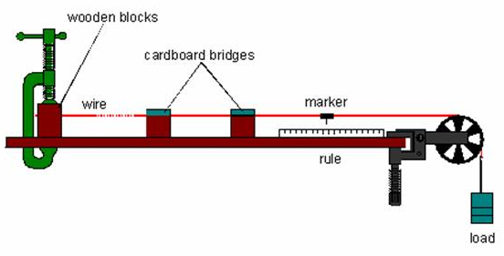
3.4.1 Investigating stretching a wire
Apparatus |  | Analysis | Work out tensile force from the mass added to the hanger ( x 9.81) and extension form the ruler readings
Method | Attach a marker to the wire and fixer the ruler in position Progressively add masses to hanger Record reading on ruler and masses added to hanger | Reducing error/ H&S | At the start the mass hanger must just be heavy enough to keep the wire taught The wire may snap- wear eye protection and place a box below the mass hanger- to catch the weight- don’t stand beneath this!

Slide 7
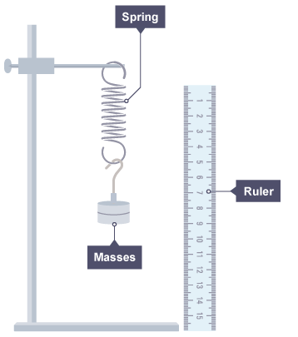
3.4.1 Investigating force-extension characteristics of other materials
Apparatus |  | Analysis | Plot a graph of force (weight) versus extension to show force-extension characteristics of material
Method | Masses are added to the spring Extension is measured for different loads Method can be used for rubber bands, elastic cord, strip of polythene You would need to do a trial run to decide suitable range of values of the load force for the material | Reducing error/ H&S | Clamp the ruler do that 0cm is level with the base of the spring so extension can be directly read Use a set square to make sure the clamped ruler is vertical to the bench The spring may snap- wear eye protection and place a box below the mass hanger- to catch the weight- don’t stand beneath this!

Slide 8
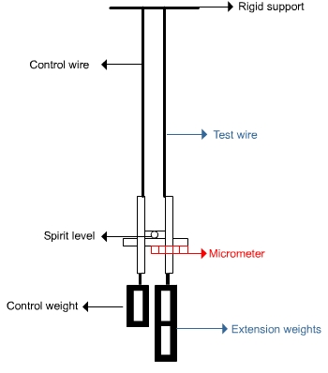
3.4.2 Calculating the Young modulus from a stress-strain graph
Searle’s Apparatus |  | Analysis | Plot a graph of stress (y) (weight added ÷ cross-sectional area) against strain (x) (extension ÷ original length) Gradient = Young’s modulus of the material of test wire
Method | Measure diameter of wire with a micrometer and original length of wire under tension but before additional load added Add weights to right hand side and measure extension Extension is very small so vernier scale is used Reading of micrometer is noted when spirit level levelled and extra load added | Reducing error/ H&S | The wire may snap- wear eye protection and place a box below the mass hanger- to catch the weight- don’t stand beneath this!

Slide 9
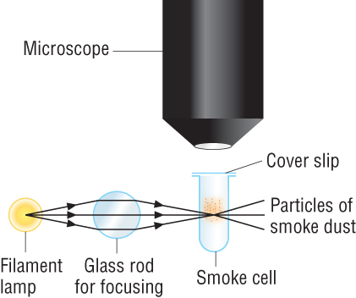
5.1.2 Describe an experiment for Brownian motion and state the important conclusions from this experiment
Apparatus/method | Microscope should be focussed on smoke which will show up as tiny dots of light | Conclusions | All molecules are continuously moving randomly in different directions and different speeds. Air particles are much smaller than the smoke particles

Slide 10
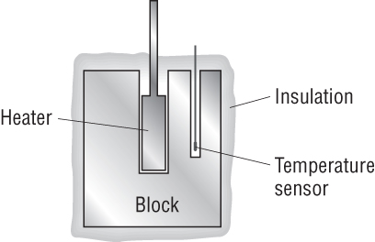
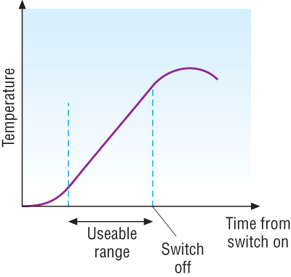
5.1.3 Determining the value of the specific heat capacity of a material
Apparatus |  | Analysis
Method | A Block of metal of mass, m has two holes drilled into it: one for an electrical heater and the other for a temperature sensor that can be connected to a data logger. The metal is well lagged, and the heater is switched on. Either the power of the heater needs to be known or both the current, I (series), and the potential difference across the heater, V (parallel), need to be measured. | Reducing error/ H&S | Make sure the block is well insulated to reduce heat transfer to the surroundings. This method is likely to overestimate c as more energy is required for a change in T, due to heat transfer to surroundings Don’t handle power supplies with wet hands, heaters may burn, don’t fully submerge an immersion heater in water

Slide 11
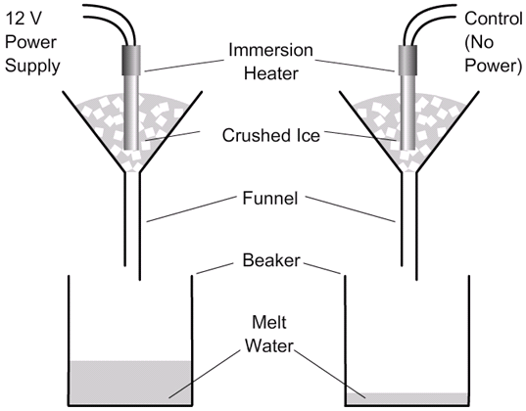
5.1.3 Determining the specific latent heat of fusion
Apparatus |  | Analysis | Difference in water mass (m_{a}-m_{b}) is due to electrical energy input (VIt) E = mL_{f} ∴ L_{f} = VIt m_{a}-m_{b}
Method | Place known mass of ice in 2 funnels, connected heater on left to power, P (or measure V (parallel) and I (series), P=IV), don’t connect control. Turn left heater on when water starts to drip Turn heater off after 15 mins and measure mass of water in both beakers. | Reducing error/ H&S | Don’t handle power supplies with wet hands, heaters may burn, do not fully submerge an immersion heater in water

Slide 12
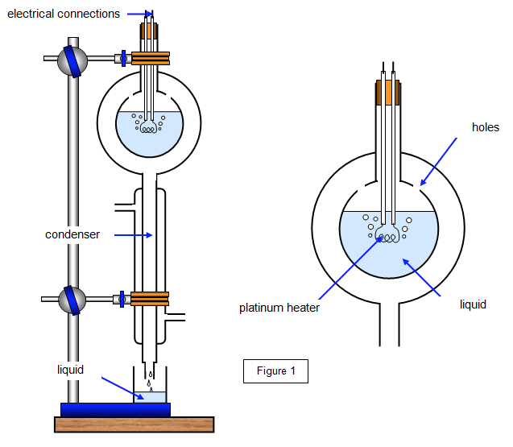
5.1.3 Determining the specific latent heat of vaporisation
Apparatus |  | Analysis | From first set of data collection you will get: 1) V₁I₁t = m₁ L_{v} + Q (where Q is energy transferred to surroundings) From second set of data collection you will get: 2) V₂I₂t =m₂L_{v} + Q Substituting 1 into 2 will give: (V₂I₂-V₁I₁)t=(m₂-m₁)L_{v} So L_{v} can be found and energy transferred to surroundings is eliminated
Method | Heat water to boiling point Measure voltage and current of heater and mass of water water vapour collected over time, t. Change voltage/current then repeat to get 2 data sets | Reducing error/ H&S | Don’t handle power supplies with wet hands, heaters may burn, do not fully submerge an immersion heater in water Assumes Q = constant

Slide 13
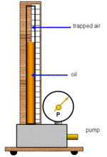
5.1.4 Investigating pV = constant (Boyle’s law)
Apparatus |  | Analysis | The unit given for PV is Nm. To get the value in Nm, the volume needs to be in m³ and the pressure in Pa. It is very difficult to check the shape of a graph that shows the inverse proportion of P and V if P is plotted against V. A straight line graph should be obtained if P is plotted against 1/V, to show the product PV is constant.
Method | The apparatus can be pumped up to a high pressure and then very slowly vented. Pressure and volume of the air is recorded as pressure is incrementally vented | Reducing error/ H&S | It is important to do the experiment slowly so that the temperature will always be room temperature. A gas cools as it expands, and time must be allowed for the temperature to be constant.

Slide 14
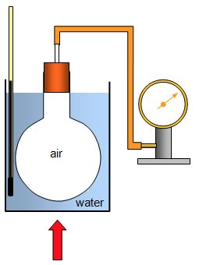
5.1.4 Investigating pressure and temperature of a gas at constant volume
Apparatus |  | Analysis | Plot a graph of pressure (y-axis) versus temp- this should be a straight line through origin, as p/t =constant Note: If Kelvin is used extrapolating the graph back to cross the x-axis will give a value for absolute zero
Method | Fixed mass of gas heated in a sealed flask of constant volume Pressure of the gas at temperatures between 0-100°C recorded | Reducing error/ H&S | Thermometer should not touch container- accurate temp reading Flask should not touch the bottom of the container- heat transfer Possible errors from leaks- ensure tight seal Flask may explode- experiment should be done behind safety screen

Slide 15
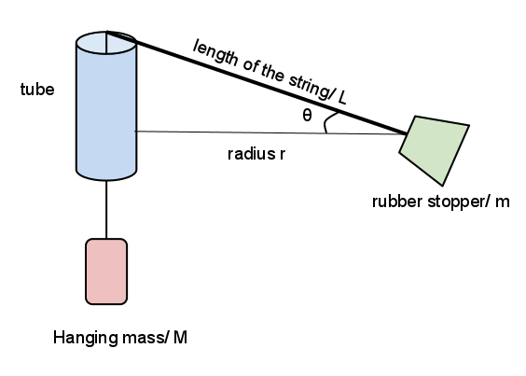
5.2.2 Investigating circular motion using a whirling bung
Apparatus |  | Analysis | Determine avg. bung speed from: v = s/t So v = 10 x 2πr t Plot a graph of F against v² with a line of best fit. Where F = the weight on the string F = mv² r So, the gradient of the line will equal m/r The mass of the bung can be determined from r = 0.3m
Method | Mark a point on the string 0.3m from the bung and attach 1N weight to string The bung is whirled in a circle at constant speed with a radius of 0.3 m Measure the time, t, for 10 revolutions Repeat for different values of centripetal force by adding mass, m | Reducing error/ H&S | Repeat experiment several times and get mean value Ensure the mark on the string is easy to see to help keep the radius constant Wear eye protection Do not do this in crowded areas

Slide 16
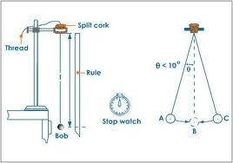
5.3.1 Determining period/frequency of simple harmonic oscillations
Apparatus |  | Analysis | Period is the time for one oscillation Frequency = 1/period
Method | Rise up pendulum to set angle measured with protractor Release and start stop watch Record time for x oscillations | Reducing error/ H&S | Repeat experiment several times and get mean value There are difficulties with exact timing of an single oscillations Use a video camera or light gates to record the time of one oscillations If recording multiple oscillations the amplitude will reduce with each swing due to air resistance

