Slide 1
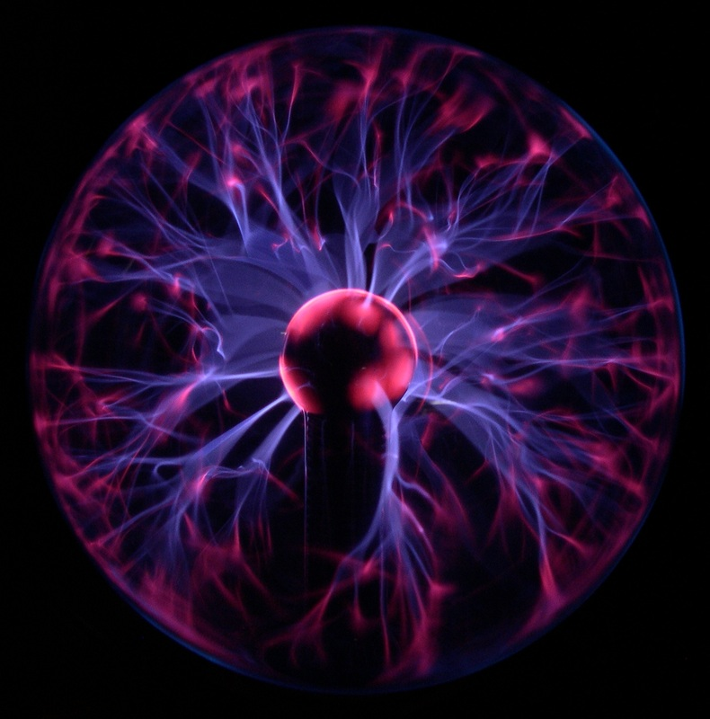
Electric fields
Electric fields
Module 5: Newtonian world and astrophysics
Module 6: Particles and medical physics
6.1: Capacitors
6.2: Electric fields
6.3: Electromagnetism
6.4 Nuclear and particle physics
6.5 Medical imaging
1. Electric field lines and field strength
2. Uniform electric fields and capacitance
3. Coulombs Law
4. Motion of charged particles
5. Electric potential and electric potential energy

Slide 2
Electric fields and field lines
Electric fields
Module 5: Newtonian world and astrophysics
Module 6: Particles and medical physics
6.1: Capacitors
6.2: Electric fields
6.3: Electromagnetism
6.4 Nuclear and particle physics
6.5 Medical imaging
1. Electric field lines and field strength
2. Uniform electric fields and capacitance
3. Coulombs Law
4. Motion of charged particles
5. Electric potential and electric potential energy

Slide 3
Electric field lines and field strength
Describe what is meant by an electric field
Draw electric field patterns around point charges
Describe electric fields around multiple charges and equipotential

Slide 4
Learning Outcome: Describe what is meant by electric fields
Why does this happen?
Notes:
https://www.youtube.com/watch?v=T6R1uFvMFNM
4:35 onwards

Slide 5
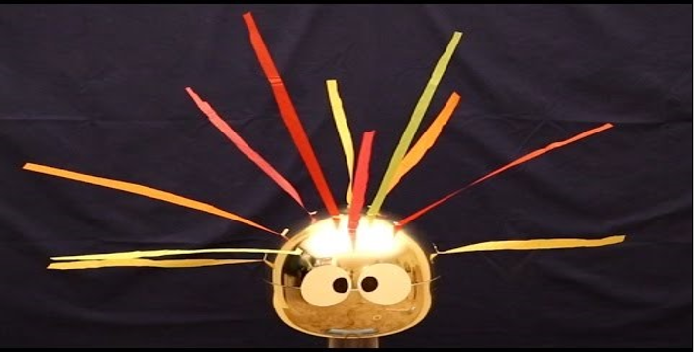
Learning Outcome: Describe what is meant by electric fields
-
-
-
-
-
-
-
-
-
-
-
-
-
-
-
-
-
-
-
-
-
-
-
-
-
-
The metal dome and “hair” becomes electrically charged so repel.
Any electrically charged object will have an electric field around it.
The hairs align to the electric field lines of the dome
Notes:
https://www.youtube.com/watch?v=T6R1uFvMFNM
4:35 onwards

Slide 6
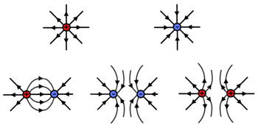
Electric field patterns
Learning Outcome: Draw electric field patterns

Slide 7
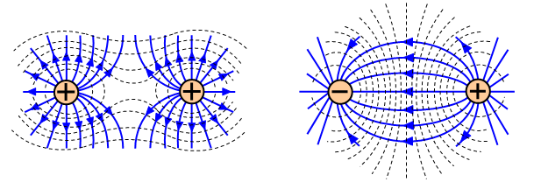
Equipotential lines
Learning Outcome: Describe electric fields around multiple charges and equipotential

Slide 8
Electric fields and field lines
Electric fields
Module 5: Newtonian world and astrophysics
Module 6: Particles and medical physics
6.1: Capacitors
6.2: Electric fields
6.3: Electromagnetism
6.4 Nuclear and particle physics
6.5 Medical imaging
1. Electric field lines and field strength
2. Uniform electric fields and capacitance
3. Coulombs Law
4. Motion of charged particles
5. Electric potential and electric potential energy

Slide 9
Electric field strength
Describe what is meant by electric field strength
Describe how electric field strength varies in radial fields
Calculate electrical field strength in radial fields

Slide 10
Learning Outcome: Describe what is meant by electric field strength
Electric field strength is the force experienced per unit positive charge at a point within an electric field
This is Q- note this changes later!!
E = F
Q
The units of electric field strength are therefore NC⁻¹
Notes:
https://www.youtube.com/watch?v=T6R1uFvMFNM
4:35 onwards

Slide 11
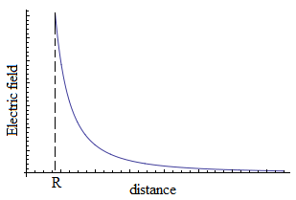
What would a graph of electric field strength versus distance (r) look like?
Learning Outcome: Describe how electric field strength varies in radial fields
What is the mathematical relationship between E and r?

Slide 12
What would a graph of electric field strength versus distance (r) look like?
Learning Outcome: Describe how electric field strength varies in radial fields
What is the mathematical relationship between E and r?

Slide 13
What would a graph of electric field strength versus distance (r) look like?
Learning Outcome: Describe how electric field strength varies in radial fields
What is the mathematical relationship between E and r?
E α 1/r² (inverse square law)

Slide 14
Learning Outcome: Calculate electrical field strength in radial fields
E α 1/r² (inverse square law)
What other factors will affect E, for a charge placed in a radial field?

Slide 15
Learning Outcome: Calculate electrical field strength in radial fields
E α 1/r² (inverse square law)
What other factors will affect E, for a charge placed in a radial field?
Size of charge causing field (Q)
Permittivity of space which charge is placed in (assuming “free space” = Ε_{o})

Slide 16
Learning Outcome: Calculate electrical field strength in radial fields
E α 1/r² (inverse square law)
What other factors will affect E, for a charge placed in a radial field?
Size of charge causing field (Q) E α Q
Permittivity of space which charge is placed in (assuming “free space” = Ε_{o})
E = Q
4πΕ_{o}r²

Slide 17
Learning Outcome: Calculate electrical field strength in radial fields
E = Q
4πΕ_{o}r²
Q- Size of charge causing field
Ε_{o} - Permittivity of space which charge is placed in, assuming “free space”
r- Distance from point charge
A charge of -5 C is placed in the electric field of a 10C charge at a distance of 55 cm, what electric field strength would it experience?

Slide 18
Learning Outcome: Calculate electrical field strength in radial fields
E = Q
4πΕ_{o}r²
Q- Size of charge causing field
Ε_{o} - Permittivity of space which charge is placed in, assuming “free space”
r- Distance from point charge
A charge of -5 C is placed in the electric field of a 10C charge at a distance of 55 cm, what electric field strength would it experience?
E = 10 = 10
4π x 8.85 x 10⁻¹² x 0.55² 3.36 x 10 ⁻¹¹
E = 2.98 x 10¹¹ NC⁻¹

Slide 19
Uniform electric fields and capacitance
Electric fields
Module 5: Newtonian world and astrophysics
Module 6: Particles and medical physics
6.1: Capacitors
6.2: Electric fields
6.3: Electromagnetism
6.4 Nuclear and particle physics
6.5 Medical imaging
1. Electric field lines and field strength
2. Uniform electric fields and capacitance
3. Coulombs Law
4. Motion of charged particles
5. Electric potential and electric potential energy

Slide 20
Uniform electric fields and capacitance
Define and calculate electric field strength
Describe and calculate the electric field between two parallel plates
Analyse capacitance of parallel plate capacitors

Slide 21
Learning Outcome: Define and calculate electric field strength
Electric field strength is the force experienced per unit positive charge at a point within an electric field
E = F
Q
The units of electric field strength are therefore NC⁻¹
Notes:
https://www.youtube.com/watch?v=T6R1uFvMFNM
4:35 onwards

Slide 22
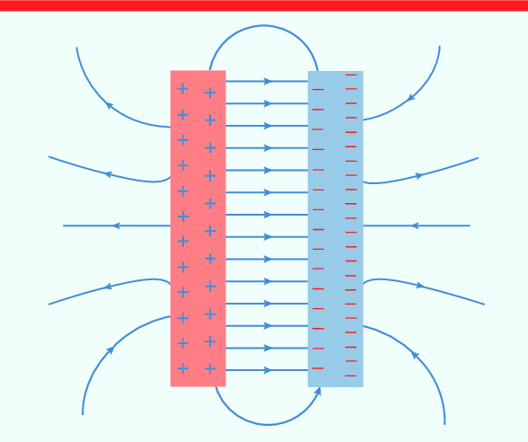
Learning Outcome: Describe and calculate the electric field between two parallel plates

Slide 23
Learning Outcome: Describe and calculate the electric field between two parallel plates
A positive charge placed between the parallel plates will experience a force towards the negative plate dependant on the electric field between the plates
E = F F= EQ
Q
The charge will accelerate towards the negative plate and gain kinetic energy
The energy it gains can be calculated by:
W = Fd
+
As E = VQ
VQ = Fd and as F =EQ
VQ = EQd so V = Ed or E = V
d
E = Energy
E = Electric field strength

Slide 24
Learning Outcome: Describe and calculate the electric field between two parallel plates
Find the force on the 5C charge
2cm
E = F
Q
E = V
d
+
500 V

Slide 25
Learning Outcome: Describe and calculate the electric field between two parallel plates
Find the force on the 5C charge
2cm
E = F
Q
E = V
d
+
Electric field strength on charge:
E = 500 = 25,000 NC⁻¹
0.02
Force on charge:
F = 25,000 x 5 = 125,000 N
500 V

Slide 26
A capacitor has two oppositely charged plates. Remember the capacitance of a capacitor was defined as Charge per Voltage (C = Q/V)
Learning Outcome: Analyse capacitance of parallel plate capacitors
What factors affect the capacitance?
+

Slide 27
A capacitor has two oppositely charged plates. Remember the capacitance of a capacitor was defined as Charge per Voltage (C = Q/V)
Learning Outcome: Analyse capacitance of parallel plate capacitors
+
What factors affect the capacitance?
Plate separation (d)
C α 1/d
Plate surface area (A)
C α A
The permittivity of the insulator between the plates
C α ε
Where: ε = ε_{r}ε₀
ε_{r} is the relative permittivity of an insulator and ε₀ is the permittivity of free space
So: C = εA
d

Slide 28
Learning Outcome: Analyse capacitance of parallel plate capacitors
So: C = εA
d
Where: ε = ε_{r}ε₀
ε_{r} is the relative permittivity of an insulator and ε₀ is the permittivity of free space
2cm
What is the capacitance of this capacitor?
+
20 cm²

Slide 29
Learning Outcome: Analyse capacitance of parallel plate capacitors
So: C = εA
d
Where: ε = ε_{r}ε₀
ε_{r} is the relative permittivity of an insulator and ε₀ is the permittivity of free space
2cm
+
What is the capacitance of this capacitor?
C = 8.85 x 10⁻¹² x 0.0020
C = 1.77 x 10⁻¹⁴ F
20 cm²

Slide 30
Coulombs Law
Electric fields
Module 5: Newtonian world and astrophysics
Module 6: Particles and medical physics
6.1: Capacitors
6.2: Electric fields
6.3: Electromagnetism
6.4 Nuclear and particle physics
6.5 Medical imaging
1. Electric field lines and field strength
2. Uniform electric fields and capacitance
3. Coulombs Law
4. Motion of charged particles
5. Electric potential and electric potential energy

Slide 31
Coulomb’s Law
Describe the force between two charged particles
Derive Coulombs Law
Practise using Coulomb’s Law

Slide 32
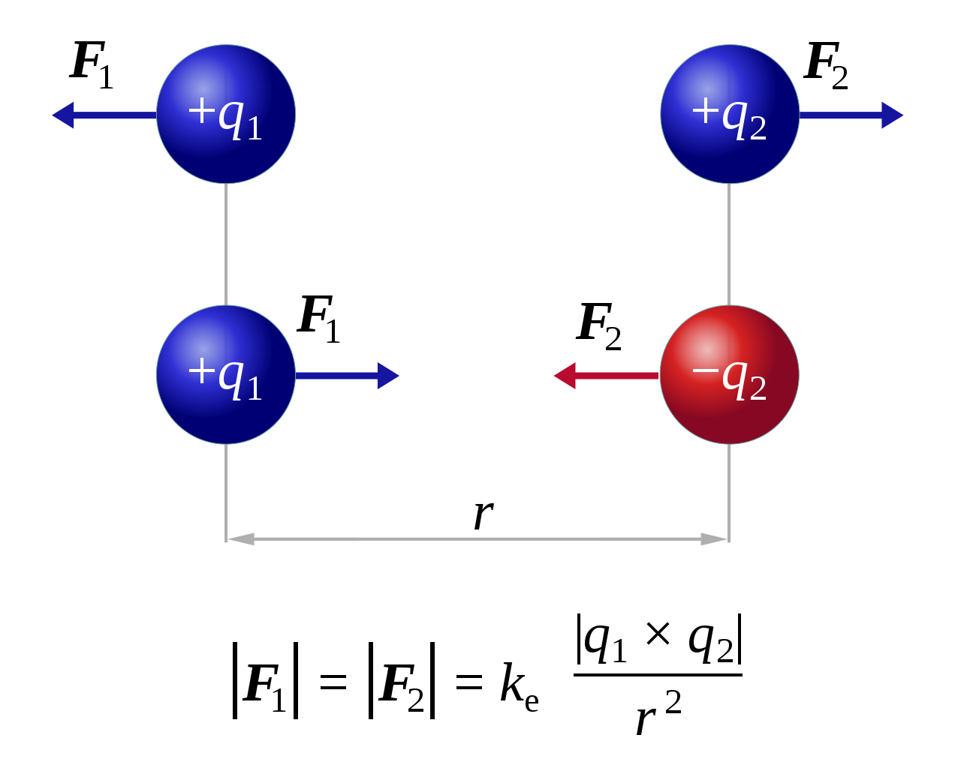
Learning Outcome: Describe the force between two charged particles

Slide 33
Learning Outcome: Derive Coulombs Law

Slide 34
Learning Outcome: Derive Coulombs Law

Slide 35
Learning Outcome: Practise using Coulombs Law
What is the force of repulsion between two electrons held one metre apart in a vacuum? (electron charge = 1.6 x 10⁻¹⁹ C)

Slide 36
Learning Outcome: Practise using Coulombs Law
What is the force of repulsion between two electrons held one metre apart in a vacuum? (electron charge = 1.6 x 10⁻¹⁹ C)
F = kQq/r² = (9.0 x 10⁹ x 1.6 x 10⁻¹⁹ x 1.6 x 10⁻¹⁹)/ 1² = 2.3 x 10⁻²⁸ N

Slide 37
Electric fields
Electric potential and potential energy
Module 5: Newtonian world and astrophysics
Module 6: Particles and medical physics
6.1: Capacitors
6.2: Electric fields
6.3: Electromagnetism
6.4 Nuclear and particle physics
6.5 Medical imaging
1. Electric field lines and field strength
2. Uniform electric fields and capacitance
3. Coulombs Law
4. Motion of charged particles
5. Electric potential and electric potential energy

Slide 38
Electric potential and potential energy
Describe what is meant by electric potential
Describe what is meant by electric potential energy
Describe the link between force and electric potential energy

Slide 39
Learning Outcome: Describe what is meant by electric potential
Electric potential (V) is the is the work done per unit positive charge to move the charged particle from a point infinitely far away to a point within an electric field of another charged particle (Q)
r
Infinity
V = 0 JC⁻¹
At surface of Q
V = Max JC⁻¹

Slide 40
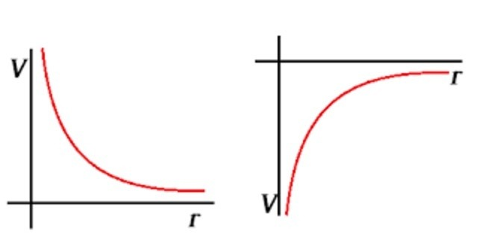
Learning Outcome: Describe what is meant by electric potential
Electric potential (V) is the is the work done per unit positive charge to move the charged particle from a point infinitely far away to a point within an electric field of another charged particle
r
Infinity
V = 0 JC⁻¹
At surface of Q
V = Max JC⁻¹
For a repulsive force- requires energy to move towards particle. V positive
For an attractive force- loses energy moving towards particle. V negative

Slide 41
Learning Outcome: Describe what is meant by electric potential
Electric potential (V) is the is the work done per unit positive charge to move the charged particle from a point infinitely far away to a point within an electric field of another charged particle
r
Infinity
V = 0 JC⁻¹
At surface of Q
V = Max JC⁻¹
For a repulsive force- requires energy to move towards particle. V positive
For an attractive force- loses energy moving towards particle. V negative

Slide 42
Learning Outcome: Describe what is meant by electric potential
r
Infinity
V = 0 JC⁻¹
At surface of Q
V = Max JC⁻¹
A simple model of a hydrogen atom can be thought of as an electron 0.50 × 10⁻¹⁰ m from a proton.
Calculate the electrical potential 0.50 × 10⁻¹⁰ m from a proton.
(electron charge = 1.6 x 10⁻¹⁹ C)

Slide 43
Learning Outcome: Describe what is meant by electric potential
r
Infinity
V = 0 JC⁻¹
At surface of Q
V = Max JC⁻¹
A simple model of a hydrogen atom can be thought of as an electron 0.50 × 10⁻¹⁰ m from a proton.
Calculate the electrical potential 0.50 × 10⁻¹⁰ m from a proton.
(electron charge = 1.6 x 10⁻¹⁹ C)
V = kQ/r = 9.0 x 10⁹ x 1.6 x 10⁻¹⁹ / (0.50 x 10⁻¹⁰) = 28.8 V

Slide 44
Learning Outcome: Describe what is meant by electric potential energy
Electric potential energy is the is the work done to move a charged particle from a point infinitely far away to a point within an electric field of another charged particle
Q
q
r
Infinity
Energy = 0 J
At surface of Q
Energy = Max J

Slide 45
Learning Outcome: Describe what is meant by electric potential energy
Electric potential energy is the is the work done to move a charged particle (q) from a point infinitely far away to a point within an electric field of another charged particle (Q)
Q
q
r
Infinity
Energy = 0 J
At surface of Q
Energy = Max J
How would you change this to electric potential energy?

Slide 46
Learning Outcome: Describe what is meant by electric potential energy
Electric potential energy is the is the work done to move a charged particle from a point infinitely far away to a point within an electric field of another charged particle
Q
q
r
Infinity
Energy = 0 J
At surface of Q
Energy = Max J
Only difference is q is included

Slide 47
Learning Outcome: Describe what is meant by electric potential energy
Q
q
r
Infinity
Energy = 0 J
At surface of Q
Energy = Max J
A simple model of a hydrogen atom can be thought of as an electron 0.50 × 10⁻¹⁰ m from a proton.
Calculate the electrical potential energy 0.50 × 10⁻¹⁰ m from a proton.
(electron charge = 1.6 x 10⁻¹⁹ C)

Slide 48
Learning Outcome: Describe what is meant by electric potential energy
Q
q
r
Infinity
Energy = 0 J
At surface of Q
Energy = Max J
A simple model of a hydrogen atom can be thought of as an electron 0.50 × 10⁻¹⁰ m from a proton.
Calculate the electrical potential energy 0.50 × 10⁻¹⁰ m from a proton.
(electron charge = 1.6 x 10⁻¹⁹ C)
EPE = Vq = 28.8 x 1.6 x 10⁻¹⁹ = 4.61 x 10⁻¹⁸ J

Slide 49
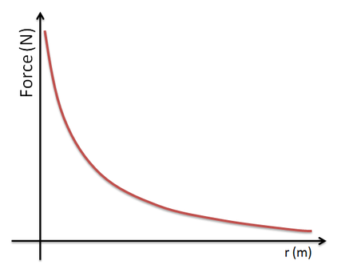
Learning Outcome: Describe the link between force and electric potential energy
What would be the link between the force between two particles and the electric potential energy to move with of them towards the other?

Slide 50
Learning Outcome: Describe the link between force and electric potential energy
What would be the link between the force between two particles and the electric potential energy to move with of them towards the other?
Area under graph = force (F) x distance (r) = work done

