Slide 1
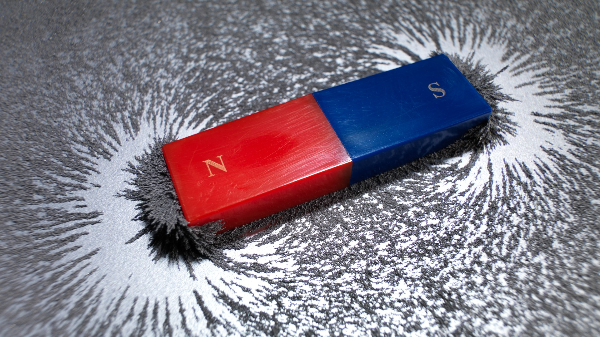
Electromagnetism
Magnetic fields and forces
1. Magnetic fields and forces
2. Calculating magnetic forces and flux
3. Investigating magnetic flux
4. Forces on particles in magnetic fields
5. Faraday and Lenz’s Law
6. Generators
7. Transformers
8. Investigating transformers
Module 5: Newtonian world and astrophysics
Module 6: Particles and medical physics
6.1 & 2 Electric fields and capacitors
6.3 Electromagnetism
6.4 Nuclear and particle physics
6.5 Medical imaging

Slide 2
Magnetic fields and forces
Describe what is meant by a magnetic forces
Describe different ways in which magnetic fields occur
Draw magnetic field lines

Slide 3
Learning Outcome: Describe what is meant by a magnetic forces
Notes:
https://phet.colorado.edu/en/simulations/coulombs-law

Slide 4
Learning Outcome: Describe what is meant by a magnetic forces
Electric and magnetic forces are the same force- electromagnetic forces
Both are caused by charged particles:
Electric- stationary charged particles
Magnetic- moving charged particles
Notes:
https://youtu.be/GMnsZuEE_m8
https://www.youtube.com/watch?v=T6R1uFvMFNM
4:35 onwards

Slide 5
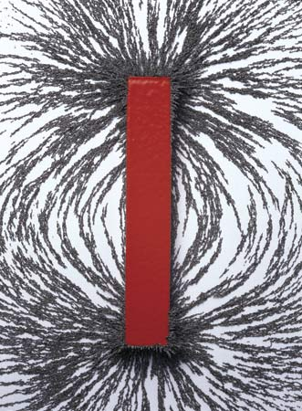
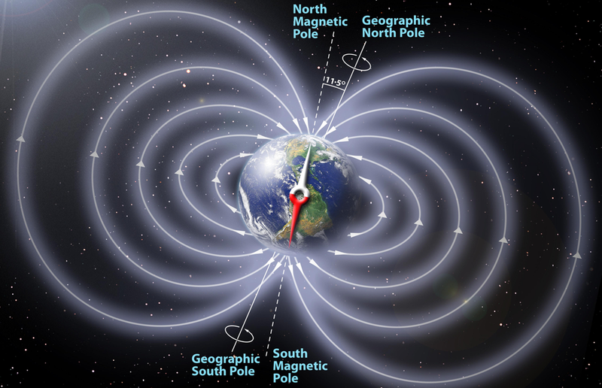
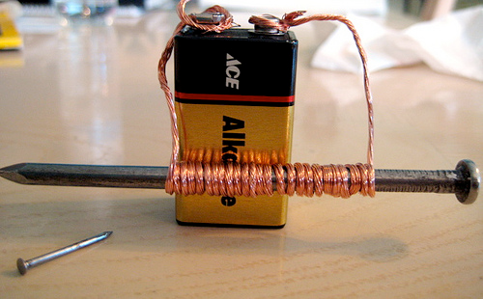
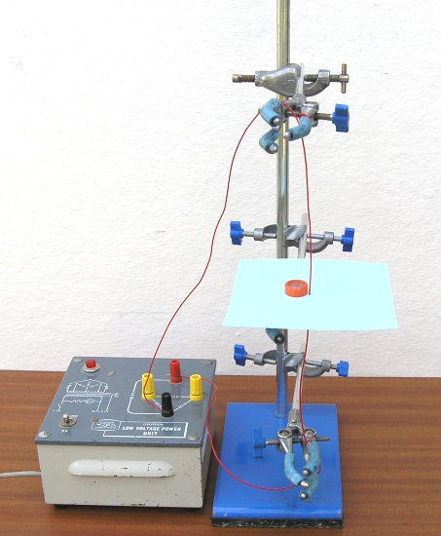
Learning Outcome: Describe different ways in which magnetic fields occur

Slide 6
Learning Outcome: Describe different ways in which magnetic fields occur

Slide 7
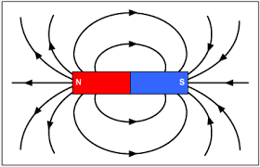
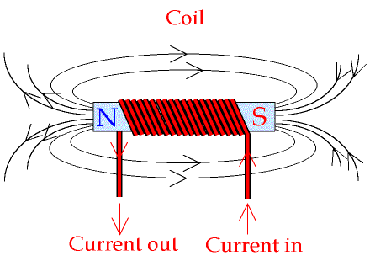
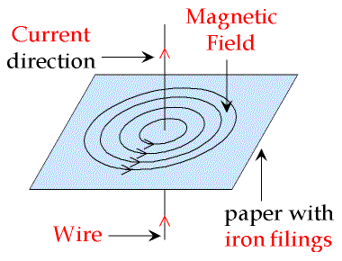
Learning Outcome: Draw magnetic field lines

Slide 8
Electromagnetism
Magnetic forces and flux
1. Magnetic fields and forces
2. Calculating magnetic forces and flux
3. Investigating magnetic flux
4. Forces on particles in magnetic fields
5. Faraday and Lenz’s Law
6. Generators
7. Transformers
8. Investigating transformers
Module 5: Newtonian world and astrophysics
Module 6: Particles and medical physics
6.1 & 2 Electric fields and capacitors
6.3 Electromagnetism
6.4 Nuclear and particle physics
6.5 Medical imaging

Slide 9
Magnetic forces and flux
Describe how magnetic forces occur between magnetic fields
Derive a formula to calculate flux and field strength
Investigate magnetic flux

Slide 10
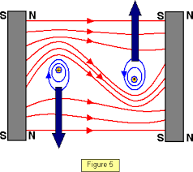
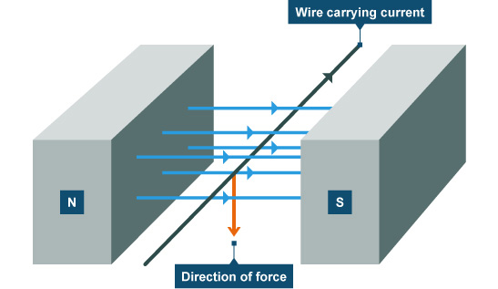
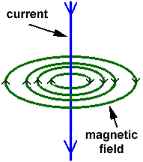
Learning Outcome: Describe how magnetic forces occur between magnetic fields
Magnetic forces
As a wire carrying a current creates a magnetic field around it.
A wire carrying a current placed in a magnetic field will experience a force as the fields interact
This creates a catapult field
+
Notes:
Include a demo of how a force is created when an electromagnet is placed into a magnetic field. Video showing this effect: https://www.youtube.com/watch?v=F1PWnu01IQg

Slide 11
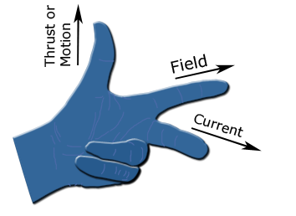
Fleming’s left hand rule
Learning Outcome: Describe how magnetic forces occur between magnetic fields
Fleming’s left hand rule can be used to predict the direction of the motion of the wire caused by the force
First finger
ThuMb
SeCond finger

Slide 12
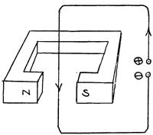
Fleming’s left hand rule
Learning Outcome: Describe how magnetic forces occur between magnetic fields
Fleming’s left hand rule can be used to predict the direction of the motion of the wire caused by the force
What would be the direction of motion for this wire
Notes:
Do this one together as a class

Slide 13
Learning Outcome: Describe how magnetic forces occur between magnetic fields
Draw yourself your own labelled Fleming’s left hand rule and use this to predict the motion of the wire for pictures A, B and C

Slide 14
Calculating the force
Learning Outcome: Derive a formula to calculate flux and field strength
The force (N) experienced by a current carrying wire placed in a magnetic field depends on:
The strength of the magnetic field (magnetic flux density)
The current (A) the wire is carrying
The length (m) of the wire in the field
Force on = Magnetic flux x current (A) x length (m)
wire (N) density (T)

Slide 15
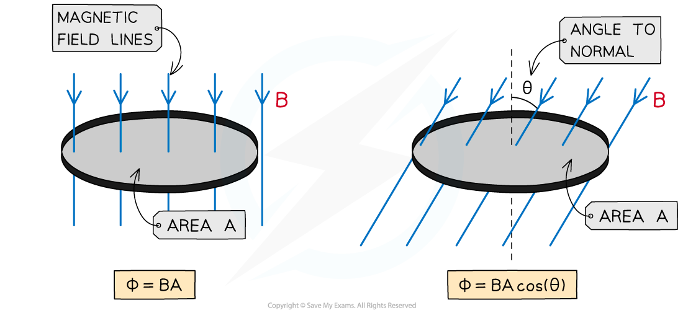
Learning Outcome: Describe Faraday’s Law of electromagnetic induction
Measuring magnetic field strength
Magnetic flux density (B)- strength of the magnetic field (field lines per area), unit: Tesla (T)
Magnetic flux- total magnetic field lines, unit: Webers (Wb)
Notes:
https://www.youtube.com/watch?v=T6R1uFvMFNM
4:35 onwards

Slide 16
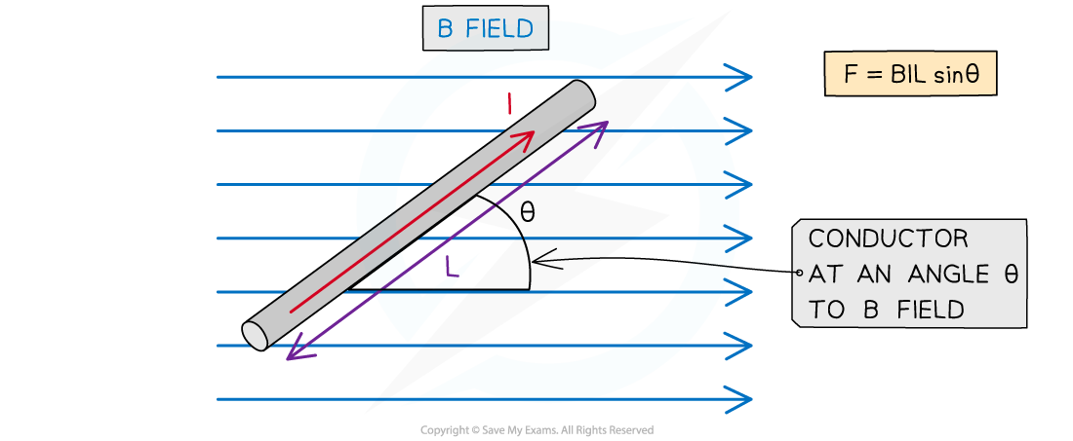
Calculating the force
Learning Outcome: Derive a formula to calculate flux and field strength
The force (N) experienced by a current carrying wire placed in a magnetic field depends on:
The strength of the magnetic field (magnetic flux density) perpendicular to the wire
The current (A) the wire is carrying
The length (m) of the wire in the field
Force on = Magnetic flux x current (A) x length (m) x sin θ
wire (N) density (T)

Slide 17
Learning Outcome: Derive a formula to calculate flux and field strength

Slide 18
Learning Outcome: Derive a formula to calculate flux and field strength

Slide 19
Learning Outcome: Investigate magnetic flux
Finding the magnetic field strength of a magnet using F=BIL
1) Set up your equipment and make sure the mass balance reads zero. Record the mass on the scales for each of the currents below:
2) Measure the length of wire in between the magnets and record this
3) Plot a graph of Current (x-axis) versus Force (y-axis) and draw a straight best fit line (As I and F should be directly proportional)
4) Find the gradient of your line.
5) Show that B= gradient/L and use this to find a value for B
Current (A) | Mass (g) | Force (N)
0.5
1
1.5
2
2.5
3

Slide 20
Electromagnetism
Forces on particles in fields
1. Magnetic fields and forces
2. Calculating magnetic forces and flux
3. Investigating magnetic flux
4. Forces on particles in magnetic fields
5. Faraday and Lenz’s Law
6. Generators
7. Transformers
8. Investigating transformers
Module 5: Newtonian world and astrophysics
Module 6: Particles and medical physics
6.1 & 2 Electric fields and capacitors
6.3 Electromagnetism
6.4 Nuclear and particle physics
6.5 Medical imaging

Slide 21
Forces on particles in fields
Describe forces on particles in fields
Explain why particles follow circular paths
Describe how velocity selectors work

Slide 22
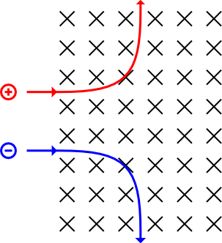
Learning Outcome: Describe forces on particles in fields
Moving charged particles will interact with a magnetic field as they have their own magnetic field
The force exerted on the particle can be calculated from:
F= BIL
Given that I = Q/t and v=L/t
Derive an equation for F in terms of B, Q and v

Slide 23
Learning Outcome: Describe forces on particles in fields
Moving charged particles will interact with a magnetic field as they have their own magnetic field
The force exerted on the particle can be calculated from:
F= BIL
Given that I = Q/t and v=L/t
Derive an equation for F in terms of B, Q and v
F=BQv

Slide 24
Fleming’s left hand rule
Learning Outcome: Describe forces on particles in fields
Fleming’s left hand rule can be used to predict the direction of the motion of the charge (remember “current” is conventional current (the direction a positive charge moves!)
First finger
ThuMb
SeCond finger

Slide 25
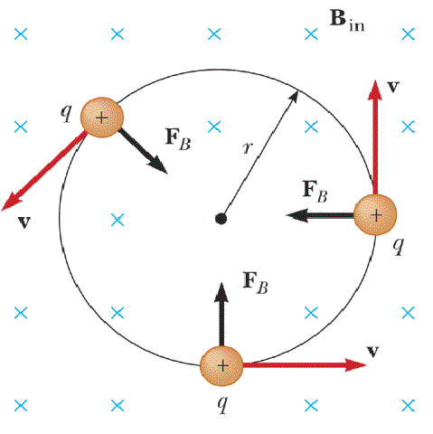
Learning Outcome: Explain why particles follow circular paths
Charged particles moving perpendicular to a magnetic field follow a circular path as the force applied is perpendicular to the direction the particle is moving (think Fleming’s rule!)
F = BQv
and as it moving in a circle… F= mv²/r
Therefore: BQv = mv²/r
BQ=mv/r
r= mv
BQ

Slide 26
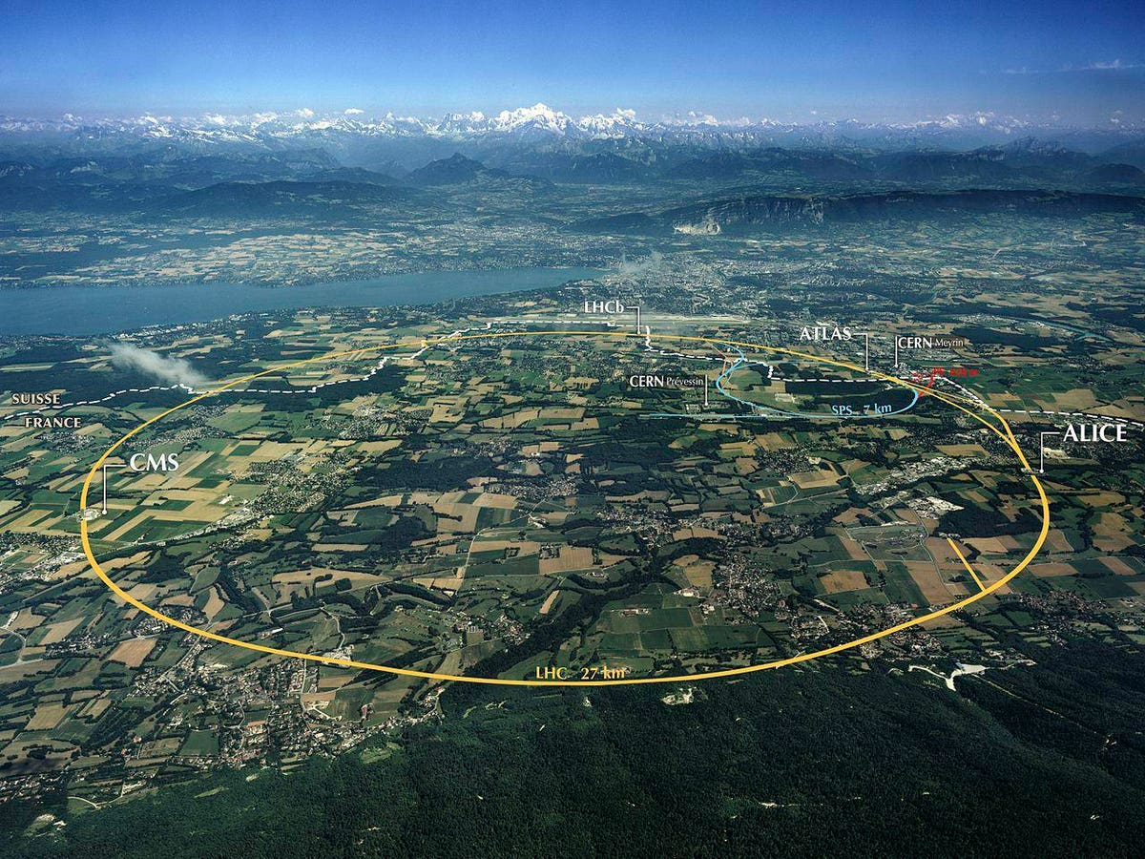
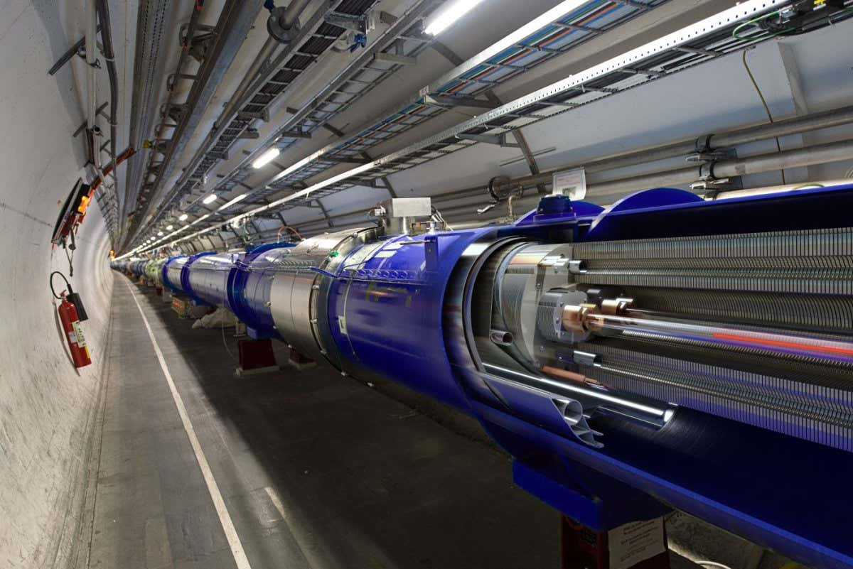
Learning Outcome: Explain why particles follow circular paths
This is the principle applied in particle accelerators to get particles to move in circular paths approaching the speed of light

Slide 27
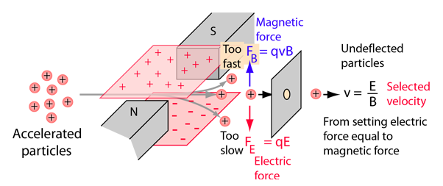
Learning Outcome: Describe how velocity selectors work
Particles are sent through a perpendicular magnetic and electric field
Force due to the electric field: F=QE
Force due to magnetic field: F = BQv
A particle will travel straight through when these forces are equal: QE=BQv
So v=E/B
Velocity selectors are used in mass spectrometry to select particles of a particular mass

Slide 28
Faraday and Lenz’s Law
Electromagnetism
1. Magnetic fields and forces
2. Calculating magnetic forces and flux
3. Investigating magnetic flux
4. Forces on particles in magnetic fields
5. Faraday and Lenz’s Law
6. Generators
7. Transformers
8. Investigating transformers
Module 5: Newtonian world and astrophysics
Module 6: Particles and medical physics
6.1 & 2 Electric fields and capacitors
6.3 Electromagnetism
6.4 Nuclear and particle physics
6.5 Medical imaging

Slide 29
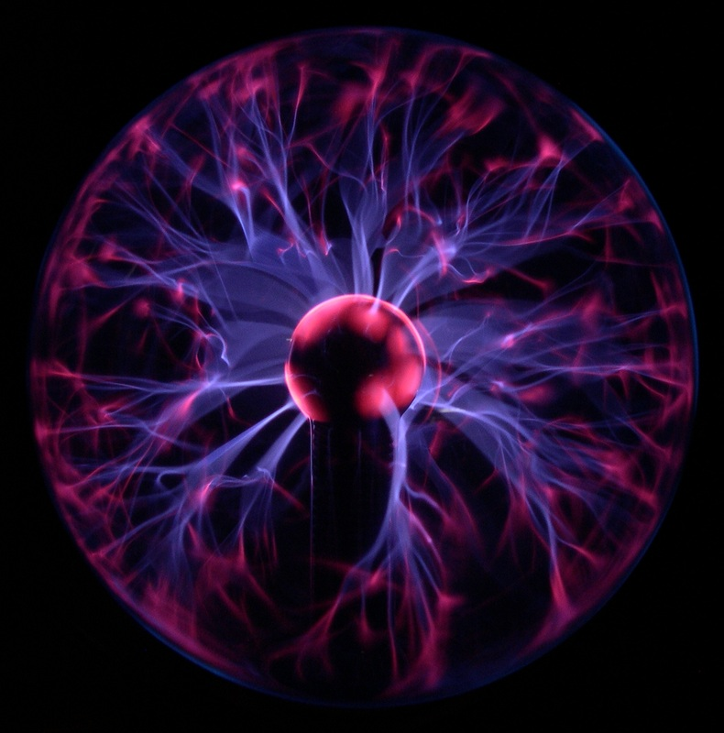
Faraday and Lenz’s Law
Describe electromagnetic induction
Describe Faraday’s Law of electromagnetic induction
Describe Lenz’s Law

Slide 30
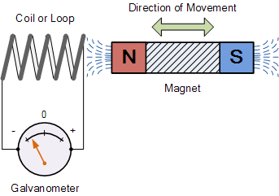
Learning Outcome: Describe what electromagnetic induction is
c
What is electromagnetic induction
When a wire is moved through a magnetic field or a magnetic field changes around a wire a potential difference is induced which causes a current to flow through the wire
Notes:
Demo of this with Helmholtz coils and Galvanometer, student practical using neodynium magnets, voltmeters and copper coiled wire

Slide 31
Learning Outcome: Describe Faraday’s Law of electromagnetic induction
A recap of ideas covered so far:
Magnetic flux density (B)- strength of the magnetic field (field lines per area), unit: Tesla (T)
Magnetic flux- total magnetic field lines, unit: Webers (Wb)
Notes:
https://www.youtube.com/watch?v=T6R1uFvMFNM
4:35 onwards

Slide 32
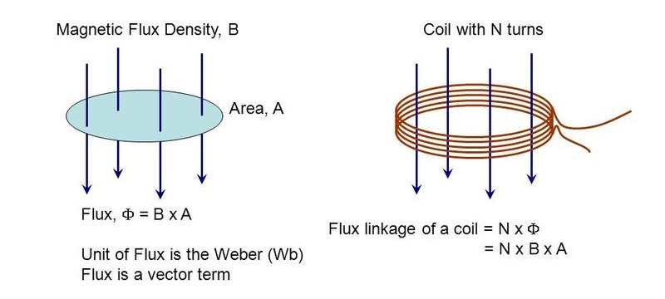
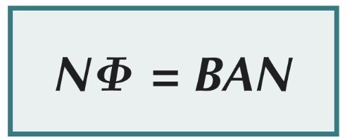
Learning Outcome: Describe Faraday’s Law of electromagnetic induction
Magnetic flux linkage- Measure of total magnetic field generated by a coil, unit: Webers (Wb)
Notes:
https://www.youtube.com/watch?v=T6R1uFvMFNM
4:35 onwards

Slide 33
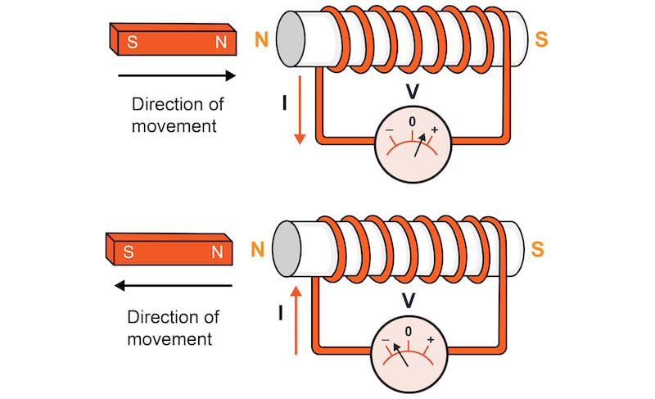
Learning Outcome: Describe Faraday’s Law of electromagnetic induction
Faraday’s Law:
“Induced e.m.f. is directly proportional to the rate of change of flux linkage”
Notes:
https://phet.colorado.edu/sims/html/faradays-law/latest/faradays-law_all.html

Slide 34
Learning Outcome: Describe Faraday’s Law of electromagnetic induction
Notes:
https://phet.colorado.edu/sims/html/faradays-law/latest/faradays-law_all.html

Slide 35
Learning Outcome: Describe Lenz’s Law
Lenz’s Law:
“The induced e.m.f. is always in such a direction as to oppose the change that caused it”
Notes:
https://www.youtube.com/watch?v=QwUq8xM_8bY

Slide 36
Learning Outcome: Describe Lenz’s Law
Notes:
https://www.youtube.com/watch?v=QwUq8xM_8bY

Slide 37
Generators
Electromagnetism
1. Magnetic fields and forces
2. Calculating magnetic forces and flux
3. Investigating magnetic flux
4. Forces on particles in magnetic fields
5. Faraday and Lenz’s Law
6. Generators
7. Transformers
8. Investigating transformers
Module 5: Newtonian world and astrophysics
Module 6: Particles and medical physics
6.1: Capacitors
6.2: Electric fields
6.3: Electromagnetism
6.4 Nuclear and particle physics
6.5 Medical imaging

Slide 38
Electromagnetic induction and Generators
Describe the function of an alternating current generator
Describe how the generated current can be increased
Apply Faraday’s Law to generators

Slide 39
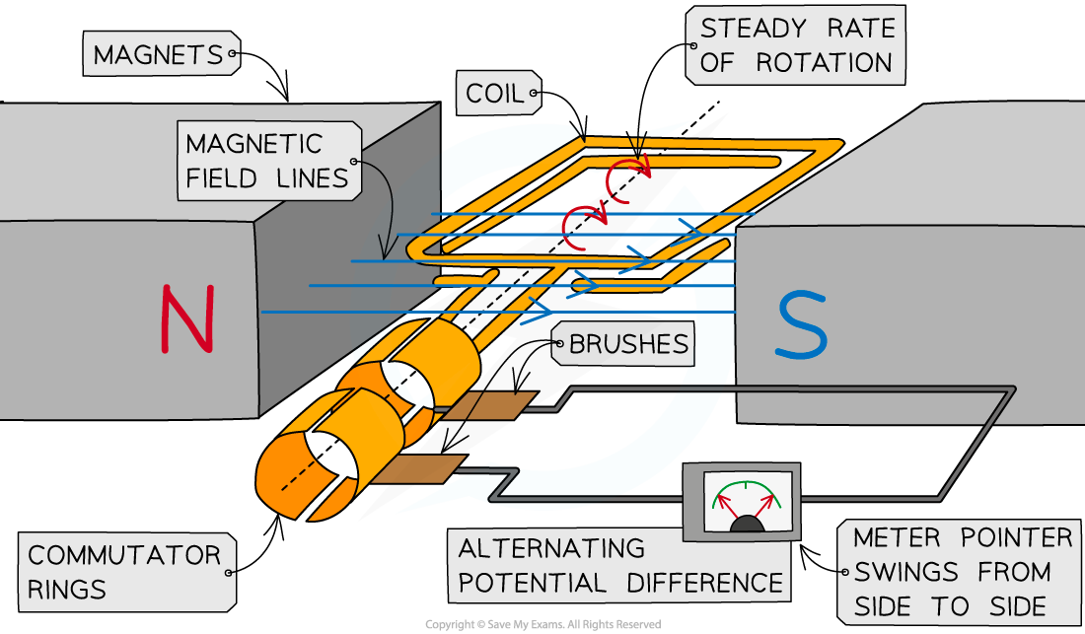
Generators- alternator
Learning Outcome: Describe the function of an alternating current generator
The coil moves through the magnetic field cutting magnetic field lines
A potential difference is induced (across the coil)
There is a complete circuit, so a current is induced (in the coil)
Every half turn the potential difference reverses direction as the coil cuts through the magnetic field in the opposite direction
So (every half turn) the current changes direction creating an alternating current
1
Notes:
Give students magnets to investigate with at this point

Slide 40
Learning Outcome: Describe how the generated current can be increased
Faraday’s Law:
“Induced e.m.f. is directly proportional to the rate of change of flux linkage”
Notes:
https://phet.colorado.edu/sims/html/faradays-law/latest/faradays-law_all.html

Slide 41
Learning Outcome: Describe how the generated current can be increased
Faraday’s Law:
“Induced e.m.f. is directly proportional to the rate of change of flux linkage”
So to increase induced current:
Rotate quicker
More coils
Stronger magnetic field
Notes:
https://phet.colorado.edu/sims/html/faradays-law/latest/faradays-law_all.html

Slide 42
Learning Outcome: Apply Faraday’s Law to generators
Notes:
https://phet.colorado.edu/sims/html/faradays-law/latest/faradays-law_all.html

Slide 43
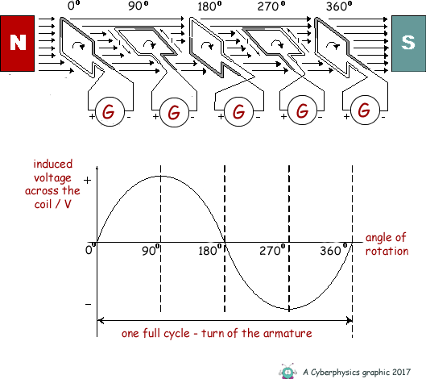
Learning Outcome: Apply Faraday’s Law to generators
Notes:
https://phet.colorado.edu/sims/html/faradays-law/latest/faradays-law_all.html

Slide 44
Transformers
Electromagnetism
1. Magnetic fields and forces
2. Calculating magnetic forces and flux
3. Investigating magnetic flux
4. Forces on particles in magnetic fields
5. Faraday and Lenz’s Law
6. Generators
7. Transformers
8. Investigating transformers
Module 5: Newtonian world and astrophysics
Module 6: Particles and medical physics
6.1: Capacitors
6.2: Electric fields
6.3: Electromagnetism
6.4 Nuclear and particle physics
6.5 Medical imaging

Slide 45
Transformers
Describe how a transformer works
Apply Faraday’s law to derive the transformer equation
Apply the transformer equation to calculations and the national grid

Slide 46
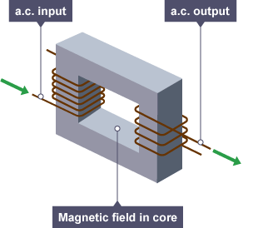
Learning Outcome: Describe how a transformer works
Transformers are used for increasing and decreasing voltage between two coils
How would the alternating current coming in at the primary coil be transferred to the secondary coil?
Why would the voltage in the primary coil be different in the primary and secondary coil?
Why do you need an alternating current?
Why is iron used in the core?
Notes:
Demo of this with Helmholtz coils and Galvanometer, student practical using neodynium magnets, voltmeters and copper coiled wire

Slide 47
Learning Outcome: Describe how a transformer works
Transformers
1) Alternating current is put into a primary coil of wire
3) The cores magnetic field induces a current into a secondary coil
2)A magnetic field is induced into an iron core
Why do you need an alternating current?
Why is iron used in the core?
Notes:
Demo of this with Helmholtz coils and Galvanometer, student practical using neodynium magnets, voltmeters and copper coiled wire

Slide 48
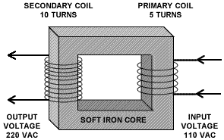
Learning Outcome: Apply Faraday’s law to derive the transformer equation
Transformers are used to:
Increase voltage (Step-up transformer)
Decrease voltage (Step-down transformer)
This is determined by the number of primary and secondary turns on the transformer.
Notes:
Demo of this with Helmholtz coils and Galvanometer, student practical using neodynium magnets, voltmeters and copper coiled wire

Slide 49
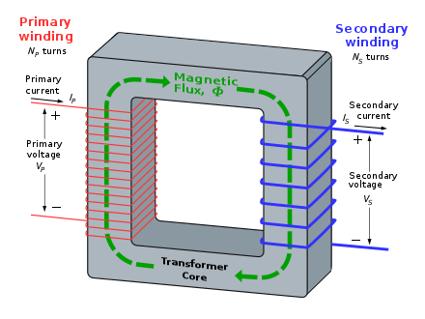
Learning Outcome: Apply Faraday’s law to derive the transformer equation
For the primary coil:
V_{p} = -N_{p} dΦ
dt
For the secondary coil:
V_{s} = -N_{s} dΦ
dt
Notes:
Demo of this with Helmholtz coils and Galvanometer, student practical using neodynium magnets, voltmeters and copper coiled wire

Slide 50
Learning Outcome: Apply Faraday’s law to derive the transformer equation
For the primary coil:
V_{p} = N_{p} dΦ
dt
For the secondary coil:
V_{s} = N_{s} dΦ
dt
If the electrical energy transfer is 100% efficient all the electrical power is conserved so that:
V_{p} I_{p} = V_{s} I_{s}
Therefore: I_{p} N_{p} dΦ = I_{s} N_{s} dΦ
dt dt
Simply (as change in flux is constant for both): I_{p} N_{p} = I_{s} N_{s}
Notes:
Demo of this with Helmholtz coils and Galvanometer, student practical using neodynium magnets, voltmeters and copper coiled wire

Slide 51
Learning Outcome: Apply Faraday’s law to derive the transformer equation
For the primary coil:
V_{p} = N_{p} dΦ
dt
For the secondary coil:
V_{s} = N_{s} dΦ
dt
If the electrical energy transfer is 100% efficient all the electrical power is conserved so that:
V_{p} I_{p} = V_{s} I_{s}
Therefore: I_{p} N_{p} dΦ = I_{s} N_{s} dΦ
dt dt
Simply (as change in flux is constant for both): I_{p} N_{p} = I_{s} N_{s}
N_{s} =V_{s} = I_{p}
N_{p} V_{p} I_{s}
Notes:
Demo of this with Helmholtz coils and Galvanometer, student practical using neodynium magnets, voltmeters and copper coiled wire

Slide 52
Learning Outcome: Apply the transformer equation to calculations and the national grid
Notes:
Demo of this with Helmholtz coils and Galvanometer, student practical using neodynium magnets, voltmeters and copper coiled wire

Slide 53
Learning Outcome: Apply the transformer equation to calculations and the national grid

Slide 54
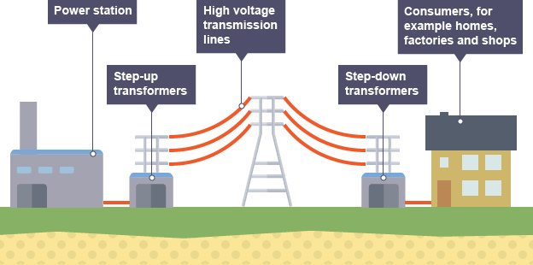
Learning Outcome: Apply the transformer equation to calculations and the national grid
Describe how electricity is transmitted across the national grid
Why is it an advantage to transmit at high voltages?
Remember power loss: P= V²/R and P = I²R
Notes:
Demonstration of this experiment

