Slide 1
Motion and Uncertainty Analysis

Slide 2
A-Level Physics
1. Development of practical skills in physics
2. Foundations of Physics
3. Forces and motion
4. Electrons, waves and photons
5. Newtonian world and astrophysics
6. Particles and medical physics
3.1 Motion and uncertainty
3.2 Forces
3.3. Work, Energy and power
3.4. Materials
3.5 Newton’s laws and momentum
Displacement, velocity and acceleration
Velocity, acceleration and displacement graphs
Uncertainty and error analysis
SUVAT
Acceleration of free fall
Stopping distance
Projectiles

Slide 3
Displacement, velocity and acceleration
Describe the difference between distance, displacement, speed and velocity
Calculate speed and velocity
Define and calculate acceleration

Slide 4
D
Learning Outcome: Describe the distance between distance, displacement, speed and velocity
Distance, d (m) – The length travelled from one position to another (Scalar)
Displacement, s (m)- The distance travelled in a particular direction (Vector)

Slide 5
Learning Outcome: Describe the distance between distance, displacement, speed and velocity
Speed is the distance travelled in a particular time (m/s)
Increasing the speed means increasing the distance travelled in the same time.
When the speed of an object remains the same we describe this as constant speed.
Speed measured in m/s
Distance measured in m
Time measured in s

Slide 6
Learning Outcome: Describe the distance between distance, displacement, speed and velocity
Velocity is the distance travelled in a particular direction (or displacement) in a particular time (m/s)
Increasing the velocity means increasing the distance travelled in the same time or changing the direction.
When the velocity of an object remains the same we describe this as constant velocity.
Velocity (v) measured in m/s
Displacement (s) measured in m
Time (t) measured in s
Velocity = Displacement Time

Slide 7
Acceleration
Learning Outcome: Define and calculate acceleration
Acceleration (m/s²) is the rate at which velocity changes.
When an object’s velocity increases we call this acceleration.
When an object’s velocity decreases we call this deceleration
A negative acceleration can mean an object is getting slower or getting quicker in the opposite direction!

Slide 8
Acceleration
Learning Outcome: Define and calculate acceleration
Acceleration (m/s²) is the rate at which velocity changes.
a = acceleration measured in m/s²
v = final velocity (m/s)
u = initial velocity (m/s)
t = time (s)

Slide 9
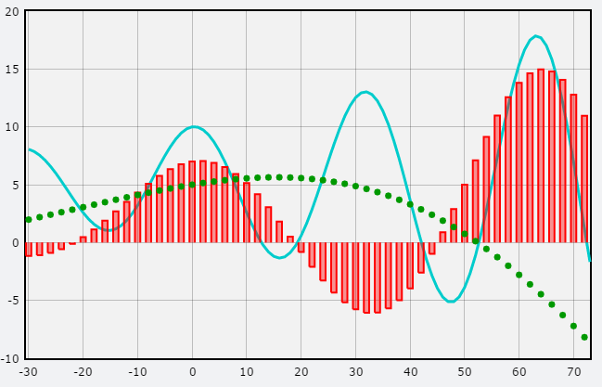
Velocity, acceleration and displacement graphs
Describe displacement-time graphs and information that can be gathered
Describe velocity-time graphs and the information that can be gathered
Convert between graph types

Slide 10
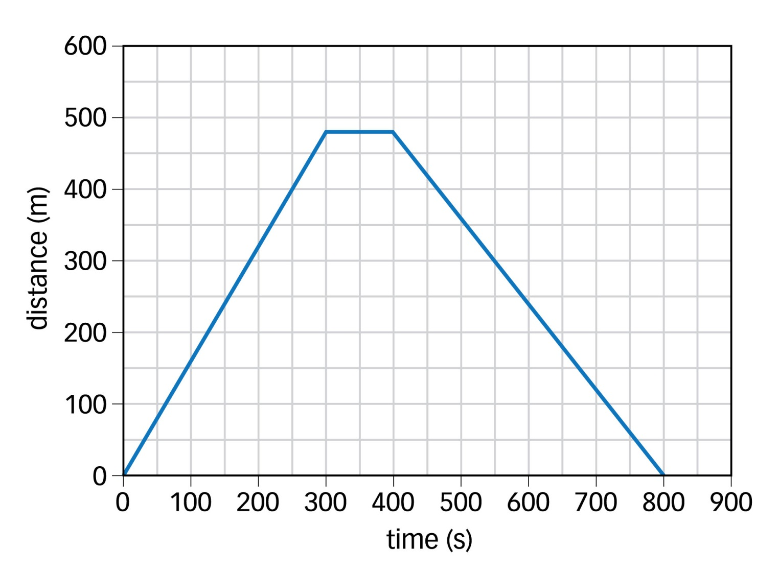
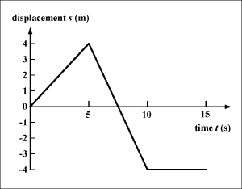
Learning Outcome: Describe displacement-time graphs and information that can be gathered
To find the gradient (speed) of a curve, draw a tangent to the line
Slowing down
Constant speed forwards
Constant speed backwards
Constant speed, any direction
1.2m/s
1.6m/s
Speeding up
Stationary
A distance time graph just shows total distance travelled- this value can never decrease
A displacement-time graph shows direction as well, any decreasing value shows the object travelling in the opposite direction. A negative value shows it’s returned to its start point (0) and continues travelling backwards
Gradient = speed (distance- time graph) or velocity (speed time-graph)
Notes:
Go through different distance-time graphs

Slide 11
Learning Outcome: Describe velocity-time graphs and the information that can be gathered
Decelerating (Slowing down)
Velocity (m/s)
Accelerating forwards
Accelerating (Speeding up)
Decreasing rate of acceleration
Decelerating forwards
Speed (m/s)
1.2m/s
Constant speed, any direction
1.6m/s
Increasing rate of acceleration
Area = displacement
Stationary
Accelerating backwards
A speed time graph just shows speed travelled- this value can decrease
A velocity-time graph shows direction as well, any negative value shows the object travelling in the opposite direction (as it is shown by a negative gradient on a displacement- time graph).
Gradient = acceleration Area under graph = distance or displacement
Notes:
Go through different distance-time graphs

Slide 12
Learning Outcome: Convert between graph types
A
B
C
D
Bob walks away along a straight line at a constant speed
Bob constantly increases his speed in the same direction
Bob throws a ball upwards on Earth (ignoring air resistance) and then catches it as it falls back down
Bob goes for a walk in a straight line, but gets tired so stops for a rest before resuming at a constant speed
Notes:
Distance/time graph card sort

Slide 13
Analysing error and uncertainty
Describe types of measurement error
Calculate absolute and percentage uncertainties
Plot worst fit lines to establish uncertainty and find percentage difference

Slide 14
Learning Outcome: Describe types of measurement error
Measurement errors- difference between measured and true value
Systematic error
Causes readings to differ from the true value by a consistent amount each time due to methods/instruments used. Can’t be dealt with by repeats
Zero error- a measuring system gives a false reading when the true value is zero
Random error
Causes reading to be spread about the true value. Present when any measurement is made, and can be reduced by taking more measurements

Slide 15
Learning Outcome: Describe types of measurement error

Slide 16
Learning Outcome: Describe types of measurement error
Name that error- Systematic or random
Bob measures a table, his first measurement is 51 cm, the second is 53 cm, the true value is 52cm
Bob measures out some liquid in a measuring cylinder he gets three measurements of 503 ml, but the true measurement was 500 ml
Bob weighs out some gold on a mass balance, the mass is 56 g, he removes all the gold and the mass balance reads 3g.

Slide 17
Learning Outcome: Calculate absolute and percentage uncertainties
Absolute and percentage uncertainties in single measurements
The absolute uncertainty in a measurement is based on the resolution of the measuring equipment
e.g. the measuring cylinder has a resolution of 1 ml, every measurement will have an uncertainty of ±0.5 ml

Slide 18
Learning Outcome: Calculate absolute and percentage uncertainties
Absolute and percentage uncertainties in single measurements
The percentage uncertainty is the absolute uncertainty expressed as a percentage of the measurement taken
e.g. the measuring cylinder has a resolution of 1 ml, every measurement will have an absolute uncertainty of ±0.5 ml
If we measure out 10 ml of liquid the percentage uncertainty is: (0.5/10) x 100 = 5%
If we measure out 100 ml of liquid the percentage uncertainty is: (0.5/100) x 100 = 0.5%
The percentage uncertainty depends on the measurement

Slide 19
Learning Outcome: Calculate absolute and percentage uncertainties
Absolute and percentage uncertainties in multiple measurements
The absolute uncertainty in multiple measurements is half the range
E.g. Bob measures the length of a piece of string and obtains 3 measurement of 33.4 cm, 33.6 cm and 33.5 cm.
The mean of these measurements is 33.5 cm
The range of these measurements is 0.2 cm, so the absolute uncertainty in the mean is expressed as: 33.5 ± 0.1 cm

Slide 20
Learning Outcome: Calculate absolute and percentage uncertainties
Absolute and percentage uncertainties in multiple measurements
The absolute uncertainty in multiple measurements is half the range
E.g. Bob measures the length of a piece of string and obtains 3 measurement of 33.4 cm, 33.6 cm and 33.5 cm.
The mean of these measurements is 33.5 cm
The range of these measurements is 0.2 cm, so the absolute uncertainty in the mean is expressed as: 33.5 ± 0.1 cm
The percentage uncertainty is the absolute uncertainty as a percentage of the mean: (0.1/33.5) x 100 = 0.3%

Slide 21
Learning Outcome: Calculate absolute and percentage uncertainties
Combing absolute and percentage uncertainties
If you add two measurements together the absolute uncertainties are added
e.g. 12 ± 0.5 cm and 13 ± 0.25 cm = 25 ± 0.75 cm

Slide 22
Learning Outcome: Calculate absolute and percentage uncertainties
Combing absolute and percentage uncertainties
If you add two measurements together the absolute uncertainties are added
e.g. 12 ± 0.5 cm and 13 ± 0.25 cm = 25 ± 0.75 cm
If you multiply or divide two measurements together the percentage uncertainties are added
e.g. 12 ± 0.5 cm (4.2%) x 13 ± 0.25 cm (1.9%)
Total percentage error = 4.2 + 1.9 = 6.1%
= 156 ± 9.5 cm² (rework percentage uncertainty as absolute)

Slide 23
Learning Outcome: Calculate absolute and percentage uncertainties
Combing absolute and percentage uncertainties
If you add two measurements together the absolute uncertainties are added
e.g. 12 ± 0.5 cm and 13 ± 0.25 cm = 25 ± 0.75 cm
If you multiply or divide two measurements together the percentage uncertainties are added
e.g. 12 ± 0.5 cm (4.2%) x 13 ± 0.25 cm (1.9%)
Total percentage error = 4.2 + 1.9 = 6.1% = 156 ± 9.5 cm²
If a measurement is raised to a power then the percentage uncertainty is multiplied by the power
12 ± 0.5 cm (4.2%)³ = 4.2 x 3 = 12.6% = 1728 ± 217 cm³

Slide 24
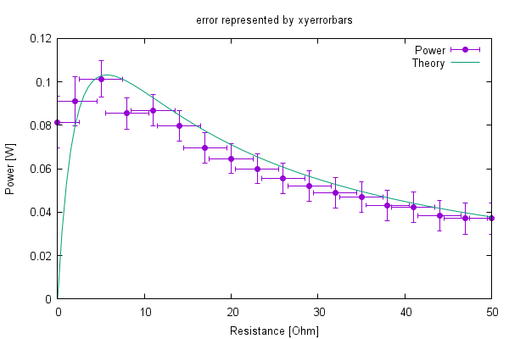
Learning Outcome: Plot worst fit lines to establish uncertainty
Error bars show ± of the absolute uncertainty in a measurement

Slide 25
Learning Outcome: Plot worst fit lines to establish uncertainty
A line of worst fit is a line that gives the maximum/minimum possible gradient while still being inside the error bars

Slide 26
Learning Outcome: Plot worst fit lines to establish uncertainty
A line of worst fit is a line that gives the maximum/minimum possible gradient while still being inside the error bars
The percentage uncertainty can be found out by:
% uncertainty = worst fit gradient – best fit gradient x 100
best fit gradient

Slide 27
Learning Outcome: Work out percentage difference
Percentage difference = Difference between measured and true x 100
True value

Slide 28
Analysing error and uncertainty
Measurement errors
Absolute and percentage uncertainties in multiple measurements
Measurement errors- difference between measured and true value
Absolute and percentage uncertainties in single measurements
The absolute uncertainty in a measurement is based on the resolution of the measuring equipment
The absolute uncertainty in multiple measurements is half the range
E.g. Bob measures the length of a piece of string and obtains 3 measurements of 33.4 cm, 33. 6 cm and 33.5 cm.
The mean of these measurements is 33.5 cm
The range of these measurements is 0.2 cm, so the absolute uncertainty in the mean is expressed as: 33.5 ± 0.1 cm
The percentage uncertainty is the absolute uncertainty as a percentage of the mean: e.g. (0.1/33.5) x 100 = 0.3%
e.g. the measuring cylinder has a resolution of 1 ml, every measurement will have an absolute uncertainty of ±0.5 ml
If we measure out 10 ml of liquid the percentage uncertainty is: (0.5/10) x 100 = 5%
If we measure out 100 ml of liquid the percentage uncertainty is: (0.5/100) x 100 = 0.5%
The percentage uncertainty depends on the measurement
Systematic error
Causes readings to differ from the true value by a consistent amount each time due to methods/ instruments used. Can’t be dealt with by repeats
Zero error- a measuring system gives a false reading when the true value is zero
Random error
Causes reading to be spread about the true value. Present when any measurement is made, and can be reduced by taking more repeats
Uncertainties on graphs
Error bars show the absolute uncertainty of measurements.
A line of worst fit is a line that gives the maximum/minimum possible gradient while still being inside the error bars
Combing absolute and percentage uncertainties
If you add or minus two measurements together the absolute uncertainties are added
e.g. 12 ± 0.5 cm and 13 ± 0.25 cm = 25 ± 0.75 cm
If you multiply or divide two measurements together the percentage uncertainties are added
e.g. 12 ± 0.5 cm (4.2%) x 13 ± 0.25 cm (1.9%)
Total percentage error = 4.2 + 1.9 = 6.1% = 156 ± 9.5 cm²
If a measurement is raised to a power then the percentage uncertainty is multiplied by the power
e.g. 12 ± 0.5 cm (4.2%)³ = 4.2 x 3 = 12.6% = 1728 ± 217 cm³
% uncertainty in gradient= worst fit gradient – best fit gradient x 100 best fit gradient
Percentage difference
Percentage difference = Measured value– true value x 100 True value

Slide 29
SUVAT equations
Define units and variables of suvat
Derive the SUVAT equations
Practise using SUVAT equations

Slide 30
Learning Outcome: Define units and variables of SUVAT
The SUVAT equations or the “equations of motion” are 4/5 equations which combine the following variables in order to describe motion with constant acceleration
s = displacement (m)
u = initial velocity (ms⁻¹)
v = final velocity (ms⁻¹)
a = acceleration (ms⁻²)
t = time (s)
Notes:
Go through different distance-time graphs

Slide 31
Learning Outcome: Derive the SUVAT equations
Learning Outcome: Derive the SUVAT equations
1.2m/s
1.6m/s
Notes:
Go through different distance-time graphs

Slide 32
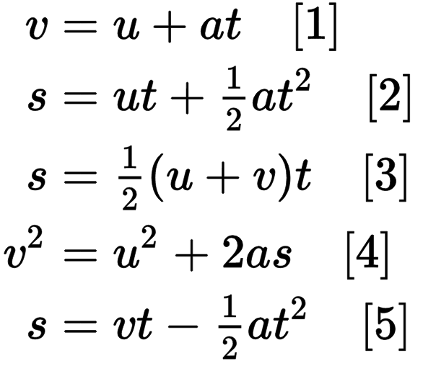
Learning Outcome: Practise using SUVAT equations
A duck waddles up to a lemonade stand starting at a speed of 0.5 ms⁻¹ and a final speed of 1 ms⁻¹. If the lemonade stand is 5 m away how long would it take him?
s = 5 m
u = 0.5 ms⁻¹
v = 1 ms⁻¹
a = x
t = ?
s= 0.5 (u+v)t
t= 2s/(u+v)
t = 2 x 5 /(0.5+1)
t = 10/1.5
t = 6.67 s
s= 0.5 (u+v)t
5= 0.5(u+v)t
5 = 0.5(0.5 +1)t
5 = 0.75t
t = 6.67 s

Slide 33
Learning Outcome: Practise using SUVAT equations
If the store holder throws a grape to the duck when he is 5 m away with an initial horizontal speed of 10 ms⁻¹ and a final horizontal speed of 5 ms⁻¹, how long will it take the grape to reach the duck?
s = 5 m
u = 10 ms⁻¹
v = 5 ms⁻¹
a = x
t = ?
s = 0.5(u + v)t
t= 2s/(u+v)
t=2 x 5/(10+5)
t= 10/15
t= 0.67 s
s = 0.5(u + v)t
5 = 0.5(10+5)t
5 = 0.5 x 15 x t
5 = 7.5t
t= 0.67 s

Slide 34
Learning Outcome: Practise using SUVAT equations
Another duck waddles up to a lemonade stand with an acceleration of 0.4 ms⁻², her initial velocity is 0.6 ms⁻¹ and final velocity is 1.8 ms⁻¹. If the lemonade stand is 4 m away has she reached it yet?
s = ?
u = 0.6 ms⁻¹
v = 1.8 ms⁻¹
a = 0.4 ms⁻²
t = x
v²=u² + 2as
s= v²-u²/2a
s = 1.8²-0.6²/2 x 0.4
s = 2.88/0.8
s = 3.6 m
v²=u² + 2as
1.8²= 0.6² + (2 x 0.4)s
3.24 = 0.36 + 0.8s
2.88 = 0.8s
s = 3.6 m

Slide 35
Stopping distances
Define thinking, braking and stopping distance
Explain factors that affect thinking and braking distance
Calculate stopping distances

Slide 36
Learning Outcome: Define stopping, thinking and braking distance
Thinking and braking distance
Thinking distance:
The distance travelled between a driver seeing a hazard and applying the brakes
Braking distance:
The distance travelled between the driver applying the brakes and the car stopping
+
=
Stopping distance:
The total distance travelled between the driver seeing the hazard and the car coming to a stop

Slide 37
Learning Outcome: Factors that affect stopping distance
Road conditions
Drugs
Thinking Distance
Braking Distance
Speed
Car condition
Distractions

Slide 38
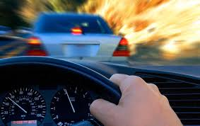
Learning Outcome: Calculate thinking distance
Calculating thinking distance
During the time taken for a driver to react to a hazard we assume the speed is constant
Distance= speed x time
Thinking distance= speed x reaction time
s₁ = ut₀
Answer the following questions:
A driver has a reaction time of 2 s, their speed is 15 ms⁻¹, what is their thinking distance?
A driver has a thinking distance of 150 m, if their speed is 30 ms⁻¹, what is their reaction time?

Slide 39
Learning Outcome: Calculate thinking distance
Calculating thinking distance
1. A driver has a reaction time of 2 s, their speed is 15 ms⁻¹ what is their thinking distance?
s₁ = ? u = 15 t₀ = 2
s₁ = ut₀
= 15 x 2
= 30 m
2. A driver has a thinking distance of 150 m, if their speed is 30 ms⁻¹, what is their reaction time?
s₁ = 150 u = 30 t₀ = ?
s₁ = ut₀ t₀ = s₁ ÷ u
= 150 ÷ 30
= 5 s

Slide 40
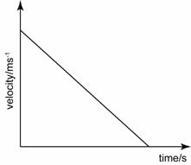
Learning Outcome: Calculate braking distance
Calculating braking distance
During the time taken for a driver to brake they will decelerate from their initial speed (u) to a stop (v)
10
Area under graph =
0.5 x base x height =
0.5 x 20 x 10 =
100 m
20

Slide 41
Learning Outcome: Calculate braking distance
Calculating braking distance
During the time taken for a driver to brake they will decelerate from their initial speed (u) to a stop (v)
Braking distance can also be calculated using suvat equations:
v²=u²+2as s =(v²-u²)/2a
Answer the following questions:
A driver travelling at 10 m/s decelerates at 2.5 ms⁻² before coming to a stop. What is their braking distance? 20 m
A duck waddling at 0.5 m/s decelerates at 0.1 ms⁻² before coming to a stop, what would their braking distance be? 1.25 m

Slide 42
Projectiles
Describe projectile motion
Divide projectile velocity into horizontal and vertical components
Solve problems involving horizontal projectiles using SUVAT

Slide 43
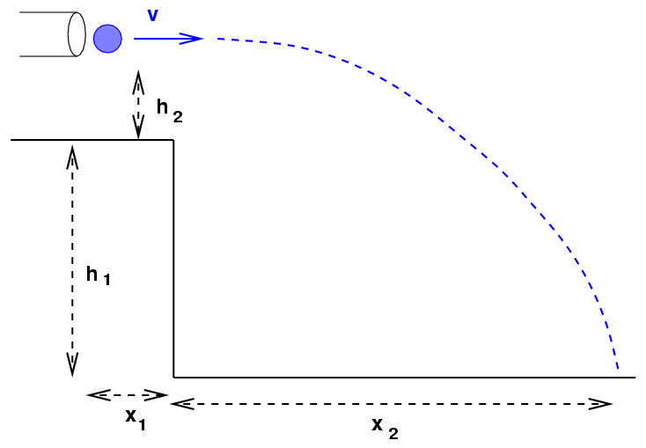
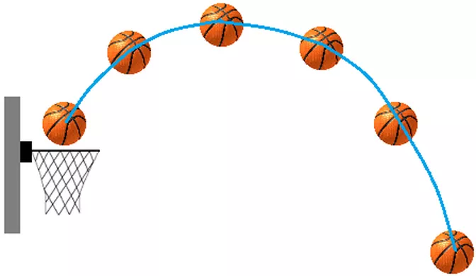
Learning Outcome: Describe projectile motion
Projectile motion is motion involving a horizontal and vertical component
Horizontal displacement is always positive (1 direction)
There is only acceleration in the vertical component (g)

Slide 44
Learning Outcome: Divide projectile motion into horizontal and vertical components
8 ms⁻¹
8 ms⁻¹
8 ms⁻¹
0 ms⁻¹
8 ms⁻¹
9.81 ms⁻¹
8 ms⁻¹
19.62 ms⁻¹
29.43 ms⁻¹
Each bullet represents 1 second
39.24 ms⁻¹

Slide 45
Learning Outcome: Divide projectile motion into horizontal and vertical components
v= 8 ms⁻¹
v = 12.65 ms⁻¹
8 ms⁻¹
8 ms⁻¹
v = 21.19 ms⁻¹
8 ms⁻¹
v = 30.50 ms⁻¹
0 ms⁻¹
8 ms⁻¹
Actual (resultant) velocity at any given time can be found by resolving v_{x} and v_{y} using pythagoras
v= √ v_{x}² + v_{y}²
9.81 ms⁻¹
v = 40.05 ms⁻¹
8 ms⁻¹
19.62 ms⁻¹
29.43 ms⁻¹
39.24 ms⁻¹

Slide 46
Learning Outcome: Divide projectile motion into horizontal and vertical components
θ = 0 °
θ = 50.8 °
8 ms⁻¹
8 ms⁻¹
θ = 67.8 °
8 ms⁻¹
θ =74.8 °
0 ms⁻¹
8 ms⁻¹
9.81 ms⁻¹
θ = 78.5°
8 ms⁻¹
The angle, θ, from the horizontal can be found by:
θ = tan⁻¹ (v_{y}/v_{x})
19.62 ms⁻¹
29.43 ms⁻¹
39.24 ms⁻¹

Slide 47
Learning Outcome: Solve problems involving horizontal projectiles using SUVAT
What features of horizontal and vertical motion are standard for all horizontally fired projectiles?
Horizontal:
s = s_{h}
u = u_{h}
v = u_{h}
a = 0
t = t
Vertical:
s = s_{v}
u = 0
v = v_{v}
a = 9.81
t = t

Slide 48
Learning Outcome: Solve problems involving horizontal projectiles using SUVAT
A Nerf gun is fired at 8 ms⁻¹ from a height of 5 m, how long does it take to hit the floor
8 ms⁻¹
Horizontal:
s = s
u = 8
v = 8
a = 0
t = t
Vertical:
s = 5
u = 0
v = v
a = 9.81
t = t
Vertical:
s = ut + ½ at²
5 = 0t + 0.5 x 9.81 x t²
5 = 0.5 x 9.81 x t2
t² = 1.02
t = 1 s

Slide 49
Learning Outcome: Solve problems involving horizontal projectiles using SUVAT
A Nerf gun is fired at 8 ms⁻¹ from a height of 5 m, what horizontal distance does it travel?
8 ms⁻¹
Horizontal:
s = s
u = 8
v = 8
a = 0
t = 1
Vertical:
s = 5
u = 0
v = v
a = 9.81
t = 1
Horizontal:
s = ut + ½ at²
s = 8 x 1 + 0.5 x 0 x 1²
s = 8 m

Slide 50
Learning Outcome: Solve problems involving horizontal projectiles using SUVAT
A Nerf gun is fired at 8 ms⁻¹ it hits the floor after 3.5 seconds. What is its velocity and angle to the floor on impact
8 ms⁻¹
Horizontal:
s_{h} = x
u_{h} = 8 ms⁻¹
v_{h} = 8 ms⁻¹
a_{h} = 0 ms⁻²
t = 3.5 s
Vertical:
s_{v} = x
u_{v} = 0 ms⁻¹
v_{v} = v_{v}
a_{v} = 9.81 ms⁻²
t = 3.5 s
a_{v}= (v_{v} – u_{v})/t
v_{v} = a_{v}t + u_{v} = (9.81 x 3.5) + 0= 34.34 ms⁻¹
v= √ v_{h}² + v_{v}² = √8² + 34.34² = 35.35 ms⁻¹
θ = tan⁻¹ (v_{v}/v_{h}) = tan⁻¹ (34.34/8) = 76.89

Slide 51
Projectiles at angles
Describe projectile motion at an angle
Divide projectile motion at an angle into horizontal and vertical components
Solve problems involving angled projectiles using SUVAT

Slide 52
Learning Outcome: Describe projectile motion at angles
Horizontal displacement is always positive
Acceleration only acts in the vertical direction, in the opposite direction to initial displacement
Horizontal velocity remains constant
Vertical velocity decreases to zero and then increases back to the original (assuming overall vertical displacement = 0)

Slide 53
Learning Outcome: Divide projectile motion into horizontal and vertical components
u sin θ
u ms⁻¹
θ
u cos θ
Each bullet represents 1 second

Slide 54
Learning Outcome: Divide projectile motion into horizontal and vertical components
u sin θ
u ms⁻¹
θ
u cos θ
If u = 8 ms⁻¹, what would be the horizontal and vertical component of the velocity at 0, 2 and 4s, θ= 40

Slide 55
Learning Outcome: Divide projectile motion into horizontal and vertical components
6.13 ms⁻¹
5.14 ms⁻¹
8 ms⁻¹
6.13 ms⁻¹
θ
-14.48 ms⁻¹
-34.1 ms⁻¹
6.13 ms⁻¹
If u = 8 ms⁻¹, what would be the horizontal and vertical component of the velocity at 0, 2 and 4s, θ= 40

Slide 56
Learning Outcome: Divide projectile motion into horizontal and vertical components
u sin θ
u ms⁻¹
θ
u cos θ
Horizontal Vertical(up) Vertical(down)
S = s_{h} s = s_{v} s= s_{v}
u = u cos θ u = u sin θ u = 0
v = u cos θ v = 0 v = u sin θ
a = 0 a = -9.81 a = 9.81
t = t t = 0.5t t= 0.5t

Slide 57
Learning Outcome: Solve problems involving angled projectiles using SUVAT
What would be the maximum height reached?
Vertical (up)
s = s_{v}
u = 8 cos 40 = 5.14
v = 0
a = -9.81
t= x
v²= u² + 2as
0 = 5.14² + (2 x -9.81 x s)
19.62s = 26.42
1.35 m
u sin θ
8 ms⁻¹
Θ=40
u cos θ

Slide 58
Learning Outcome: Solve problems involving angled projectiles using SUVAT
b) How long would the bullet take to hit the ground
Vertical (up)
s = 1.35
u = 5.14
v = 0
a = -9.81
t= x
v = u + at
0 = 5.14 + -9.81t
9.81t = 5.14
t_top = 0.52 s
t_total = 1.04 s
u sin θ
8 ms⁻¹
Θ=40
u cos θ

Slide 59
Learning Outcome: Solve problems involving angled projectiles using SUVAT
c) How far away does the bullet land?
Horizontal
s = s
u = 8 sin 40 = 6.13
v = 6.13
a = 0
t= 1.04
s = ½ (u + v)t
s = 0.5 (6.13+6.13)1.04
s = 6.38 m
u sin θ
8 ms⁻¹
Θ=40
u cos θ

