Slide 1
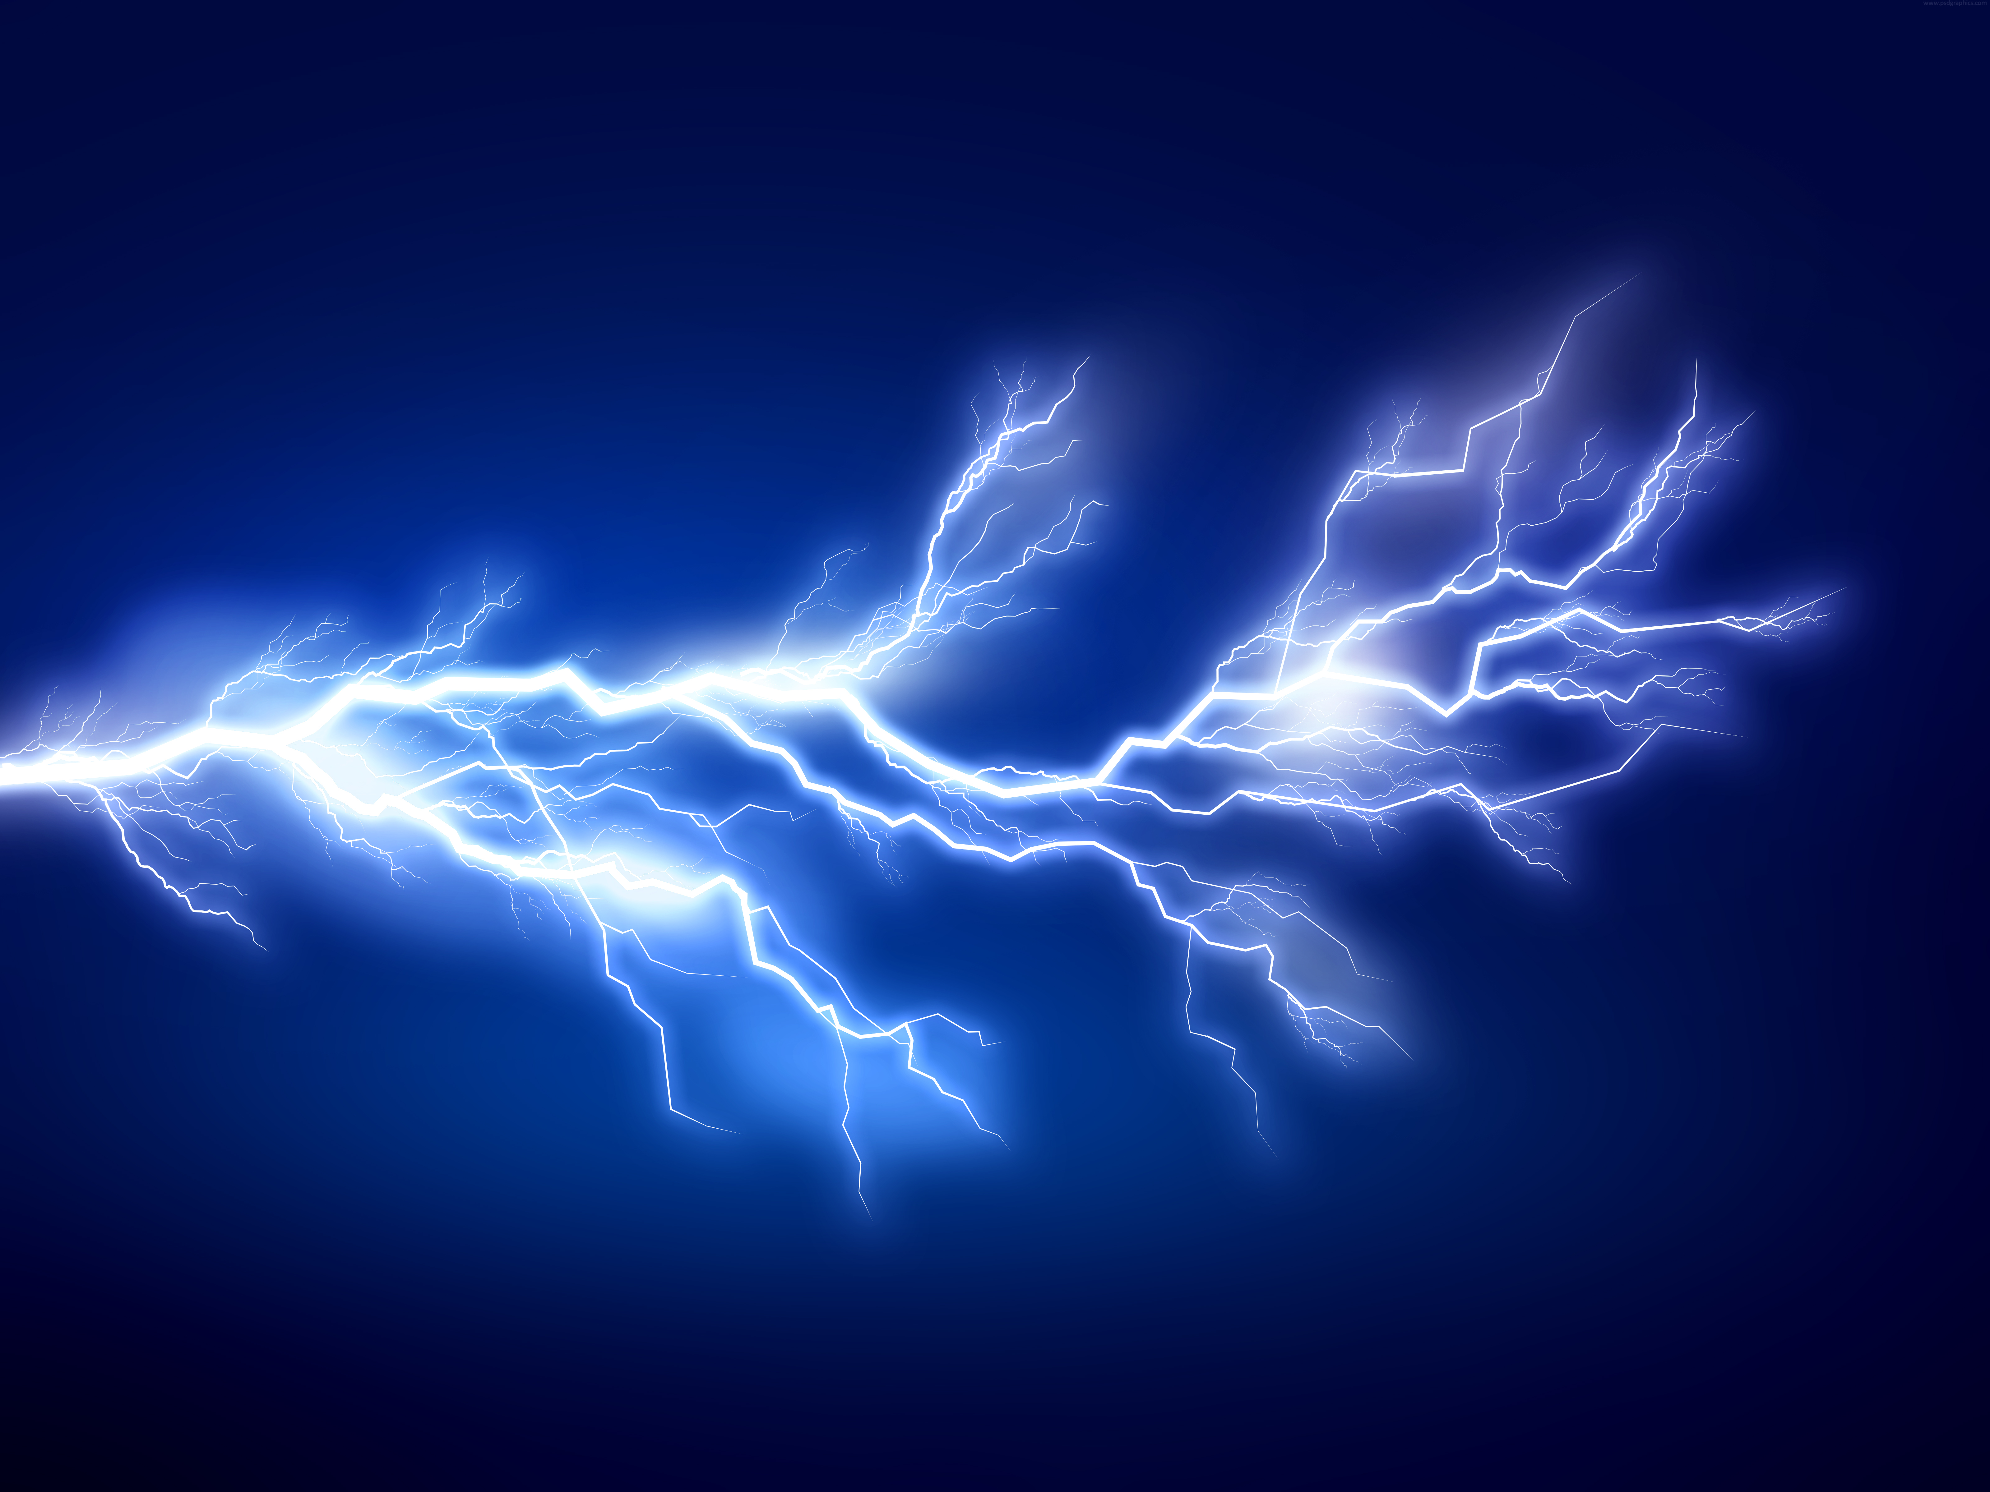
Electricity revision
Name 3 things you’ve learnt in the electricity topic
Notes:
Think, pair, share

Slide 2
Electricity
Static electricity
Describe how static electricity builds up when a cloth is rubbed on a balloon
Explain why a person who has become charged receives an electric shock when they touch a metal pole. Include the term “potential difference”
Draw the electric field around two spheres with the same charge and two spheres with different charges
Electricity units and symbols
Complete the below table
Draw the correct symbols for the below components
Switch Ammeter
Voltmeter Bulb
Variable | Variable symbol | Unit | Unit symbol
Current
Charge
Voltage

Slide 3
Current, p.d. and resistance
Define electricity
Define current
Define voltage
Describe the difference between potential difference and electromotive force
Series and parallel circuits
Draw an example series and parallel circuit including 2 bulbs
Describe how you measure the voltage and current in your above circuits, should your equipment go in series or parallel?
Describe how current and voltage vary in series and parallel circuits
Electricity in the home
Label the plug below and describe the function of each labeled component
Explain what the difference between AC and DC is and give an example power source for each
State the frequency of UK mains electrical current
State the voltage of UK mains electricity

